Slide 1

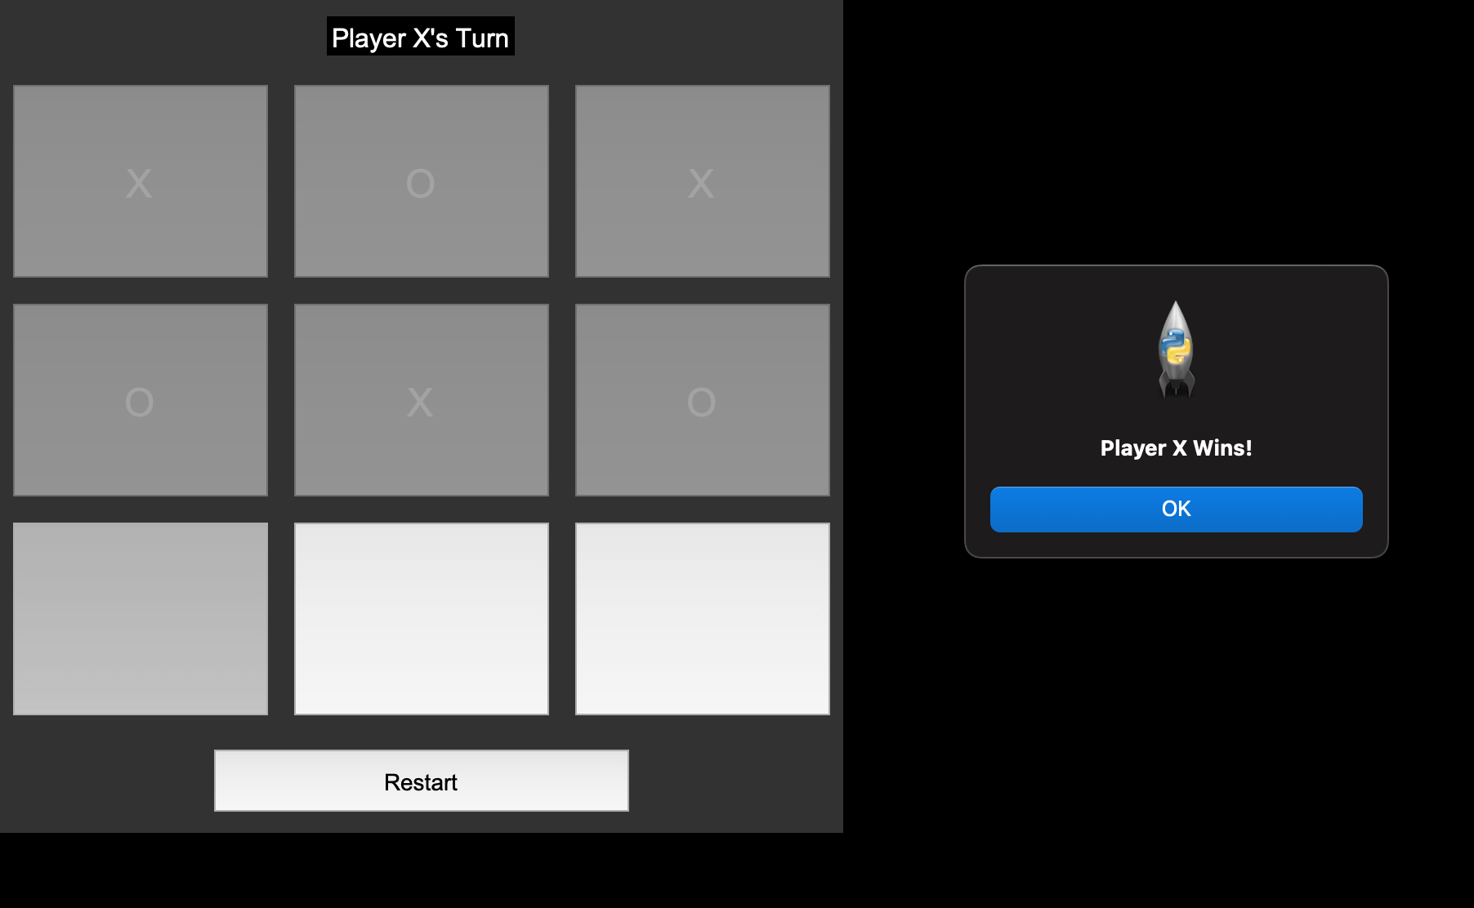
Tic-Tac-Toe
Lenny Garcia & Lizbeth Garcia
Play Tic Tac Toe with a friend
This Python-based Tic Tac Toe game lets two players take turns placing X’s and O’s on a 3x3 board, with built-in win detection, input validation and option to play again for endless fun.

