Slide 1
Todo List with Flask
Team Member:
Mohamad Dabdoub (Solo project)
Team Member: Mohamad Dabdoub | GitHub: github.com/ksu-is/todo-with-flask

Slide 2
ToDo With Flask
“Organize your day, one task at a time.”
• A web-based To-Do list app using Flask
• Users can add, complete, and delete tasks
• Data stored locally in JSON format
• Lightweight and ideal for daily task tracking
• User-friendly and minimalist interface
Team Member: Mohamad Dabdoub | GitHub: github.com/ksu-is/todo-with-flask

Slide 3
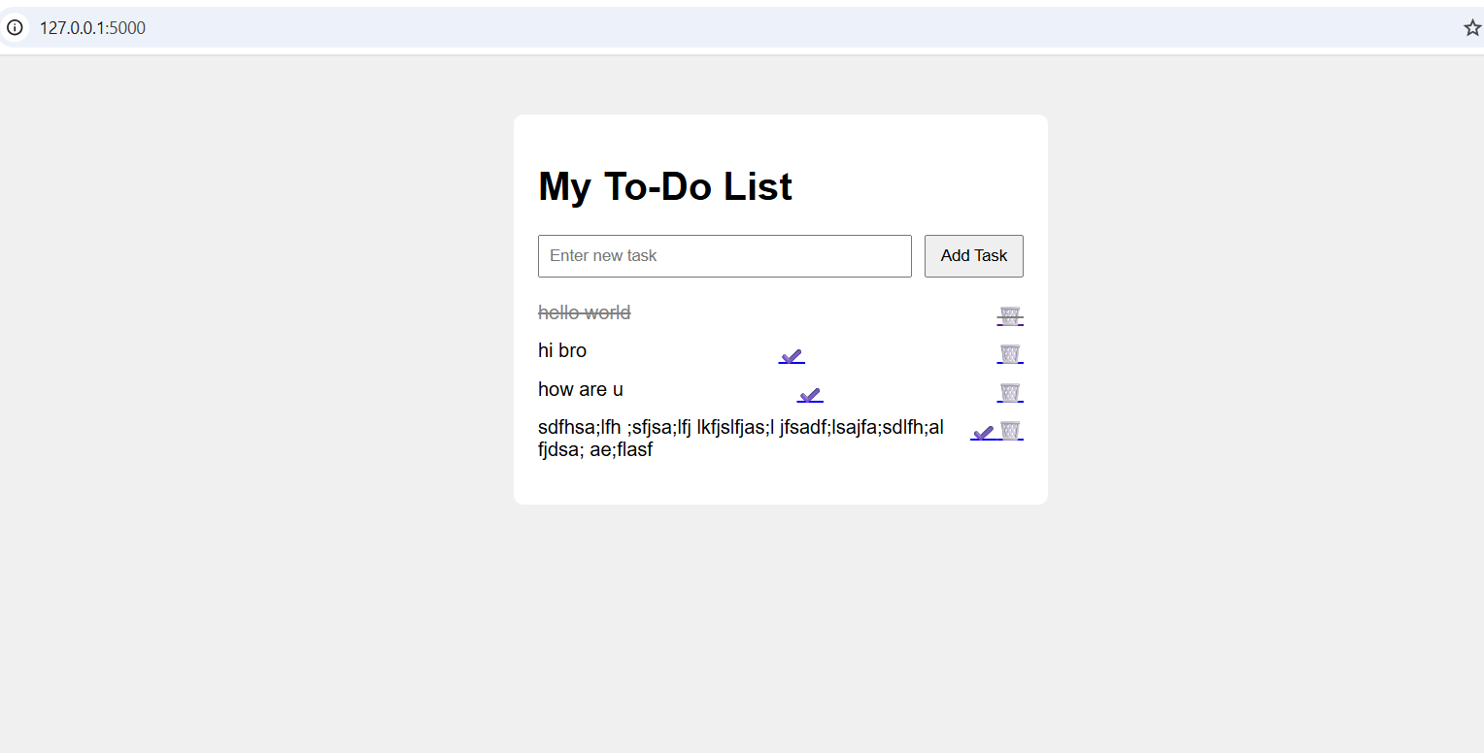
About the Project
Simple web-based task manager
Built with Python and Flask
Persistent local storage (tasks.json)
Clean and minimal interface
Ideal for students, professionals, and solo users
Team Member: Mohamad Dabdoub | GitHub: github.com/ksu-is/todo-with-flask

