Slide 1
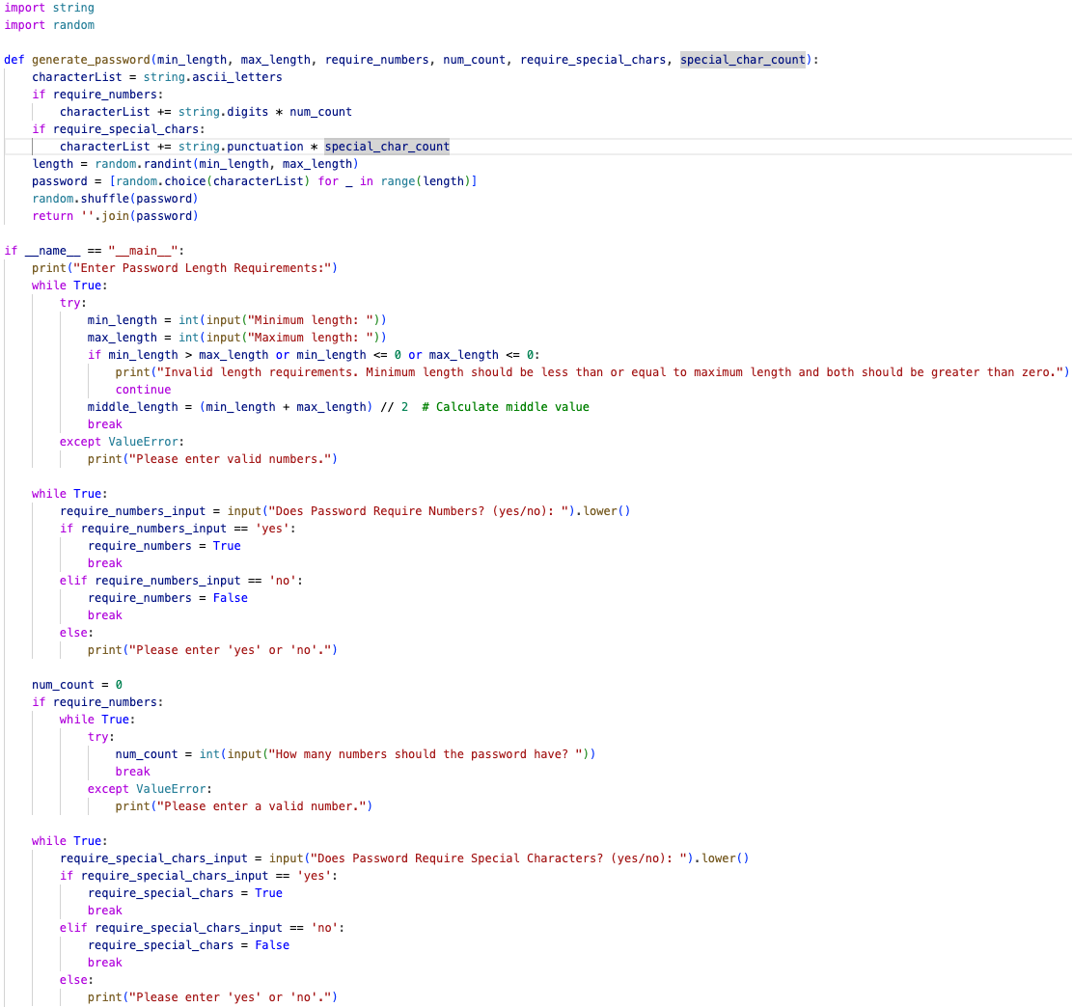

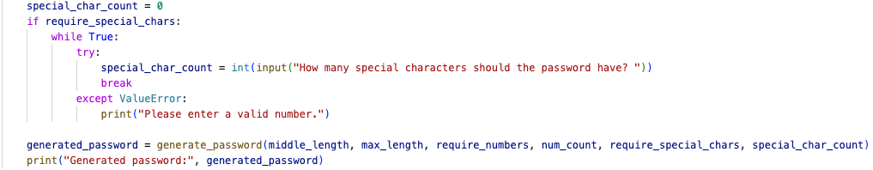
Unique Password Generator by: Esha Chaudhary
Objective: Develop a software for generating complex passwords to address the challenges of creating secure passwords.
Design Approach: Software guides user through prompts to specify password criteria.
Criteria Includes:
Desired number of characters
Required number of numbers and special characters
Benefits:
Time-saving: Eliminate the need to spend time thinking of and creating passwords.
Enhanced Security: Reduce the risk of hacking by generating complex and unique passwords

