Slide 1
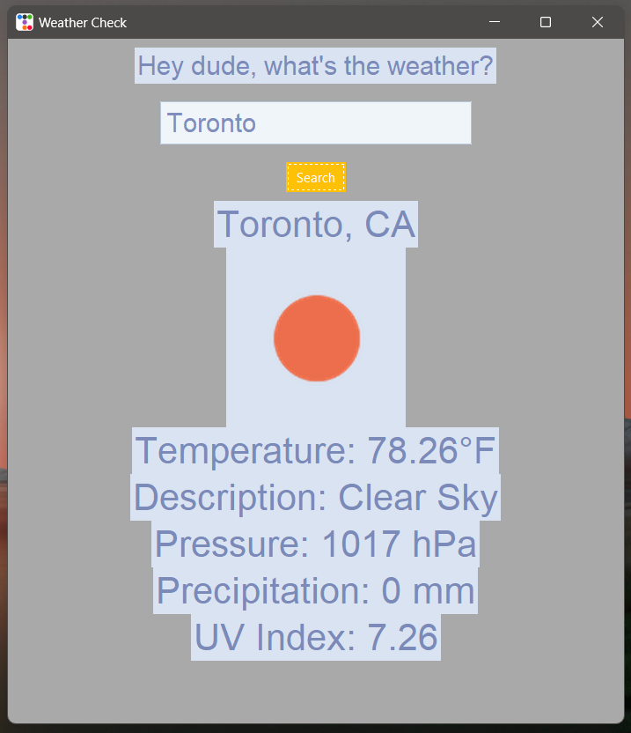
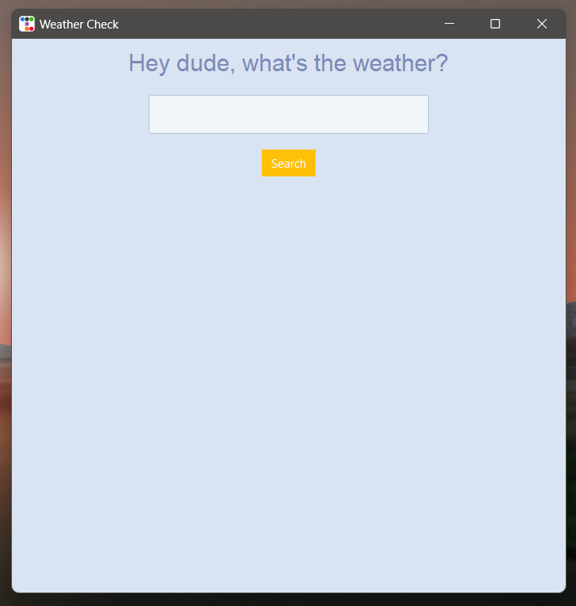
Weather Check Hey dude what's the weather?
Sirish Bethapudi
Ever went to the beach and got rained on?
Or
Walked out of the house to get hit be a hail?
Or
Your Buddy asked you,
“Hey dude what's the weather?”
You need an
instant weather check app!!!
Features:
Easy to use and simple look!
Shows you the current weather, Temperature, UV, and Precipitation!
Repository: https://github.com/ksu-is/weather_check

