Slide 1
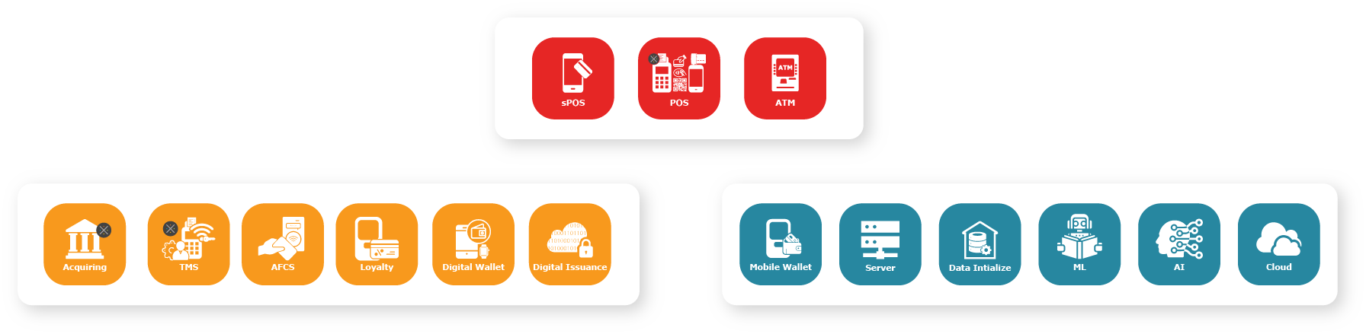
Login and Registration With Spring Security
Global Software Solutions, Services & Technology Centre
CMMi Level 5

Slide 2
What is Spring Security?
Definition: Spring Security is a powerful and customizable authentication and access-control framework for Java applications.
Key Features:
Authentication and Authorization
Protection against common attacks
Integration with various technologies
CSRF:
Definition: CSRF is an attack that tricks the user into performing actions on behalf of the attacker.

Slide 3
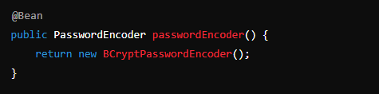
JSON Array
Password Encryption with BCrypt
Importance of Encryption: Protects passwords by making it difficult for attackers to retrieve the original password even if they get access to the hashed value.
BCrypt Algorithm:
Adaptive hashing algorithm designed to be computationally expensive to resist brute-force attacks.

Slide 4
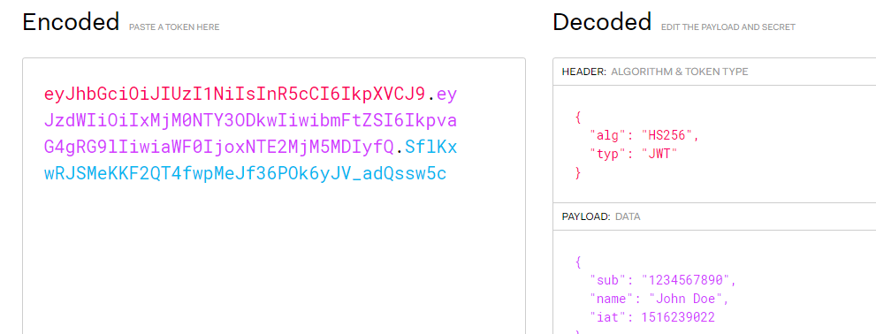
JSON Array
JWT
Definition: JWT is a compact, URL-safe means of representing claims to be transferred between two parties.
Structure:
Header: Contains metadata about the type of token and the hashing algorithm used.
Payload: Contains the claims (e.g., user information).
Signature: Ensures the token hasn’t been altered.

Slide 5
JSON Array
Best Practices
Secure Configuration: Always keep your Spring Security configurations up-to-date and use non-deprecated methods.
Strong Encryption: Use BCrypt for password hashing to enhance security.
Token Management: Ensure JWT tokens are short-lived and refresh them periodically.
Regular Audits: Perform regular security audits and update dependencies.

Slide 6
JSON Array
JSON Arrays Operations
You can add, remove, and modify elements in JSON arrays using JavaScript array methods.
let jsonArray = ["Apple", "Banana", "Cherry"];
jsonArray.push("Date"); // Adds Date to the array
jsonArray.splice(1, 1); // Removes Banana from the array
jsonArray[0] = "Apricot"; // Changes Apple to Apricot
2.Looping Through JSON Arrays:
let jsonArray = ["Apple", "Banana", "Cherry"];
jsonArray.forEach(function(item, index) {
console.log(index + ": " + item);
});
3.Accessing JSON Arrays in JavaScript
let jsonArray = ["Apple", "Banana", "Cherry"];
console.log(jsonArray[0]); // Outputs: Apple

Slide 7
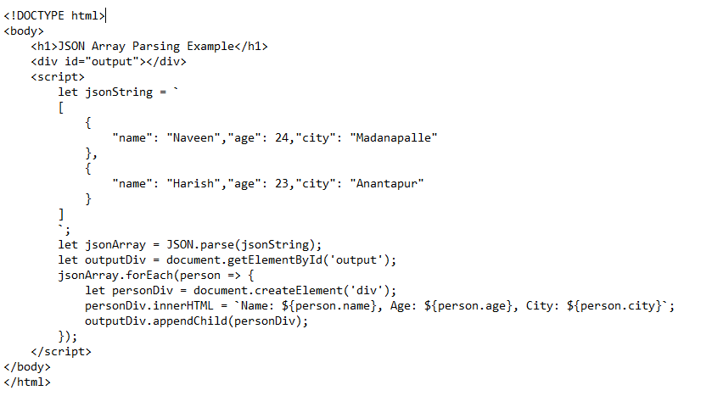
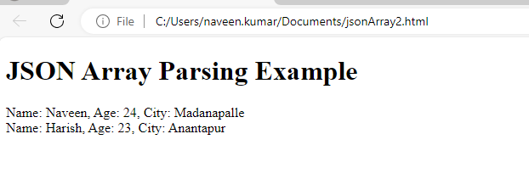
JSON Array
Parsing JSON Array
Use `JSON.parse()` to convert JSON strings to JavaScript objects.

Slide 8
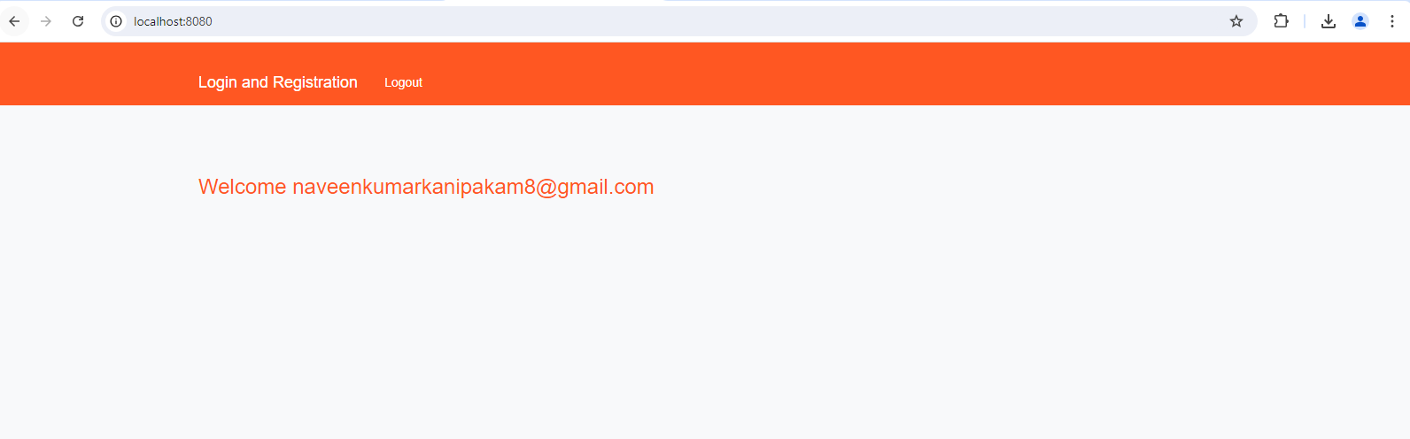
JSON Array
Stringifying JSON Arrays
U

Slide 9
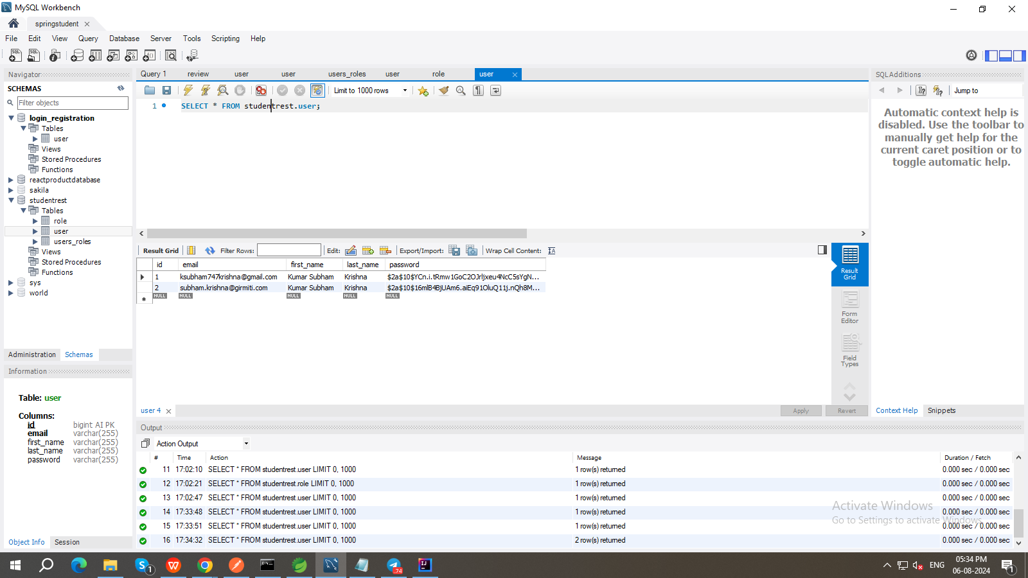
JSON Array
Practical Applications

Slide 10
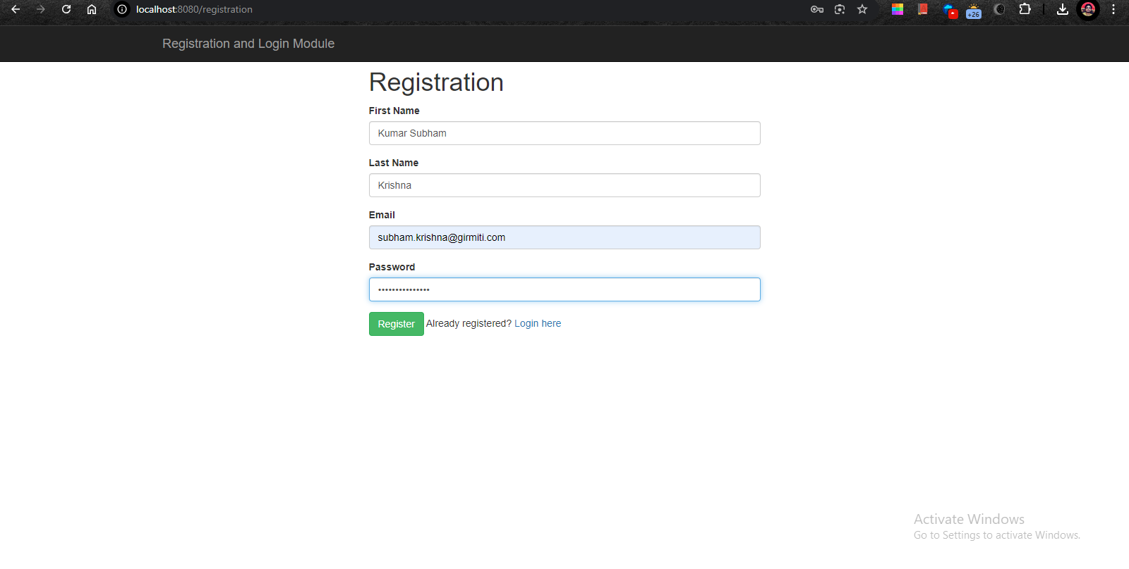

Slide 11
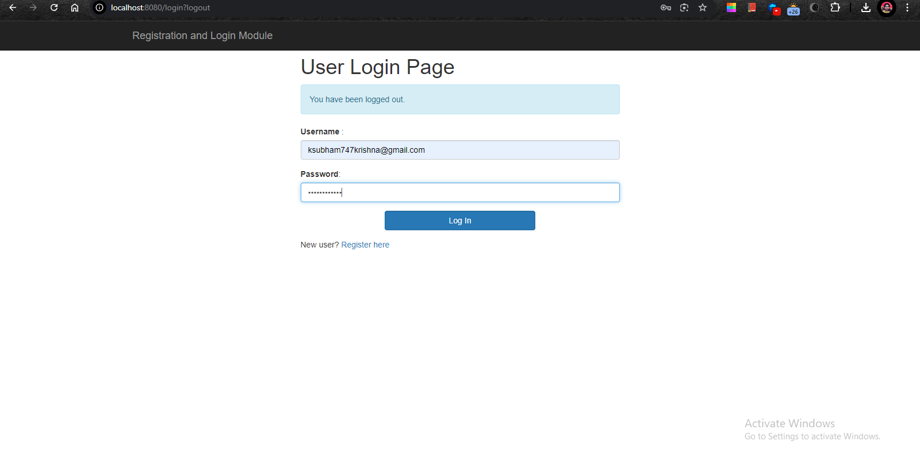

Slide 12
Discussions

