Slide 1
Computer Graphics: Rendering
Lecture 9: Transformations
Kartic Subr

Slide 2
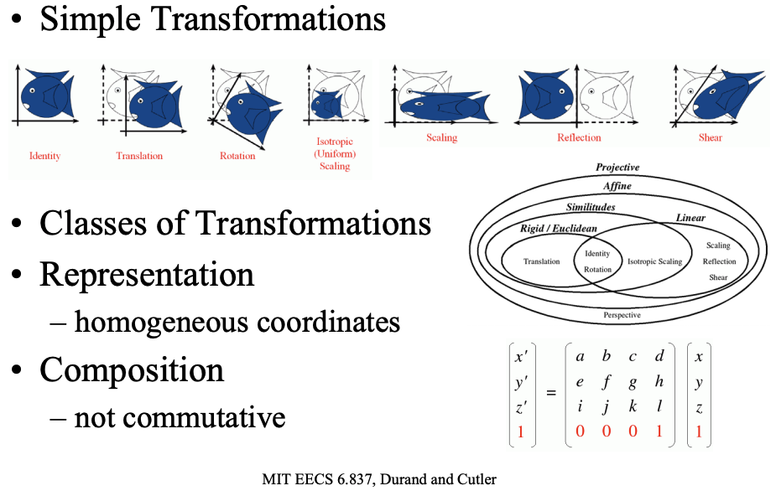
Transformations
Durand and Cutler’s Slides here

Slide 3
Transformations

Slide 4


Camera space transformation - recap
x
f_{x}
$$α$$
u
r11
$$r12$$
r13
t1
X
y
0
f_{y}
v
r21
r22
r23
t2
Y
1
0
0
1
r31
r32
r33
t3
Z
1
2D pixel coordinates
intrinsic
extrinsic
3D world coordinates

Slide 5
Pixels to rays
Read this
Watch this

Slide 6
Transformed objects

Slide 7
The transformed sphere

Slide 8
Transforming hit structure elements

Slide 9
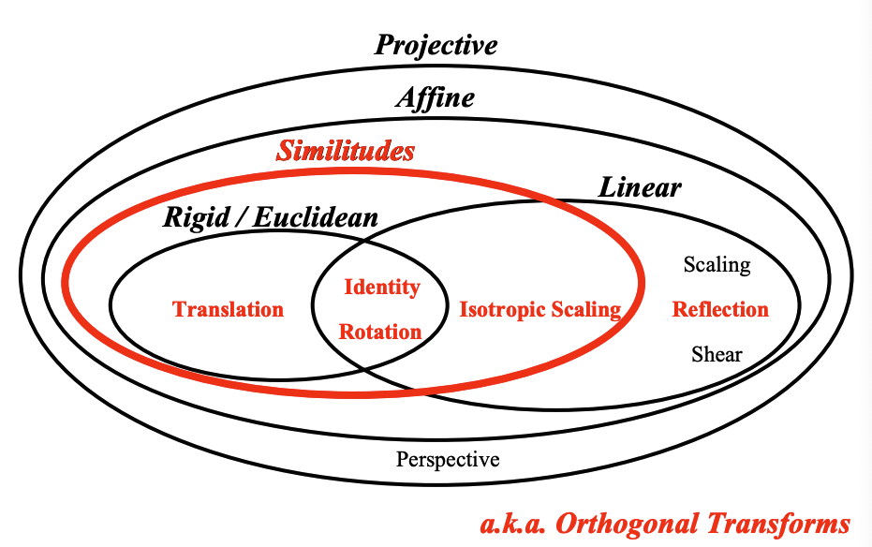

Slide 10
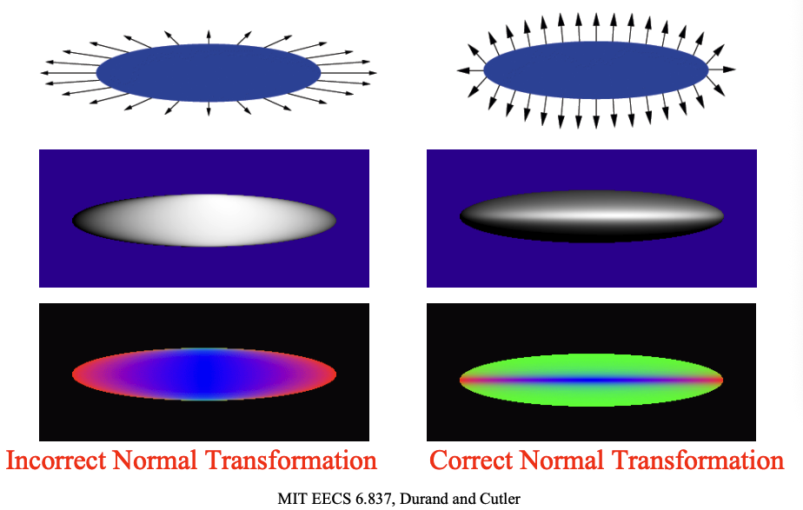

Slide 11
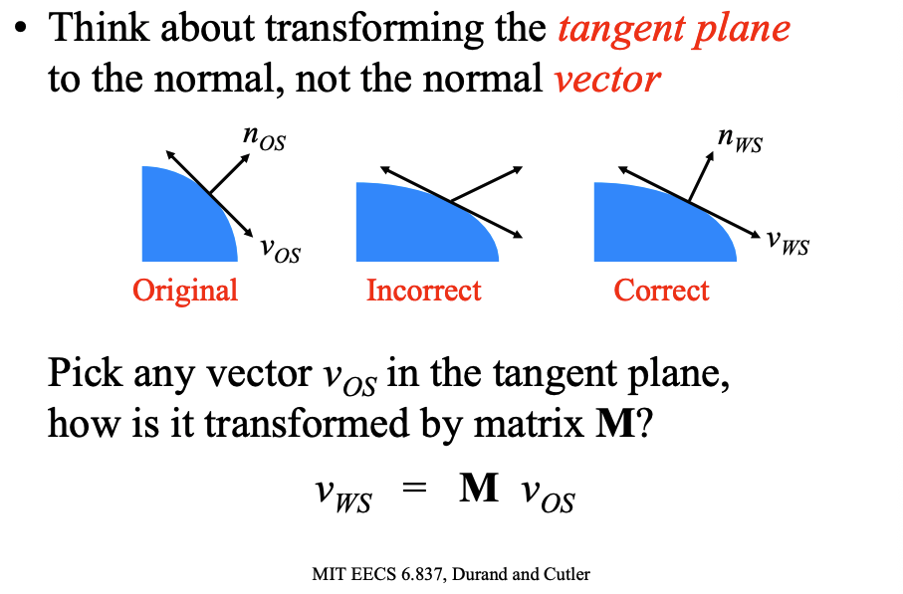

Slide 12
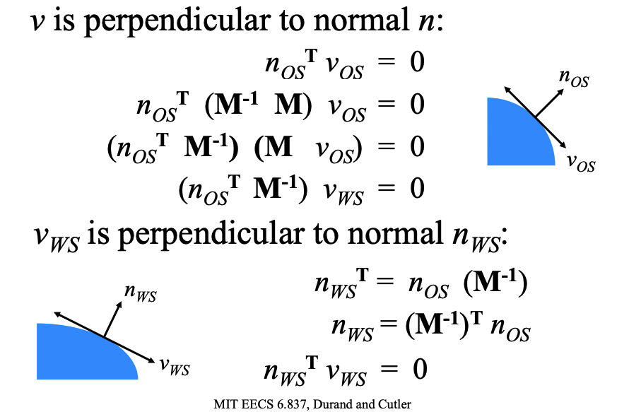

Slide 13
