Slide 1

Computer Graphics: Rendering
Lecture 9: Transformations
Kartic Subr

Slide 2
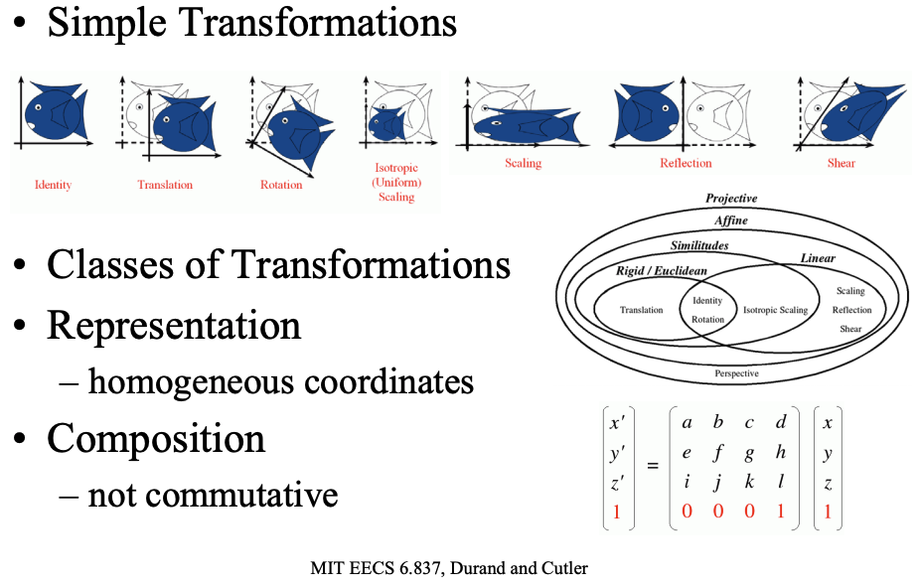

Transformations
Durand and Cutler’s Slides here

Slide 3
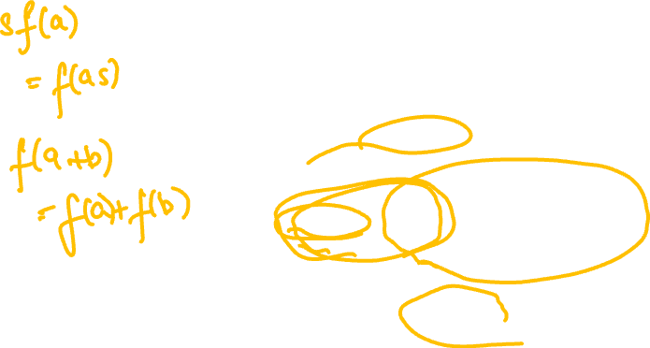
Transformations

Slide 4


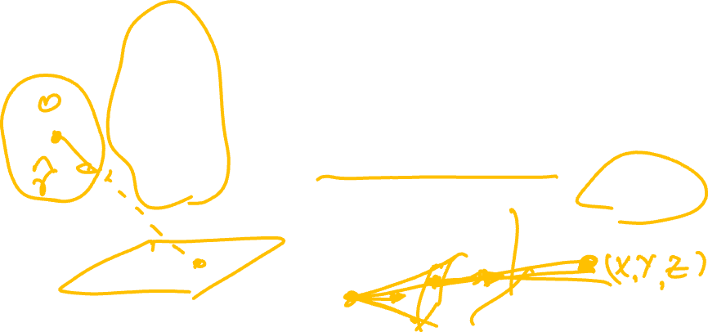
Camera space transformation - recap
x
f_{x}
$$α$$
u
r11
$$r12$$
r13
t1
X
y
0
f_{y}
v
r21
r22
r23
t2
Y
1
0
0
1
r31
r32
r33
t3
Z
1
2D pixel coordinates
intrinsic
extrinsic
3D world coordinates

Slide 5
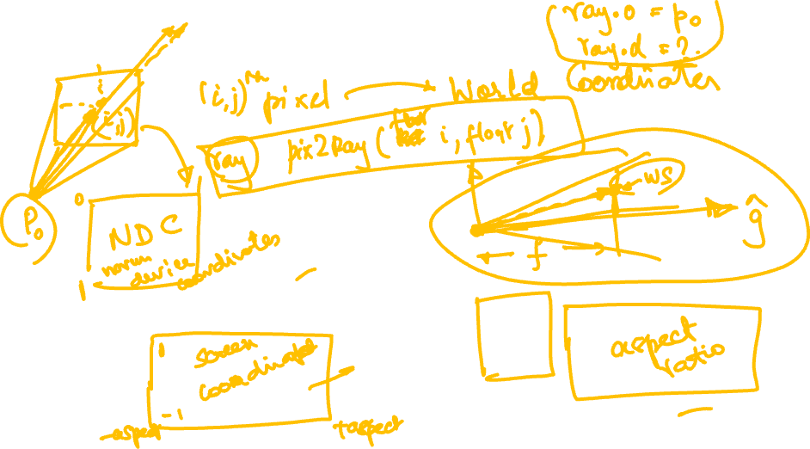
Pixels to rays
Read this
Watch this

Slide 6
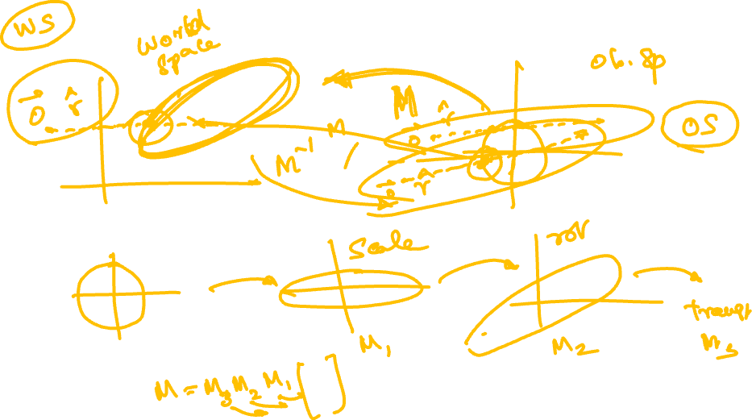
Transformed objects

Slide 7
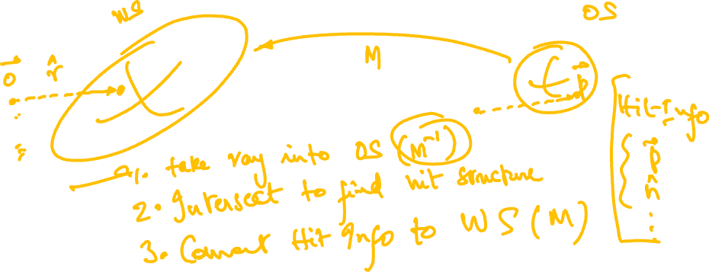
The transformed sphere

Slide 8
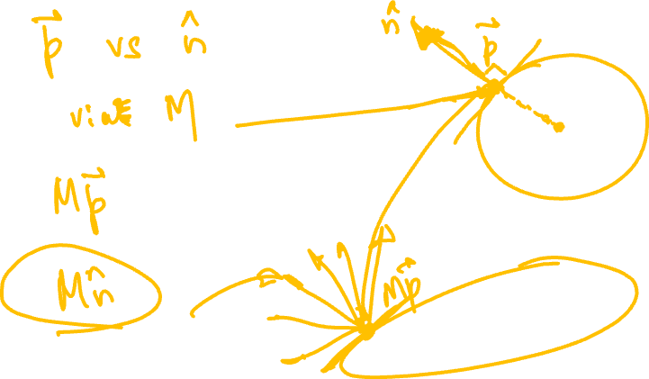
Transforming hit structure elements

Slide 9
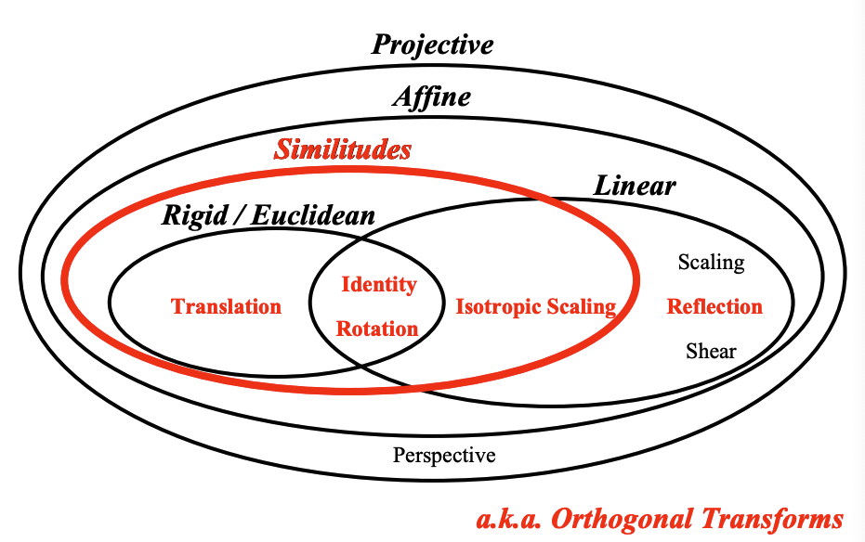

Slide 10
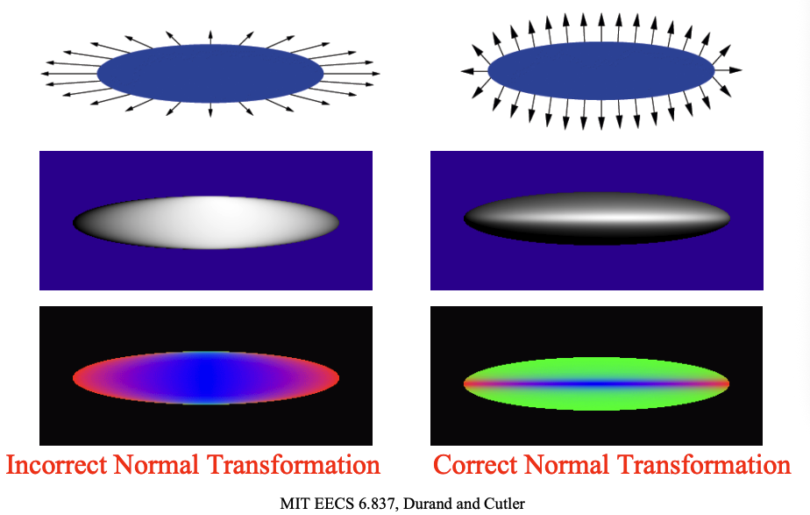


Slide 11
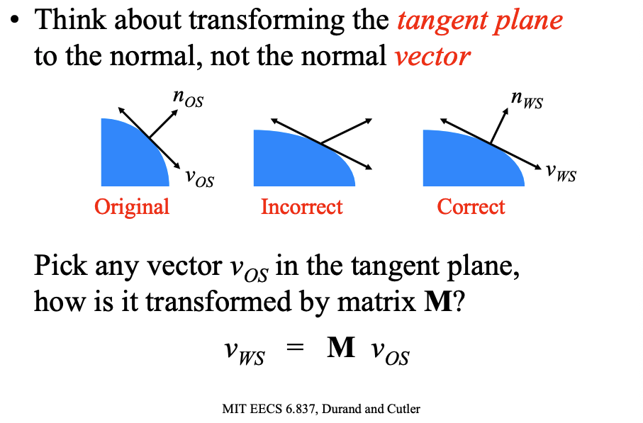


Slide 12
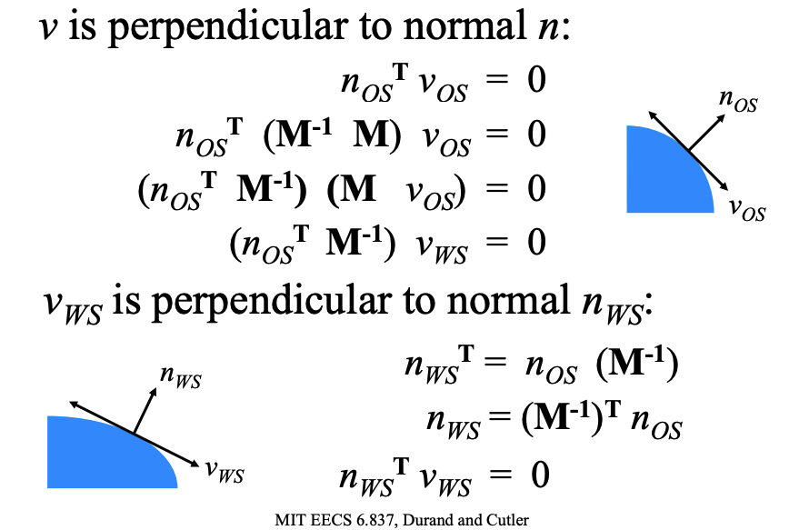
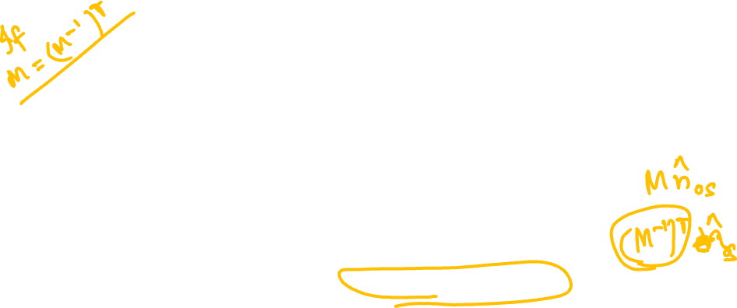

Slide 13
