Slide 1
Computer Graphics: Rendering
Lectures 10: Path tracing
Kartic Subr

Slide 2


Slide 3
MC integration: Area of a circle

Slide 4
MC integration errors

Slide 5

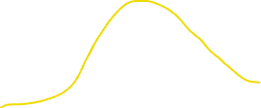

Recap: impact of sampling pdf
Sampler
Sampler
Sampler

Slide 6



Dividing by the sampling pdf
Sampler
Sampler
Sampler

Slide 7
MC integration errors

Slide 8
MC integration errors

Slide 9


Slide 10
MC integration: importance sampling

Slide 11
Light transport

Slide 12


Incident or incoming radiance at x
$$n$$
$$x$$

Slide 13




Differential irradiance at infinitesimal patch
$\text{d}E_{i}$ = $L(x, ω_{i})\text{ (}ω_{i}\text{.n) }\text{d}ω_{i}$
$$n$$
radiance
$$L(x, ω_{i})$$
W m⁻²
differential irradiance at x,
due to one incident ray
W m⁻² Sr⁻¹
$$\text{d}ω_{i}$$
$$\text{dA}$$
$$x$$

Slide 14

Outgoing radiance along a direction
radiance
$$L(x, ω_{i})$$
$$L(x, ω_{o})$$
$$\text{d}ω_{i}$$
$$\text{dA}$$
$$x$$

Slide 15

Linear optics: reflected radiance ∝ irradiance
d$L\left(x, ω_{o}\right)$ $∝ \text{d}E_{i}$

Slide 16
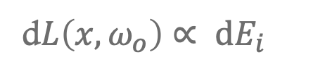

Linear optics: reflected radiance ∝ irradiance
Constant of proportionality is a function!
d$L\left(x, ω_{o}\right)$ $∝ \text{d}E_{i}$
d$L\left(x, ω_{o}\right)$ $=ρ(ω_{i},ω_{o}) \text{d}E_{i}$
constant of proportionality
Constant for a given pair of incident-outgoing directions
Determines appearance of opaque materials
Bidirectional Reflectance Distribution Function (BRDF)-

Slide 17

Linear optics: reflected radiance ∝ irradiance
Constant of proportionality is a function!
d$L\left(x, ω_{o}\right)$ $=ρ(ω_{i},ω_{o}) \text{d}E_{i}$
Constant for a given pair of incident-outgoing directions
Determines appearance of opaque materials
Bidirectional Reflectance Distribution Function (BRDF)-

Slide 18


BRDF slice per incident direction
$$ω_{i}$$
$ρ(ω_{i},:)$
more light along
direction of specular reflection

Slide 19
BRDF slice per incident direction
$$ω_{i}$$
$ρ(ω_{i},:)$
more light along
direction of specular reflection

Slide 20
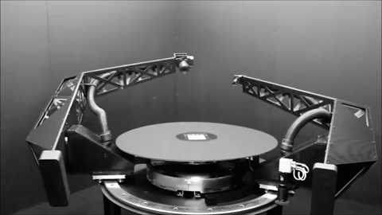
BRDF measurement - gonioreflectometer
tabulate 4D measured values?
[robotae]
http://www.cs.cmu.edu/afs/cs/academic/class/15462-f09/www/lec/lec9.pdf

Slide 21
phase functions
commonly used material models
BSDF
BSSRDF
SvBRDF

Slide 22



Slide 23

Reflection: multiple incident rays
$L\left(x, ω_{o}\right)$ = $\sum_{i}{ ρ(ω_{i},ω_{o}) \text{d}E_{i}}$
contributions for different directions weighted by BRDF

Slide 24

Add emission from surface at x
$L\left(x, ω_{o}\right)$ =$L_{e}\left(x, ω_{o}\right)$ + $\sum_{i}{ ρ(ω_{i},ω_{o}) \text{d}E_{i}}$
contributions for different directions weighted by BRDF

Slide 25

In the limit …
$L(x, ω_{o})$ = $L_{e}\left(x, ω_{o}\right)$. + $\int_{H^{2}}^{ }{ ρ\left(ω_{i},ω_{o}\right) L(x, ω_{i}) \text{(}ω_{i}\text{.n) }\text{d}ω_{i}}$
surface emission
hemisphere
BRDF
incident radiance
cosine dependence
… the rendering equation
[Kajiya 86]

Slide 26

In the limit …
$L(x, ω_{o})$ = $L_{e}\left(x, ω_{o}\right)$. + $\int_{H^{2}}^{ }{ ρ\left(ω_{i},ω_{o}\right) L(x, ω_{i}) \text{(}ω_{i}\text{.n) }\text{d}ω_{i}}$
surface emission
hemisphere
BRDF
incident radiance
cosine dependence
… the rendering equation
[Kajiya 86]

Slide 27
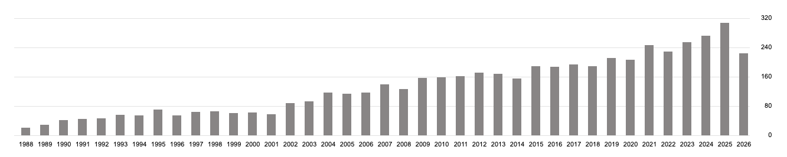
The rendering equation
Citations per year
(Google scholar)
[Kajiya 86] https://dl.acm.org/citation.cfm?id=15902

Slide 28
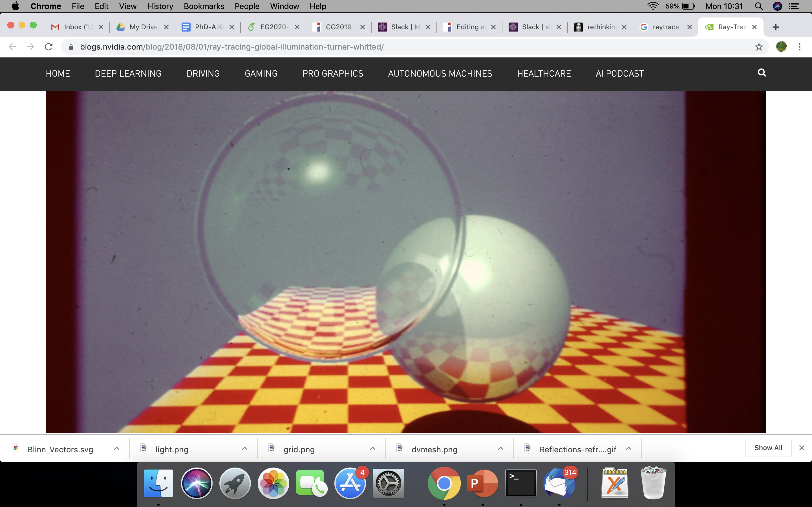
Contrast with Whitted raytracing
How to get ‘soft’ shading and lighting effects?

Slide 29
Solving the rendering equation

Slide 30
Estimate integrals recursively
1) Sample hemisphere at last bounce to camera

Slide 31
Estimate integrals recursively
1) Sample hemisphere at last bounce to camera
2) Trace each sample ray back to intersection

Slide 32
Estimate integrals recursively
1) Sample hemisphere at last bounce to camera
2) Trace each sample ray back to intersection
3) Sample those hemispheres
4) Recurse until k bounces
5) Use recursion results to estimate radiance

Slide 33
Estimate integrals recursively
k bounces with n samples each
= n^k samples per pixel
e.g. 8000 spp if n = 20 and k = 3

Slide 34
Let there be blur!
Numerical integration
aperture
time
materials
penumbra
Distributed ray tracing [Cook et al 1984]

Slide 35
Whitted ray tracing – ray tree
primary ray
1 bounce
reflected ray
refracted ray
light ray
2 bounces
3 bounces : 3^3 = 27 rays

Slide 36
Distributed ray tracing – ray tree
primary ray
estimating integral by averaging
1 bounce
2 bounces
3 bounces : 10^3 = 1000 rays

Slide 37
Helps, but expensive!

Slide 38

Better way to solve the rendering equation?
estimating integral by averaging
path tracing [Veach98]

Slide 39
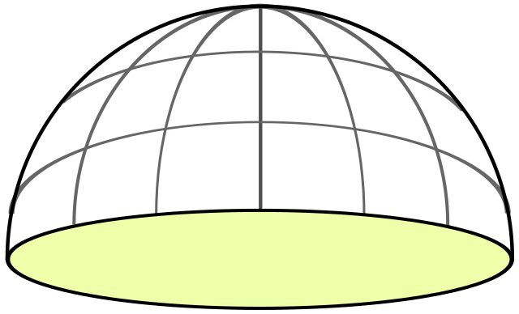
Random sampling at each level
x₁ drawn randomly in [0,1] x [0,1]

Slide 40
Random sampling at each level
x₂ drawn randomly in [0,1] x [0,1]

Slide 41
When to terminate?
x_{d} drawn randomly in [0,1] x [0,1]
?

Slide 42
When to terminate path?
Fixed depth d
When radiance is low
threshold
randomly
Russian roulette

Slide 43

More bounces? depends on scene
2 bounces
9 bounces
https://twitter.com/DisneyAnimation/status/1146085535057715200

Slide 44
Path tracing each pixel - overview
pixel area
2D
aperture
2D
2d+5 dimensions
exp. time
1D
bounces
d*2D
pixel value = average radiance
(over sampled paths)

Slide 45
Path tracing each pixel - overview
pixel area
2D
aperture
2D
2d+5 dimensions
N samples
per pixel
exp. time
1D
bounces
d*2D
pixel value = average radiance
(over sampled paths)

Slide 46
Path tracing: mapping samples to paths
pixel area
2D
aperture
2D
2d+5 dimensions
N samples
per pixel
exp. time
1D
map sample to path
& record radiance
randomly sample
the hypercube
bounces
d*2D
pixel value = average radiance
(over sampled paths)

Slide 47
Path tracing: mapping samples to paths
pixel area
2D
aperture
2D
2d+5 dimensions
N samples
per pixel
exp. time
1D
bounces
d*2D
randomly sample
the hypercube
map sample to path
& record radiance
pixel value = average radiance
(over sampled paths)

Slide 48
Path tracing - maths
pixel average radiance
pixel filter weighting
[https://jo.dreggn.org/path-tracing-in-production/2019/index.html

Slide 49
http://madebyevan.com/webgl-path-tracing/

Slide 50
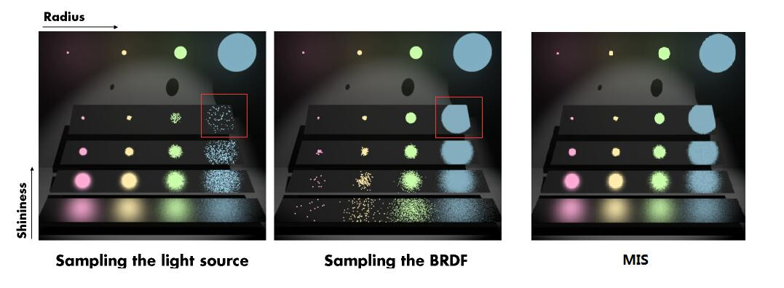
Importance sampling paths

Slide 51
Importance sampling paths

Slide 52
Importance sampling paths

Slide 53
This course so far …
maths
physics
self-learning
programming

Slide 54
This course so far …
self-learning
maths
physics
programming

Slide 55

This course
v 1.0 (2007, Columbia University, NY)
Evolved
  current trends/needs (e.g. online resources, LLMs)
  mixture of fun + skills (awareness vs career in CG)

Slide 56
Feedback/appraisal
Don’t like aspects of the course?
  Email me
  edStem message
Love the course?
  What do you like?
  Consider nominating the course/instructor/tutor (will open later)
https://www.eusa.ed.ac.uk/whatson/awards/teachingawards

