Slide 1
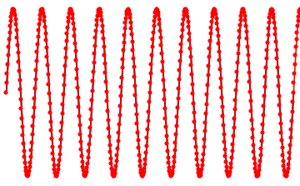
Computer Graphics: Rendering
Lecture 13: Sampling and reconstruction
Kartic Subr

Slide 2
What is sampling?

Slide 3
Sampling a sinusoid

Slide 4
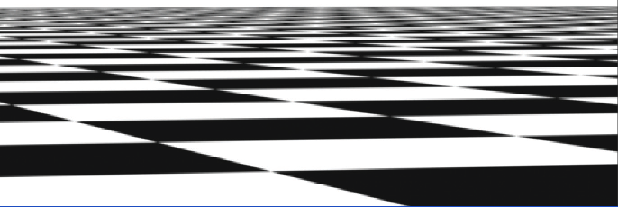
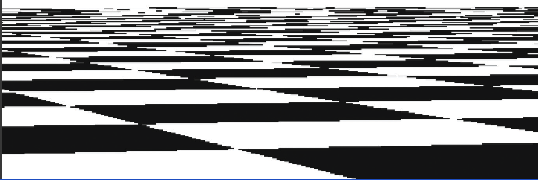
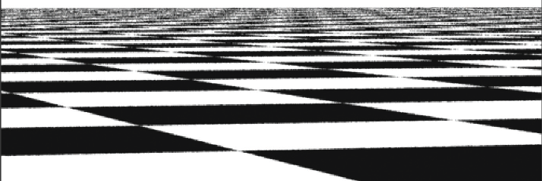
What is sampling?
https://pbr-book.org/3ed-2018/Sampling_and_Reconstruction/Stratified_Sampling

Slide 5
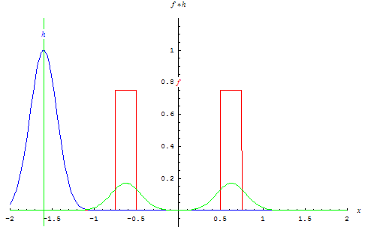



Function reconstruction problem
$$f(x)$$
$$f_{s}(x)$$
$$f_{r}(x)$$

Slide 6

Interpolate samples using a fixed function g(x)
$$f(x)$$
$$g(x)$$
$$f_{s}(x)$$
$$f_{r}(x)$$

Slide 7

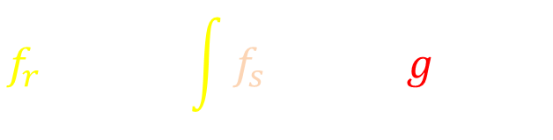
Convolution with a `reconstruction kernel’
$$f_{r} \left(x\right)= \int{f_{s}\left(x−y\right)g\left(y\right)dy}$$
$$=f_{s}⊗g$$
$$f(x)$$
$$g(x)$$
$$f_{s}(x)$$
$$f_{r}(x)$$

Slide 8
How to reduce reconstruction error?

Slide 9
Some preliminaries: this lecture

Slide 10
Dirac-Delta distribution
Notes:
\hat{f}(\omega) = \int\limits_{-\infty}^{\infty} f(x) e^{-2\pi \mathrm{\imath} \omega x} \mathrm{d}x
\hat{f}(\omega) = \int\limits_{-\infty}^{\infty} f(x) \cos ({2\pi \omega x}) \mathrm{d}x + \mathrm{\imath} \int\limits_{-\infty}^{\infty} f(x) \sin ({2\pi \omega x}) \mathrm{d}x

Slide 11
Dirac-Delta distribution
Zero everywhere else
Unit integral
Identity function for convolution
Notes:
\hat{f}(\omega) = \int\limits_{-\infty}^{\infty} f(x) e^{-2\pi \mathrm{\imath} \omega x} \mathrm{d}x
\hat{f}(\omega) = \int\limits_{-\infty}^{\infty} f(x) \cos ({2\pi \omega x}) \mathrm{d}x + \mathrm{\imath} \int\limits_{-\infty}^{\infty} f(x) \sin ({2\pi \omega x}) \mathrm{d}x

Slide 12
Recall: ‘Operate on’ a vector?
operator
a
b
u
au + bv
=
c
d
v
cu + dv

Slide 13
Which vector – unaffected by operator?
?
a
b
u
u
=
constant
c
d
v
v

Slide 14
Which vector – unaffected by operator?
a
b
u
u
=
constant
c
d
v
v
Eigenvector of matrix

Slide 15

Continuous - Eigenfunctions
Eigenfunction of differential operator?
$$\frac{d}{dx}$$

Slide 16


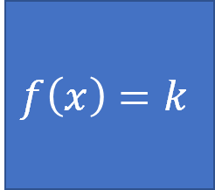

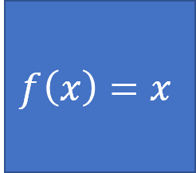
$$\frac{d}{dx}$$
$$f\left(x\right)=x$$
$$f\left(x\right)=k$$

Slide 17
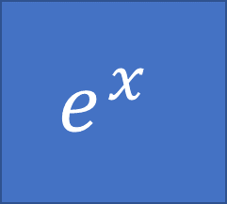
Move out of my way. I’m a derivative operator!!
You can’t bully me. Meet your Eigenfunction. You won’t affect me!
$$e^{x}$$

Slide 18

HA! I am
$$\frac{d}{dy}$$
$$e^{x}$$

Slide 19


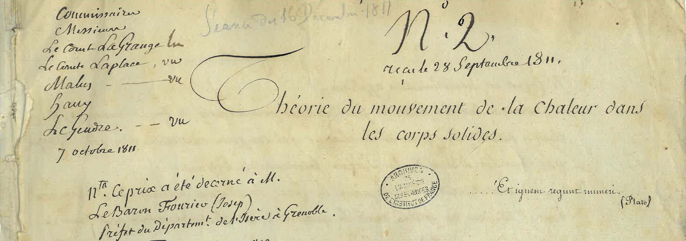
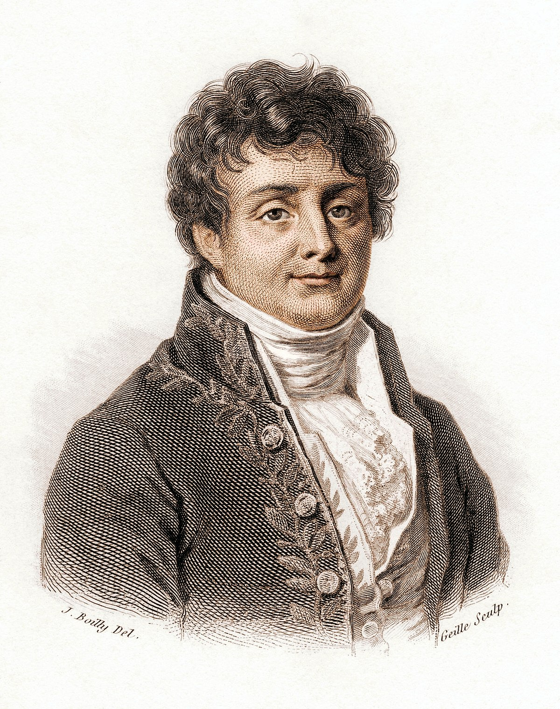
Fourier analysis: origin and intuition
Eigenfunction of the differential operator
scaling
Joseph Fourier, 1807
Notes:
\frac {\mathrm d} {\mathrm {d}x} e^{\lambda x} = \lambda e^{\lambda x}
f(x) = \sum\limits_{i=1}^N e^{\lambda_i x}, \quad \frac {\mathrm d} {\mathrm {d}x} f(x) = \sum\limits_{i=1}^N \lambda_i e^{\lambda_i x}

Slide 20

Use this to solve differential equations
Eigenfunction of the differential operator
differential equations -> algebraic equations
scaling
projection
Notes:
\frac {\mathrm d} {\mathrm {d}x} e^{\lambda x} = \lambda e^{\lambda x}
f(x) = \sum\limits_{i=1}^N e^{\lambda_i x}, \quad \frac {\mathrm d} {\mathrm {d}x} f(x) = \sum\limits_{i=1}^N \lambda_i e^{\lambda_i x}

Slide 21

If $λ$ is complex, then sinusoids …

Slide 22
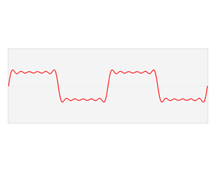
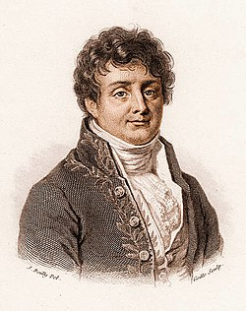
The Fourier domain
Image credits: Wikipedia
A special trigonometric series which could represent any arbitrary function
Notes:
\hat{f}(\omega) = \int\limits_{-\infty}^{\infty} f(x) e^{-2\pi \mathrm{\imath} \omega x} \mathrm{d}x

Slide 23

The continuous Fourier transform
Fourier
domain
primal
(space, time, etc.)
domain
Notes:
\hat{f}(\omega) = \int\limits_{-\infty}^{\infty} f(x) e^{-2\pi \mathrm{\imath} \omega x} \mathrm{d}x

Slide 24

The Fourier transform: `frequency’ domain
frequency
domain
frequency
projection onto sin and cos
Notes:
\hat{f}(\omega) = \int\limits_{-\infty}^{\infty} f(x) e^{-2\pi \mathrm{\imath} \omega x} \mathrm{d}x
\hat{f}(\omega) = \int\limits_{-\infty}^{\infty} f(x) \cos ({2\pi \omega x}) \mathrm{d}x + \mathrm{\imath} \int\limits_{-\infty}^{\infty} f(x) \sin ({2\pi \omega x}) \mathrm{d}x

Slide 25
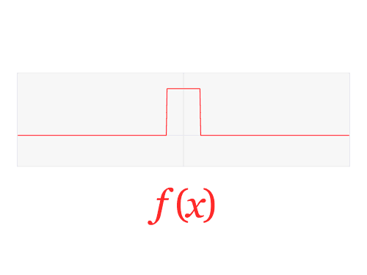


The Fourier Transform
high freq.
0
0
$$ξ$$
low-frequencies
$$x$$
high freq.

Slide 26
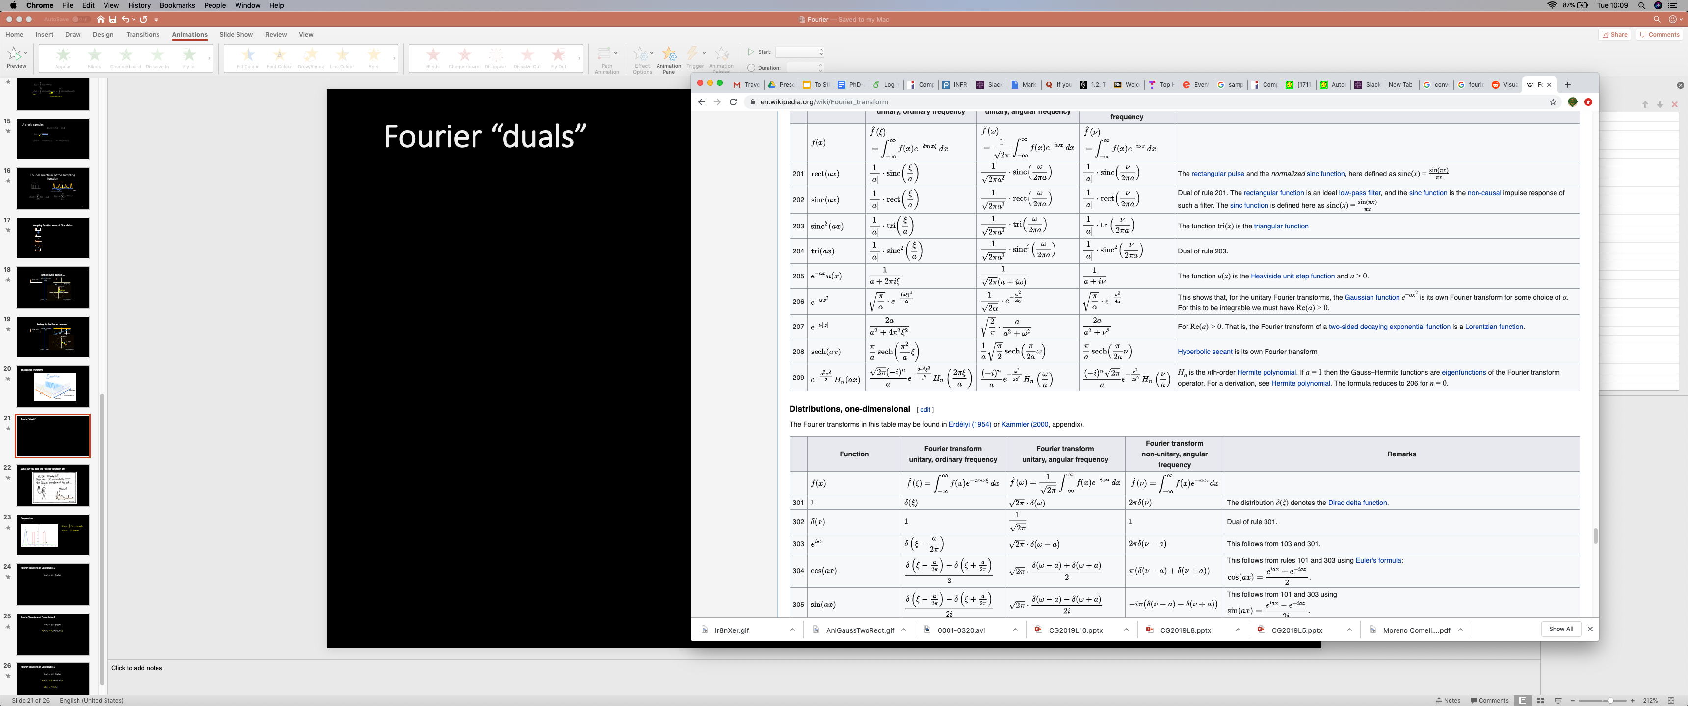


Fourier “duals”
$$f\left(x\right)$$
$$F\left(ξ\right)$$

Slide 27
What can you take the Fourier transform of?
xkcd.com

Slide 28




A single sample:
phase
amplitude = 1
frequency
Notes:
\hat{f}(\omega) = \int\limits_{-\infty}^{\infty} f(x) e^{-2\pi \mathrm{\imath} \omega x} \mathrm{d}x
\hat{f}(\omega) = \int\limits_{-\infty}^{\infty} f(x) \cos ({2\pi \omega x}) \mathrm{d}x + \mathrm{\imath} \int\limits_{-\infty}^{\infty} f(x) \sin ({2\pi \omega x}) \mathrm{d}x

Slide 29
sampling function = sum of Dirac deltas
+
+
+
Notes:
Any unweighted, sampling function can be expressed as the sum of impulses (or Dirac delta functions).

Slide 30
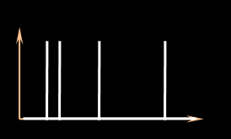


Fourier spectrum of the sampling function
sampling function
amplitude (sampling spectrum)
frequency
phase (sampling spectrum)
Notes:
To abstract away these approaches, we analyse the estimators based on the signature of the sampling function in the Fourier domain. eg. This plot shows the amplitude (yellow) and phase (blue) of the sampling signal.

Slide 31

In the Fourier domain …
Fourier transform
Dirac delta
Frequency
Imaginary
amplitude
phase
Real
primal
Fourier
Complex plane
Notes:
The Fourier transform of a Dirac delta function is a constant (amplitude) with a phase that is linear in frequency (before the modulo 2pi)

Slide 32
Review: in the Fourier domain …
Fourier transform
Dirac delta
Frequency
Imaginary
Imaginary
Real
Real
primal
Fourier
Complex plane
Complex plane
Notes:
The Fourier transform of a Dirac delta function is a constant (amplitude) with a phase that is linear in frequency (before the modulo 2pi)

Slide 33
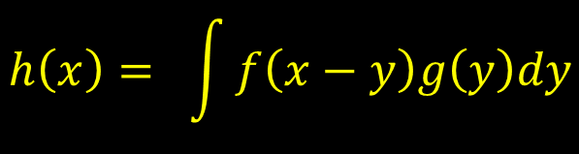




Remember convolution?
$$h\left(x\right)= \int{f\left(x−y\right)g\left(y\right)dy}$$
$$h\left(x\right)= f\left(x\right)⊗g(x)$$
$$g$$
$$f$$
$$h$$

Slide 34
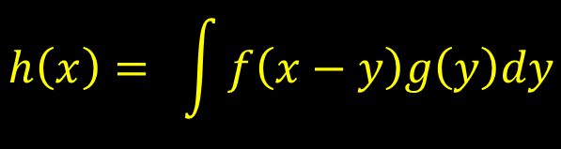

Fourier Transform of Convolution ?
$$h\left(x\right)= f\left(x\right)⊗g(x)$$
$$g$$
$$f$$
$$h\left(x\right)= \int{f\left(x−y\right)g\left(y\right)dy}$$
$$h$$

Slide 35

Fourier Transform of Convolution ?
$$h\left(x\right)= f\left(x\right)⊗g(x)$$
$$g$$
$$ℱ(h\left(x\right))=ℱ(f\left(x\right)⊗g\left(x\right))$$
$$f$$
$$h\left(x\right)= \int{f\left(x−y\right)g\left(y\right)dy}$$
$$h$$

Slide 36

Fourier Transform of Convolution ?
$$h\left(x\right)= f\left(x\right)⊗g(x)$$
$$g$$
$$ℱ(h\left(x\right))=ℱ(f\left(x\right)⊗g\left(x\right))$$
$$f$$
$$H\left(ξ\right)=F\left(ξ\right) G\left(ξ\right)$$
$$h\left(x\right)= \int{f\left(x−y\right)g\left(y\right)dy}$$
$$h$$

Slide 37
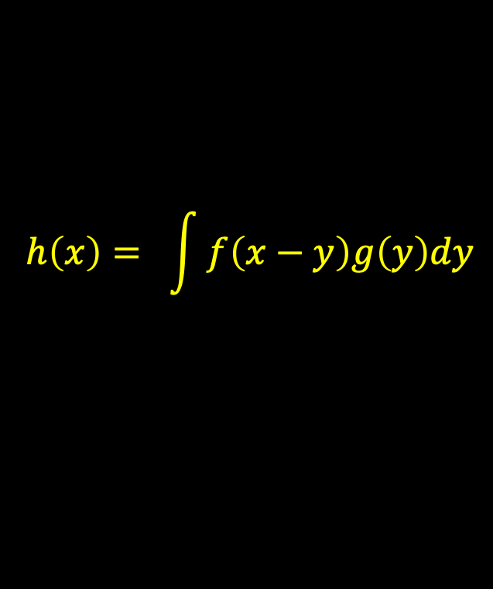

Convolution theorem
$$ℱ\left(f\left(x\right)⊗g\left(x\right)\right)=F\left(ξ\right) G\left(ξ\right)$$
Fourier transform of a convolution
product of Fourier transformed functions
$$h\left(x\right)= \int{f\left(x−y\right)g\left(y\right)dy}$$

Slide 38
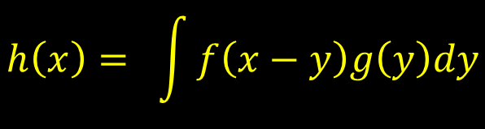
Alternative way to calculate convolutions
$$h\left(x\right)= \int{f\left(x−y\right)g\left(y\right)dy}$$
Fast Fourier Transform
Obtain Fourier transforms F and G
Multiply, so H = F.G
Take the inverse Fourier transform of H
h = H⁻¹
Fast Fourier Transform

Slide 39


What if we apply the Fourier transform?
$$f_{r} \left(x\right)= \int{f_{s}\left(x−y\right)g\left(y\right)dy}$$
$$=f_{s}⊗g$$
$$f(x)$$
$$F_{r}(ξ) =F_{s}(ξ) G(ξ)$$
$$g(x)$$
$$f_{s}(x)$$
$$f_{r}(x)$$

Slide 40
How to assess sampling and reconstruction error?

Slide 41




Focus on the sampling operation first:
$$f(x)$$
$$f_{s}\left(x\right)$$
$$x$$
multiply

Slide 42



What are these in the Fourier domain?
$$f(x)$$
$$f_{s}\left(x\right)$$
$$x$$
convolve

Slide 43



Intuition: Sampling function
$$F_{s}\left(ξ\right)$$
$$f_{s}\left(x\right)$$
$$x$$
$$ξ$$

Slide 44
Intuition: Sampling function
$$F_{s}\left(ξ\right)$$
$$f_{s}\left(x\right)$$
$$x$$
$$ξ$$

Slide 45













Sampling in the Fourier Domain
$$f(x)$$
$$f_{s}\left(x\right)$$
$$x$$
convolve

Slide 46











How to remove aliases?
convolve
multiply Fourier spectrum by box

Slide 47








Sparse sampling (squeezed in Fourier domain)
convolve

Slide 48
Sparse sampling (squeezed in Fourier domain)
convolve
aliasing

Slide 49
Nyquist-Shannon Sampling theorem

Slide 50
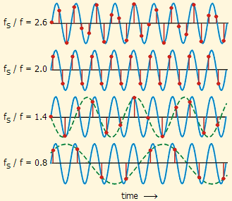

Slide 51
Multiplication by a box in the Fourier (frequency) domain…
-B
B
-4B
-2B
2B
4B
convolve
multiply Fourier spectrum by box

Slide 52












... convolution with a reconstruction kernel (in x)
-B
B
-4B
-2B
2B
4B
convolve
multiply Fourier spectrum by box
convolve with kernel g(x)

Slide 53
Is a convolution with a reconstruction kernel (in the primal, or x)
-B
B
-4B
-2B
2B
4B
convolve
multiply Fourier spectrum by box
Find kernel whose Fourier spectrum best matches this box
convolve with kernel g(x)

Slide 54
Will recap next lecture …

