Slide 1
Computer Graphics Rendering
Lecture 14: Sampling for Rendering Part 1
Kartic Subr

Slide 2







Sampling = multiplication
$$|S\left(ω\right)|$$
$$f_{s}\left(x\right)=f\left(x\right) . s(x)$$
-$ω$
0
+$ω$
sampled function
sampling function
$$|F\left(ω\right)|$$
-$ω$
0
+$ω$

Slide 3








Functions in Fourier domain
primal
$$|F\left(ω\right)|$$
$$⟺$$
Fourier
dual
-$ω$
0
+$ω$
x
$$|S\left(ω\right)|$$
Fourier
dual
$$⟺$$
x
-$ω$
0
+$ω$

Slide 4
Convolution theorem
$$|F\left(ω\right)|$$
MULTIPLY
=
CONVOLVE
-$ω$
0
+$ω$
x
$$|S\left(ω\right)|$$
x
-$ω$
0
+$ω$

Slide 5





Sampling = convolution (Fourier domain)
$$f_{s}\left(x\right)=f\left(x\right) . s(x)$$
$$F_{s}\left(ω\right)=F\left(ω\right) ⊗S(ω)$$
$$|F\left(ω\right)|$$
MULTIPLY
-$ω$
0
+$ω$
CONVOLVE
$$|S\left(ω\right)|$$
-$ω$
0
+$ω$

Slide 6




Convolution results in overlapping spectra
$$f_{s}\left(x\right)=f\left(x\right) . s(x)$$
$$|F\left(ω\right)|$$
$$F_{s}\left(ω\right)=F\left(ω\right) ⊗S(ω)$$
-$ω$
0
+$ω$
CONVOLVE
MULTIPLY
$$|S\left(ω\right)|$$
-$ω$
0
+$ω$

Slide 7
To move these away, change sampling function
$$f_{s}\left(x\right)=f\left(x\right) . s(x)$$
$$|F\left(ω\right)|$$
$$F_{s}\left(ω\right)=F\left(ω\right) ⊗S(ω)$$
-$ω$
0
+$ω$
CONVOLVE
MULTIPLY
$$|S\left(ω\right)|$$
Change
-$ω$
0
+$ω$

Slide 8
Stretching S to higher frequencies …
$$f_{s}\left(x\right)=f\left(x\right) . s(x)$$
$$|F\left(ω\right)|$$
$$F_{s}\left(ω\right)=F\left(ω\right) ⊗S(ω)$$
-$ω$
0
+$ω$
CONVOLVE
MULTIPLY
$$|S\left(ω\right)|$$
Change
-$ω$
0
+$ω$

Slide 9
We can see the central replica and aliases
$$f_{s}\left(x\right)=f\left(x\right) . s(x)$$
$$|F\left(ω\right)|$$
$$F_{s}\left(ω\right)=F\left(ω\right) ⊗S(ω)$$
-$ω$
0
+$ω$
aliases
central replica
aliases
CONVOLVE
MULTIPLY
$$|S\left(ω\right)|$$
-$ω$
0
+$ω$

Slide 10

Pushing further removes overlaps
$$f_{s}\left(x\right)=f\left(x\right) . s(x)$$
$$|F\left(ω\right)|$$
$$F_{s}\left(ω\right)=F\left(ω\right) ⊗S(ω)$$
-$ω$
0
+$ω$
aliases do not overlap
CONVOLVE
MULTIPLY
$$|S\left(ω\right)|$$
-$ω$
0
+$ω$

Slide 11




Higher sampling rate = stretched out spectrum
$$f_{s}\left(x\right)=f\left(x\right) . s(x)$$
$$|F\left(ω\right)|$$
-$ω$
0
+$ω$
CONVOLVE
MULTIPLY
$$|S\left(ω\right)|$$
-$ω$
0
+$ω$

Slide 12

Removing aliases: 1) Increase sampling rate
$$F_{s}\left(ω\right)=F\left(ω\right) ⊗S(ω)$$

Slide 13

Removing aliases: 2) Crop signal (Fourier)
original signal
if sampling is
sufficiently dense
reconstructed signal
$$F_{r}\left(ω\right)= R\left(ω\right) . \left( F\left(ω\right) ⊗S\left(ω\right) \right)=F\left(ω\right)$$
multiply
convolve
select central replica
reconstruction function/filter/kernel
$$R\left(ω\right)$$
zero out aliases

Slide 14

Convolve (Primal) = Crop (Fourier)
$$f_{r}\left(x\right)=r\left(x\right)⊗( f\left(x\right) . s\left(x\right) )$$
$$F_{r}\left(ω\right)= R\left(ω\right) . \left( F\left(ω\right) ⊗S\left(ω\right) \right)=F\left(ω\right)$$

Slide 15

Convolve (Primal) = Crop (Fourier)
$$f_{r}\left(x\right)=r\left(x\right)⊗( f\left(x\right) . s\left(x\right) )$$
$$F_{r}\left(ω\right)= R\left(ω\right) . \left( F\left(ω\right) ⊗S\left(ω\right) \right)=F\left(ω\right)$$
aliasing

Slide 16


Convolve (Primal) = Crop (Fourier)
Fourier Transform
$$f_{r}\left(x\right)=r\left(x\right)⊗( f\left(x\right) . s\left(x\right) )$$
$$F_{r}\left(ω\right)= R\left(ω\right) . \left( F\left(ω\right) ⊗S\left(ω\right) \right)=F\left(ω\right)$$
Inverse Fourier Transform
aliasing

Slide 17


(Nyquist-Shannon) Sampling Theorem
Sampling rate > 2B guarantees no aliasing
Provided:
Function is bandlimited (B is max frequency)
Sampling is regular (comb function)
-B
$$|F\left(ω\right)|$$
B
Bandlimited
-$ω$
0
+$ω$
aliasing

Slide 18
For any dimension: e.g. pixels in 2D
aliasing

Slide 19
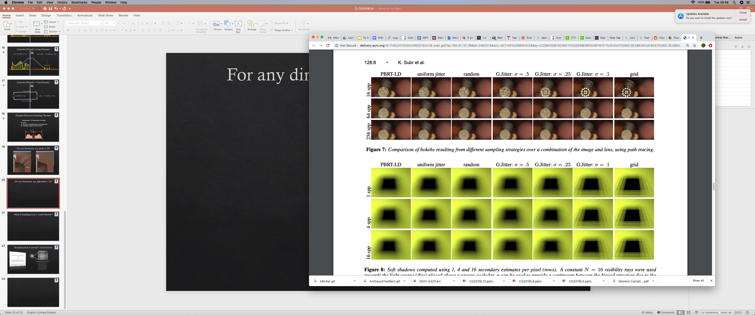
For any dimension: e.g. light paths > 2D
comb (regular grid)
16 spp
1 spp
But this is numerical integration, not reconstruction !
What is the connection
between these two classes of problems?
64 spp
4 spp
256 spp
16 spp

Slide 20
Adding randomness is good. Why?
comb (regular grid)
jittered grid
16 spp
random noise is
less objectionable
although undesirable
structured artifacts are visually disturbing
1 spp

Slide 21
Minimum distance between samples
structure + random

Slide 22
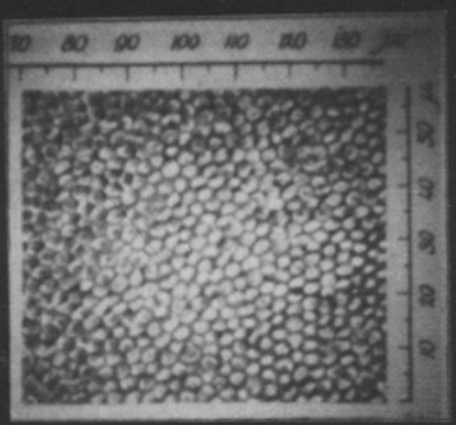
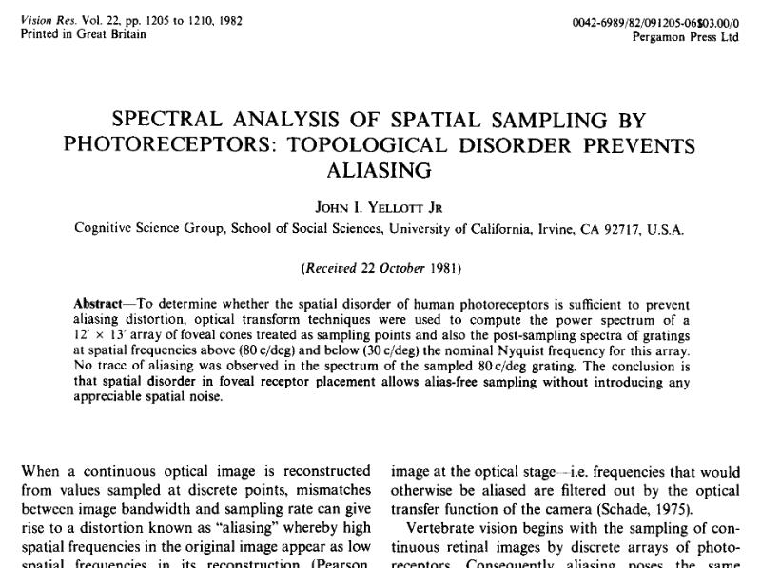
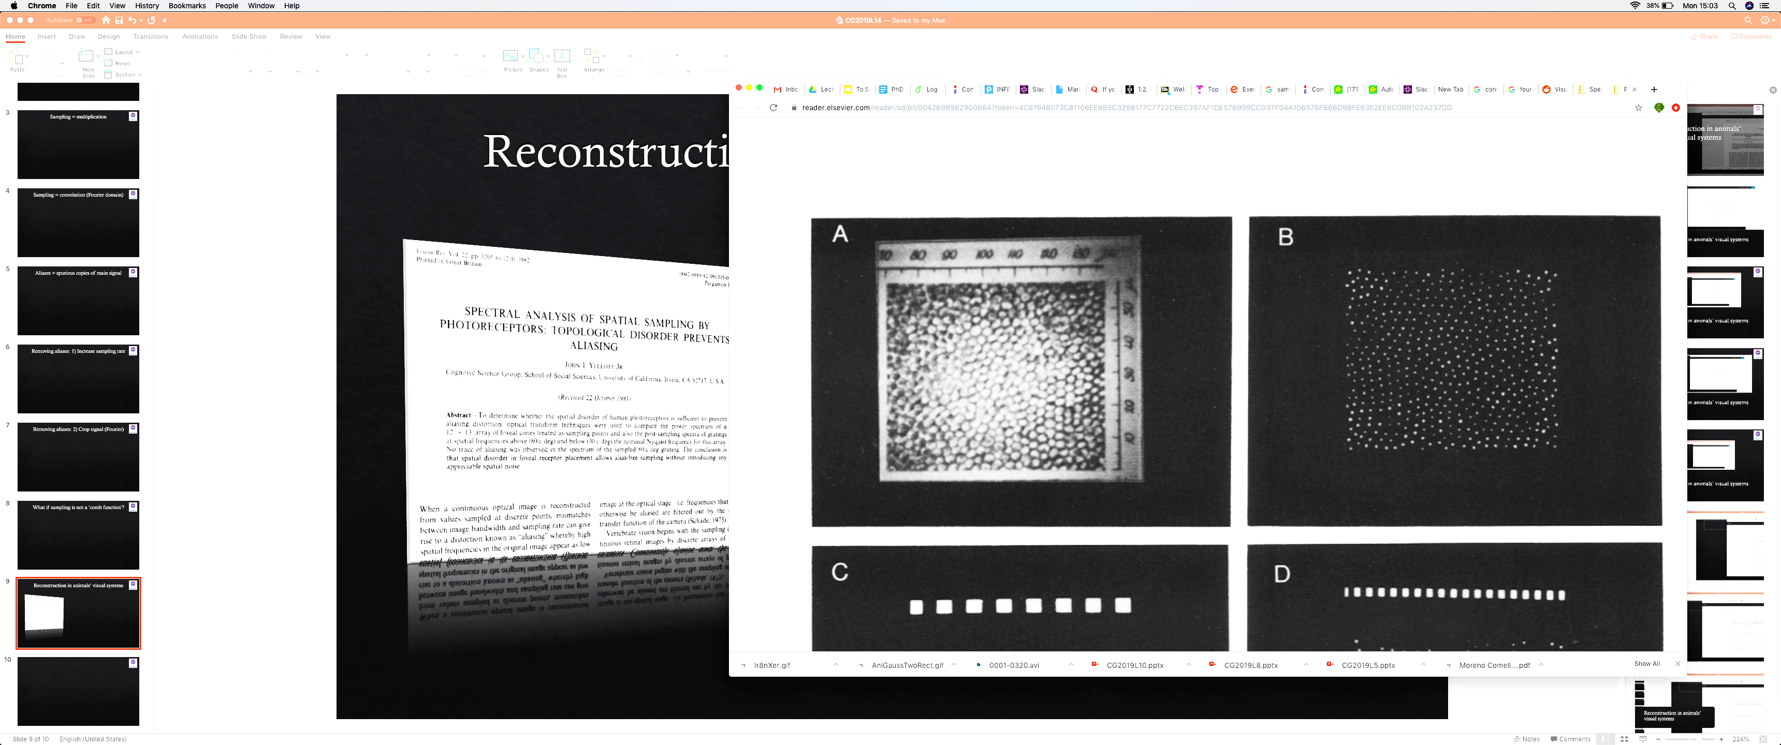
Reconstruction in animals’ visual systems
regular structure but not a grid

Slide 23
Reconstruction in animals’ visual systems

Slide 24


Gap in low-frequencies in Fourier spectrum
not a comb!
not a comb!
$$|S\left(ω\right)|$$
appear random, but minimum distance enforced
important
-$ω$
0
+$ω$
x

Slide 25
Random sampling spectrum is flat
not a comb!
not a comb!
random
$$|S\left(ω\right)|$$
-$ω$
0
+$ω$
x

Slide 26
Gap in low-frequencies in Fourier spectrum
not a comb!
not a comb!
$$|S\left(ω\right)|$$
appear random, but minimum distance enforced
important
-$ω$
0
+$ω$
x

Slide 27


Slide 28
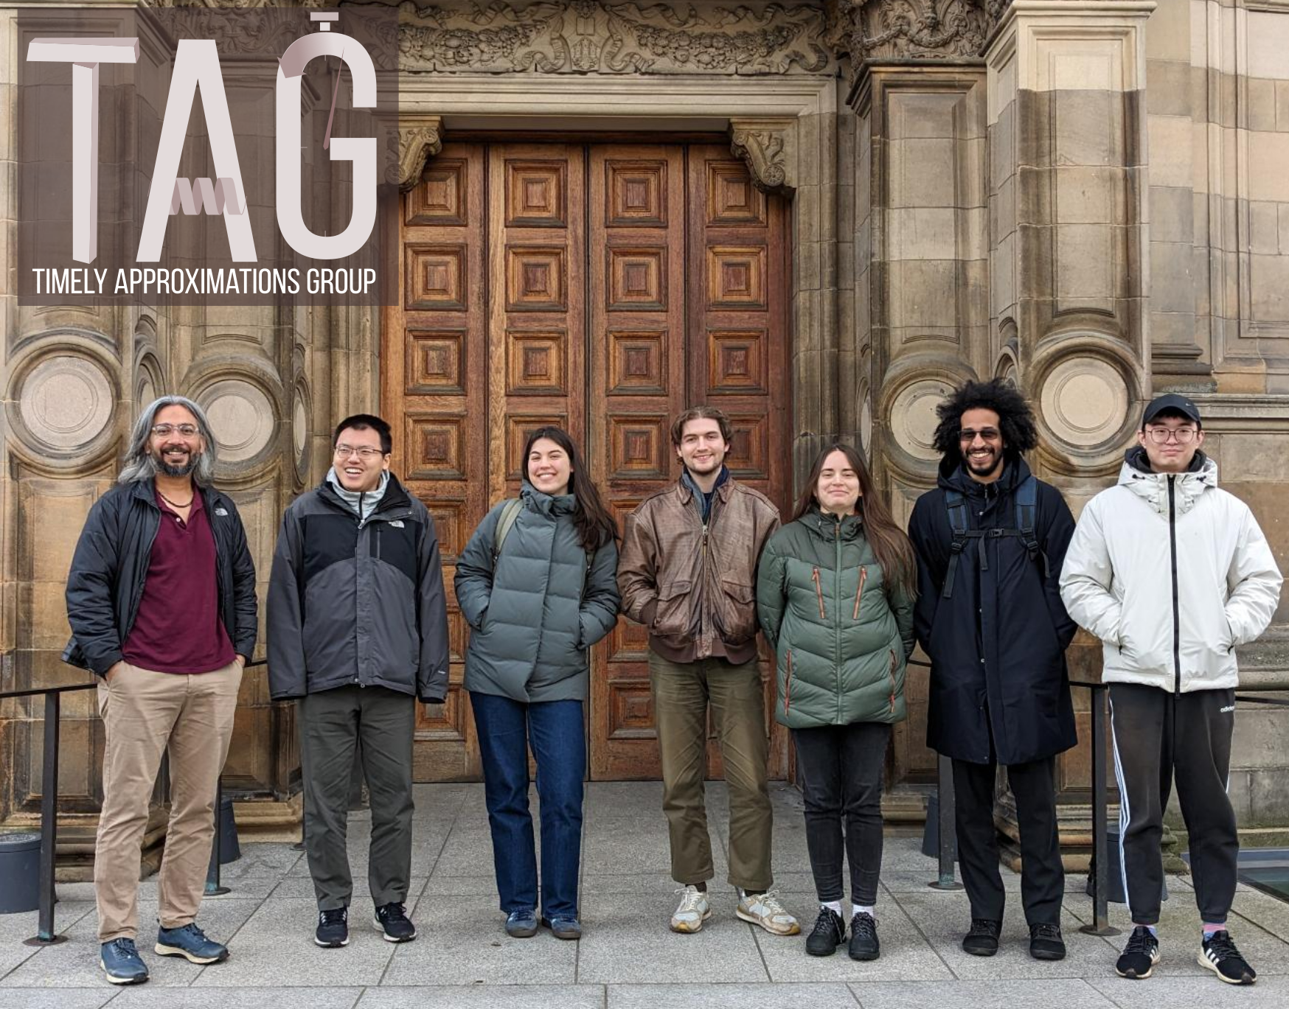
PhD opportunities!

Slide 29




PhD opportunities!

Slide 30
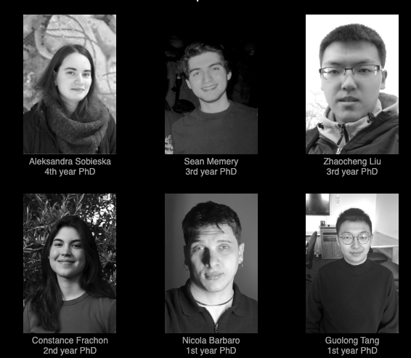
PhD opportunities!

