Slide 1
Computer Graphics: Rendering
Lecture 2: Imaging-- Radiometry, Photometry
Kartic Subr

Slide 2
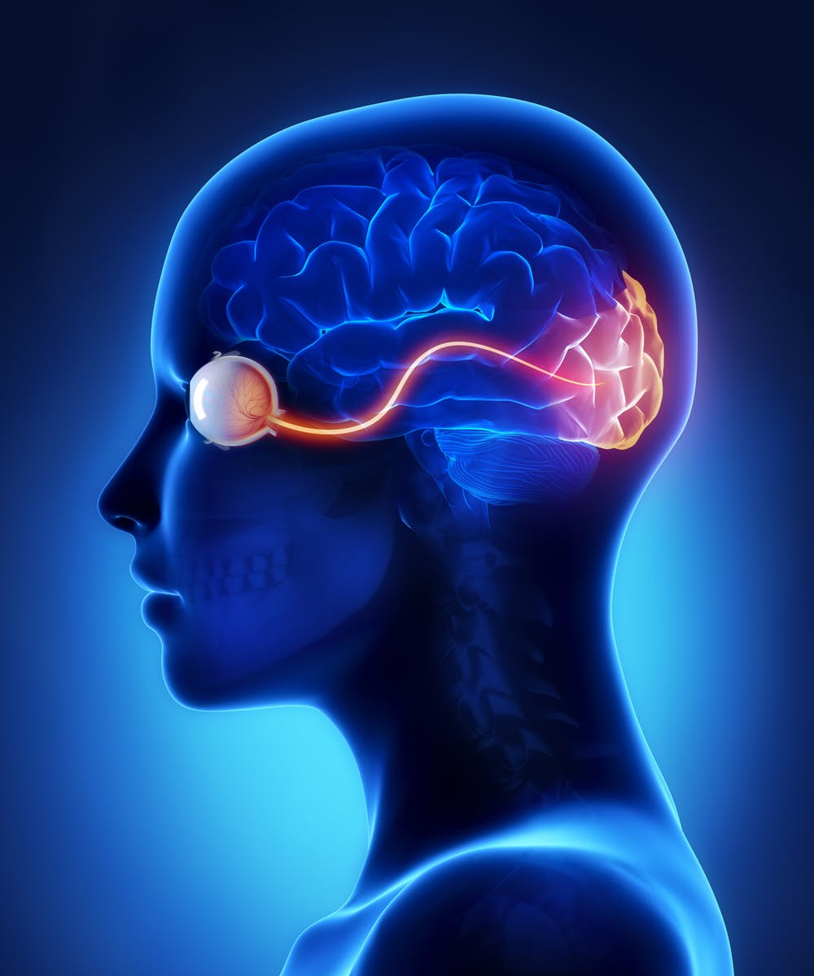
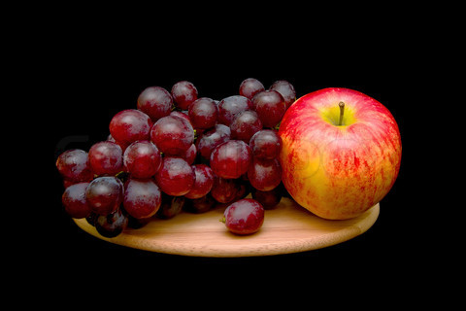
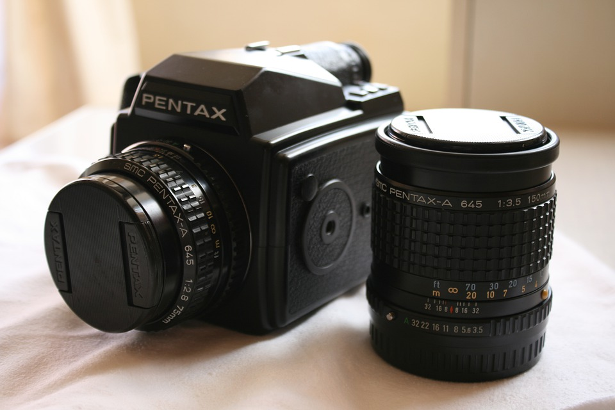

Computer Graphics
Real
photography
image manipulation
rendering
Virtual

Slide 3
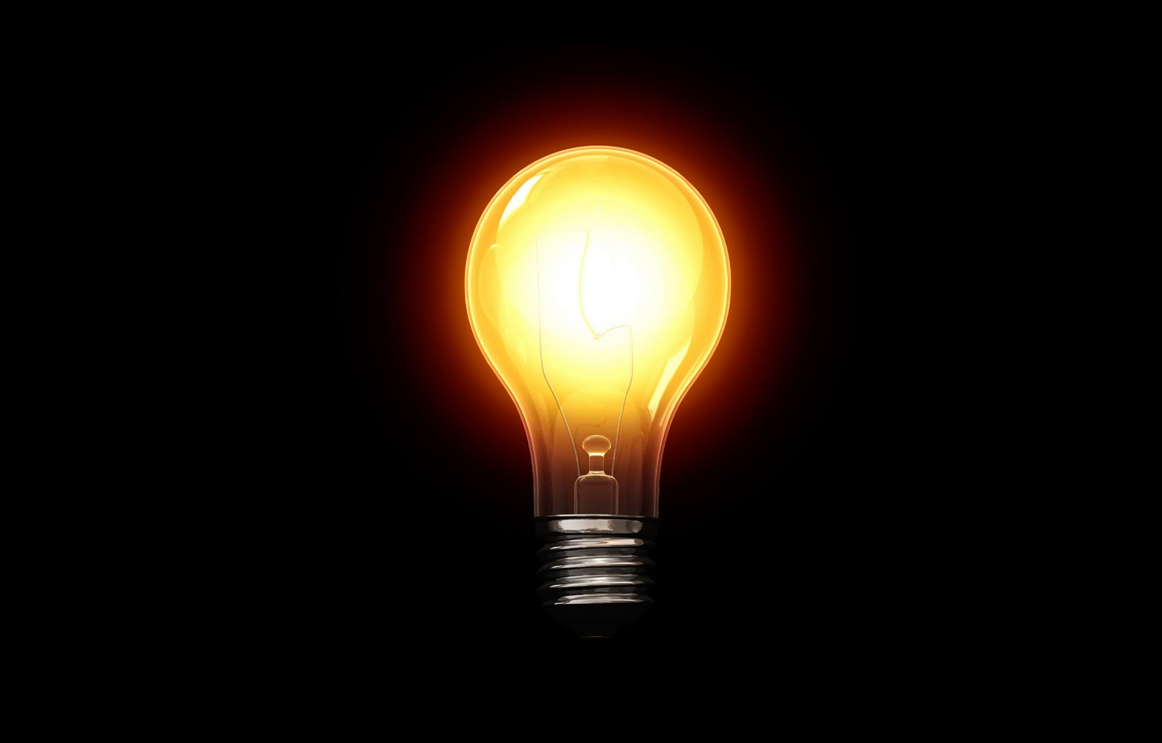
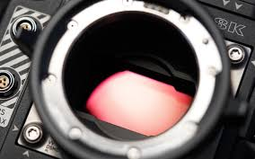
Energy in the scene
Cool visualization in this video

Slide 4

What do cameras record?
Obviously, it is …ehmm
…‘light stuff’?

Slide 5
What is light?

Slide 6
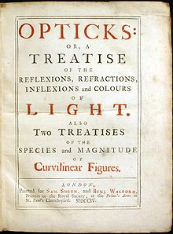
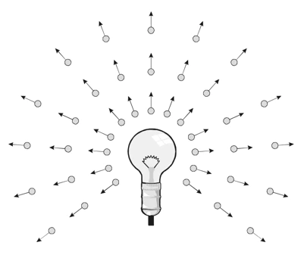
What is light?
Isaac Newton 1704

Slide 7
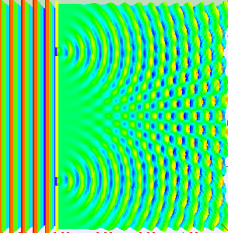
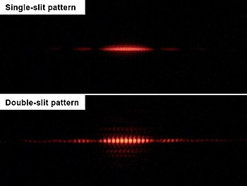
What is light?
Isaac Newton 1704
Thomas Young 1801

Slide 8
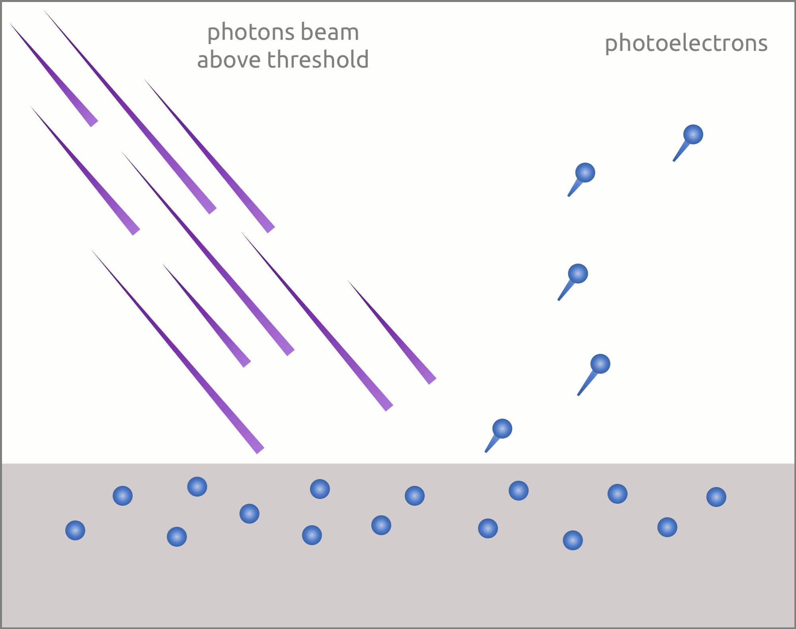
What is light?
Isaac Newton 1704
Thomas Young 1801
1887 Hertz, 1902 Lenard, 1905 Einstein

Slide 9
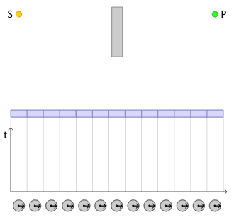
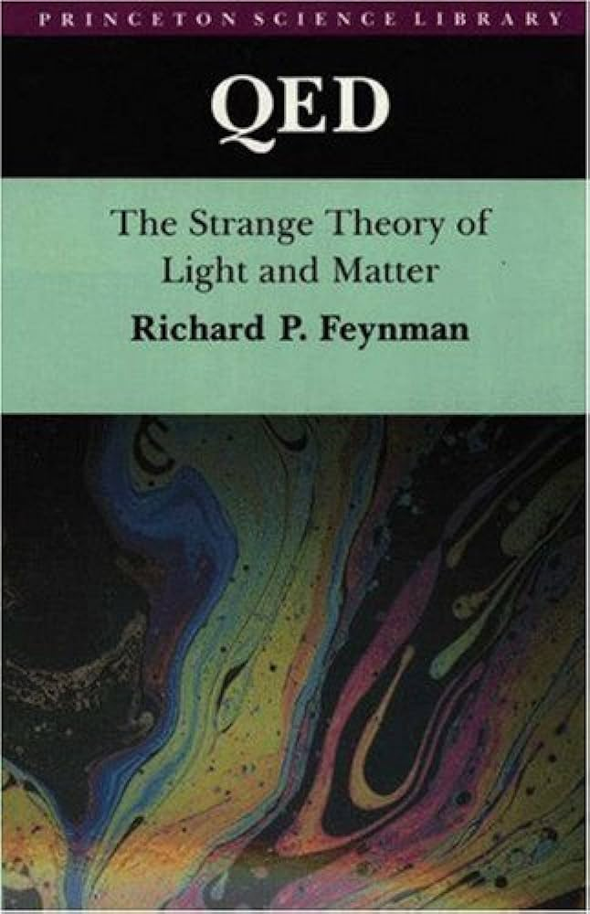
Straight lines?
Feynman 1985, read this

Slide 10
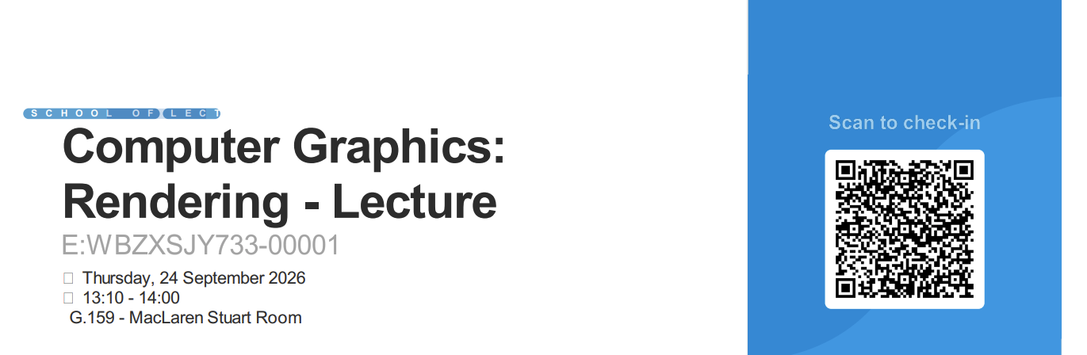

Slide 11
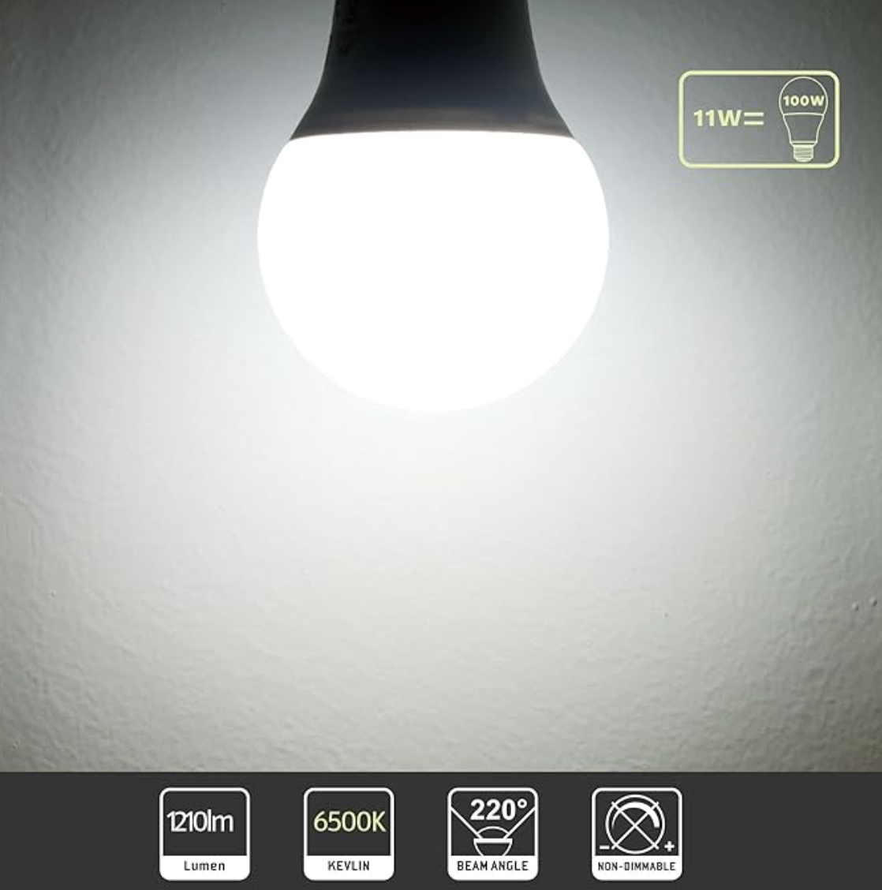
ROTTYI Light Bulbs
100W Equivalent, 6500K Bulbs, 11W 1210LM LED

Slide 12
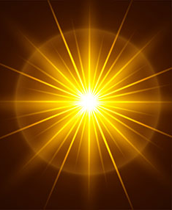
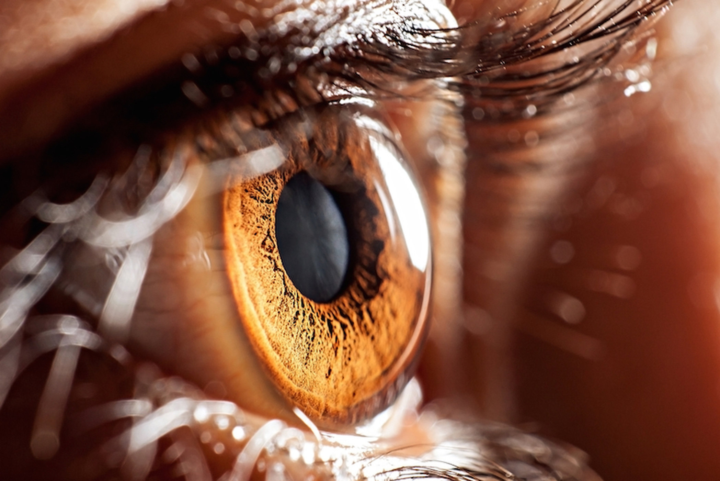
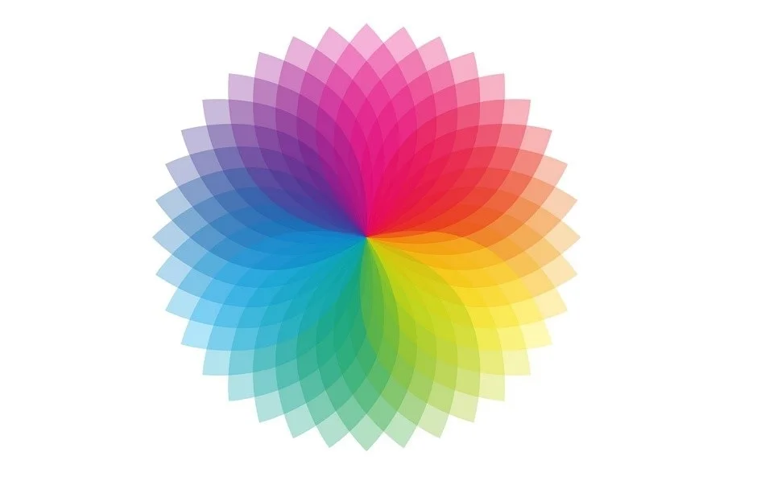
The study of light
radiometry
photometry
colorimetry
Interested in knowing more? Read this

Slide 13
The study of light
photometry

Slide 14
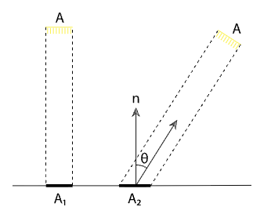
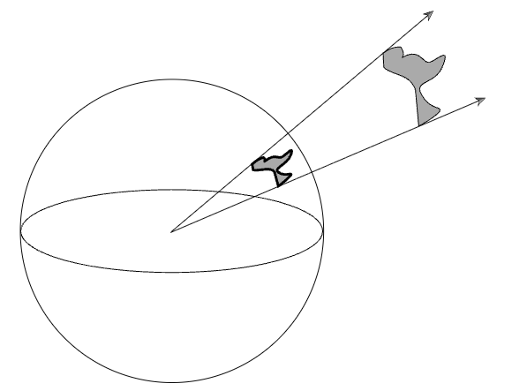
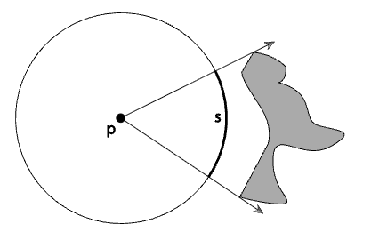
Radiometry
per area
per time
energy
power
per direction
https://pbr-book.org/3ed-2018/Color_and_Radiometry/Radiometry#sec:radiometry

Slide 15
Radiometry
irradiance
per area
per direction
Watt/m²
per time
energy
power
radiance
Watt
Watt/ m² Sr
Joules
per direction
per area
radiant
intensity
Watt/Sr

Slide 16
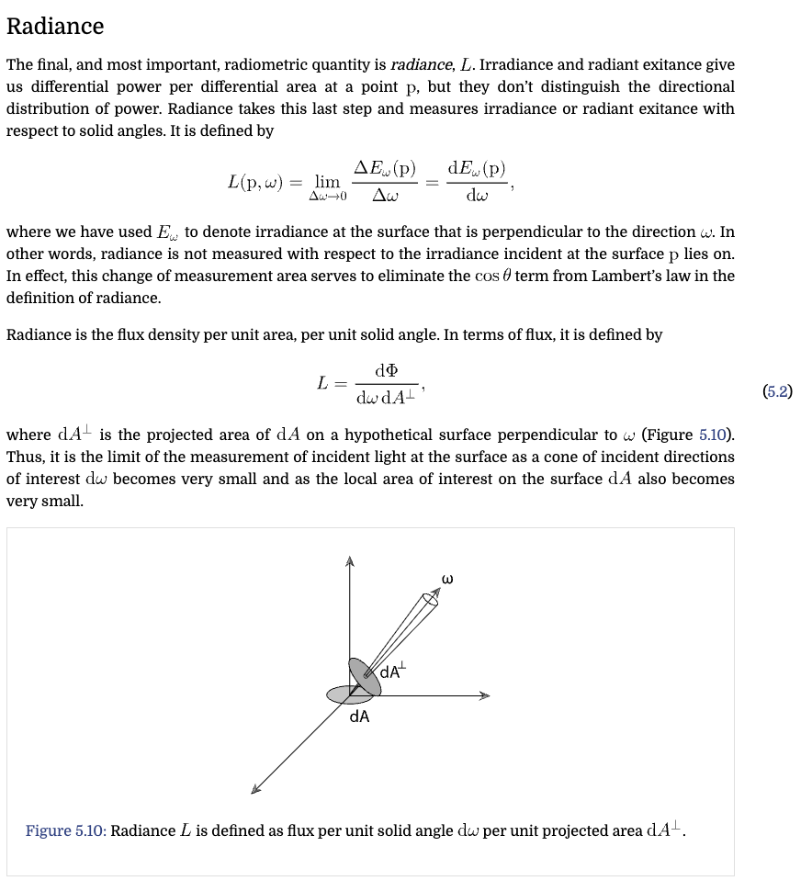





Radiometry
$$\frac{∂}{∂A}$$
$$\frac{∂}{∂ω}$$
irradiance
$$\frac{∂}{∂t}$$
per area
per direction
per time
energy
power
radiance
per direction
per area
$$\frac{∂}{∂ω}$$
radiant
intensity
$$\frac{∂}{∂A}$$

Slide 17
Radiometry
$$\frac{∂}{∂A}$$
$$\frac{∂}{∂ω}$$
radiosity
$$\frac{∂}{∂t}$$
per area
per direction
per time
energy
power
radiance
per direction
per area
$$\frac{∂}{∂ω}$$
radiant
intensity
$$\frac{∂}{∂A}$$

Slide 18




$$\frac{∂}{∂A}$$
$$\frac{∂}{∂ω}$$
radiosity
$$\frac{∂}{∂t}$$
per area
per direction
per time
energy
power
radiance
per direction
per area
$$\frac{∂}{∂ω}$$
radiant
intensity
$$\frac{∂}{∂A}$$
ROTTYI Light Bulbs
100W Equivalent, 6500K Bulbs, 11W 1210LM LED

Slide 19

Radiometry
Study of light energy in a scene

Slide 20
Radiometric qty. per wavelength
radiosity
per area
per direction
per time
energy
power
radiance
per direction
per area
radiant
intensity
per wavelength?

Slide 21
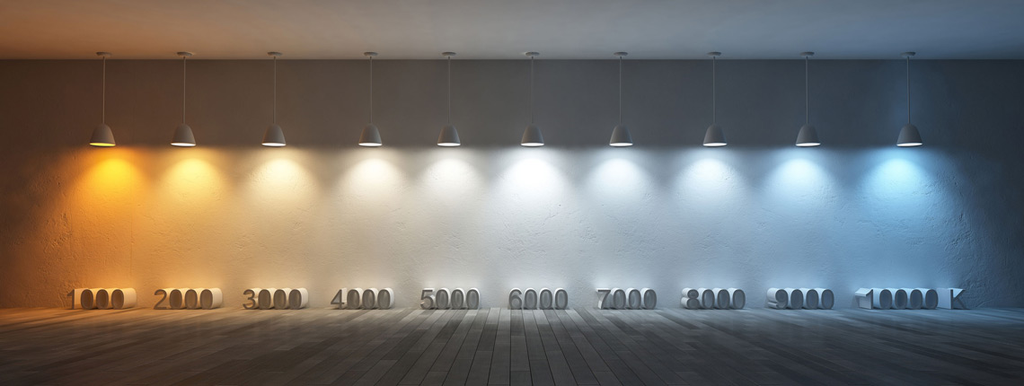
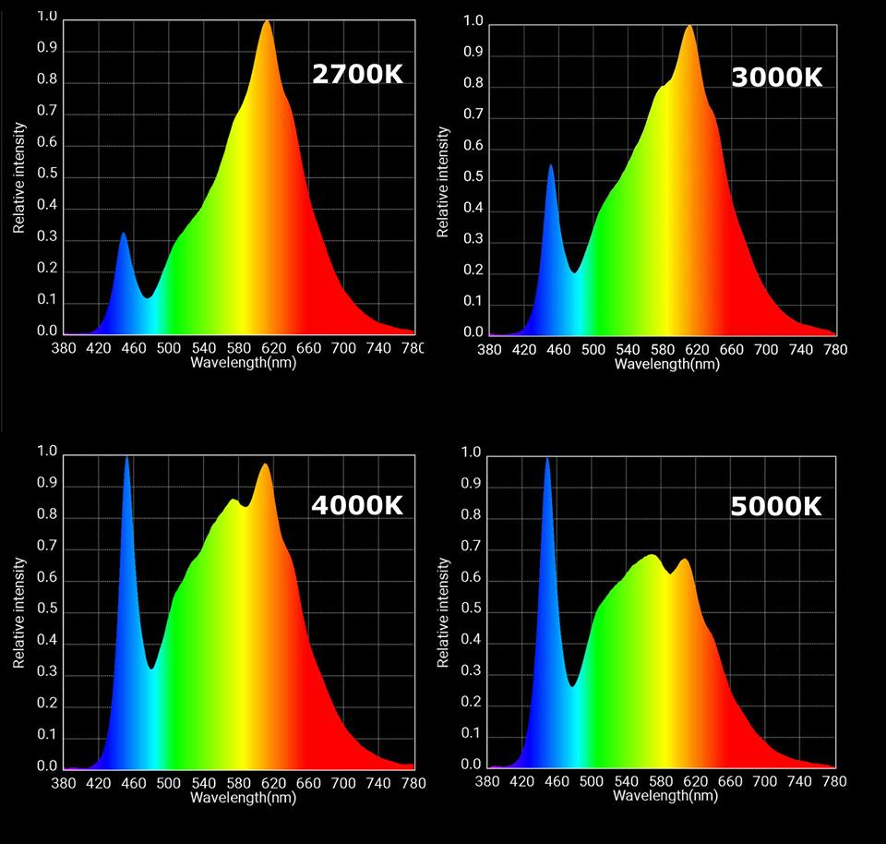
Spectrometry: radiometric qty. per wavelength
radiant
intensity
https://www.softlights.org/chapter-11-color-temperature/
Interested in modelling this? Look here

Slide 22
$$\frac{∂}{∂A}$$
$$\frac{∂}{∂ω}$$
radiosity
$$\frac{∂}{∂t}$$
per area
per direction
per time
energy
power
radiance
per direction
per area
$$\frac{∂}{∂ω}$$
radiant
intensity
$$\frac{∂}{∂A}$$
?

Slide 23
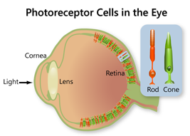
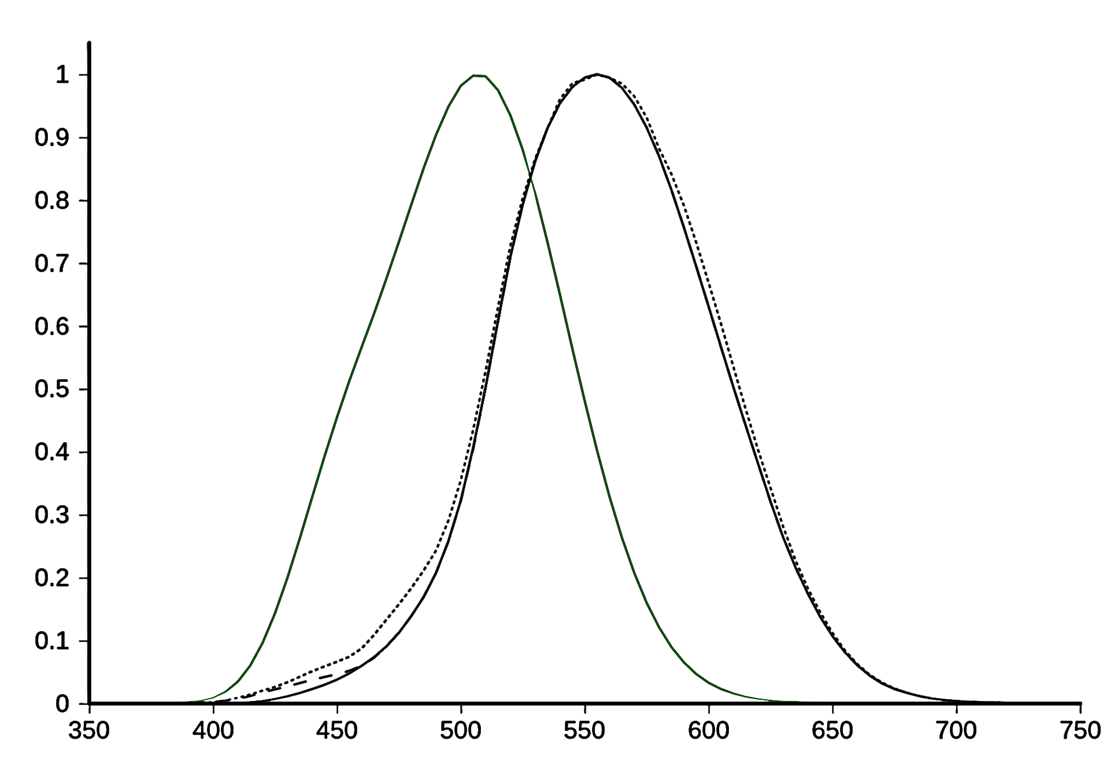

Photometry
Study of perceived light energy in a scene

Slide 24
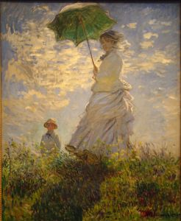
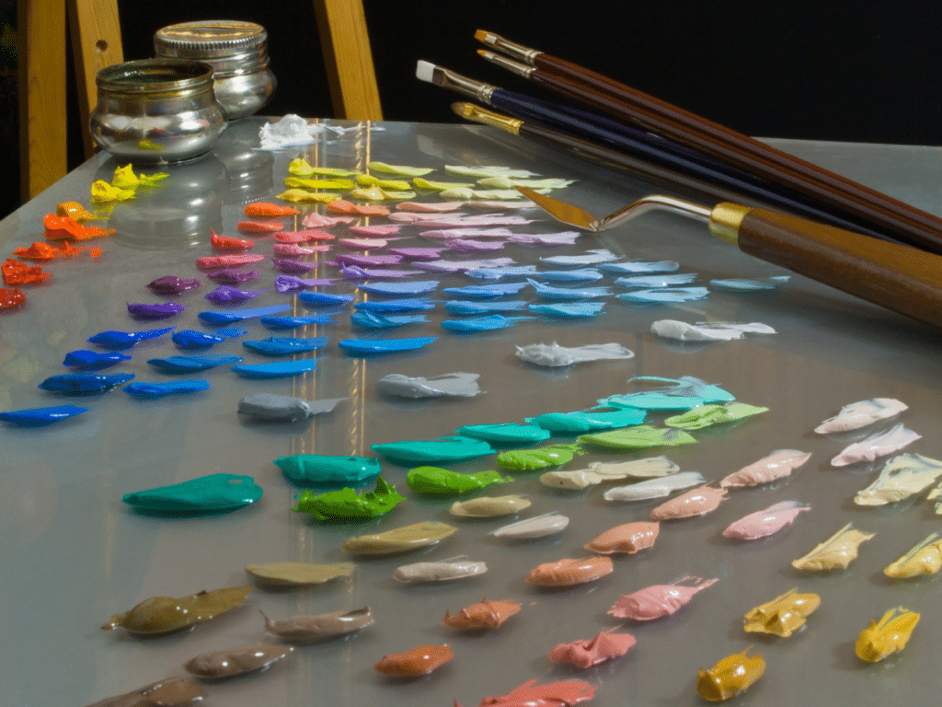
Photometry
Study of perceived light energy in a scene
https://www.artistsnetwork.com/art-subjects/understanding-value-and-tone-for-better-painting/?srsltid=AU7gw4XCjfndc3QTZLq7gSuoT5rK0YdFpfZCcWaYHzFv6vL5hVUnk11D
https://finearttutorials.com/wp-content/uploads/2022/04/how-to-mix-colour-values-in-art-1024x768.png

Slide 25
Photometry
Study of perceived light energy in a scene
Notes:
V(lambda) and luminance as integral

Slide 26
Photometry
Study of perceived light energy in a scene
see document projector …
Notes:
V(lambda) and luminance as integral

Slide 27
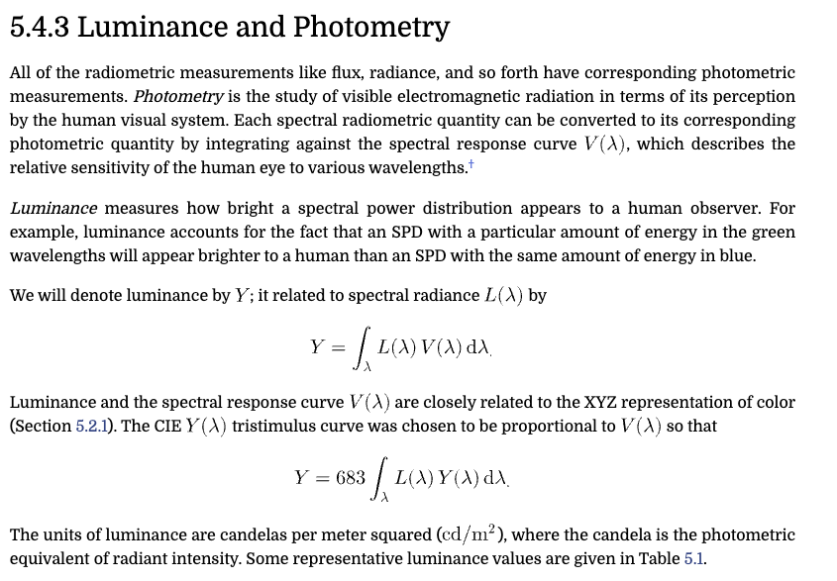

Slide 28
irradiance
per area
per direction
per time
energy
power
radiance
per direction
per area
radiant
intensity
illuminance
luminous
flux
luminance
luminous
intensity

Slide 29
irradiance
power
radiance
radiant
intensity
illuminance
luminous
flux
luminance
luminous
intensity

Slide 30
irradiance
power
radiance
radiant
intensity
illuminance
luminous
flux
luminance
luminous
intensity

Slide 31
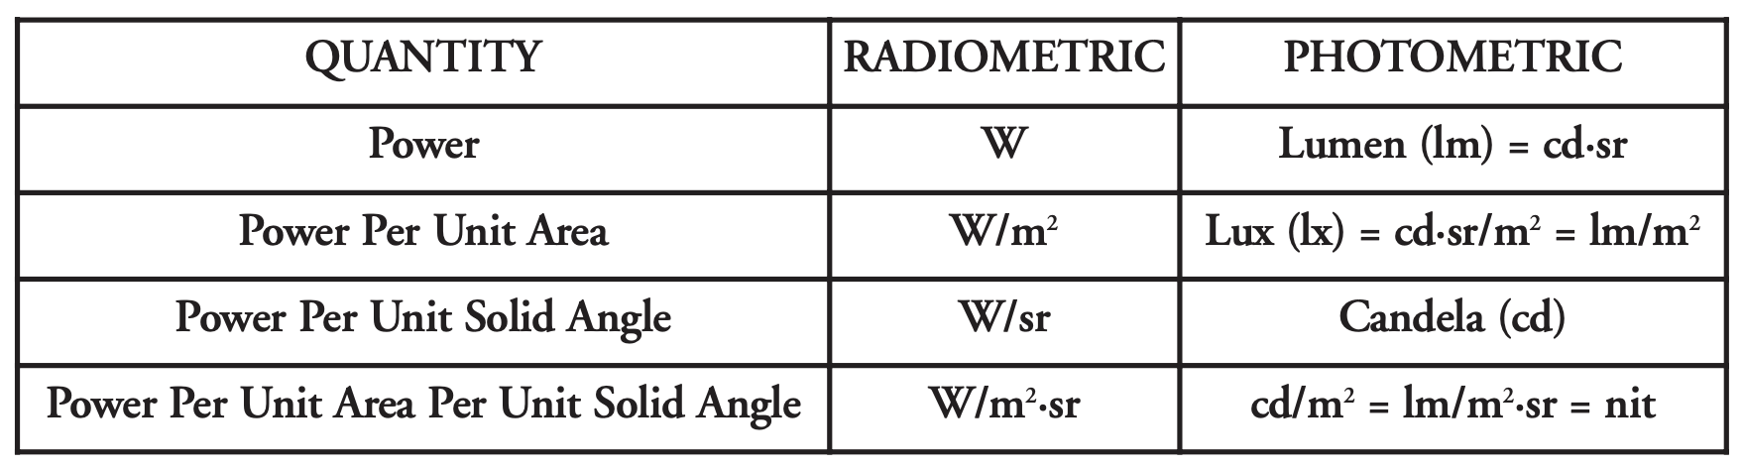

Slide 32
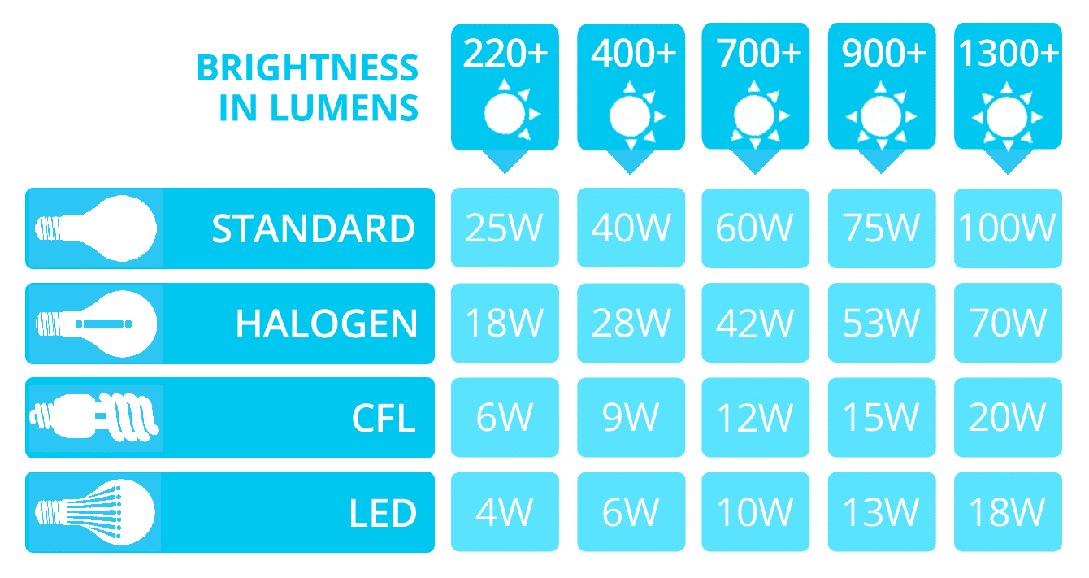

Slide 33
$$\frac{∂}{∂A}$$
$$\frac{∂}{∂ω}$$
radiosity
$$\frac{∂}{∂t}$$
per area
per direction
per time
energy
power
radiance
per direction
per area
$$\frac{∂}{∂ω}$$
radiant
intensity
$$\frac{∂}{∂A}$$

Slide 34
$$\frac{∂}{∂A}$$
$$\frac{∂}{∂ω}$$
radiosity
$$\frac{∂}{∂t}$$
per area
per direction
per time
energy
power
radiance
per direction
per area
$$\frac{∂}{∂ω}$$
radiant
intensity
$$\frac{∂}{∂A}$$

Slide 35

Spectral sensitivity of our eyes

Slide 36
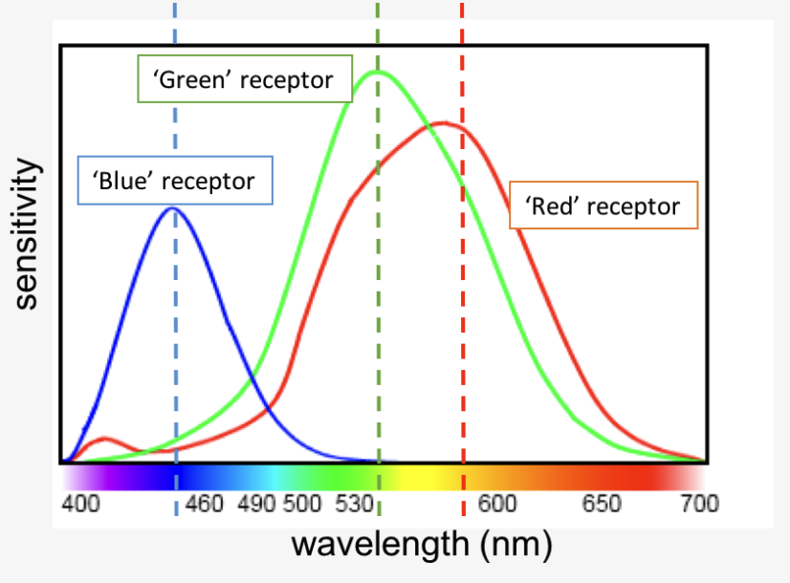

Slide 37

Spectral response of cones

Slide 38

Rods, cones, etc.

Slide 39
plotting S,M,L as 3D points as a function of wavelength

Slide 40


Slide 41
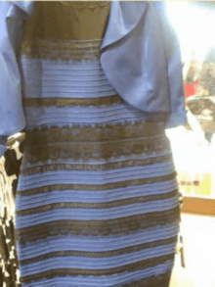
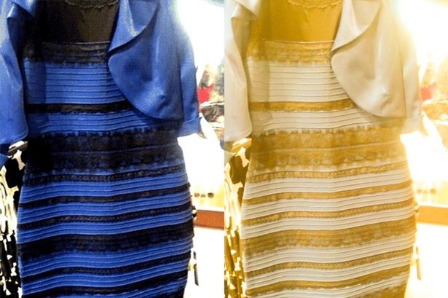
Metamers
http://persci.mit.edu/people/adelson/checkershadow_proof

Slide 42
Colorimetry
Trichromatic theory of light (Thomas Young)
According to the theory, any color can be represented as a combination of stimulation across these three cone types. For example, yellow light (around 580 nm) does not stimulate a “yellow” receptor — instead, it is perceived because it produces a certain ratio of responses between L- and M-cones, with little S-cone activation.
If you woud like to read about the history of this theory …

Slide 43
Trichromatic theory of light

Slide 44
Trichromatic theory of light

Slide 45
Matching Experiment
tweak sliders
r
target colour
observed
colour
g
b

Slide 46
Matching Experiment
g
r
b

Slide 47
Tristimulus values

Slide 48
Tristimulus values

Slide 49
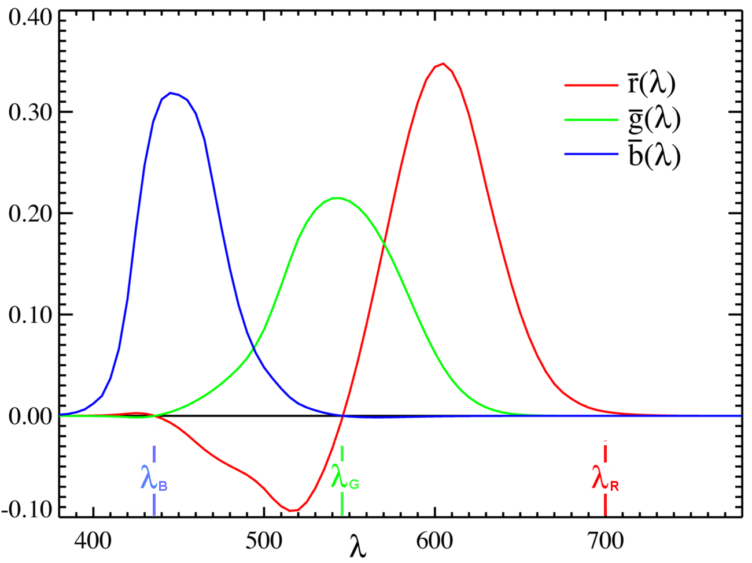
Tristimulus values: RGB matching functions
Confusing? Read more here
(search for ‘Maxwell’ on the page)
or here

Slide 50
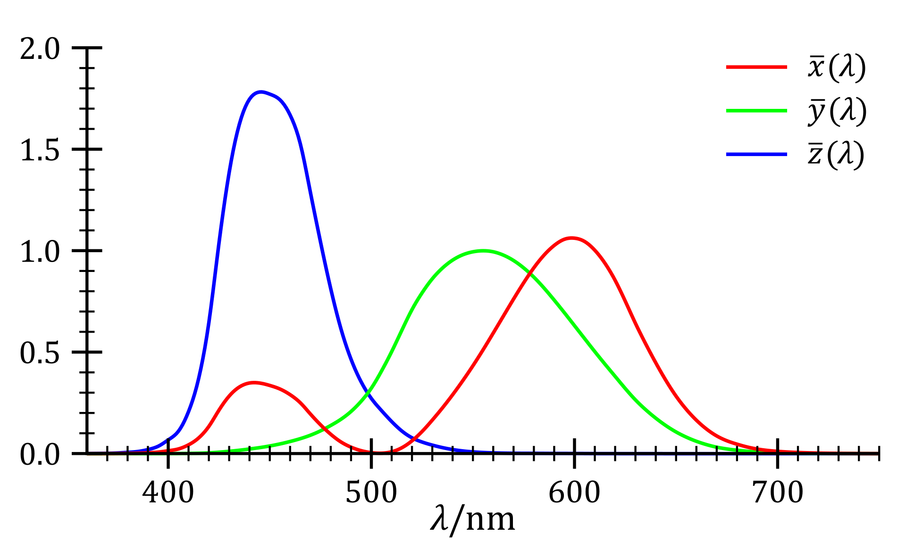
RGB to CIE XYZ space
M

Slide 51
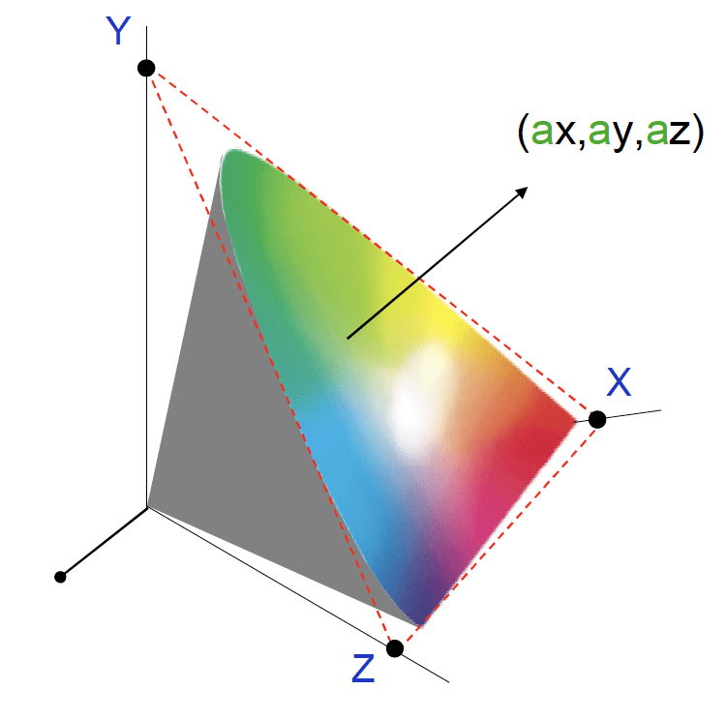

Slide 52
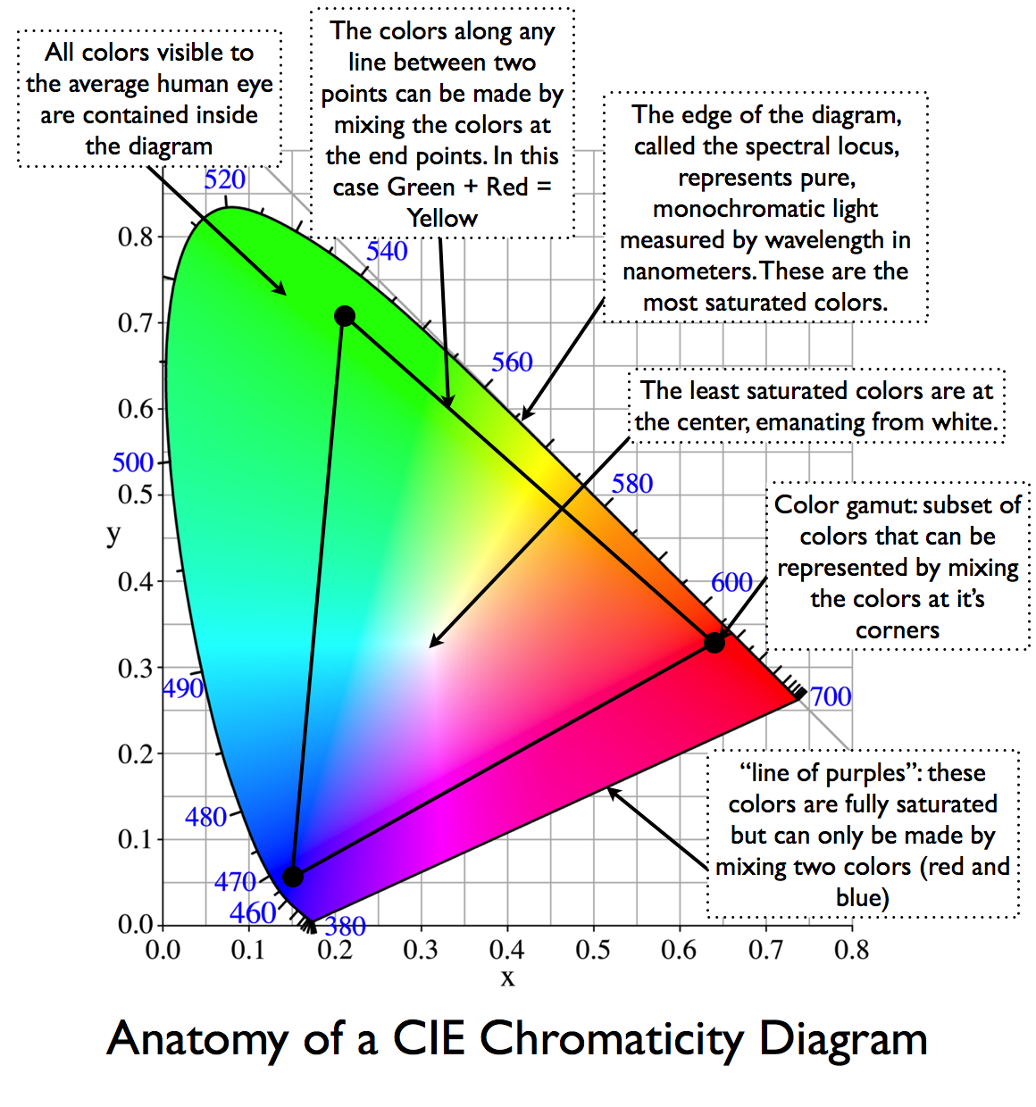
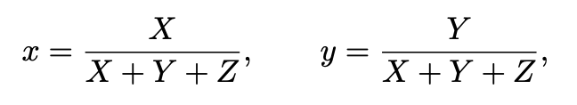

Slide 53
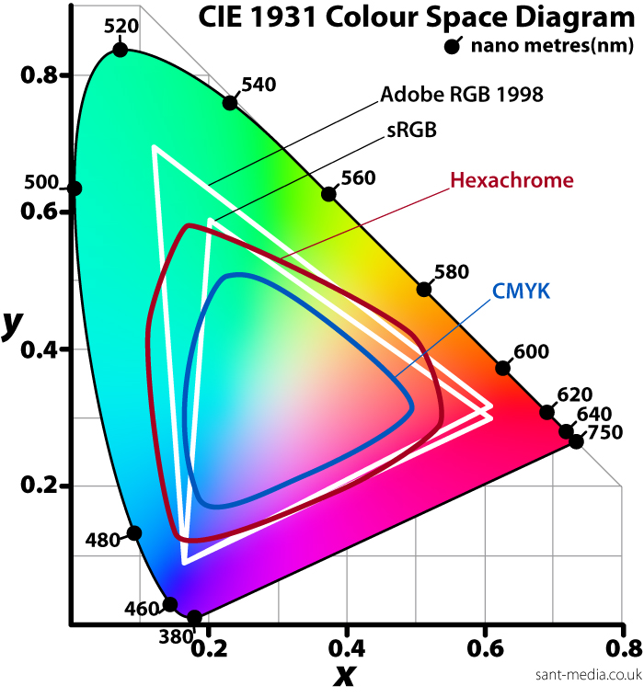
Colour spaces

Slide 54
The study of light
radiometry
photometry
colorimetry
Interested in knowing more? Read this

Slide 56
Disruption

