Slide 1
What to expect when you’re expecting… the End of your PhD
Keiran Suchak, Petar Hristov

Slide 2
Introductions

Slide 3
Keiran Suchak
2010 – 2013 : BSc Physics, Imperial College London
2013 – 2014 : MSc Aerospace Dynamics, Cranfield University
2014 – 2015 : Aviation Observations Scientist, Met Office
2015 – 2016 : MSc Mathematics, University of Leeds
2016 – 2017 : Analyst/Developer, Ampere Analysis
2017 – 2022 : CDT Data Analytics and Society, University of Leeds
2020 : Data Science Fellow, Connect Places Catapult + Buckinghamshire County Council
2022 – Present : Research Fellow, University of Leeds

Slide 4
Petar Hristov
Date – Date : Qualification, Institution

Slide 5
Experiences

Slide 6
Coming to the end of the PhD
Writing up the PhD
Applying for jobs
Moving on

Slide 7
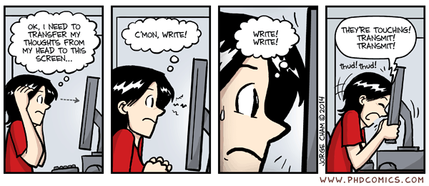
Writing up
PhD Writing Process
Notes:
The lows…

Slide 8
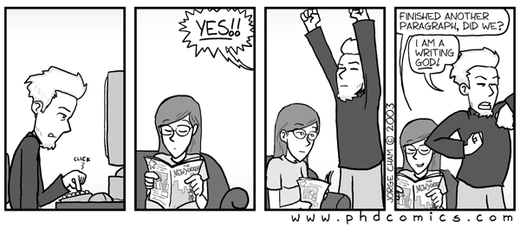
Writing up
PhD Writing Process
Notes:
… And the highs

Slide 9
Applying for jobs

Slide 10
Applying for jobs
I was lucky, I guess
I just kinda’ fell into it…
I happened to be in the right place the right time

Slide 11
Moving on
Finishing the PhD
Starting a new job
What is it like working as a Postdoc?

Slide 12
Tips

Slide 13
Writing up
Start writing early
It doesn’t have to be perfect
It’s easier to edit documents than writing from scratch

Slide 14
Applying for jobs
What sort of job do I want to do?
Where do I find them?
How do I write a good application?

Slide 15
Applying for jobs – “Proactive Serendipity”
Think about what you want from your job
Be ambitious
Talk to supervisors
Talk to your peers
Review each other’s CVs
Why do you want to do your job?
Think about transferable skills
Contact the PI
Notes:
Do you want to work with other people?
Do you want to work independently?
Do you want to work on topics related to your PhD?
Do you want to continue to work with your supervisor?
Let them know that you are interested in pursuing a postdoc

Slide 16
Extra materials

Slide 17
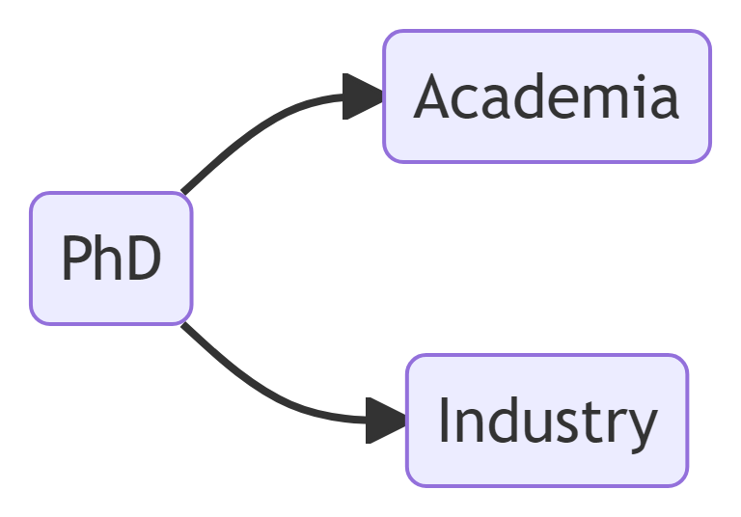
Options

