Slide 1
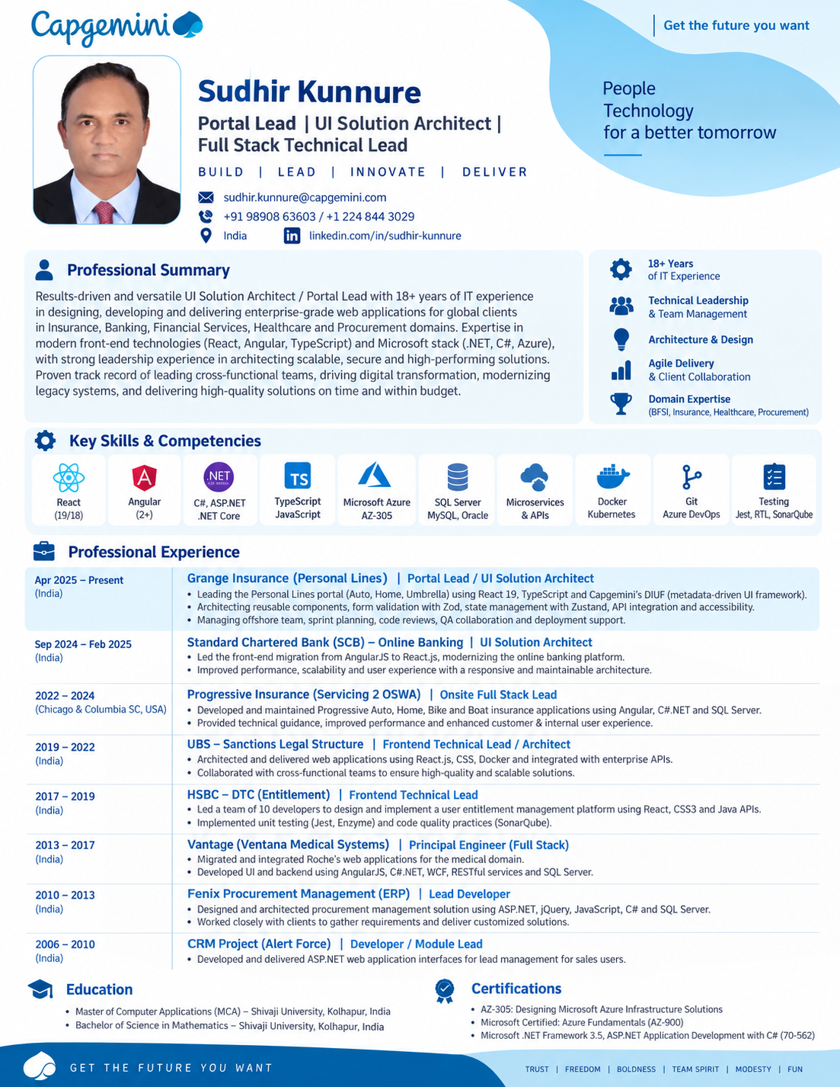
Notes:
One-page profile reproduced from the supplied reference image. The visible slide is image-based to preserve the original design exactly.

