Slide 1

AI-Driven Event Monitoring System Using Computer Vision and Vision-Language Models
Under the Guidance of xxxxxx.
Team members:
Gampa Anupama (23BD1A1216)
Kodipyaka Sujana Gupta (23BD1A1231)
Mudiga Shivani (23BD1A1239)

Slide 2
Abstract
Large-scale events require continuous situational awareness, rapid incident triage, and coordinated response across multiple stakeholder roles. This project presents an integrated AI-based event monitoring and response platform that unifies live surveillance analytics, incident reporting, volunteer coordination, and attendee assistance within a single full-stack system. The backend combines Express, MongoDB, and Socket.IO for realtime issue tracking, alert propagation, and role-based workflow management, while the frontend uses React and Vite to provide dedicated dashboards for admins, volunteers, and attendees. On the AI layer, the system uses a YOLOv8 model for real-time fire detection, CLIP-based semantic classification for violence detection, MTCNN and FaceNet face embeddings for missing-person search, and ORB feature matching for lost-object search. A Gemini-based chatbot further summarizes event logs to generate operational insights. The architecture is designed to convert AI detections into actionable alerts, assign them to authorized responders, and track resolution status end-to-end. By bridging computer vision, vision-language modeling, identity verification, and human coordination, the platform provides a practical framework for safer, faster, and more organized event management.
Keywords: Event monitoring, YOLOv8, computer vision, real-time surveillance, incident management, face recognition, CLIP, geolocation tracking

Slide 3
LITERATURE SURVEY
Paper | Methodology | Key Contribution | Limitation
An Enhanced Framework for Real-Time Dense Crowd Abnormal Behavior Detection using YOLOv8 (2025) | YOLOv8 + Soft-NMS | Detects abnormal crowd behavior in dense public gatherings with improved accuracy (91.6%). | Focuses only on crowd anomaly detection and lacks integrated event management.
YOLOv5 + Deep SORT for Crowd Surveillance (2023) | YOLOv5 + Deep SORT + SVM | Performs crowd tracking and anomaly detection in surveillance videos. | High computational cost and reduced real-time performance in dense crowds.
GAN-Based Crowd Anomaly Detection (2022) | GAN + U-Net + Transfer Learning | Detects abnormal crowd behavior using deep learning techniques. | Sensitive to occlusions, illumination changes, and produces lower accuracy in complex scenes.
Lightweight CNN for Violence Detection (2021) | Lightweight CNN | Detects violent activities in surveillance videos with good accuracy. | Detects only violence and lacks crowd analysis, missing-person tracking, and emergency coordination.
Key Observations
Most existing research focuses on a single task such as violence detection or crowd anomaly detection.
Existing systems do not provide end-to-end event management.
Limited support for missing person identification, lost item recovery, and volunteer coordination.
Few systems integrate Computer Vision, Geo-Intelligence, and Role-Based Access into one platform.
These limitations motivated the development of Vigilance, which provides a unified AI-driven event monitoring solution.

Slide 4
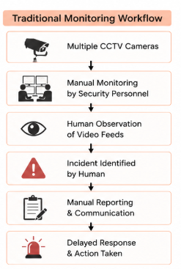
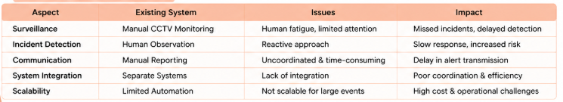
Existing System
Current Event Monitoring Approaches
Manual CCTV surveillance by security personnel.
Conventional surveillance systems record video without intelligent analysis.
Incident reporting depends on human observation and communication.
Separate systems are used for surveillance, emergency response, and volunteer coordination.
Limited automation in detecting emergencies or abnormal activities.
Reactive response after incidents have already occurred.

Slide 5
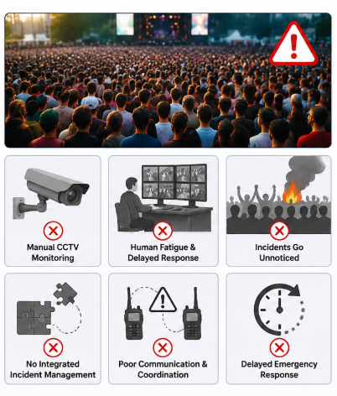
Disadvantages of Existing System
Continuous human monitoring leads to fatigue and missed incidents.
Delayed detection of fire, violence, and crowd congestion.
No automated real-time alert generation.
Poor coordination between organizers, volunteers, and emergency responders.
Difficult to locate missing persons and lost belongings.
No predictive analytics for preventing potential risks.
High operational cost due to dependence on manual surveillance.

Slide 6
Proposed System
Vigilance is an AI-powered event monitoring platform that analyses live camera feeds, turns incidents into real-time alerts, and coordinates admins, volunteers and attendees from one web application.
VISION
Live camera feed analysis
LOCATOR
AI-powered matching & recovery
NAVIGATOR
Role-based access & geo-intelligence
Live IP-camera stream processed with OpenCV
Fire detection – custom YOLOv8 model
Violence detection – CLIP ViT-B/32 zero-shot classification
On-screen alarm and detection event log
Crowd surge detection (YOLOv8 person count) (planned)
Weapon (gun) detection (planned)
Lost & Found reports for items and missing children
Missing-person search – MTCNN + FaceNet embeddings over CCTV videos
Lost-object search – ORB features + RANSAC + colour histograms
Matched frames returned as visual evidence
Dashboards for Admin, Volunteer and Attendee (JWT roles)
Face-verified volunteer login with live GPS tracking
Assign, accept, backup and resolve incidents in real time
Evacuation plan with nearest exits and assembly points
Platform core: Node.js + Express API · MongoDB Atlas · Socket.IO real-time alerts · Gemini chatbot for event summaries. Planned: AI detections verified by an admin (Human-in-the-Loop) before dispatch.

Slide 7
Advantages of Proposed System
Continuous AI detection of fire and violence reduces dependence on manual CCTV watching.
Instant, role-based alerts over WebSockets replace manual relaying of incidents.
Missing persons and lost items are searched automatically across recorded CCTV footage.
Live volunteer locations help admins choose nearby responders; volunteers can call for backup.
Secure access: bcrypt-hashed passwords, JWT role checks and face-verified volunteer login.
Attendees report issues with GPS and see the nearest exits during evacuation.
An AI chatbot summarizes detection logs for quick situational awareness.
One integrated platform instead of separate surveillance, reporting and coordination tools.
Modular AI services: new detectors (crowd surge, weapons) plug in without changing dashboards.
Existing vs Proposed
Aspect | Existing | Proposed
Surveillance | Manual CCTV monitoring | AI fire & violence detection
Incident detection | Human observation | Automatic alerts + attendee reports
Communication | Manual reporting | Real-time Socket.IO alerts
Coordination | Separate systems | Map-based volunteer assignment
Lost & Found | Manual search | Face & object search in CCTV
Access control | No role separation | JWT roles + face login

Slide 8
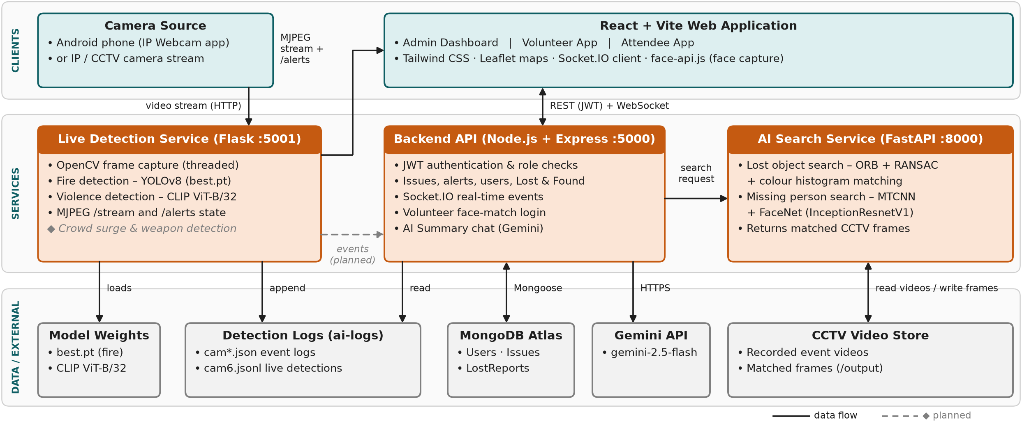
Architecture Diagram
Three layers: the React client talks to the Express API over REST + WebSocket; the API delegates CCTV searches to the FastAPI service, while the Flask service analyses the live camera stream.

Slide 9
Software Requirements Specification
Purpose: define what the AI-Driven Event Monitoring System must do for its three user roles – Admin, Volunteer and Attendee. Requirements marked "planned" are scheduled for the next phase.
Functional Requirements
FR1 User & Access Management
Attendees and volunteers sign up; volunteers register a face photo. Admin approves or deletes users; login issues a role-based JWT and volunteers must also pass a face match.
FR2 Live Surveillance
Read the IP camera stream, detect fire (YOLOv8) and violence (CLIP), draw detections, stream the video to the dashboard and raise on-screen alerts with sound.
FR3 Incident Reporting & Alerts
Attendees report issues with GPS location; admins create alerts with severity, map location and audience; every change is pushed instantly through Socket.IO.
FR4 Volunteer Coordination
Admin assigns volunteers; volunteers accept, request or take over backup and resolve issues; volunteer status and live location are tracked.
FR5 Lost & Found
Record lost items and missing children; search CCTV videos for a lost object (ORB) or a person's face (FaceNet) and keep the matched frame with the report.
FR6 Navigation & Evacuation
Attendees see the nearest exits and assembly points from their location; volunteers see assigned alerts on a map and open walking directions.
FR7 Analytics & AI Summary
Dashboard shows 24-hour activity and top volunteers; the Gemini chatbot answers questions about fire, violence and search events from detection logs.
FR8 Planned (next phase)
Crowd surge detection (YOLOv8 person count), weapon (gun) detection, and AI detections raised as alerts that an admin verifies before dispatch.

Slide 10
Software Requirements Specification
Non-Functional Requirements
Performance
Security
Reliability
Live stream capped at 24 FPS for smooth playback
Fire inference every 0.18 s and violence every 0.3 s on background threads
Alerts reach connected users in real time over WebSockets
Passwords hashed with bcrypt; uploads limited to 10 MB
JWT tokens (12 h) with role checks on every API route and socket
Volunteer login needs a face match (distance ≤ 0.5)
Detection events de-duplicated with a 10 s cooldown
Temporary search files cleaned up after every request
Failures return clear error messages to the user
Usability
Scalability & Maintainability
Portability
Separate, focused dashboard for each role
Map-based views (Leaflet) for alerts, volunteers and exits
Audible alarm and pop-up when the camera detects an incident
Independent services (Express, FastAPI, Flask) that scale and update separately
Cloud database (MongoDB Atlas)
New AI detectors plug into the live detection service
Runs in any modern browser on desktop or mobile
Services run on Windows, macOS or Linux
Any HTTP / MJPEG camera can be the video source

Slide 11
Software Requirements Specification
Software Requirements
Hardware Requirements
Category | Requirement
Operating system | Windows 10/11, macOS or Linux (64-bit)
Frontend | React 18, Vite 5, Tailwind CSS 3, Leaflet, Recharts, Socket.IO client, face-api.js 0.22
Backend | Node.js 18+, Express 5, Mongoose 8, Socket.IO 4, jsonwebtoken, bcryptjs, Multer
AI / ML | Python 3.11+, PyTorch, Ultralytics YOLOv8, OpenAI CLIP, facenet-pytorch, OpenCV, scikit-learn
AI services | FastAPI + Uvicorn, Flask + Flask-CORS
Database & APIs | MongoDB Atlas, Google Gemini API (gemini-2.5-flash)
Client tools | Chrome / Edge / Firefox; IP Webcam app (Android)
Component | Minimum | Recommended
Processor | 64-bit quad-core (Intel i5 / Ryzen 5 / Apple M1) | 6+ cores
RAM | 8 GB | 16 GB (YOLOv8, CLIP and FaceNet loaded together)
GPU | Not required (CPU inference) | NVIDIA GPU with CUDA for faster detection and search
Storage | 10 GB free (libraries, model weights, videos) | SSD with 20 GB free for recordings
Camera | Android phone with IP Webcam app on the same Wi-Fi | IP / CCTV camera with HTTP (MJPEG) stream
User devices | Smartphone or PC with browser and GPS | Webcam for volunteer face login
Network | Wi-Fi LAN for the camera stream | Internet for MongoDB Atlas, Gemini and map tiles
Hardware figures are minimums derived from the AI models the system runs.

Slide 12
System Design
Design approach: layered, service-oriented architecture – a React client, a Node.js API that owns data and real-time events, and independent Python AI services.
Module Design
Layer | Module | Technology | Responsibility
Presentation | Admin Dashboard | React, Recharts, Leaflet | Statistics, live cameras, alert map, user approval, Lost & Found, AI chat
Presentation | Volunteer & Attendee Apps | React, Leaflet, face-api.js | Assignments, backup and location sharing; issue reports, alerts, evacuation
Application | Auth & User Module | Express, JWT, bcrypt | Sign-up, login, face match, role checks, approvals
Application | Incident & Alert Module | Express, Socket.IO, Mongoose | Report, create, assign, accept, backup, resolve, broadcast
Application | Lost & Found + AI Summary | Express, Multer, Gemini API | Store reports, forward AI searches, answer questions on logs
AI Services | Live Detection Service | Flask, OpenCV, YOLOv8, CLIP | Camera ingest, fire & violence detection, MJPEG stream, event log
AI Services | AI Search Service | FastAPI, ORB, MTCNN + FaceNet | Find lost objects and missing persons in CCTV videos
Data | Storage | MongoDB Atlas, file system | Users, Issues, LostReports; uploads, videos, matched frames, logs

Slide 13
System Design
Database Design
Interface Design – REST API & events
Collection | Key fields
User | name, email, password (bcrypt hash), role, isApproved, status, lastKnownLocation, faceDescriptor [128]
Issue | reportedBy → User, description, location, status, severity, assignedTo → User[ ], needBackup, audience, timestamps
LostReport | type (item / child), name, age, item, description, location, imagePath, status, match {video, frame, output_url}
Endpoint | Role | Purpose
POST /api/signup · POST /api/login | Public | Register; login returns JWT
GET /api/admin/issues · PUT …/:id/assign | Admin | View issues; assign volunteers
POST /api/admin/alerts | Admin | Create alert with severity & location
POST /api/issues/report | Attendee | Report issue with GPS
PUT /api/volunteer/issues/:id/accept · ask-for-backup · take-backup · resolve | Volunteer | Handle assignments
PUT /api/volunteer/location | Volunteer | Share live location
GET · POST /api/lost-reports · PATCH …/:id/found | Admin, Volunteer | Lost & Found records
POST /api/search-object-multiple · /api/search-face-multiple | Admin, Volunteer | AI search in CCTV videos
POST /api/summary/chat | Admin | Gemini summary of logs
GET /stream · GET /alerts (Flask :5001) | Admin | Live video & detection state
Socket.IO: newIssueAlert · issueUpdated | All roles | Real-time updates
Issue.reportedBy and Issue.assignedTo reference User.

Slide 14
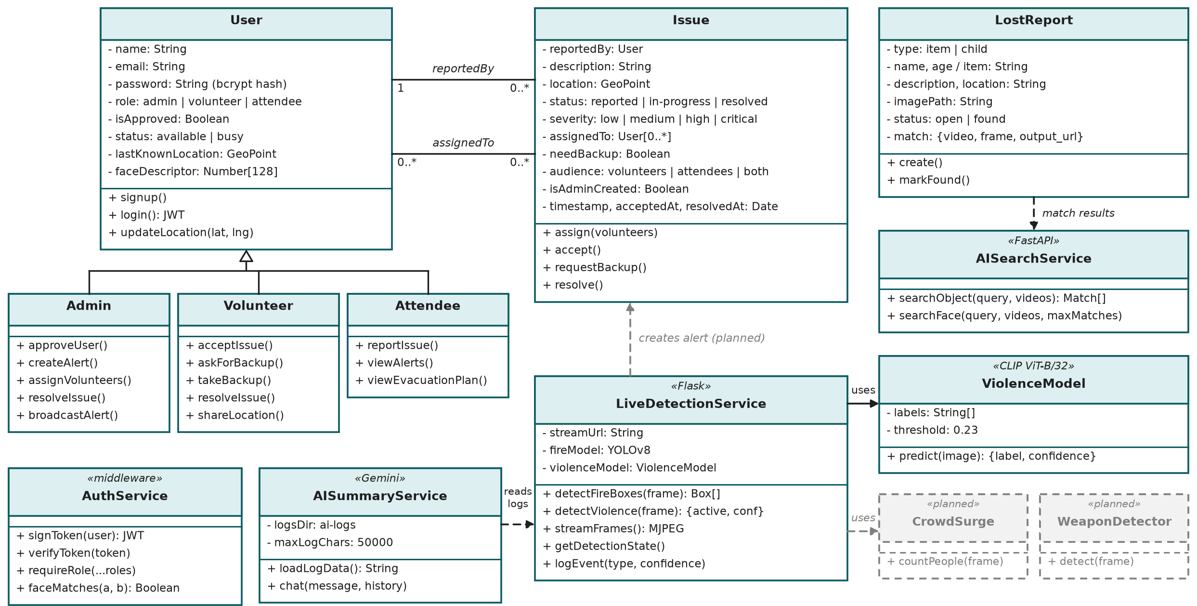
Class Diagram

Slide 15
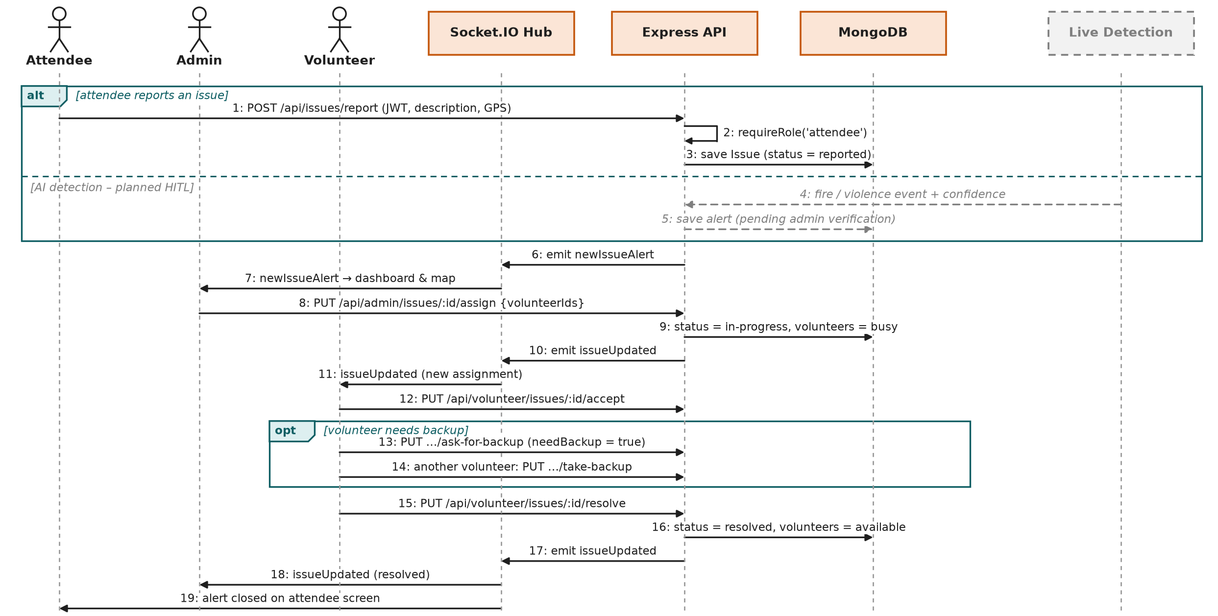
Sequence Diagram
Scenario: incident reported (or detected) → admin assigns volunteer → volunteer resolves → everyone updated live. Grey = planned.

Slide 16
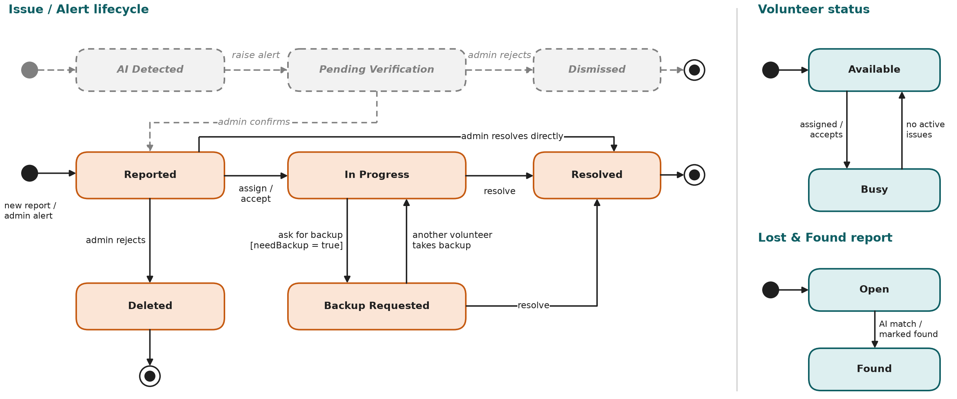
State Chart Diagram

Slide 17
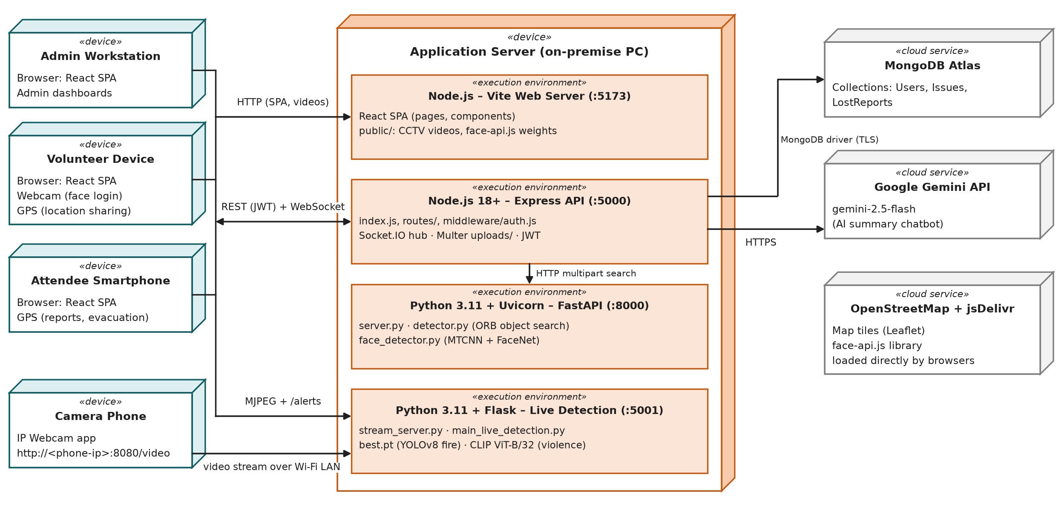
Deployment Diagram

Slide 18
Thank You

