Slide 1
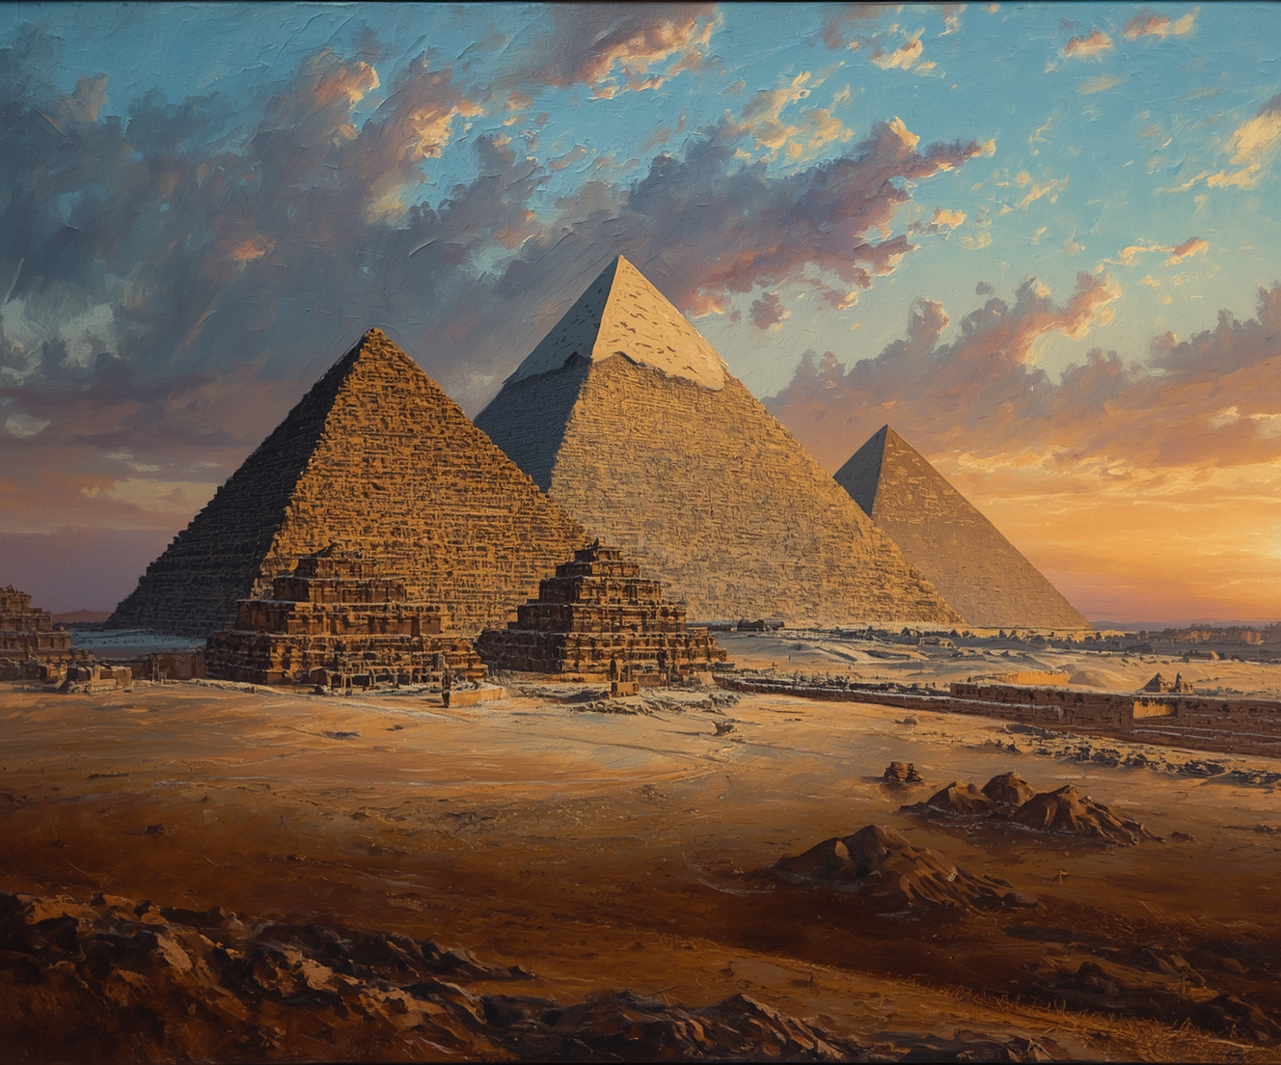
The Great Pyramids
HISTORY AND ARCHITECTURE EXPERT
KONDURI SUMANASRI

Slide 2
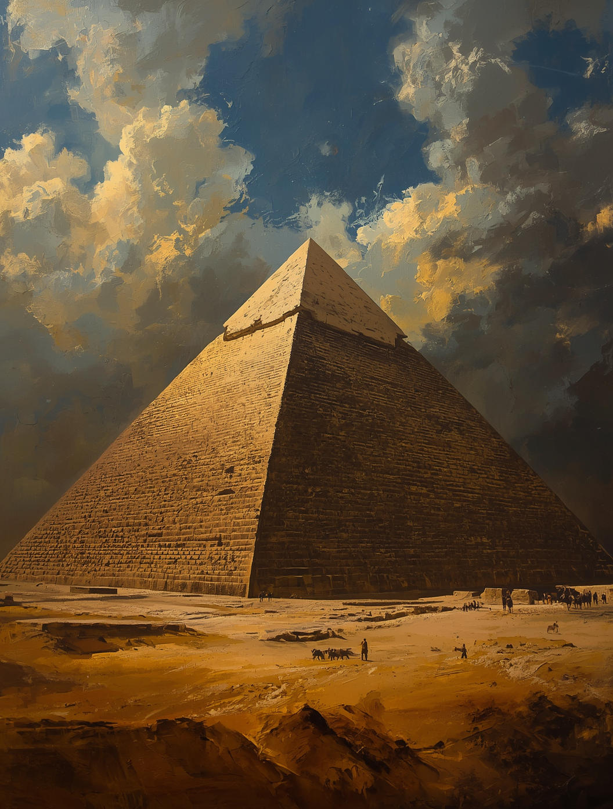
146.6 meters
The Great Pyramid of Khufu, at 146.6 meters tall, was the tallest man-made structure for over 3,800 years, showcasing ancient Egyptians' architectural innovation and precision.

Slide 3
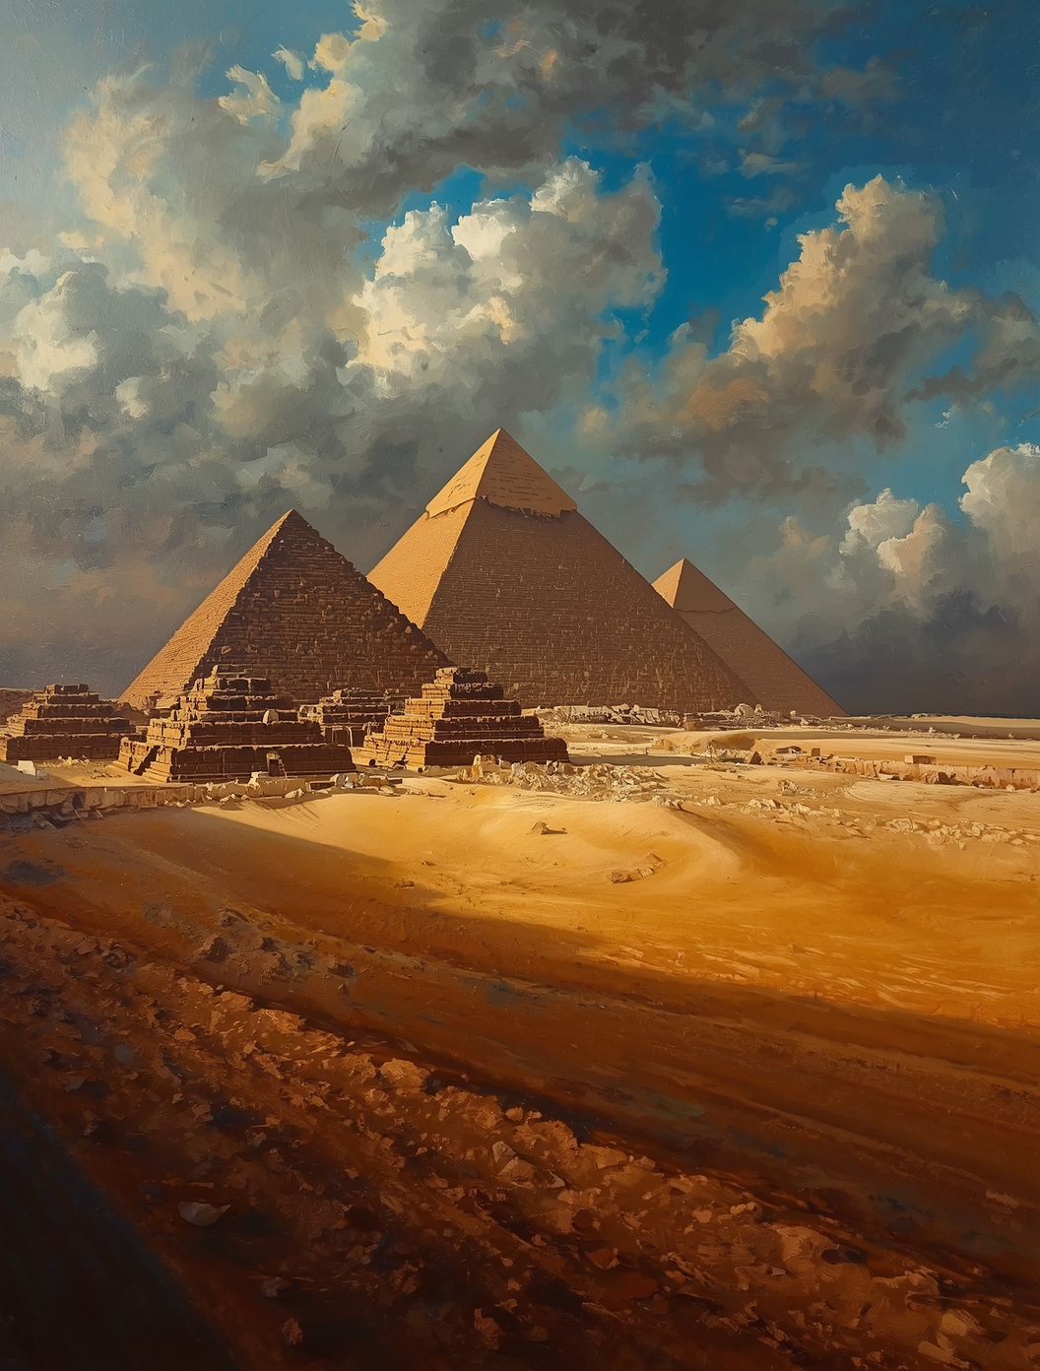
Purpose & Significance
Exploring the Role of Pyramids in Ancient Egyptian Society and Beliefs
The pyramids served as monumental tombs for the divine Pharaohs, designed to ensure their safe passage to the afterlife. They symbolized the primordial mound of creation and reflected a society deeply invested in the afterlife, housing treasures essential for the Pharaoh's journey beyond this world.

Slide 4
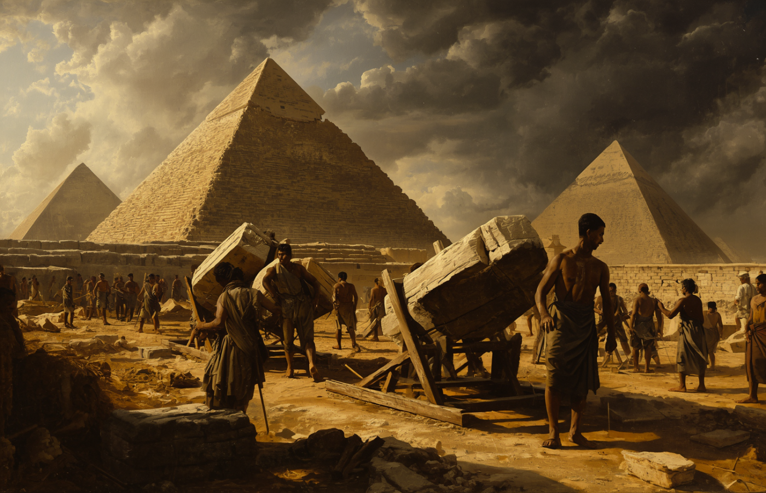
Theories Behind Pyramid Construction
Ingenious Methods
Workers employed innovative techniques to overcome construction challenges.

Slide 5
WEBSITE
reallygreatsite.com
Contact
Thank you for your attention today!
EMAIL
hello@reallygreatsite.com
PHONE
123-456-7890

