Slide 1
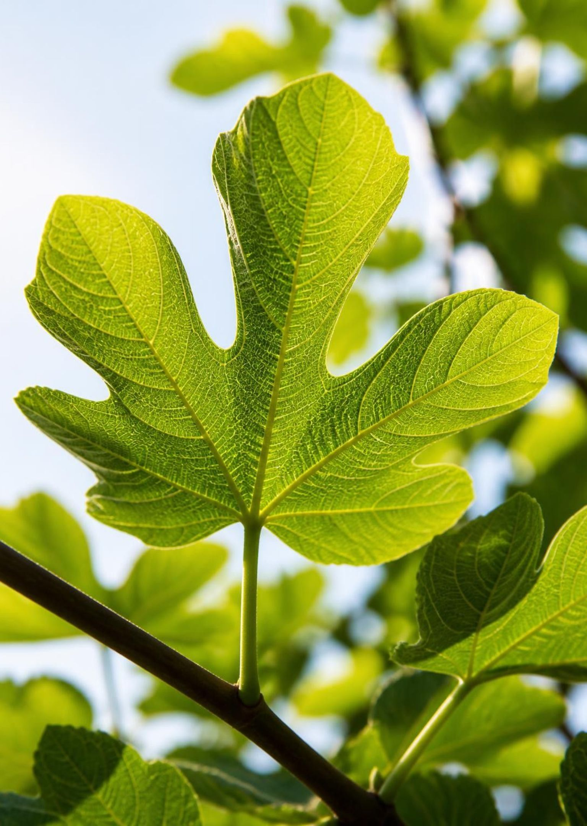


BIOLOGY · ENERGY AND LIFE
Photosynthesis: How Plants Turn Light into Life
Follow sunlight from a leaf to the food that fuels an ecosystem.
Notes:
Ask students where a plant's food comes from. Water and minerals support growth, but plants build their own sugars using carbon dioxide and energy from sunlight. Today we will follow that energy through two connected stages.

Slide 2
Plants make their own food from light, water, and air
Carbon dioxide + water + light → glucose + oxygen
Food starts here
Oxygen leaves the plant
Producers feed nearly every food chain by storing light energy in sugars.
Photosynthesis releases the oxygen we breathe.
Notes:
Read the equation from left to right. Carbon dioxide comes from the air, and water usually enters through roots. Glucose represents the sugars plants make. This is the familiar overall equation, not a single reaction. Light supplies energy; it is not a material ingredient. The released oxygen comes from water.

Slide 3
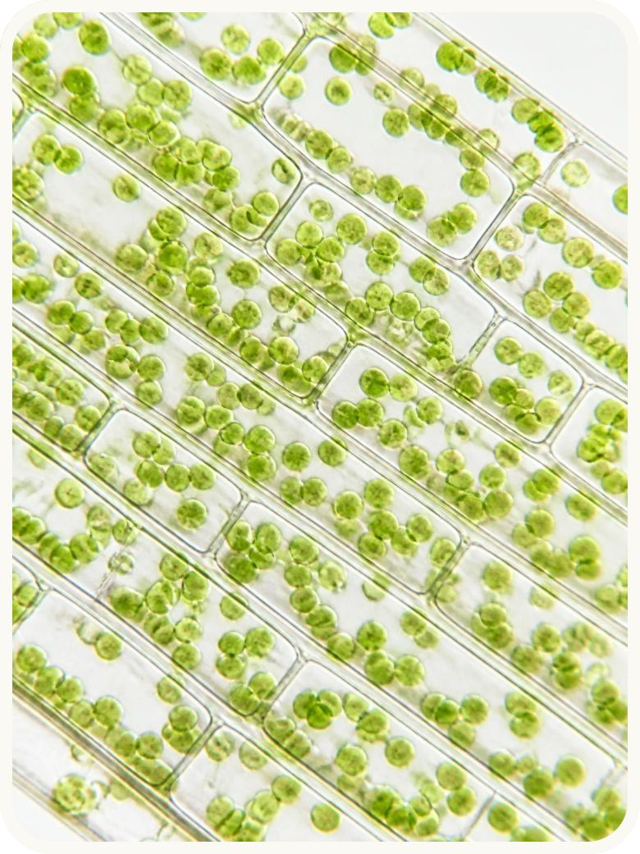
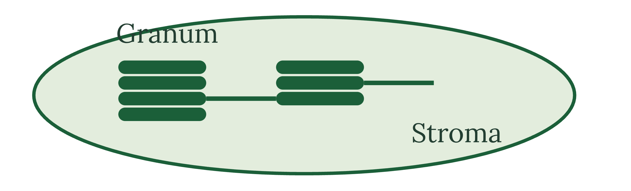
Chloroplasts are the solar panels of the cell
Thylakoids stacked in grana hold chlorophyll. The surrounding stroma is the fluid where sugar is built.
Green chloroplasts inside leaf cells.
Chlorophyll absorbs red and blue light, reflects green. That reflected light makes leaves look green.
Notes:
The photograph shows whole chloroplasts, not their internal membranes. The simplified drawing enlarges one chloroplast. One stack is a granum; multiple stacks are grana. Chlorophyll sits in thylakoid membranes. Point to the fluid around the stacks: the stroma, where the Calvin cycle takes place.

Slide 4
Two stages work as a relay
1
2
Light reactions
Calvin cycle
Thylakoid membranes capture sunlight and turn it into chemical energy.
The stroma uses that energy to build sugar from carbon dioxide.
Water enters; oxygen leaves.
CO₂ enters; a sugar building block leaves.
ATP and NADPH carry energy between them
ATP supplies energy. NADPH delivers high-energy electrons.
Notes:
The two stages are linked by molecules, not by a literal handoff of sunlight. ATP and NADPH travel from the light reactions to the Calvin cycle. After use, ADP, phosphate, and NADP⁺ can return to be recharged. The Calvin cycle does not directly capture light, but depends on the light reactions.

Slide 5
Light reactions turn sunlight into chemical energy
IN THE THYLAKOID MEMBRANE
01
02
03
04
Split water
Build a gradient
Make ATP
Make NADPH
Photosystem II absorbs light and splits water, releasing O₂ and supplying electrons.
Electrons move down the transport chain, pumping H⁺ into the thylakoid.
H⁺ flows through ATP synthase. This flow powers ATP production.
Photosystem I absorbs more light and helps produce NADPH.
Electron route: water → photosystem II → transport chain → photosystem I → NADPH
Notes:
Photosystem II comes before photosystem I in this pathway; their names reflect discovery order. Light energizes electrons at both photosystems. Water replaces the electrons lost by photosystem II. Electron transport helps create a proton gradient across the membrane. ATP synthase uses the return flow of protons to make ATP. ATP production is a linked branch, not a stop on the electron route. NADPH carries the energized electrons onward.

Slide 6



The Calvin cycle builds sugar from CO₂
IN THE STROMA · ATP AND NADPH SUPPLY THE ENERGY
Reduction
2
ATP and NADPH make G3P.
Carbon fixation
1
Rubisco attaches CO₂ to RuBP.
Regeneration
Most G3P rebuilds RuBP so the cycle continues.
3
Some G3P leaves to build glucose and other carbohydrates.
Notes:
Fixation means incorporating carbon from carbon dioxide into an organic molecule. Rubisco is the enzyme that starts this process. Reduction uses ATP and electrons supplied by NADPH. G3P is the direct sugar product, rather than a whole glucose molecule. Most of the cycle's carbon stays inside to regenerate RuBP, while some leaves to support carbohydrate production. The cycle requires energy even though it does not capture light directly.

Slide 7
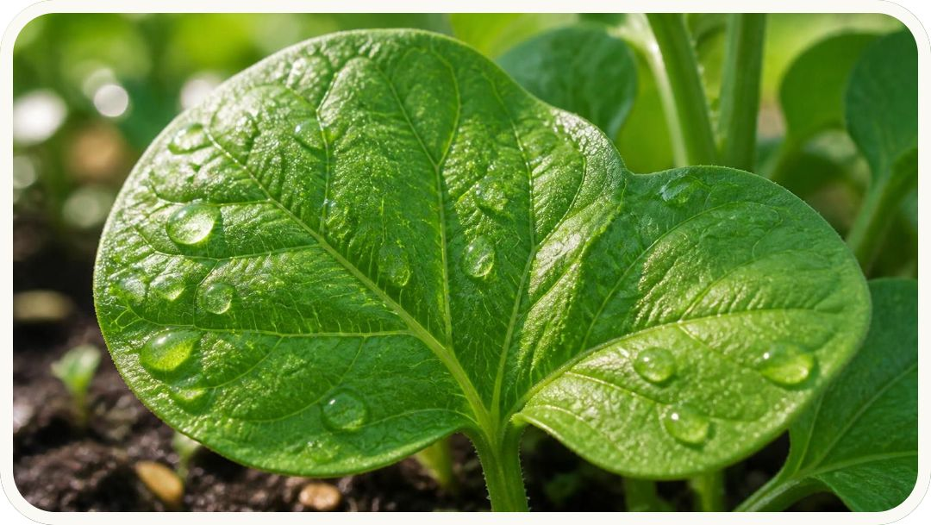
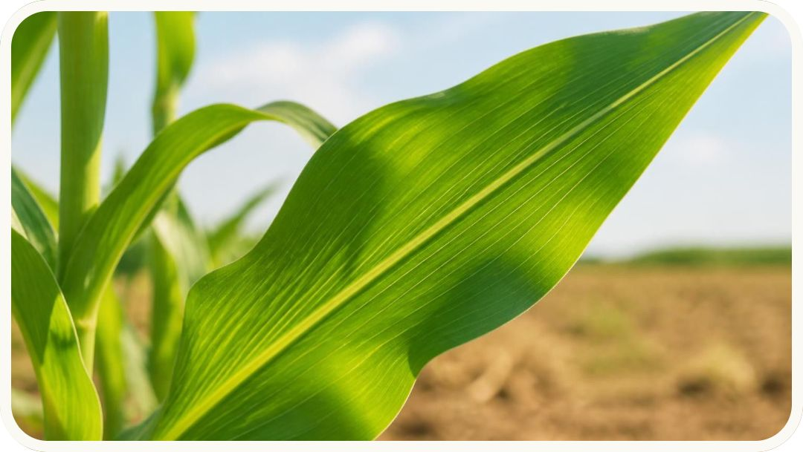
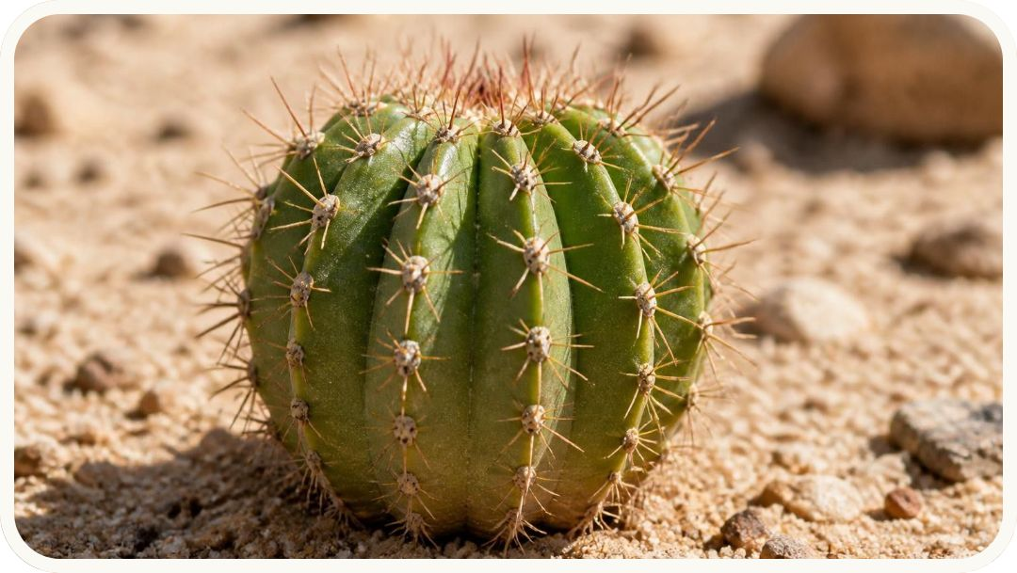
Light, CO₂, and temperature set the pace
More light speeds photosynthesis until it plateaus. Low CO₂ or extreme heat can slow the process, including enzymes like rubisco.
C3 · Bean
C4 · Corn
CAM · Cactus
The usual pathway works well in milder conditions.
Concentrates CO₂ around rubisco in hot, sunny conditions.
Takes in CO₂ at night to save water in dry climates.
Notes:
Adding light helps only while light is limiting. The rate eventually levels off because something else limits it. Extreme heat can affect enzymes, while dry conditions cause stomata to close, reducing carbon dioxide entry. C4 plants separate carbon capture and the Calvin cycle across cells. CAM plants separate them across time, opening stomata at night. Both adaptations help in hot or dry conditions.

Slide 8
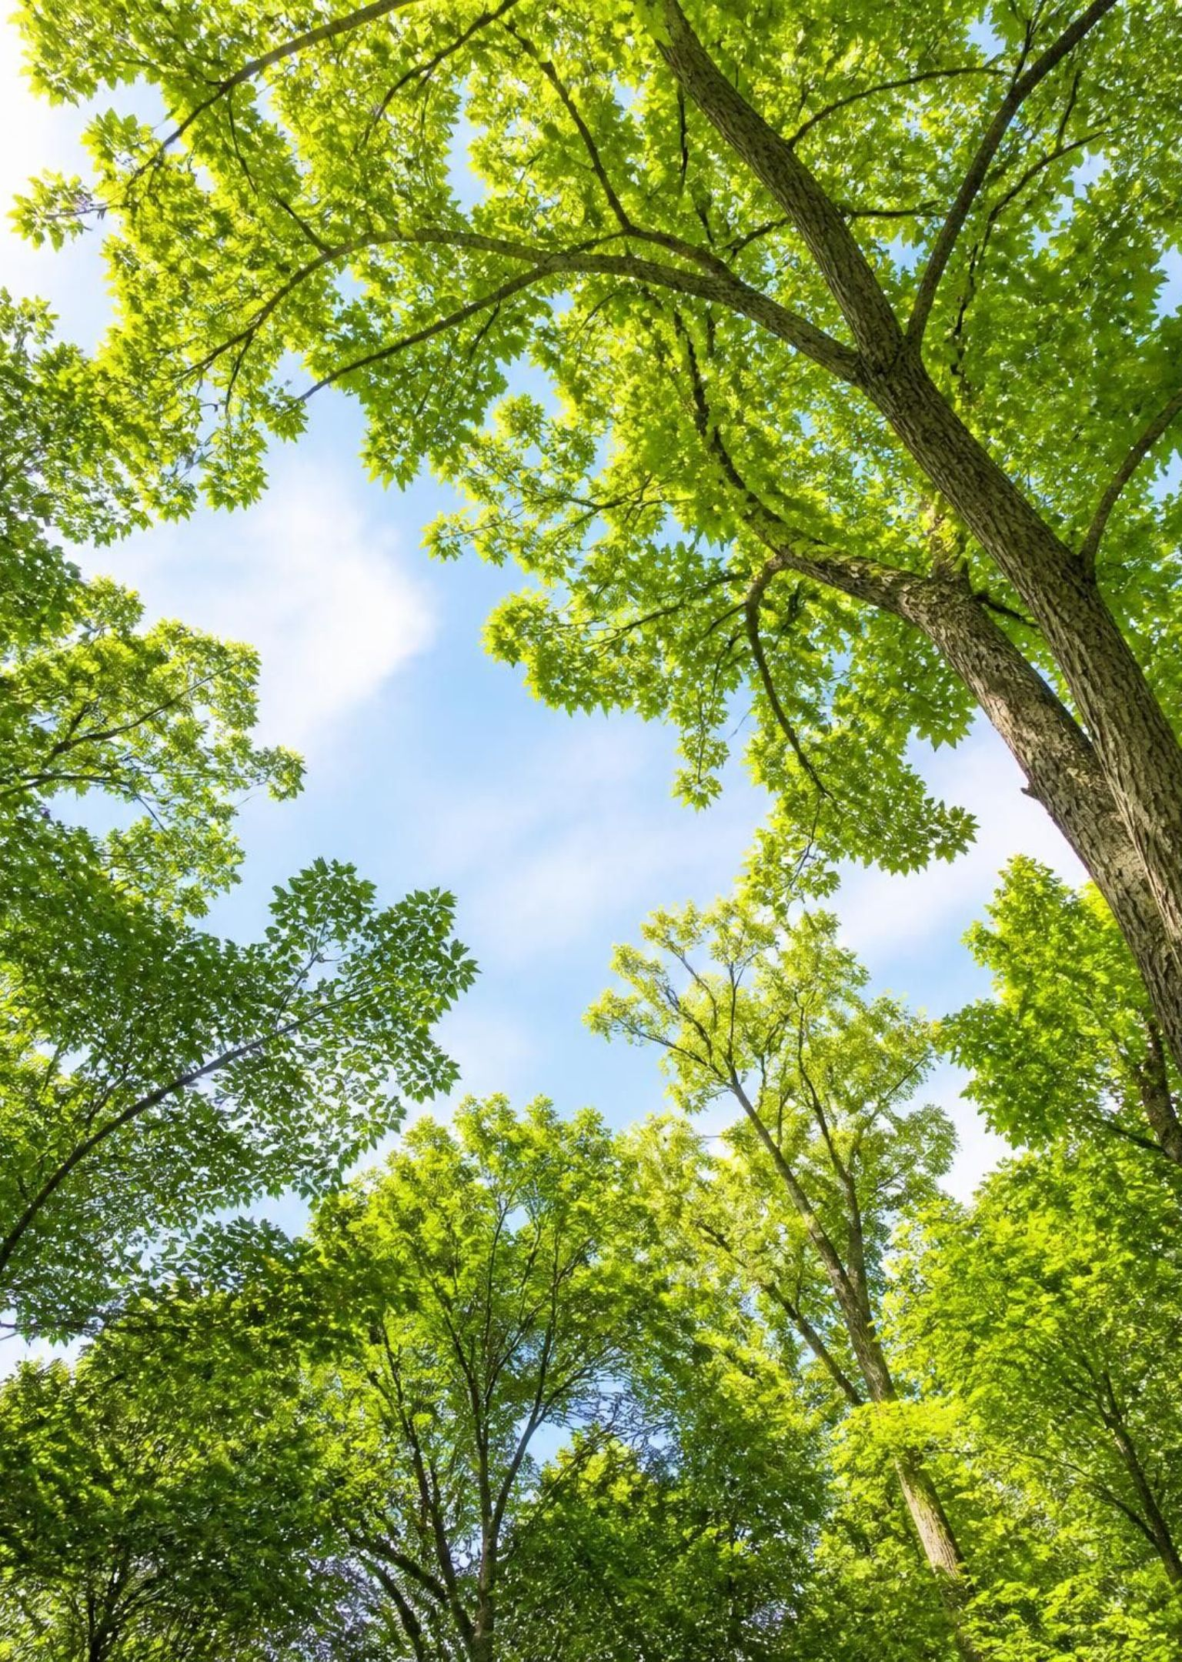
Photosynthesis powers life and shapes our climate
Photosynthesis supplies the food and oxygen that sustain ecosystems.
It removes CO₂ from the atmosphere and stores carbon in living material.
Fossil fuels hold energy captured by photosynthetic organisms long ago.
Notes:
Connect the chemistry to the forest. Sugar supports growth and food webs, while photosynthesis adds oxygen to the air. Carbon captured during photosynthesis can remain in wood and soil, but respiration, decay, and burning return carbon dioxide to the atmosphere. Fossil fuels formed from ancient organisms over long periods; burning them releases stored chemical energy and carbon. Ask students to trace the energy in one food they ate back to sunlight.

