Slide 1
Life Cycle of Field-to-Office Workflow
March 1st, 2019
Kim Sundeen, GIS Developer

Slide 2
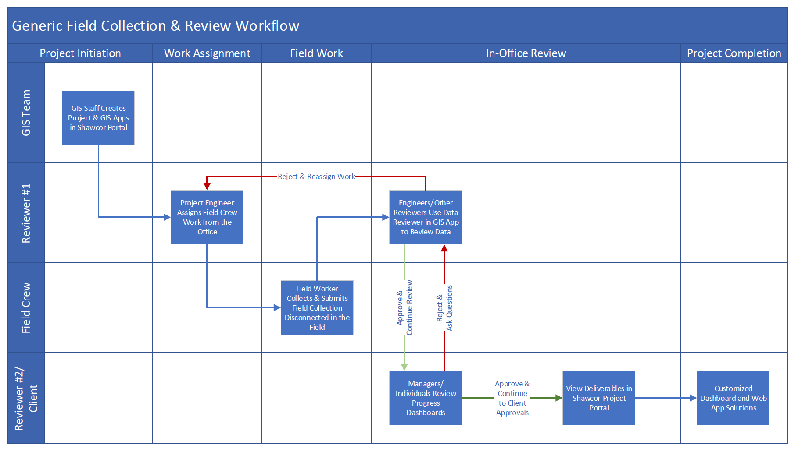
Generic Multi-Workflow & Assignment Workflow

Slide 3
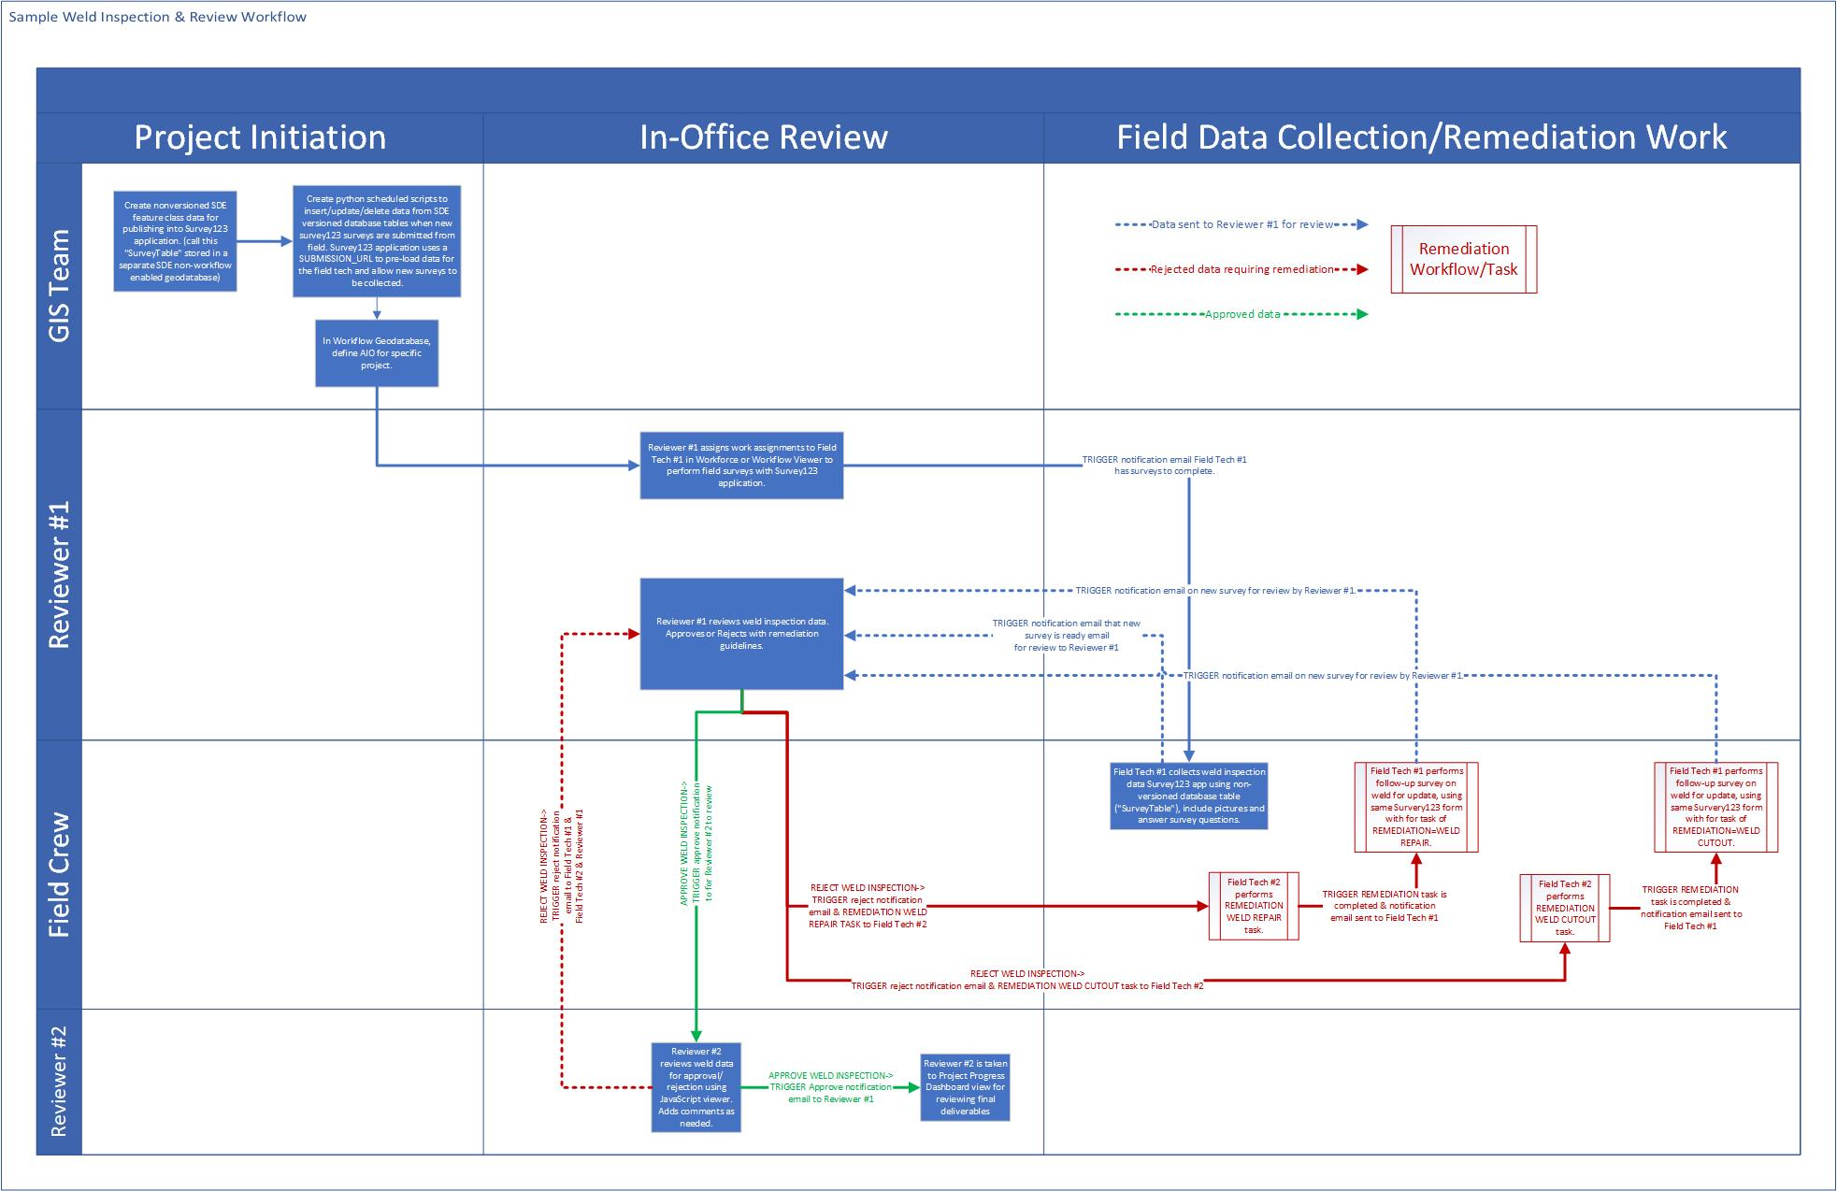
Multi-Workflow & Assignment Workflow

Slide 4
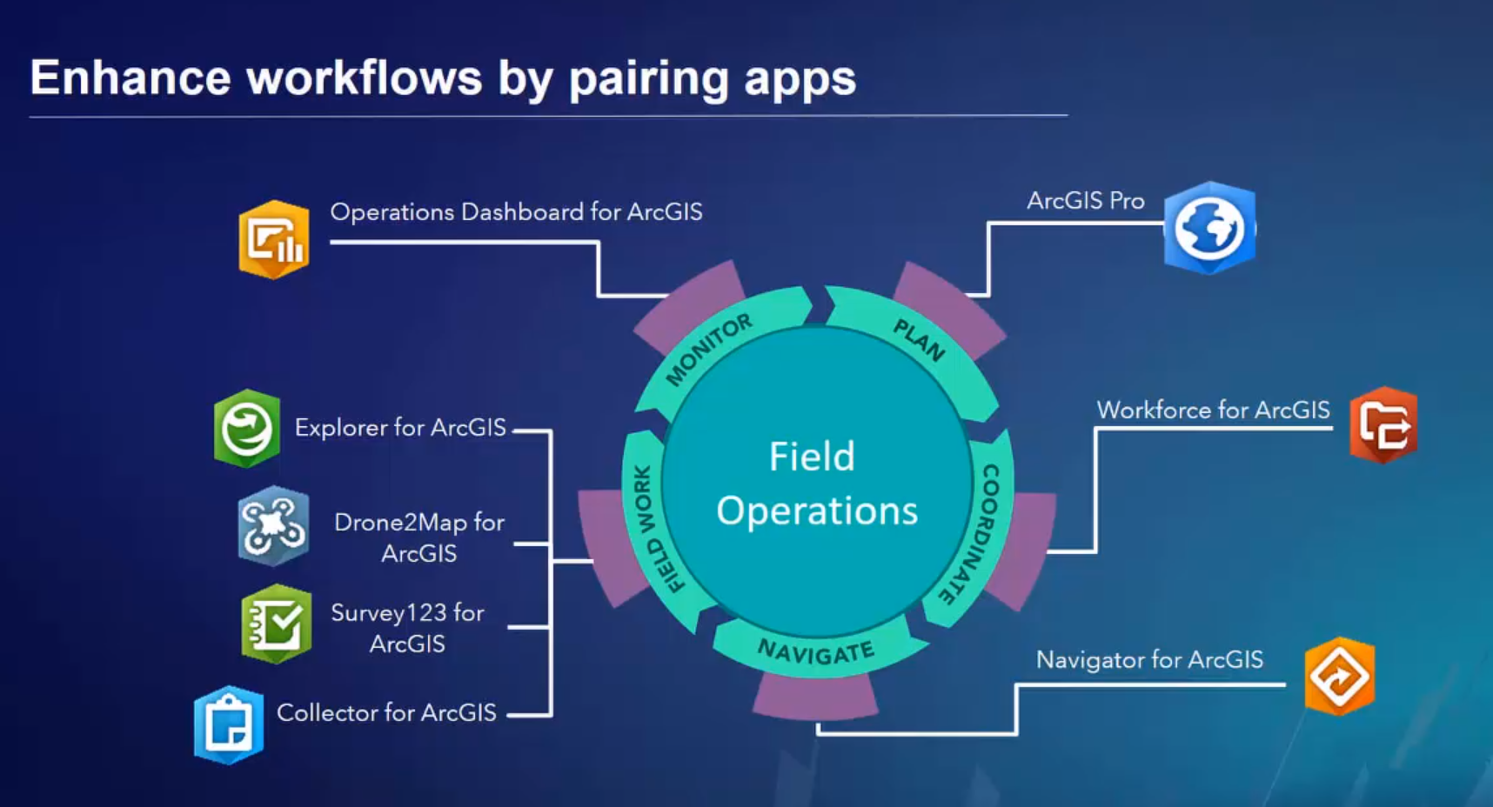
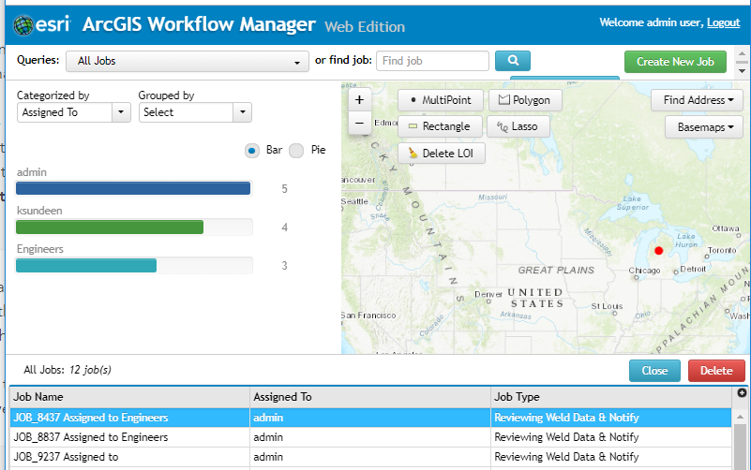
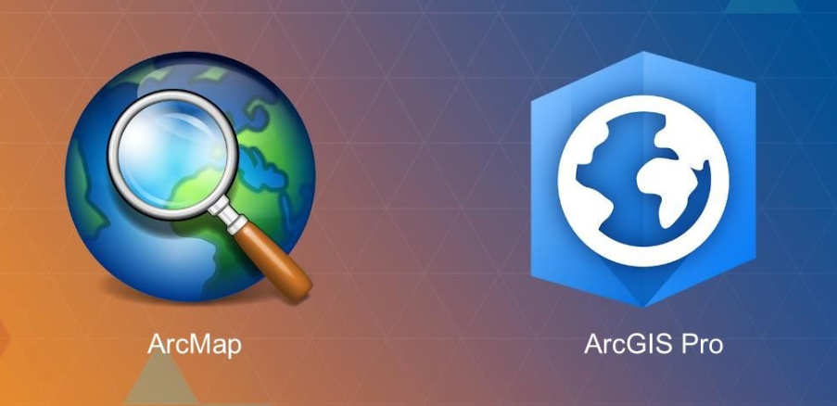
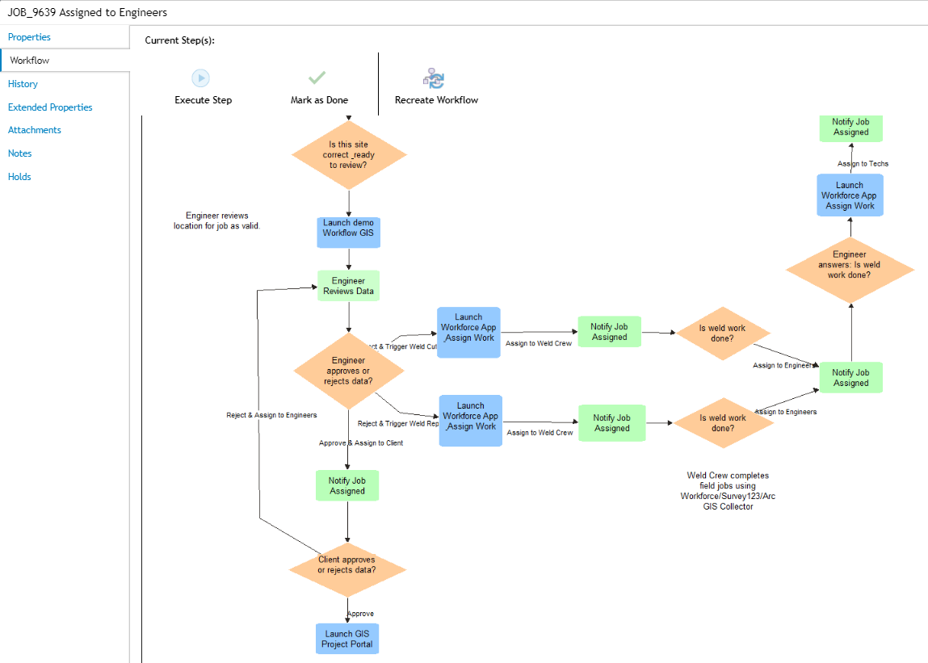
Examples of Mobile Solutions
https://www.esri.com/training/catalog/5bcf6801ca797749a46c1d93/arcgis-apps-for-the-field%3A-an-introduction/
Notes:
Navigator in ArcGIS Enterprise: https://lscgis.lsconsulting.com/aswa/home/group.html?id=795d0cce3e4d4168b7e9726d52090675

Slide 5
Field Collection Apps (Details)
Survey123 Form App: what we’re already using, starting from the FORM
Other options we’re not yet using
Workforce: provides the “glue” for connecting the office staff to field crew through assigning work types to individuals/groups.
Navigator App: turn-by-turn offline map navigation, with custom road networks.
Explorer App: disconnected For VIEW-ONLY, this app enables users to view our data, but only use for navigation or information-seeking.
ArcGIS Collector App: another disconnected mobile option, starting from the MAP
Offline Collection: https://doc.arcgis.com/en/collector-classic/ios/create-maps/offline-map-prep.htm
App Studio: a tool to help build custom mobile apps
Custom App Development with Runtime SDKs: disconnected we can gather solid requirements for more custom mobile app solutions that mix tools from all other apps. There’s a plethora of examples all over.

Slide 6
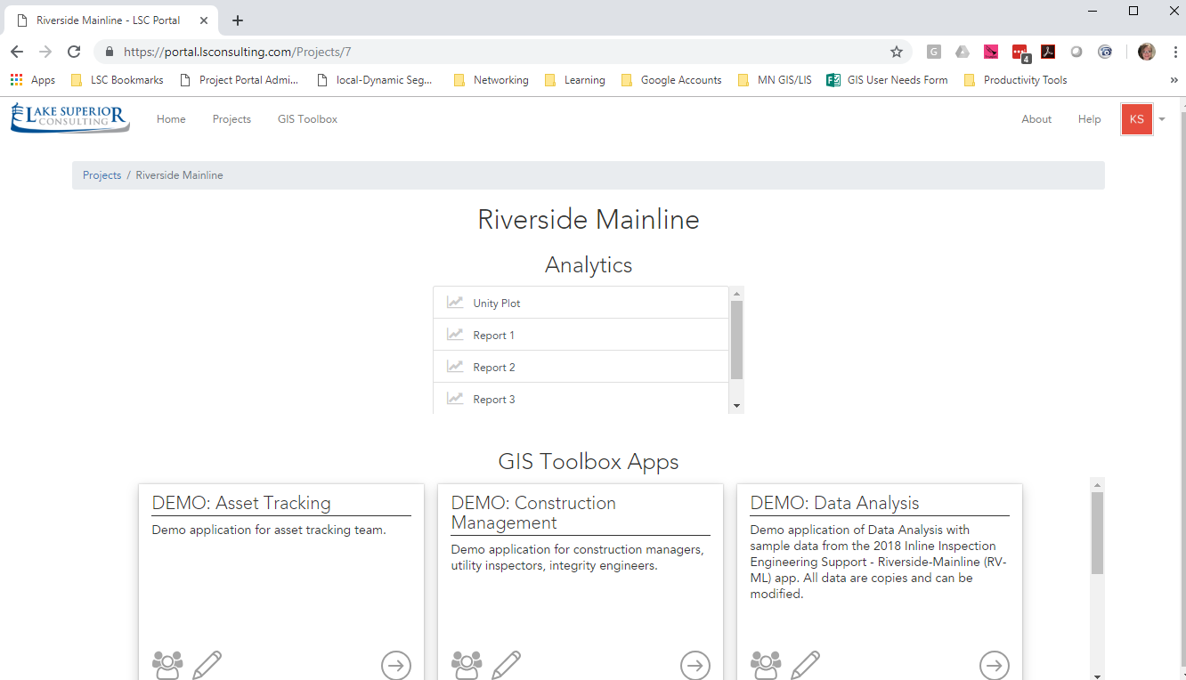
1. GIS Staff Creates Project & GIS Apps in Shawcor Portal
Build & configure Projects and linking PowerBI reports, SharePoint docs, and GIS Apps

Slide 7
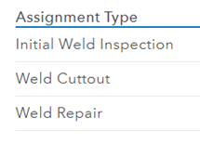
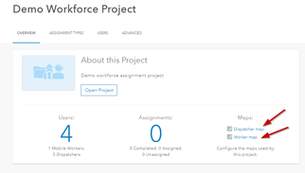
2. Project Engineer Assigns Field Crew Work from the Office
Configure the Esri Workflow Manager for custom workflows

Slide 8
3. Field Worker Collects & Submits Field Collection Disconnected in the Field
Dispatcher assigns work to field crew to use a Survey123 form or ArcGIS Collector map. https://lscgis.lsconsulting.com/aswa/apps/workforce/#/projects
Tracks worker location
Allows user to enter notes from field work if a job is completed, has issues, or is declined
Can assign specific types of work (or surveys to be completed)

Slide 9
4. Use Data Reviewer in GIS App to Review Data
Same process as before to approve or reject at multiple levels

Slide 10
5. Re-Assigns Work or New Work Based on Existing Workflow from the Office
Trigger a new workflow based on conditions.
Assign work to different staff (in-office or in-field)

Slide 11
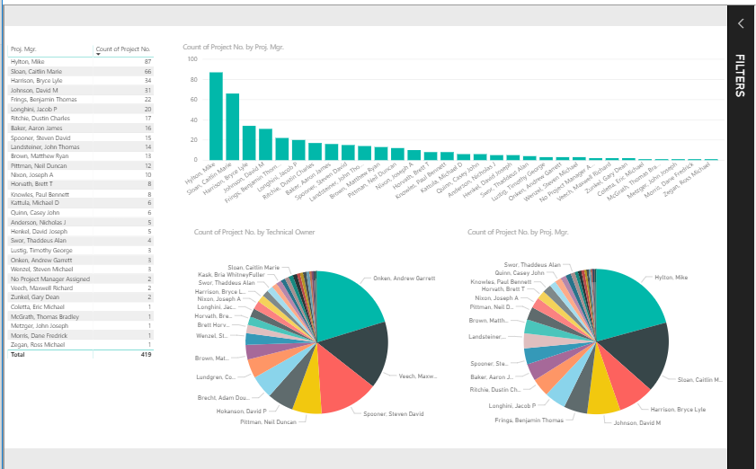
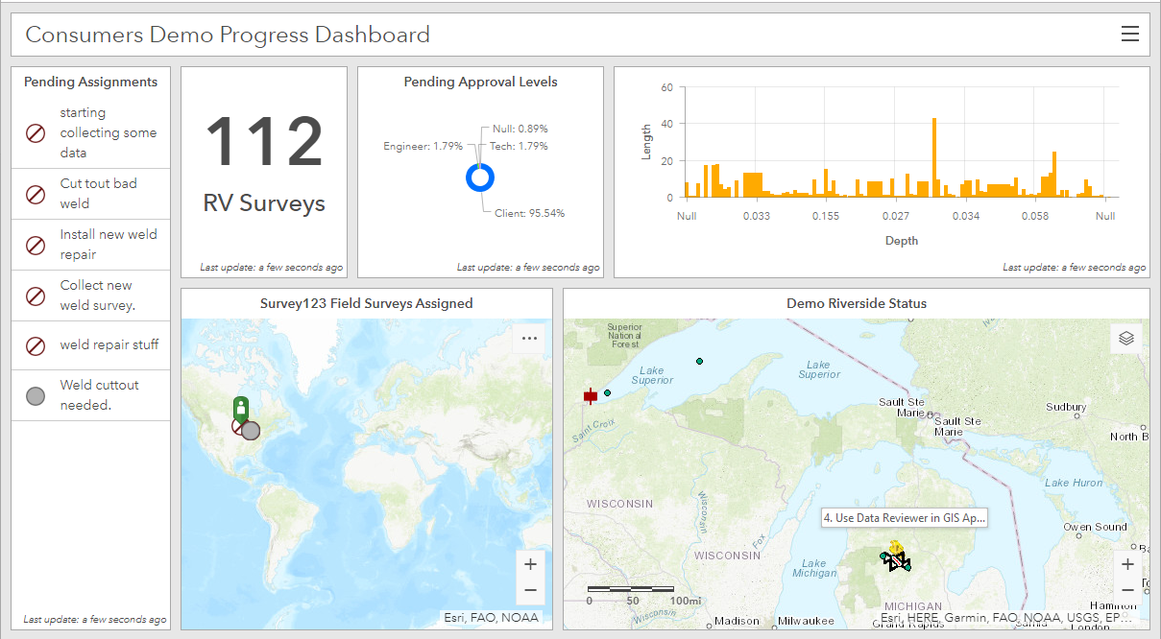
6. Managers/Individuals Review Progress Dashboards
PowerBI Dashboards
Esri Operations Dashboards

Slide 12
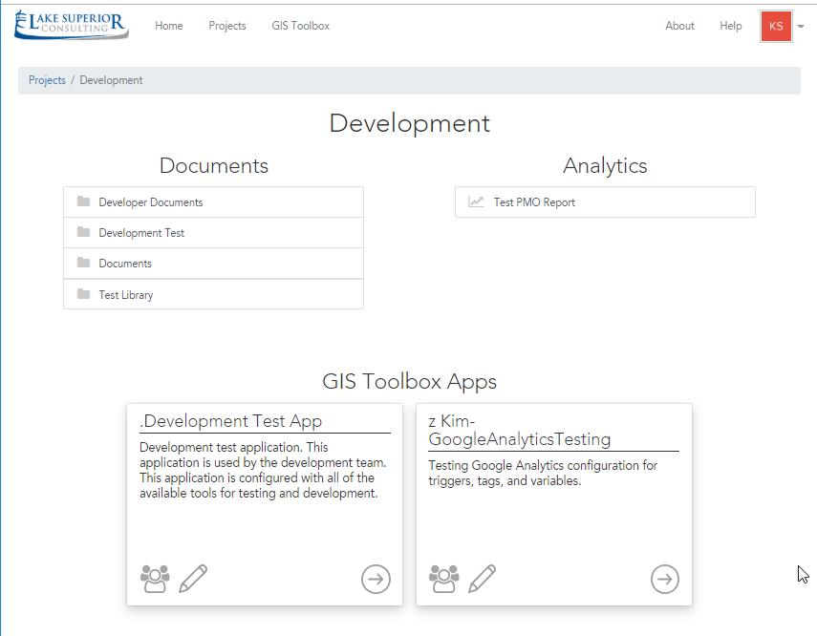
7. View Deliverables in Shawcor Project Portal

