Slide 1
Practical Data Science Assignment 2
Cars Quality Evaluation

Slide 2
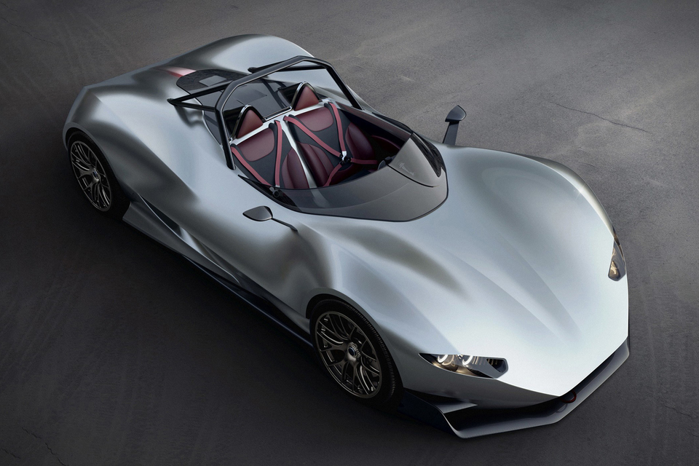
Cars Evaluation Dataset(UCI Machine Learning)
Hypothesis –Which machine learning model is best suited for predicting the “Cars Evaluation” dataset.
1. CAR ACCEPTABILITY
Buying price of the car
Maintenance cost of the car
2.TECHNICAL CHARACTERISTICS
Number of doors
Persons capacity in terms of persons to carry
Size of luggage boot
Safety of the car boot
Target Variable
Class Values – unacc/acc/good/vgood (Categorical)
No of instances – 1728
Data Preparation – No missing Values or no typos. Whole dataset is used to create model
Train/Test Ratio – 70/30

Slide 3
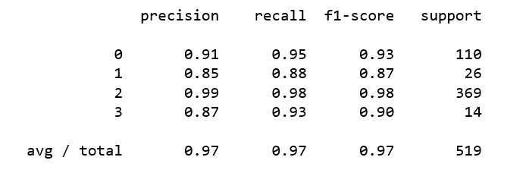

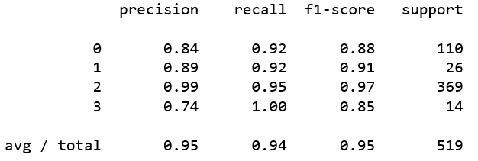

Machine Learning Model
1. Decision Tree Classification K-FOLD Cross-Validation(k=3)
Accuracy on Test – 0.75
2. Random Forest Classifier K-FOLD Cross-Validation(k=3)
Accuracy on test – 0.76

Slide 4
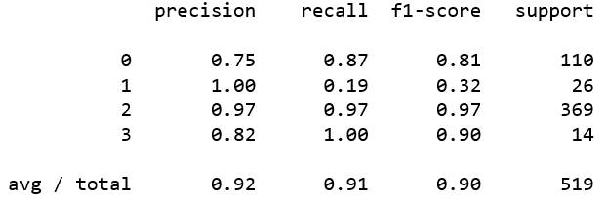
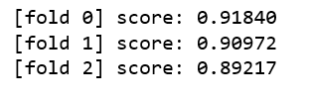
Machine Learning Model
3. Support Vector Machine K-FOLD Cross-Validation(k=3)
Conclusion
All the models had exceptional predictive accuracy but among those Decision Tree classifier has the highest accuracy , hence we conclude that the Decision Tree classifier is the best machine learning model for the cars evaluation dataset .

