Slide 1
AGENDA
Equipment Health & Maintenance Monitor (Predictive RUL)
Manufacturing Downtime Costs & Condition-Based Maintenance
Functional Requirements: Vibration RMS Telemetry, RUL Forecasting & ISO Limits
System Architecture: 3s Telemetry Simulator, WebSockets, React 18 & MongoDB 6
Operational Workflows: Reliability Engineers, Maintenance Crews & Parts Kitting
MongoDB Schemas: Machine Fleet, Time-Series Buffer, Anomaly Alerts & Repairs
Module Capabilities: Simulation Cockpit, Spline Wave Chart & 1-Click Healing
70% Phase 1 Milestone Verification, High-Res Screenshots & Phase 2 Roadmap
Agenda
Review 1 & 2 | Equipment Health & Maintenance Monitor

Slide 2
01
REQUIREMENTS
Functional & Non-Functional Engineering Requirements
Functional Predictive Maintenance Requirements
Non-Functional & Reliability Standards
Continuous 3s vibration RMS (mm/s) & high-frequency bearing peak-G streaming.
Remaining Useful Life (RUL) countdown with 95% confidence intervals [min - max hours].
Explainable anomaly alerts with sensor contribution attribution (SHAP-style XAI).
Schedule Equipment Repair with machine-specific parts kitting & technician crew dispatch.
1-Click alert healing restoring healthy nominal baselines (1.8 mm/s, 96% health).
Real-time WebSocket alerting updating fleet rosters and KPI cards without page reload.
ISO 10816 / 20816: Mechanical vibration velocity trip limits strictly enforced (4.5 mm/s).
Real-Time Reactivity: Sub-50ms WebSocket telemetry broadcast across connected clients.
High-Write Telemetry Buffer: 25-point rolling window with compound indexing.
Layout Resiliency: flex-shrink: 0 applied to panels preventing vertical compression.
Zero-Setup Deployment: 3-tier containerized stack orchestrated via Docker Compose.
Automated Verification: Playwright Core test suite driving local Google Chrome.
Requirements
Review 1 & 2 | Equipment Health & Maintenance Monitor

Slide 3
02
ARCHITECTURE
System Architecture: Condition Monitoring MERN
CLIENT TIER
APPLICATION TIER
DATA TIER
React 18 + Vite SPA
Custom SVG Spline Engine
Simulation Cockpit Bar
Bento Grid (STRATIS Style)
⇄
Node.js + Express REST API
Socket.io Duplex WebSockets
3s Telemetry Heartbeat
1-Click Healing Controllers
⇄
MongoDB 6 + Mongoose ODM
Industrial Machine Fleet
Time-Series Telemetry Buffer
Anomaly Alerts & Repairs
Physical vibration and bearing shock stream over WebSockets every 3 seconds. Faults injected via Cockpit trigger instant state updates; 1-click resolution and repairs write restored baselines directly to MongoDB.
Architectural Flow: Sensors -> Simulator -> Express -> Socket.io -> React Dashboard -> 1-Click Resolve -> MongoDB Baseline Healing.
Architecture
Review 1 & 2 | Equipment Health & Maintenance Monitor

Slide 4
03
USE CASE
Operational Use Cases & Engineering Actor Workflows
Maintenance Flow
1. 3s Sensor stream monitoring
2. Vibration or Peak-G spike trips alert
3. Live alert banner appears
4. Spline wave auto-focuses on asset
5. 1-Click Resolve or Schedule Repair
6. Parts kitting & crew assignment
7. Sign-off restores healthy baseline
Reliability & Condition Monitoring Engineer:
- Tracks vibration RMS waveforms against ISO 10816 Zone D trip limits.
- Monitors RUL degradation curves (operating hours to breakdown).
- Analyzes root-cause explainability sensor contributions (bearing crest, temperature, acoustic emission).
- Injects simulated plant scenarios to test emergency operational procedures.
Maintenance Supervisor & Field Repair Crew:
- Receives automatic equipment alert notifications with severity ratings.
- Schedules precision repairs with pre-configured OEM parts kits (bearings, seals).
- Executes work orders and signs off completion, automatically restoring machine health to 98%.
Use Case
Review 1 & 2 | Equipment Health & Maintenance Monitor

Slide 5
04
ER DIAGRAM
MongoDB Document Schemas & Relationships
Schema Strengths
Compound indexing on (machineId, timestamp)
Rolling 25-point buffer for smooth spline charts
Embedded explainability feature attribution arrays
Bidirectional foreign key links (alertId, workOrderId)
Atomic document state transitions
Zero-setup database auto-seeding on boot
Collection: machines (Fleet Roster)
- machineId, name, line, type (ROBOTIC_GEARBOX, CENTRIFUGAL_COMPRESSOR, CNC_SPINDLE, HYDRAULIC_PUMP)
- healthScore, anomalyScore, status (HEALTHY, EARLY_DEGRADATION, SEVERE_ANOMALY, CRITICAL_SHUTDOWN)
- currentVibrationRms, warningVibrationRms, currentBearingPeakG, currentTempC
- predictedRulHours, rulConfidenceMin, rulConfidenceMax
Collection: telemetryreadings (Time-Series Stream)
- machineId, timestamp (Compound Indexed), vibrationRms, bearingPeakG, tempC
- acousticEmissionDb, motorCurrentAmps, rpm, anomalyFlag
Collection: anomalyalerts
- alertId (Unique), machineId, severity (HIGH, CRITICAL), failureMode, anomalyScore
- explainability [ { feature, contributionPercent, description } ], status (OPEN, WORK_ORDER_DISPATCHED, RESOLVED)
Collection: maintenanceactions (Repairs & Tasks)
- workOrderId, machineId, title, priority, scheduledDate, assignedTeam
- partsRequired [ { partNumber, name, inStock } ], status (DISPATCHED, COMPLETED)
ER Diagram
Review 1 & 2 | Equipment Health & Maintenance Monitor

Slide 6
05
MODULES
Core Predictive Maintenance Modules
Module | Description | Key Functions
Telemetry Simulator | Core Engine | 3s heartbeat generating realistic vibration, bearing crest impact, and temperature waveforms
Simulation Cockpit | Testing Bar | Minimal dark floating bar allowing 1-click failure injection (Vib Spike, Bearing Defect, RUL Collapse, Reset)
Vibration Wave Chart | Visualization | Cubic Bezier spline with dynamic auto-zoom, machine switcher, pulsing beacon & ISO limit line
Anomaly Detection & RUL | Analytics | ISO 10816 limit checking, exponential RUL degradation modeling, and XAI feature attribution
Repairs & Tasks Dispatch | Maintenance | Context-aware repair scheduling with machine-specific parts kitting & technician assignment
Modules
Review 1 & 2 | Equipment Health & Maintenance Monitor

Slide 7
06
TECH STACK
Technology Stack & Toolchain
MongoDB 6
Express.js
React 18 + Vite
Node.js v20
NoSQL Database & Time-Series
REST API & Scenario Controller
Fast SPA & SVG Spline Engine
Telemetry Heartbeat Runtime
Supporting Tools
Socket.io: Sub-50ms bidirectional WebSocket telemetry streaming
Playwright Core: Automated end-to-end browser testing driving local Chrome
Docker & Docker Compose: Multi-container deployment with isolated networking
Mongoose ODM: Strict data modeling, validation schemas, and auto-seeding
Vanilla CSS Design System: High-density Bento cards, hairline slate borders & responsive layouts
Tech Stack
Review 1 & 2 | Equipment Health & Maintenance Monitor

Slide 8
07
UI DESIGN
User Interface Design & Layout
Design Tokens
Light theme inspired by STRATIS
Primary Accent: Industrial Orange (#ea580c)
Health Green: #059669 & Hazard Red: #dc2626
Hairline slate borders: #e2e8f0
Typography: Plus Jakarta Sans
Monospace readings: JetBrains Mono
High-Density Industrial Bento Grid:
- 4 core KPI metric cards: Overall Health %, Active Alerts, Needs Service Soon, and Scheduled Repairs.
- Real-time cubic Bezier spline area chart with dashed red threshold limit line (4.5 mm/s).
- Floating Simulation Cockpit docked unobtrusively at top right for 1-click testability.
Interactive Operational Workflows:
- Dynamic Alert Banner: Displays active anomalies with severity badges and action buttons.
- 1-Click Resolve: Instantaneous alert dismissal and physical machine restoration to 96% health.
- Schedule Equipment Repair: Pre-populates machine, failure mode & OEM parts kit.
- Anomaly Explainability Modal: Visual feature attribution contribution bars.
UI Design
Review 1 & 2 | Equipment Health & Maintenance Monitor

Slide 9
08
FRONTEND
Frontend Implementation Architecture
Built with React 18, Vite, and modular functional components with custom hooks.
Custom SVG Spline Engine: Dynamically generates smooth cubic Bezier paths without heavy charting libraries.
Auto-Zoom Scaling: Computes min/max bounds with padding to amplify subtle telemetry oscillations.
Automated Machine Auto-Focus: Instantly snaps waveform view to any machine experiencing an alert.
WebSocket State Synchronization: Listens for telemetry:stream, alert:new, and machine:update events.
Strict Layout Resiliency: flex-shrink: 0 applied to panels ensuring zero clipping across all screen sizes.
Completed Views: Overview Dashboard, Machine Diagnostics Roster, Estimated Operating Life (RUL), Equipment Alerts, Scheduled Repairs & Tasks, Live Telemetry Charts.
Frontend
Review 1 & 2 | Equipment Health & Maintenance Monitor

Slide 10
09
BACKEND
Backend Architecture & Real-Time Engine
Node.js + Express HTTP server seamlessly integrated with Socket.io WebSocket instance.
Telemetry Simulator Service: Generates 3s heartbeats with dynamic wave math and randomized physical noise.
Scenario Injection Router: POST /api/simulator/scenario executes deterministic plant fault injection.
Closed-Loop Resolution API: PATCH /api/alerts/:id/resolve restores nominal baselines and broadcasts recovery.
Work Order Lifecycle Management: Handles creation, technician assignment, and sign-off completion.
Multi-Alert Integrity Guard: Evaluates outstanding machine alarms before restoring healthy status.
Backend Endpoints: /api/overview, /api/machines, /api/simulator/scenario, /api/alerts/:id/resolve, /api/work-orders, /api/telemetry.
Backend
Review 1 & 2 | Equipment Health & Maintenance Monitor

Slide 11
10
DATABASE
Database Integration & Schema Management
Containerized MongoDB 6.0 with persistent volumes configured via Docker Compose.
Mongoose ODM schemas defining strict types, validations, and default operational thresholds.
Time-Series Telemetry Optimization: Indexed queries on (machineId, timestamp) ensure sub-10ms fetches.
Relational Linking: Maintenance work orders formally reference origin alertId and machineId.
Automatic Database Seeding: Checks collection count on boot and initializes realistic assets and history.
Data Hygiene: Simulator reset purges temporary test records and restores clean engineering baselines.
Active Collections: machines, telemetryreadings, anomalyalerts, maintenanceactions.
Database
Review 1 & 2 | Equipment Health & Maintenance Monitor

Slide 12
11
API
RESTful API Endpoints & WebSocket Events
Method | Endpoint | Description
GET | /api/overview | Fetches fleet KPIs: overall health %, active alerts, and critical RUL counts
POST | /api/simulator/scenario | Injects plant faults: VIBRATION_SPIKE, BEARING_DEFECT, RUL_COLLAPSE, RESET
GET | /api/machines/:id/telemetry | Returns 25-point historical telemetry buffer for real-time spline chart rendering
PATCH | /api/alerts/:id/resolve | 1-Click Resolve: heals machine baseline in DB and broadcasts Socket.io update
POST | /api/work-orders | Schedules repair task with OEM parts kitting, updating alert to DISPATCHED
PATCH | /api/work-orders/:id/complete | Signs off maintenance: completes task, resolves linked alert & heals machine
API
Review 1 & 2 | Equipment Health & Maintenance Monitor

Slide 13
12
STATUS
Implementation Status (70% Milestone Achieved)
Real-Time Telemetry & WebSockets
100%
Cubic Bezier Spline Wave Charts
100%
Anomaly Alerts & 1-Click Healing
100%
Repairs & Equipment Parts Kitting
100%
Simulation Cockpit Bar
100%
Overall Phase 1 Milestone Achieved
70%
Status
Review 1 & 2 | Equipment Health & Maintenance Monitor

Slide 14
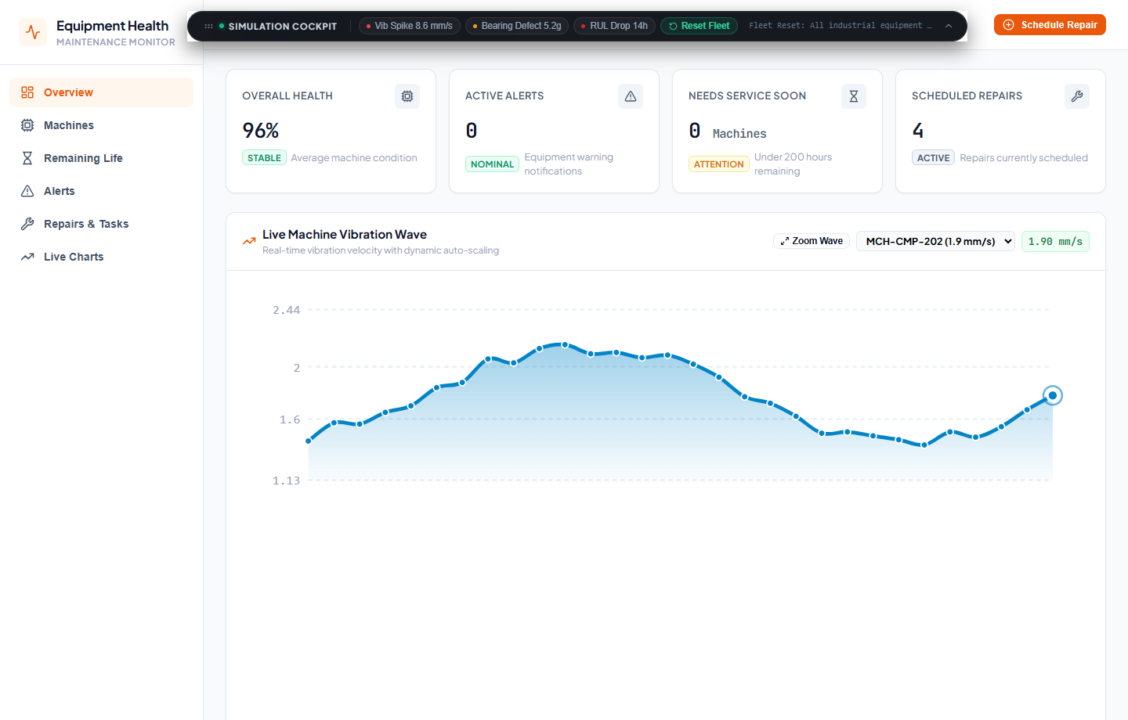
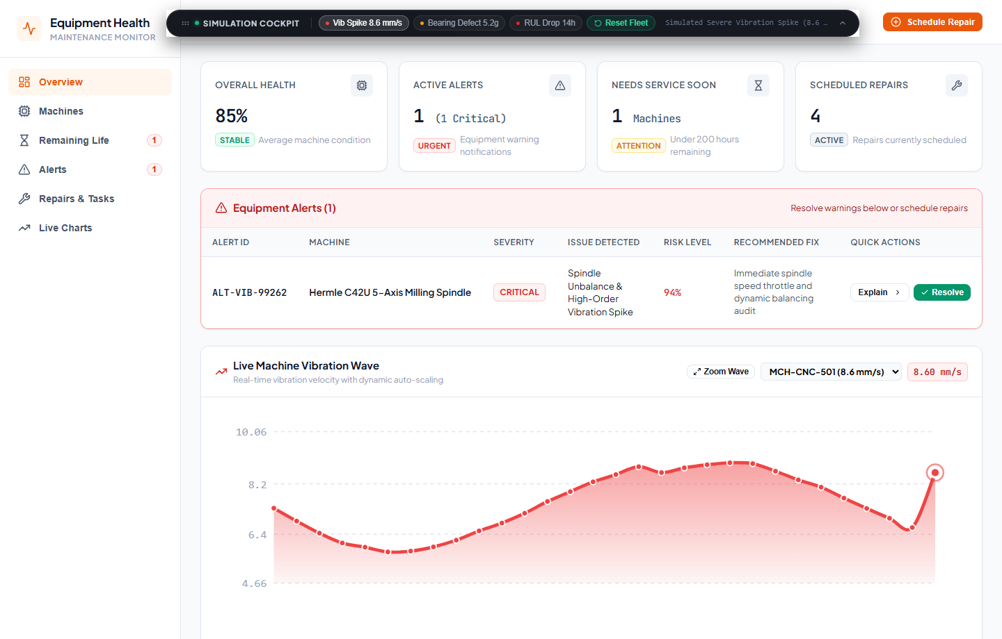
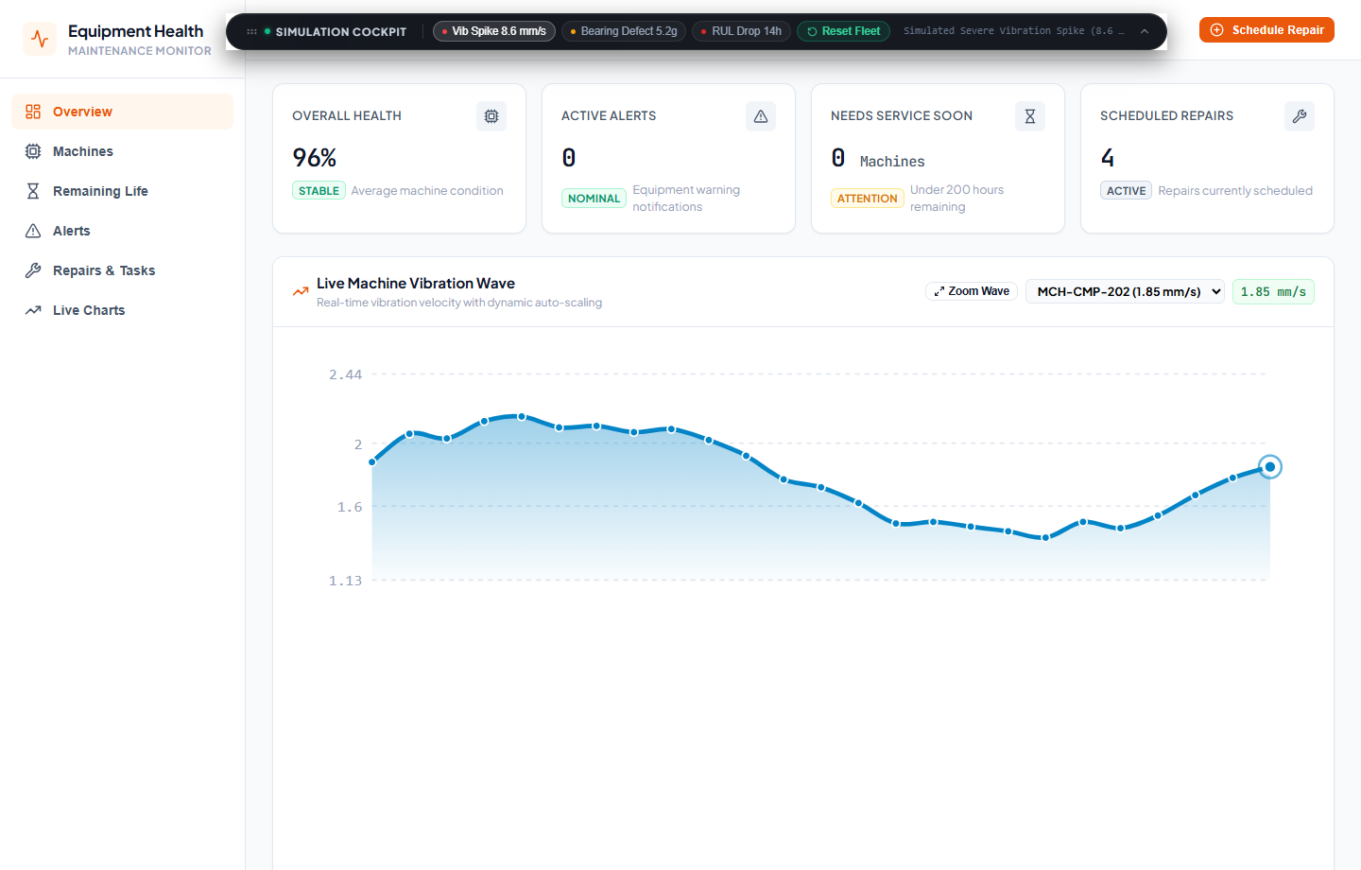
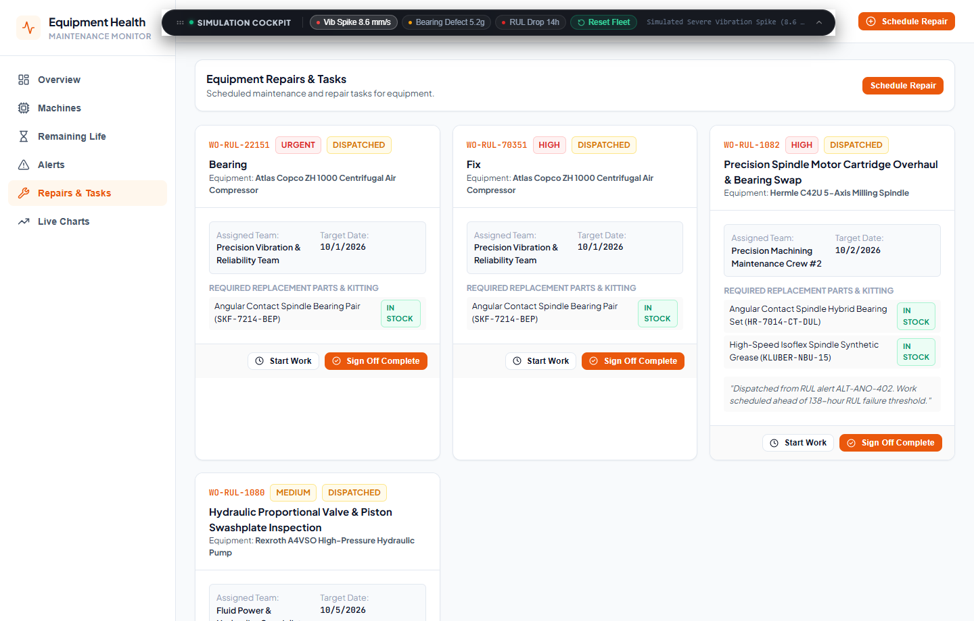
13
SCREENSHOTS
Visual Verification & Execution Screenshots
Screenshots
Review 1 & 2 | Equipment Health & Maintenance Monitor

Slide 15
14
CHALLENGES
Technical Challenges & Adopted Solutions
Challenge | Solution Adopted
Playwright subagent 404 from Azure CDN | Configured Playwright Core to automate local native Windows Chrome directly at C:\Program Files\Google\Chrome\Application\chrome.exe
Flexbox parent compressed alert table to 165px | Added flex-shrink: 0 to .panel and styled alert table cells with vertical-align: middle and nowrap badges
Chart remained parked on nominal machine during fault | Implemented dynamic machine auto-focus that automatically snaps waveform to the spiking asset
Resolving alert left machine in degraded status | Built multi-alert integrity check restoring healthy baseline (1.8 mm/s, 96% health) upon clearing last alert
Challenges
Review 1 & 2 | Equipment Health & Maintenance Monitor

Slide 16
15
NEXT STEPS
Remaining Scope & Phase 2 Roadmap (30%)
Continuous ML Retraining Pipeline: Connect a dedicated Python/FastAPI microservice for LSTM and Weibull survival models trained on run-to-failure vibration datasets.
Enterprise CMMS / SAP PM Integration: Implement REST and webhook connectors to synchronize scheduled repairs with enterprise work orders in SAP or Maximo.
Role-Based Access Control (RBAC): Differentiate access tiers between Plant Safety Officers, Reliability Engineers, and Field Maintenance Technicians.
Physical IoT Sensor Ingestion: Deploy an MQTT broker and OPC-UA gateway to ingest raw streams from industrial vibration accelerometers.
Multi-Tenant Cloud Deployment: Package Helm charts for AWS EKS / GCP Kubernetes with Prometheus & Grafana telemetry monitoring.
Comprehensive Final Documentation: Complete production operations manual and API reference handbook for final defense.
Next Steps
Review 1 & 2 | Equipment Health & Maintenance Monitor

Slide 17
16
NEXT STEPS
Standards, Specifications & Literature References
# | Reference
1 | ISO 10816 / ISO 20816: Mechanical vibration -- Evaluation of machine vibration by measurements on non-rotating parts
2 | NASA Prognostics Center of Excellence: C-MAPSS Turbofan Degradation Run-to-Failure Dataset & Wear Horizon Modeling
3 | IEEE Transactions on Reliability: Accelerated Degradation Testing & Weibull Survival Prognostics in Industry 4.0
4 | Socket.io, React 18, Node.js, and MongoDB 6 Official Specifications & Playwright Core Framework
Next Steps
Review 1 & 2 | Equipment Health & Maintenance Monitor

