Slide 1
AirBnb_Kamna
File created on: 18/06/24 8:18:34 pm GMT-7

Slide 2
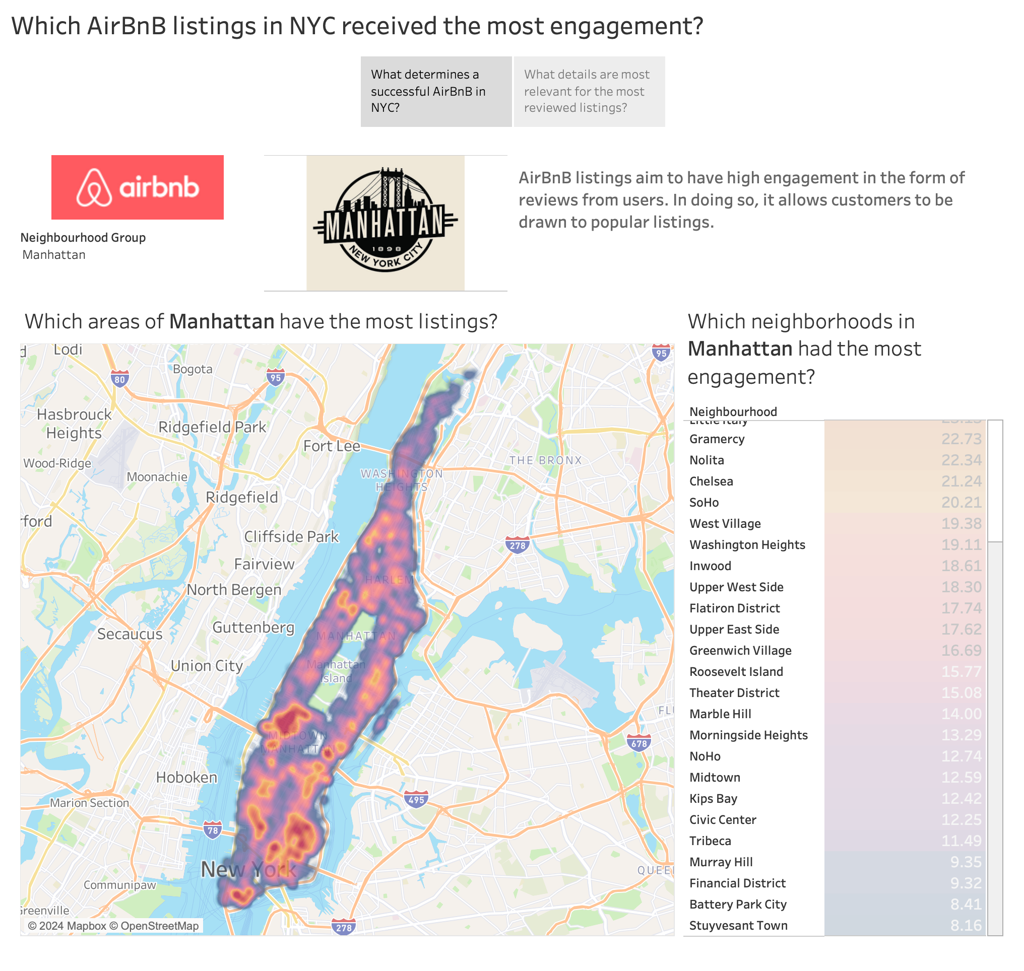

Slide 3
