Slide 1
CSE523 : Machine Learning
PROJECT - 5
Identifying hard stop & momentary stop using vehicle trajectory dataset
Parth Joshi | AU2140002
Harsh Choksi | AU2140061
Niyati Patel | AU2140097
Krutarth Vora | AU2140162
- Instructed by Prof. Mehul Raval

Slide 2
CONTENTS
1 | Problem Statement
2 | Dataset
3 | Methodology
4 | Performance & Accuracy Assessment
5 | Results & Comparison
6 | References

Slide 3
Problem Statement
The project aims to develop a model for detecting hard stops, momentary stops of vehicles also, with continuous moving vehicle using ensemble learning techniques. Hard stops refer to sudden and significant decreases in vehicle velocity, while momentary stops indicate brief halts in motion. Detecting these events is crucial for understanding driving behavior and enhancing road safety.

Slide 4
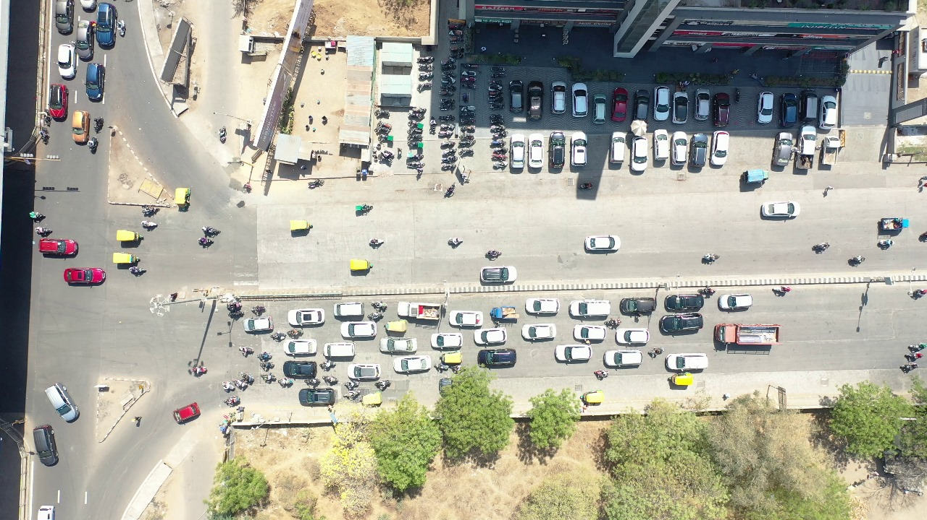
Dataset Used
https://drive.google.com/file/d/1YujFFpHv16Mi4WOX-_vte_i3n_8awXq5/view?usp=drive_link

Slide 5
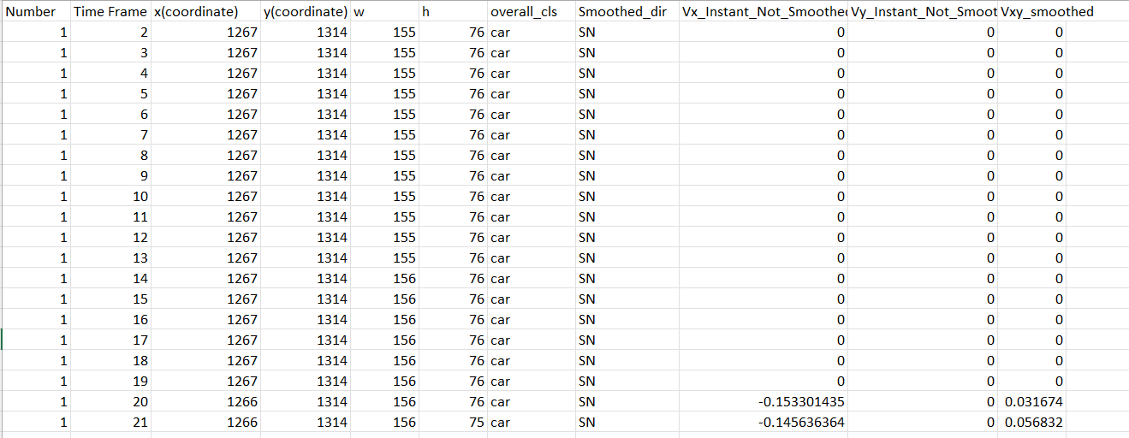

Slide 6
Methodology
Data Loading and Inspection:
The dataset is loaded into a Pandas DataFrame for further analysis.
Initial exploration includes examining the first few rows and the information summary of the DataFrame to understand its structure and content.

Slide 7
Data Preprocessing:
Missing values are handled by filling them with zeros.
Duplicates are identified and removed from the dataset.
Feature Engineering:
Relevant features are extracted from the dataset, such as distance, velocity, and acceleration.
Spatial-temporal features are derived, including average velocity over specific time windows and the number of stops within defined periods.

Slide 8
Subsampling:
Despite the large dataset size, only 10% of the data is utilized for analysis.
Purpose: Reduce computational complexity and resource demands.
Strategic Approach:
Focus on a subset comprising frequently repeated frames.
Selection of 700 frames out of approximately 9000 frames.
Objective: Capture essential data characteristics while minimizing computational burden.

Slide 9
Model Development
Random Forest Classifier Algorithm:
A robust ensemble learning technique, is chosen for its ability to handle complex datasets
During training, the algorithm constructs multiple decision trees, each trained on a different subset of the data and using a random selection of features.
The final prediction is made by aggregating the predictions of individual trees, resulting in a robust and reliable model.

Slide 10
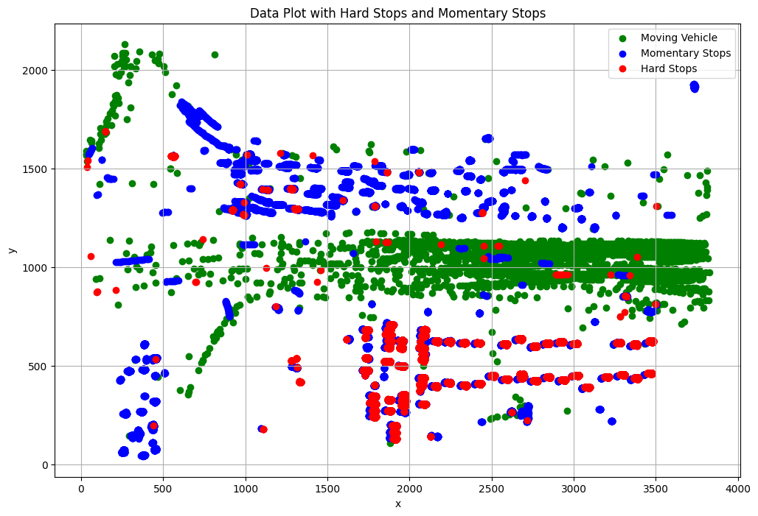
Results obtained by Random Forest Classifier:

Slide 11
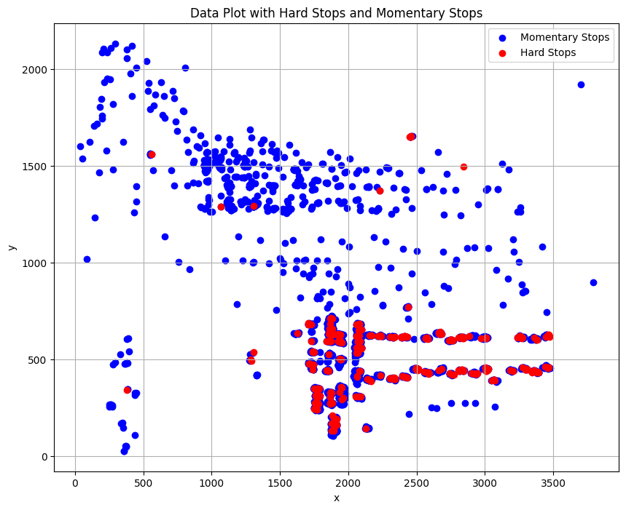
Results
Last Presented Results
Latest Findings

Slide 12
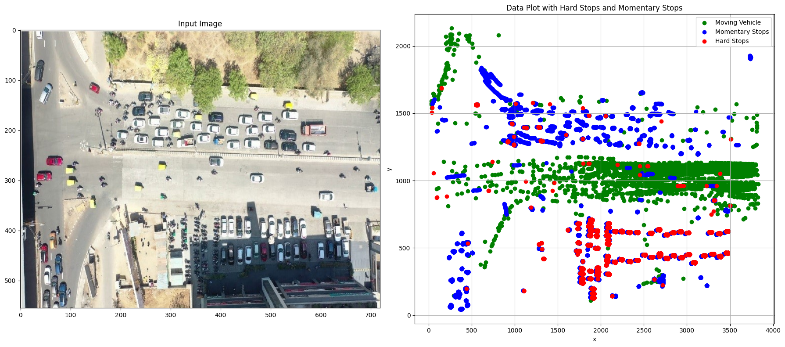
Comparison

Slide 13
Performance
Model Performance Evaluation:
Random Forest Classifier achieves high accuracy in identifying hard stops, momentary stops, and moving vehicles.
Metrics like precision, recall, F1-score, and accuracy evaluate model performance.
The classification report details true positives, false positives, true negatives, and false negatives for each class.

Slide 14
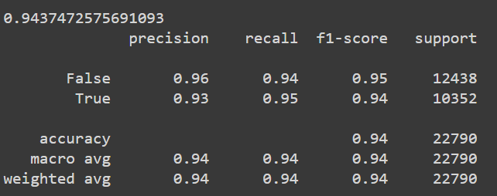
Performance
Model Accuracy Assessment:

Slide 15
References
Wu, T., Shen, H., Qin, J., & Xiang, L. (2021). Extracting Stops from Spatio-Temporal Trajectories within Dynamic Contextual Features. Sustainability (Basel), 13(2), 690. https://doi.org/10.3390/su13020690
Gong, L., Sato, H., Yamamoto, T., Miwa, T., & Morikawa, T. (2015). Identification of activity stop locations in GPS trajectories by density-based clustering method combined with support vector machines. Journal of Modern Transportation, 23(3), 202–213. https://doi.org/10.1007/s40534-015-0079-x

Slide 16

Github Repository
https://github.com/ksv1112/ML_2024_Project-5_The_Data_Detectives

Slide 17
THANK YOU

