Slide 1
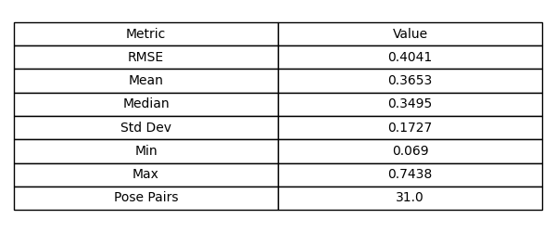
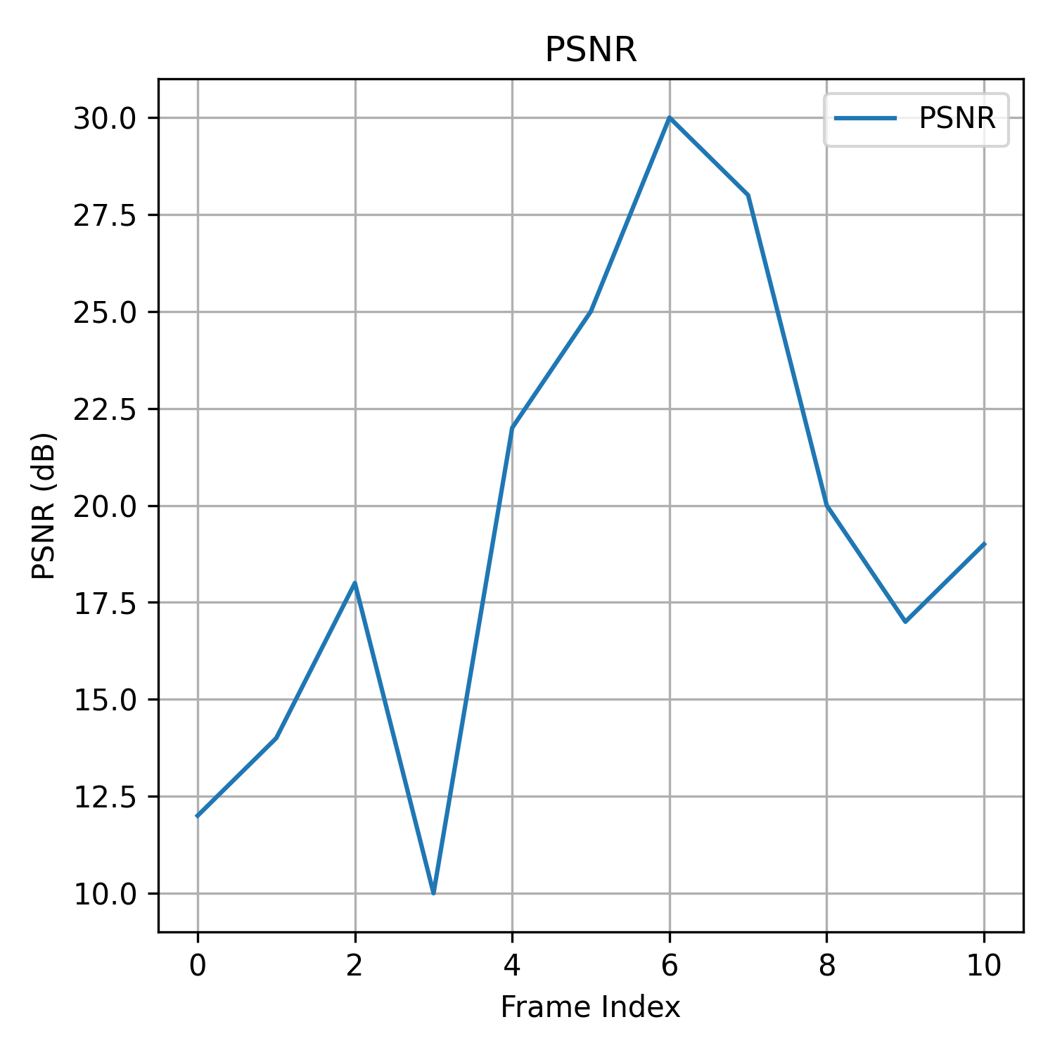

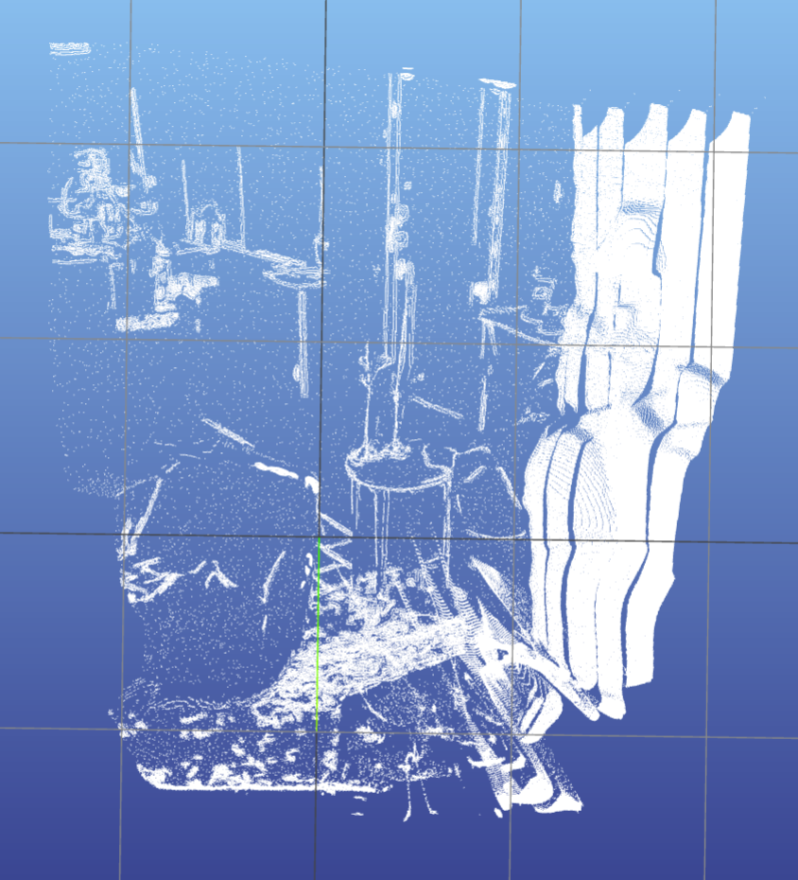

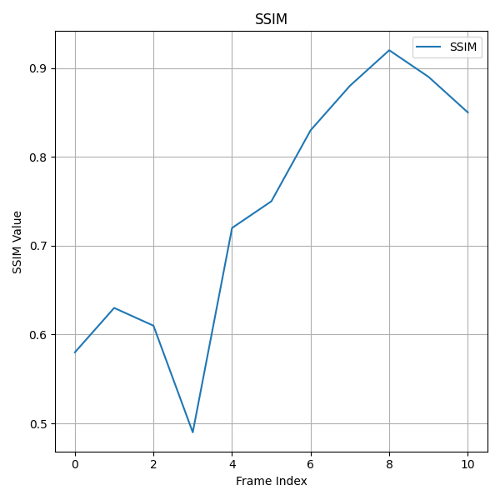

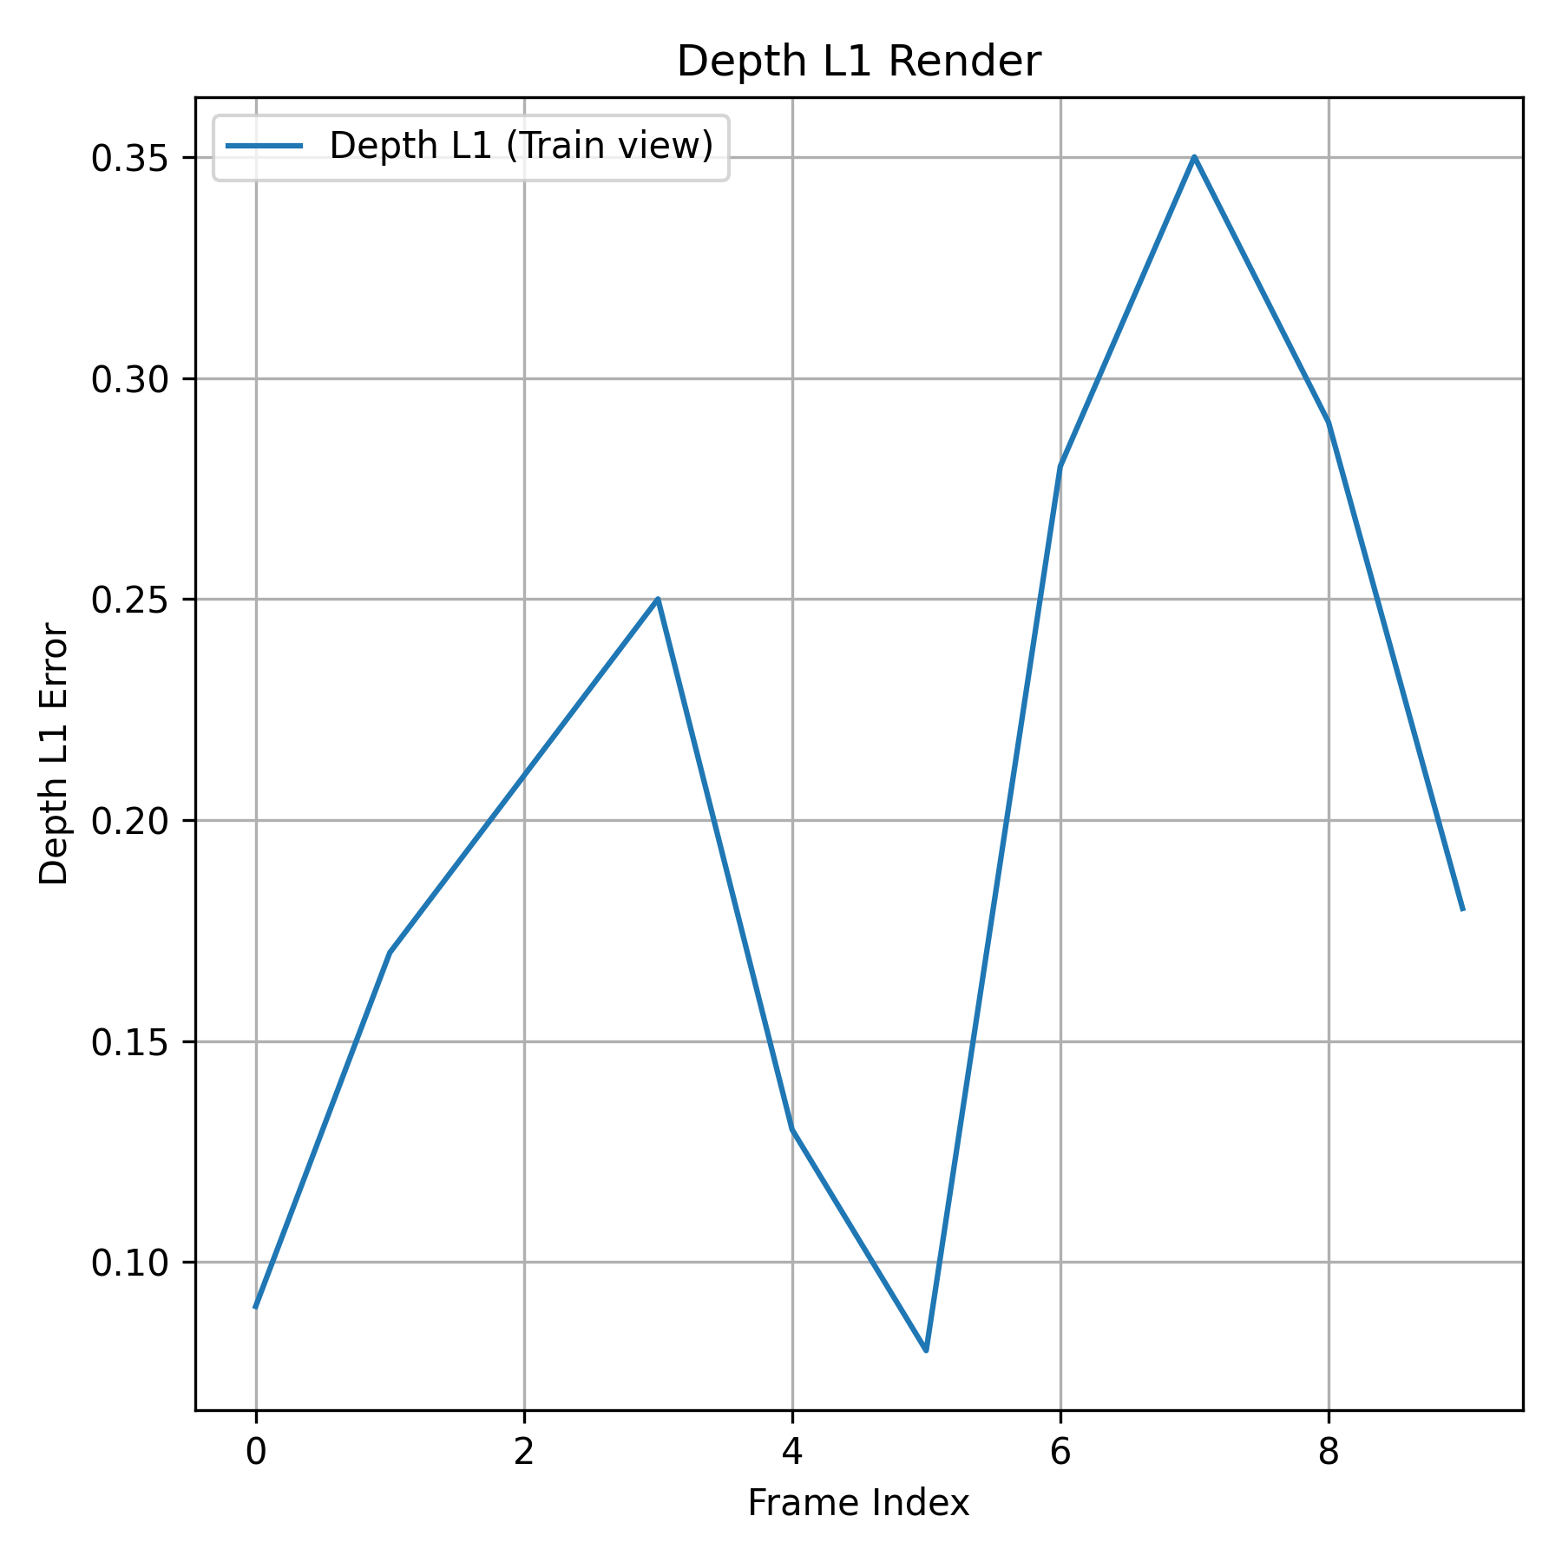
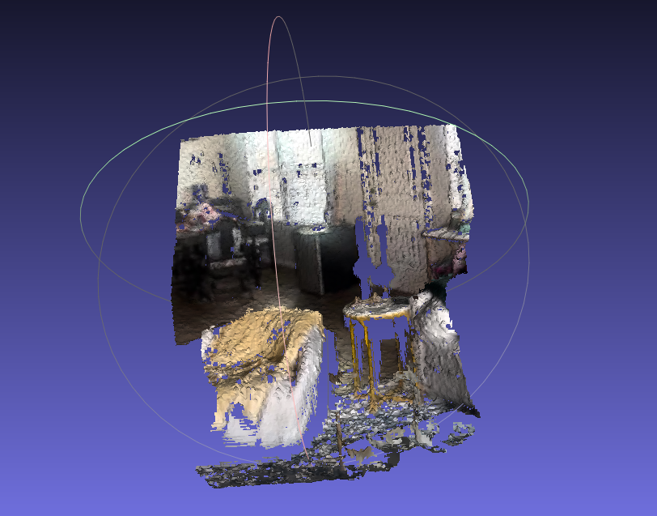
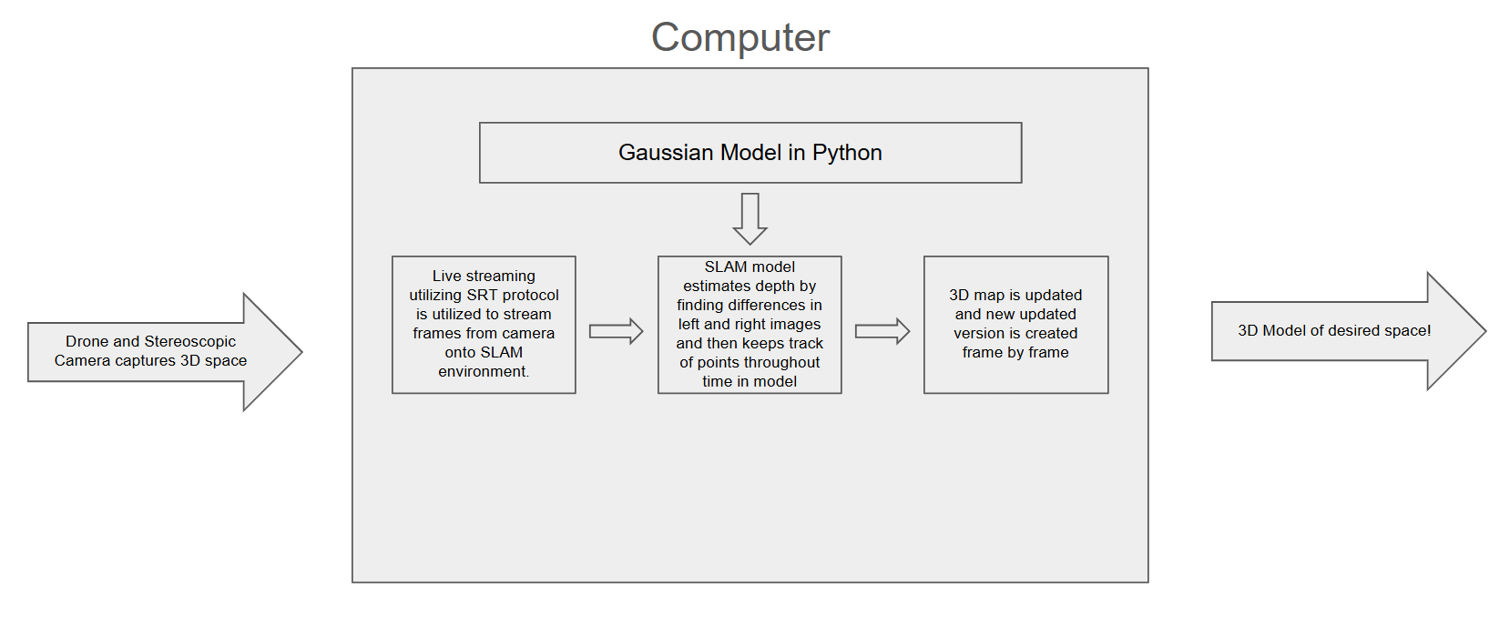
SLAM
Farris Rizwan, Dev Patel, Brian McKeown, Kiran Vengurlekar, and Ethan Ortiz
Sponsored By: SpatialGen (Zachary Handshoe)
Background/Motivation
Most existing Gaussian-SLAM implementations are limited to offline, batch processing. They’re not usable in real-time settings due to:
Slow model generation
Difficult configuration of input devices
Lack of support for real-time depth input
There is a growing need for fast, lightweight 3D reconstruction in domains like defense, emergency response, and immersive tech.
System Design
Our architecture includes:
SLAM Engine: Processes frames and generates 3D point clouds
Depth Module: Using machine learning with temporal smoothing to ensure accuracy
Streaming Client: Sends real-time data from camera to SLAM engine
Live Reconstruction: Visualizes model generation in real time
Quantitative Results
Aligned ATE Data.
This is a summary of Aligned Absolute Trajectory Error (ATE). This shows low RMSE, mean, and standard deviation values. This is indicative of high accuracy and minimal errors which is in line with accurate estimated camera pose in comparison to the reference trajectory.
PSMR (Peak Signal to Noise Ratio)
Proposed Solution
We built a real-time SLAM system capable of:
Processing live 2D video into 3D Gaussian-Splat meshes
Streaming and rendering partial reconstructions incrementally
Integrating depth data from stereo video
Exporting intermediate results mid-process
Impact
  Real-time Reconstruction: Enables field deployment for defense, emergency response, and immersive experiences.
  Accessible Visualization: Users can analyze partial models without waiting for full SLAM completion.
  Extensible Design: System can easily incorporate advanced ML-based depth enhancements and additional sensors in the future.
  Operational Scalability: Ready to scale across cloud-based infrastructure or edge devices.
SSIM (Structural Similarity Index)
Depth L1 Render
End Results
We achieved a working, real-time SLAM system with:
Integrated depth input
Frame-by-frame reconstruction
Support for live video streams and partial output
Compatibility with diverse environments
Live reconstruction of our 2D model at frame 30/320
The three graphs above evaluate the quality of rendering using metrics such as PSNR, SSIM, and Depth L1 error. Higher PSNR and SSIM values show how close the rendered image is to the original one while Depth L1 shows how accurate the depth reconstruction is.
Functional Structure
Streaming Client → Depth Mapper → SLAM Engine → Visualization UI
Modular architecture allowing independent updates to each component.
SLAM model utilizes gaussian splatting to create a real-time and dense 3D reconstruction of the environment. It shows surfaces as 3D Gaussians and this is what makes the SLAM so accurate and precise at recreation.
References
Bermudez, L. (2024, April 23). Overview of slam. Medium. https://medium.com/machinevision/overview-of-slam-50b7f49903b7
Opencv-python. PyPI. (n.d.). https://pypi.org/project/opencv-python/
Pan, G., Sun, T., Weed, T., & Scharstein, D. (2021, November 22). 2021 stereo datasets. https://vision.middlebury.edu/stereo/data/scenes2021/
Sadekar, K. (2022b, December 14). Stereo camera depth estimation with opencv (python/C++). LearnOpenCV. https://learnopencv.com/depth-perception-using-stereo-camera-python-c/
The Definitive Guide to SLAM Technology & Slam devices. NavVis. (n.d.). https://www.navvis.com/technology/slam
What is SLAM (simultaneous localization and mapping) – matlab & simulink. What Is SLAM (Simultaneous Localization and Mapping) – MATLAB & Simulink - MATLAB & Simulink. (n.d.). https://www.mathworks.com/discovery/slam.html
Key Statistical Findings
PSNR shows that rendered frames closely match the ground truth images.
SSIMs over 0.9 indicate strong structural similarity.
Depth predictions are sharp and accurate at the SLAM level
Depth maps created by stereo video are not accurate without ML
SLAM maintained performance above 1 fps in most configurations
Acknowledgements
Thank you to Zachary Handshoe and the team at SpatialGen for making this possible!
First functional iteration based on a limited number of frames
Functional Structural Design.

