Slide 1
API and scraping

Slide 2
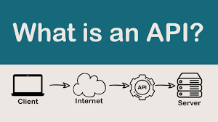
What is the API
An API, or Application Programming Interface, is a set of rules and protocols for building and interacting with software applications. APIs define the methods and data formats that programs should use to communicate with each other, effectively allowing different software systems to connect and share information.
APIs can be broadly categorized into various types, including Web APIs, Database APIs, Remote APIs, Operating System APIs
For developers, APIs simplify the coding process, as they provide a clear set of building blocks that are designed to work well together.
Notes:
Web APIs: These are designed for communication between client and server over the internet. They typically use HTTP/HTTPS protocols and are used by web applications to communicate with backend servers or by services to communicate with each other.
Operating System APIs: These provide the building blocks for software development on a specific operating system, like Windows, MacOS, or Linux. They allow developers to perform common tasks like accessing the file system, handling input/output operations, and creating user interfaces.
Database APIs: These allow applications to communicate with database management systems. SQL is a well-known example, enabling applications to manage and query data stored in a relational database.
Remote APIs: These are used for communication between software on different machines across a network. They are designed to handle all the complexities of network communication, such as remote procedure calls (RPC).

Slide 3
Json (JavaScript Object Notation)
The JSON format is often used for transmitting structured data over a network connection, particularly between a server and web applications. It serves as an alternative to XML and has become the de facto standard for REST APIs due to its simplicity and ease of use.
JSON represents data as a collection of name-value pairs (similar to a JavaScript object) . In JSON:
A name/value pair consists of a field name (in double quotes), followed by a colon, followed by a value.
Values can be strings (in double quotes), numbers, objects, arrays, true, false, or null.
Here is an example of a JSON object:
{
"name": "John Doe",
"age": 30,
"isStudent": false,
"courses": ["Mathematics", "Physics"],
"address": {
"street": "123 Main St",
"city": "Anytown"
}
}

Slide 4
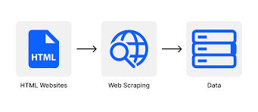
What is the scraping
Web scraping is a technique used to extract data from websites. This is done through programmatically accessing web pages and pulling out the necessary information, which is typically done with a web scraper, a specialized tool or piece of code that sends requests to the target web page and then parses the HTML document returned to extract the data.
A typical web scraping process:
Sending HTTP requests: GET request for static websites, POST requests for interaction
Parsing HTML: Navigate the HTML document tree and select elements based on their tags, classes, IDs, and other attributes. Python: BeautifulSoup
Data extraction: This data could be anything from product details on e-commerce sites, to stock prices, to sports statistics, and more.
Data processing: Restructuring the data into a more convenient format like JSON or CSV.
Storing the data: This could be in a file, a database, or some other storage system.

Slide 5
HTML (HyperText Markup Language)
HTML uses so-called "tags" to denote different elements within the content, which browsers interpret to display the content in a particular format. Tags are usually enclosed in angle brackets. For example, <p> signifies a paragraph, and <a> denotes a hyperlink.
Here's a simple example of HTML:
<!DOCTYPE html>
<html>
<head>
<title>Page Title</title>
</head>
<body>
<h1>My First Heading</h1>
<p>My first paragraph.</p>
<a href="https://www.example.com">This is a link</a>
</body>
</html>
The <!DOCTYPE html> declaration defines the document type and HTML version.
The <html> element is the root element of an HTML page.
The <head> element contains meta-information about the HTML document, like its title.
The <title> tag specifies a title for the document, which is shown in the browser's title bar or in the page's tab.
The <body> tag contains the content of the document, such as text, images, links, etc.
The <h1> element defines a large heading.
The <p> element defines a paragraph.
The <a> tag defines a hyperlink and has an attribute href that specifies the link's destination.

Slide 6
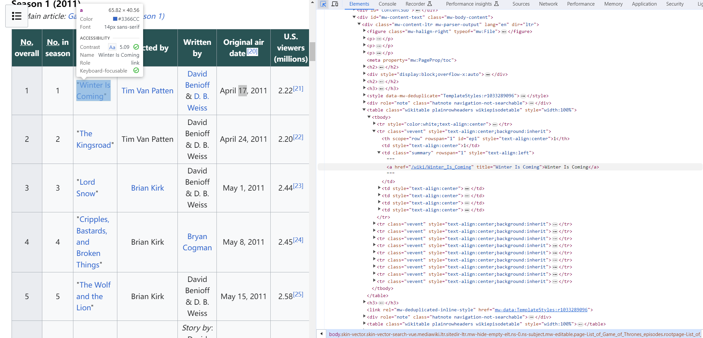
URL: https://en.wikipedia.org/w/index.php/?title=List_of_Game_of_Thrones_episodes&oldid=802553687
Sending HTTP requests:
Parsing HTML:

Slide 7
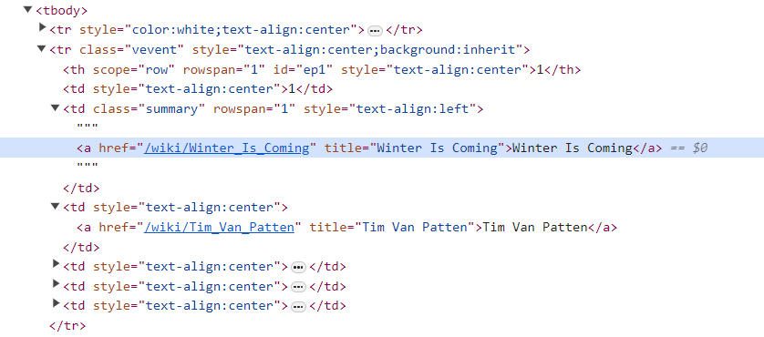
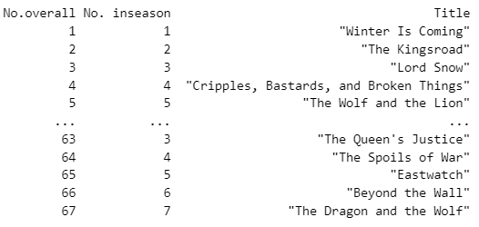
Data extraction
Data processing/ storing
Winter Is Coming

Slide 8
API vs. Scraping
APIs and web scraping both serve the purpose of accessing data from web services, but they do so in different ways and come with their own sets of advantages and considerations.
API
Structured Data Access: APIs provide a structured way to retrieve data, often in formats like JSON or XML, which are easy to parse and use in applications.
Efficiency: Using an API can be more efficient because it allows for specific queries to return only the data you need.
Reliability: APIs are maintained by the service provider and are designed to be stable interfaces for programmatic data access.
Rate Limiting: API usage is often controlled through rate limits to prevent abuse and overloading of the service.
Documentation: Well-documented APIs make it easier for developers to understand how to use them and what data they can access.
Legality and Permissions: Accessing data through an API is typically sanctioned by the service provider, and the terms of use are clearly stated.
Web Scraping
Flexibility: Scraping can access any data that is available on a web page, even if there is no API provided for that data.
Complexity: Scraping requires more effort to handle the parsing of HTML and to maintain the scraper if the website layout changes.
Effort: You may need to handle issues like pagination, session management, and dynamically loaded content through JavaScript when scraping.
Potential for Disruption: Scraping can put a load on the website’s server and can potentially violate a website’s terms of service.
Legal and Ethical Considerations: There may be legal and ethical issues to consider when scraping websites, especially regarding data privacy, copyright, and terms of service.

Slide 9
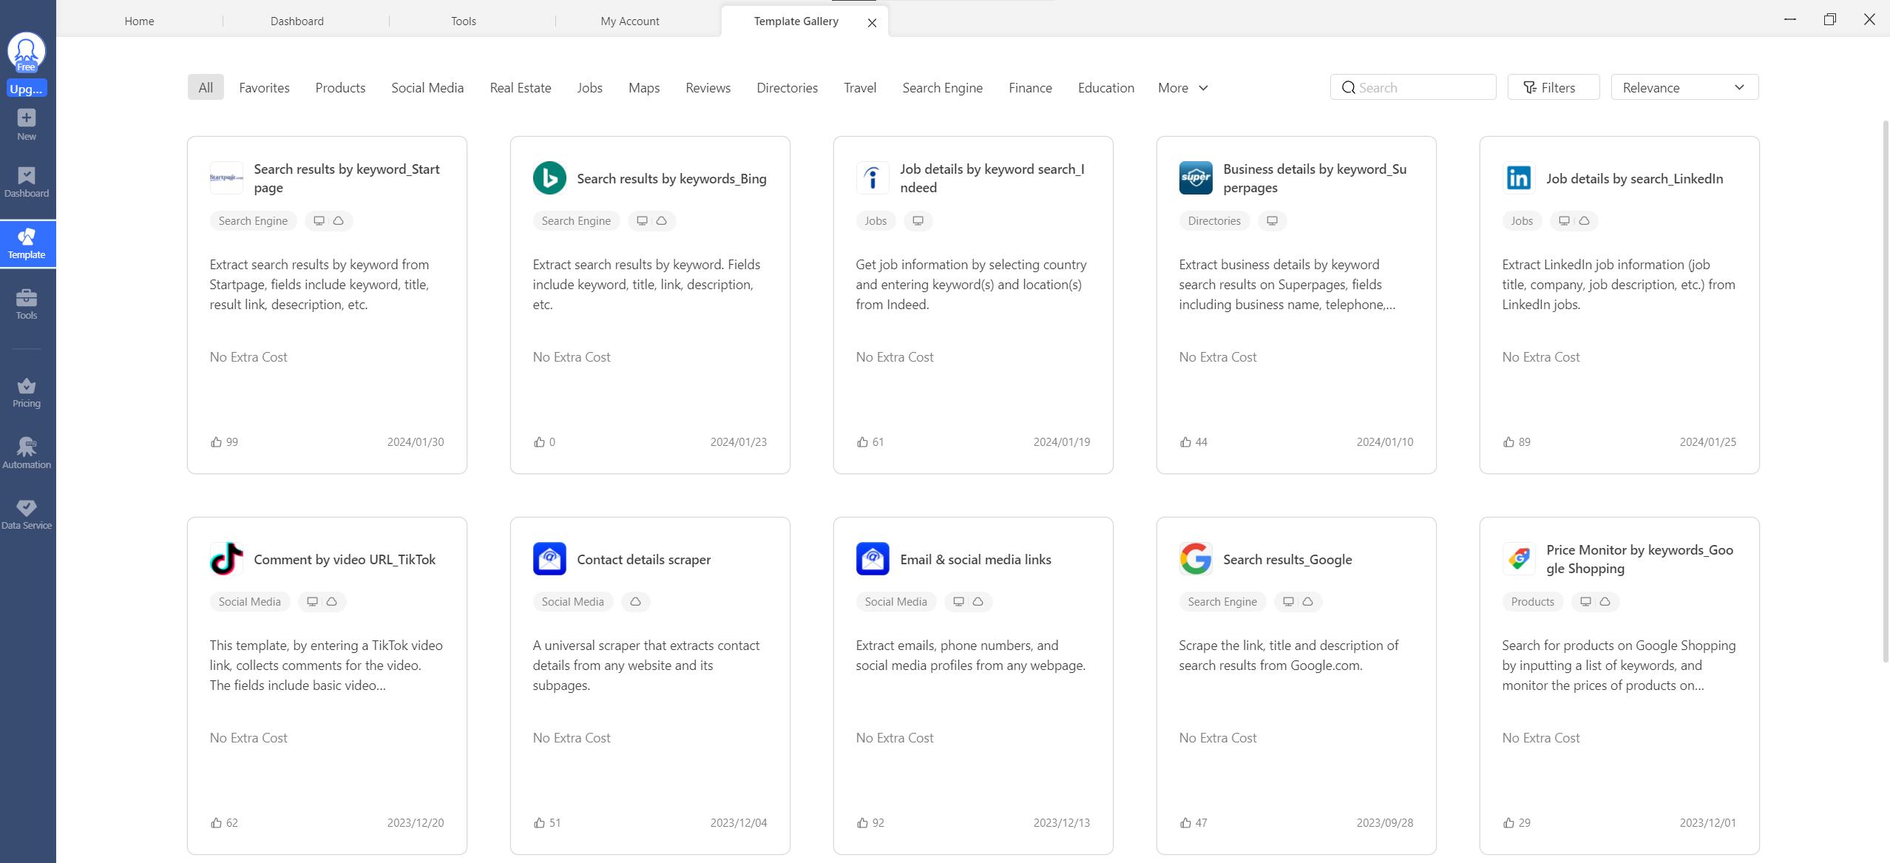
Commercial Scraping tools: Octoparse

Slide 10
Python tools
Scrapy: An open-source and collaborative framework for extracting the data you need from websites. It's a complete framework for web scraping projects, from data extraction to storage.
Selenium: A tool that allows you to automate web browsers. It's useful when you need to scrape data from websites that rely heavily on JavaScript to render content.
MechanicalSoup: A library that automates interacting with websites. It combines the Requests library and BeautifulSoup to simulate a browser, but without the overhead of actual browser automation tools like Selenium.

