Slide 1
Tutorial 12 Simulation of the Minority Game Solution

Slide 2


Representation of the Strategies
What is the number of input states of strategies with $m= 3$?
Each strategy is a function of $2^{m}=8$ input states. These input states, from 000 to 111, represent the history of the winning states in the past 3 steps.
The decisions of a strategy in response to these 8 input states (integers in the range 0 to 7) can be determined by converting the strategy number to its 8-digit binary representation. The response to input state $μ$ ($μ=0,⋯,7)$ is then the $μ^{th}$ digit of the binary representation (counting from the right).
$$2^{m}$$

Slide 3

Example of Strategy 173
Hence a strategy is represented by a list of $2^{m}$elements of 1’s and 0’s. For example, [1, 0, 1, 0, 1, 1, 0, 1] represents the strategy of:
When the market history of winners is 000, buy.
When the market history of winners is 001, sell.
When the market history of winners is 010, buy.
When the market history of winners is 011, sell.
When the market history of winners is 100, buy.
When the market history of winners is 101, buy.
When the market history of winners is 110, sell.
When the market history of winners is 111, buy.
This strategy is labeled to be 173, because
173 = 10101101₂.

Slide 4

From Strategy Outputs to Strategy Label
The conversion from 10101101₂ to 173 can be done by:
$${10101101}_{2}=1×2^{0}+0×2^{1}+1×2^{2}+1×2^{3}$$
$$+0×2^{4}+1×2^{5}+0×2^{6}+1×2^{7}$$
$$=1+0+4+8+0+32+0+128=173.$$

Slide 5

From Strategy Label to Strategy Outputs
In Python, the remainder of integer division can be obtained by the modulus operator. For example, the results in Slide 4 can be written as
$$173\%2=1, 86\%2=0, 43\%2=1, ⋯$$
In Python, the floor division of integers can be obtained by the operator “//”. For example, the results in Slide 4 can be written as
173//2 = 86, 86//2 = 43, 43//2 = 21, …

Slide 6
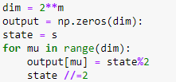
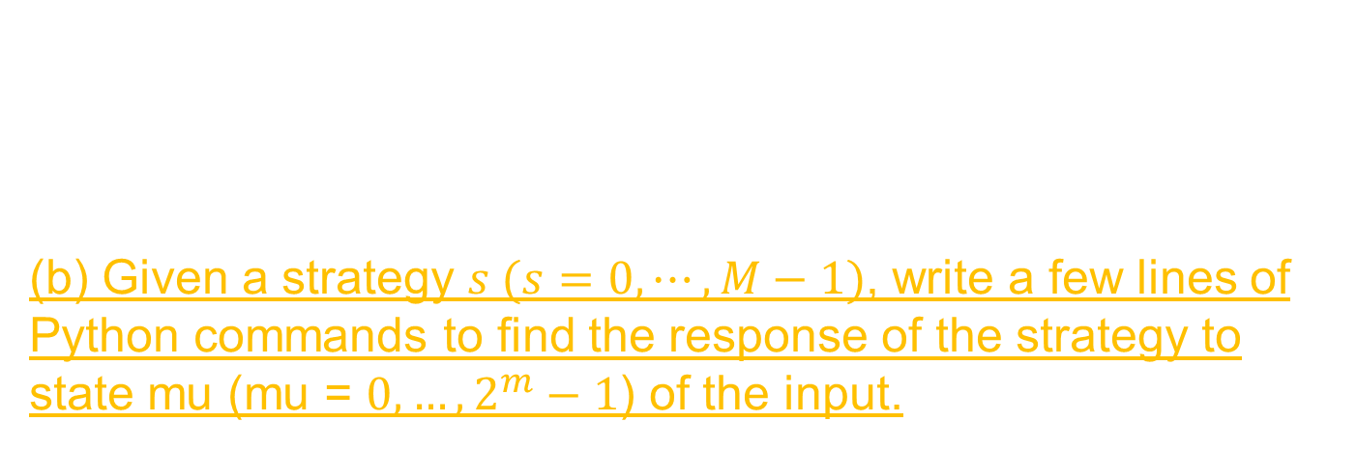
Strategy Conversion in Python
Since 173 = 10101101₂, the response of strategy 173 to
states 0, 1, 2, 3, 4, 5, 6, 7 are 1, 0, 1, 1, 0, 1, 0, 1 respectively.
(b) Given a strategy $s (s=0,⋯,M−1)$, write a few lines of Python commands to find the response of the strategy to state mu (mu = $0, …, 2^{m}−1$) of the input.

Slide 7
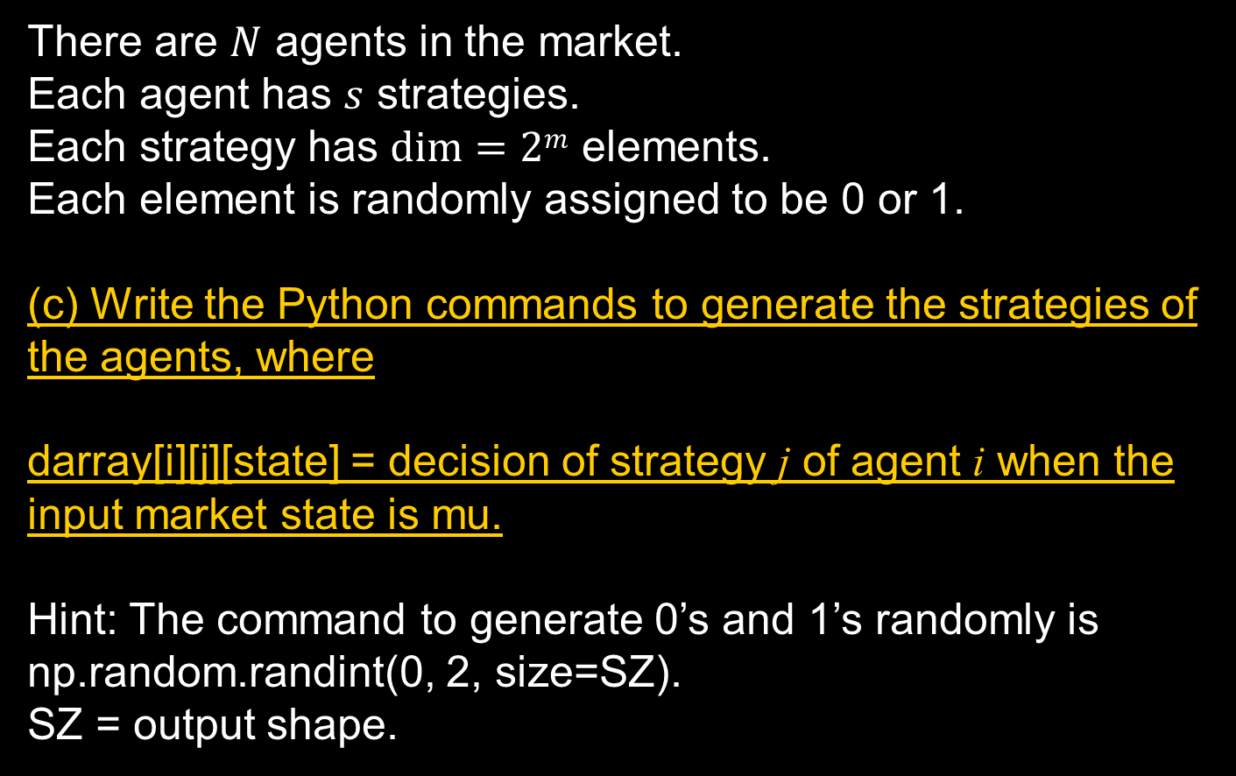
Generation of the Strategies (1)
There are $N$ agents in the market.
Each agent has $s$ strategies.
Each strategy has $dim⁡=2m$ elements.
Each element is randomly assigned to be 0 or 1.
(c) Write the Python commands to generate the strategies of the agents, where
darray[i][j][state] = decision of strategy j of agent i when the input market state is mu.
Hint: The command to generate 0’s and 1’s randomly is np.random.randint(0, 2, size=SZ).
SZ = output shape.

Slide 8

Representation of the Historical State
After the winning side (1 = buyers win, 0 = sellers win) has been determined, the input state has to be changed to give the updated history for the next step.
For example, if the present input state is 5, and the winning side is 1, then the input state has to be updated to 3, because
$$5={101}_{2}.$$
After deleting the leftmost digit and adding the rightmost digit according to the winning side, we have
$${011}_{2}=3.$$

Slide 9
Updating of the Endogenous Historical State
(d) In an endogenous minority game, write a line in Python to update the historical state mu after the winning side is determined to be w.
Hint:
Shifting a base-10 number by one leftward position is equivalent to multiplying it by 10.
Similarly, shifting a binary number by one leftward position is equivalent to multiplying it by 2.
The Python operator % is useful. % is the modulus operator. For example, 13%8 = 5 because 5 is the remainder of 13 divided by 8.

Slide 10
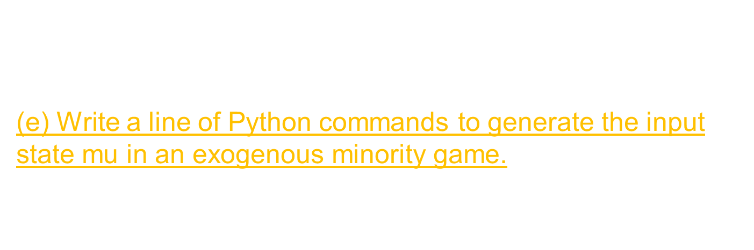
Updating of the Exogenous Historical State
The input state in an exogenous minority game is even simpler. It is randomly generated as one of the $2^{m}$ states.
(e) Write a line of Python commands to generate the input state mu in an exogenous minority game.
Hint: Use ‘randint’.

Slide 11

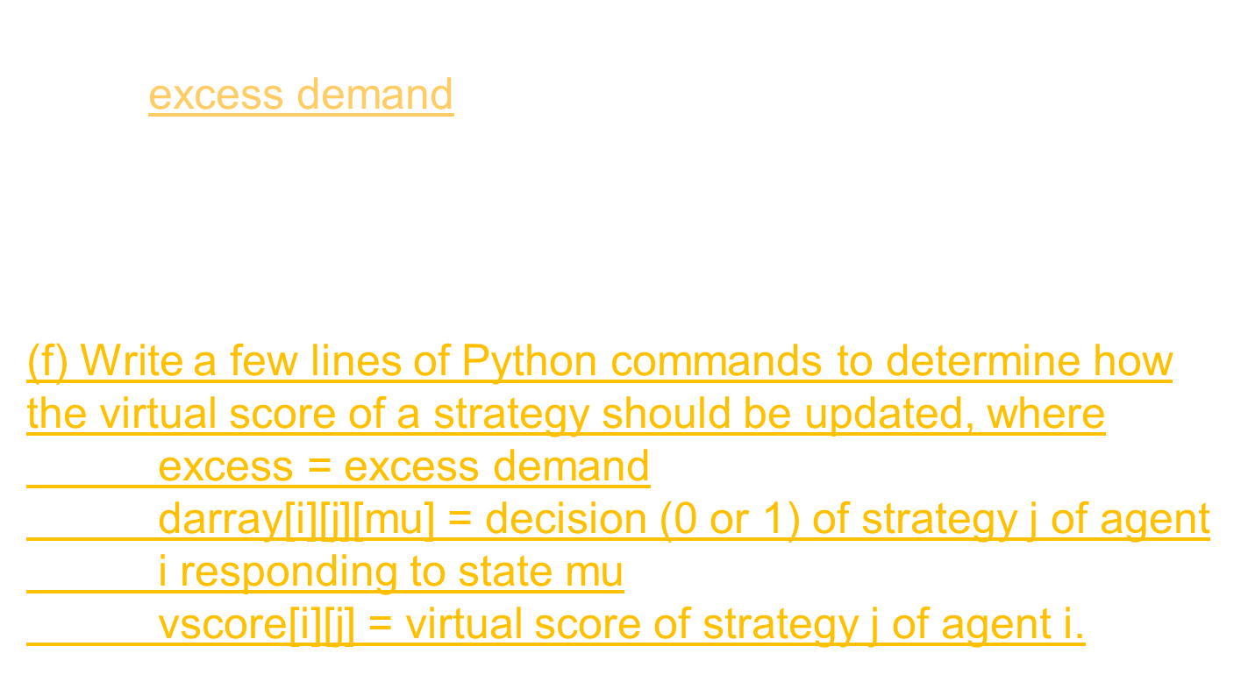
Updating of the Virtual Scores
In this simulation, we will use linear scores. It is proportional to the excess demand, defined as
$$excess demand=\frac{number of buyers−number of sellers}{total number of agents}$$
(f) Write a few lines of Python commands to determine how the virtual score of a strategy should be updated, where
excess = excess demand
darray[i][j][mu] = decision (0 or 1) of strategy j of agent i responding to state mu
vscore[i][j] = virtual score of strategy j of agent i.

Slide 12
Decision of an Agent
Given vscore[i][j] = virtual score of strategy j of agent i, it is tempting to use the Python command ‘argmax’ to determine the strategy choice of the agent.
When there are more than one strategies having the same maximum value, ‘argmax’ chooses the one that appears first.
Since the game starts with all virtual scores initialized to 0, using ‘argmax’ will freeze the choices of the agents too early!
(g) Write a few lines of Python commands to determine the strategy choice of an agent, where
jchoice = strategy choice of agent i
When two strategies have the same maximum virtual score, select one of them randomly.

Slide 13
Decision of an Agent
Hint:
This is left to you to work out, but the hints below are given:
As a first step, you may assign the first strategy to be the one with maximum virtual score.
Starting from the second strategy, you compare its virtual score with the maximum virtual score:
If the virtual score exceeds the maximum virtual score:
update the maximum virtual score
If the virtual score equals the maximum virtual score:
add the strategy to the set of candidates
Use the command random.choice() to randomly adopt the strategy .

Slide 14

Updating of the Real Scores
(h) Write the lines of Python commands to determine (i) the decision of agent i given the strategy choice jchoice, and (ii) how the real score of agent i should be updated, where
excess = excess demand
darray[i][j][mu] = decision (0 or 1) of strategy j of agent i responding to state mu
jchoice = strategy choice of agent i
decision[i] = decision of agent i
rscore[i] = real score of agent i

