Slide 1
MSDM 5003 Lecture 8 26 October 2023 Financial Derivatives and Black-Scholes Equation
Outline:
1. Futures
2. Options
3. Arbitrage pricing model
4. Binomial pricing model
5. Black-Scholes-Merton model
Acknowledgement: Materials adapted from Tutorial notes prepared by Ivan Yip and Tony Shing

Slide 2
1. Futures(期貨)
In a futures contract, both the buyer and seller of the contract make an agreement about the transaction of an asset at a certain price.
On the expiry day of the contract, they are obliged to exercise the trade of asset.

Slide 3
1.1 Position
The roles in a futures contract is:
Long position = The trader who is obliged to buy the asset
Short position = The trader who is obliged to sell the asset

Slide 4
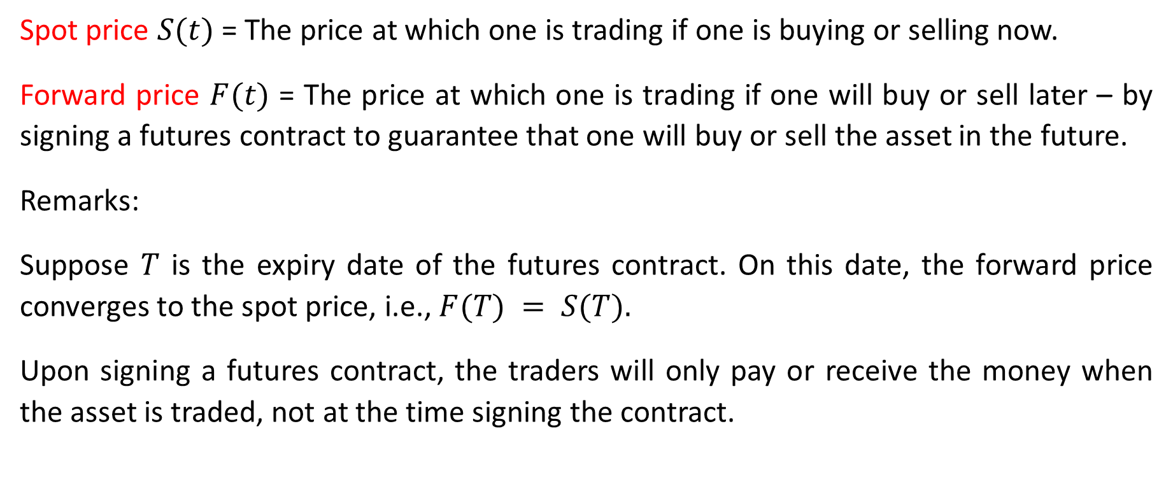
1.2 Prices
Spot price $S(t)$ = The price at which one is trading if one is buying or selling now.
Forward price $F(t)$ = The price at which one is trading if one will buy or sell later – by signing a futures contract to guarantee that one will buy or sell the asset in the future.
Remarks:
Suppose $T$ is the expiry date of the futures contract. On this date, the forward price converges to the spot price, i.e., $F(T) = S(T).$
Upon signing a futures contract, the traders will only pay or receive the money when the asset is traded, not at the time signing the contract.

Slide 5
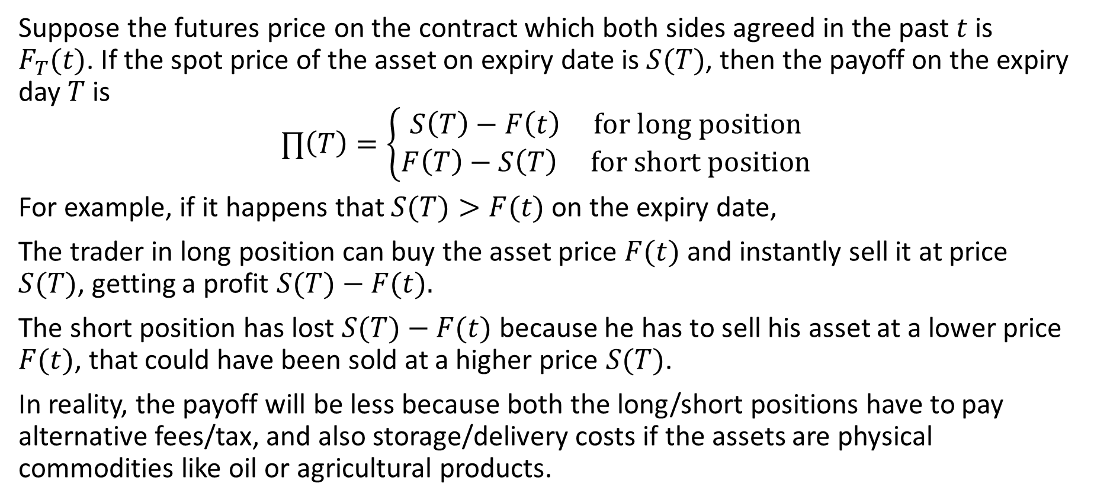
1.3 Payoff
Suppose the futures price on the contract which both sides agreed in the past $t$ is $F_{T}(t)$. If the spot price of the asset on expiry date is $S(T)$, then the payoff on the expiry day $T$ is
$$∏\left(T\right)=\left\{\begin{matrix}S\left(T\right)−F\left(t\right) for long position \\ F\left(T\right)−S\left(T\right) for short position\end{matrix}\right.$$
For example, if it happens that $S(T)>F(t)$on the expiry date,
The trader in long position can buy the asset price $F(t)$ and instantly sell it at price $S(T)$, getting a profit $S(T)−F(t).$
The short position has lost $S(T)−F(t)$because he has to sell his asset at a lower price $F(t)$, that could have been sold at a higher price $S(T)$.
In reality, the payoff will be less because both the long/short positions have to pay alternative fees/tax, and also storage/delivery costs if the assets are physical commodities like oil or agricultural products.

Slide 6
2. Options (期權)
Different from futures, an option contract gives the buyer of the option the right to trade the asset at the agreed price on/before the expiry date.

Slide 7
2.1 Position
The positions in an option contract is defined differently from futures contracts. Instead of telling who is buying/selling the asset, it tells who is buying/selling the right to trade.
Long position = Option holder = The trader who buys the contract, and thus buys the right to exercise the contract.
Short position = Option writer = The trader who sells the contract, and thus sells the right to the holder. He needs to follow the decision of the holder.

Slide 8
2.2 Types of Options
There are two types of options:
Call option (看漲期權) = Give the holder the right to buy asset.
Put option (看跌期權) = Give the holder the right to sell asset.
Together it makes 4 kinds of options traders:
Long call = Buyer of call
Short call = Seller of Call
Long put = Buyer of put
Short put = Seller of put

Slide 9
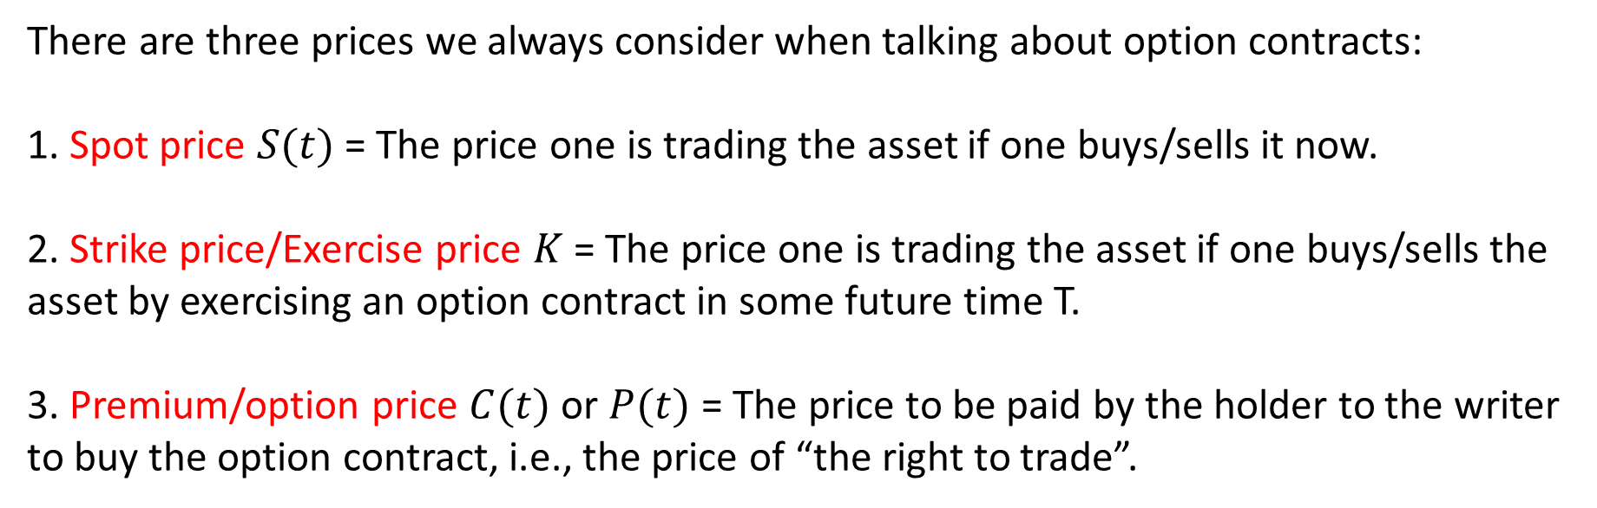
2.3 Prices
There are three prices we always consider when talking about option contracts:
1. Spot price $S(t)$ = The price one is trading the asset if one buys/sells it now.
2. Strike price/Exercise price $K$ = The price one is trading the asset if one buys/sells the asset by exercising an option contract in some future time T.
3. Premium/option price $C(t)$ or $P(t)$ = The price to be paid by the holder to the writer to buy the option contract, i.e., the price of “the right to trade”.

Slide 10
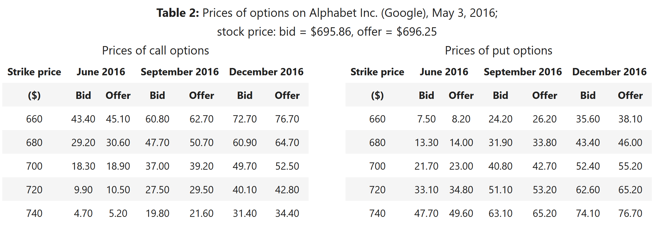
Example: A quotation of options
Here is an example of a quotation of call and put options from the Chicago Board Options Exchange (CBOE), copied from John Hull’s textbook (10th ed. P.9).

Slide 11
Example: Observations
The table shows several properties of options:
Price of a call ↓ as the strike price ↑ - Buying at a lower price is always preferable.
Price of a put ↑ as strike price ↑ - Selling at a higher price is always preferable.
Both types of option’s price ↑ as their time to expiry ↑ - Longer life, higher probability to reach the strike price.

Slide 12
2.4 Vanilla Options
The two fundamental styles are European and American options, which are collectively called the vanilla options.
European = can be exercised only on its expiry date.
American = can be exercised at any time before its expiry date.

Slide 13
Exotic Options
Options that are not European or American may be referred to as exotic options although they may still be classified as "European-like" or "American-like" according to their possible exercise dates. They derive their payoffs very differently. Here we consider calls only.
Binary = The first kind is cash-or-nothing, with which the holder earns a fixed amount of money if S(t)>K. The second kind is asset-or-nothing, with which the holder earns the asset's value if S(t)>K
Asian = The holder earns max[A(t,T)−K,0], where A(t,T) is the asset's average price from time t to the exercise date T. It may be called a Russian option if tis the option's beginning time.
Lookback = The holder earns max[M(t,T)−K,0], where M(t,T) is the asset's maximum or minimum price from time t to the exercise date T.
An Asian option and a lookback option are therefore path-dependent; they cannot be priced without the history of S. In addition to redefining payoffs, some exotic options impose rules to alter how they are exercised.
Barrier = The holder can exercise the option only if the asset's price has touched (or never touched) a barrier price before expiry.
Israeli, a.k.a. a game option = The writer can exercise the option for the holder in advance. Because the holder has lost his freedom, the writer has to pay him an extra compensation.

Slide 14
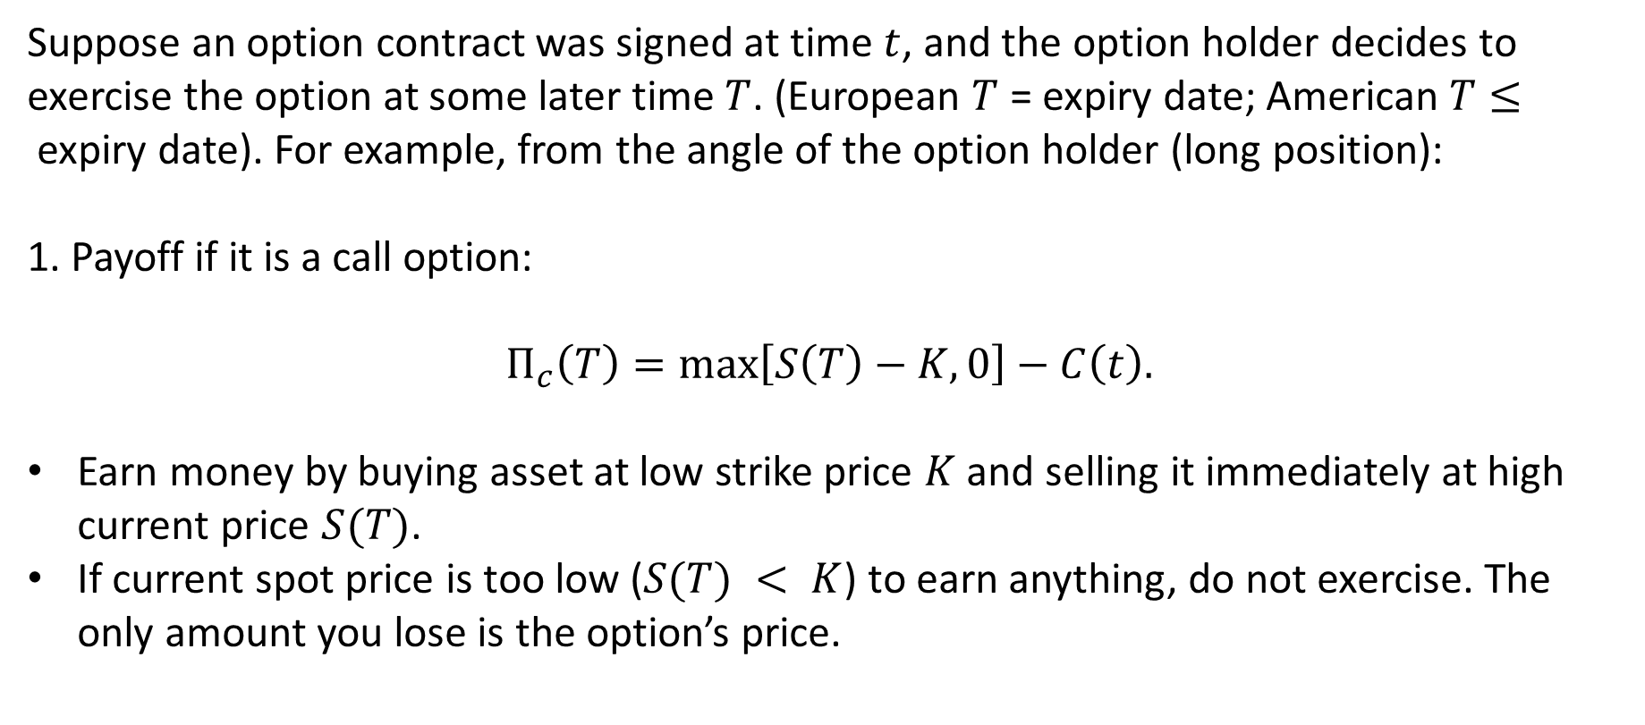
2.5 Payoff of Vanilla Options
Suppose an option contract was signed at time $t$, and the option holder decides to exercise the option at some later time $T$. (European $T$ = expiry date; American $T≤$expiry date). For example, from the angle of the option holder (long position):
1. Payoff if it is a call option:
$$Π_{c}\left(T\right)=\max\left[S\left(T\right)−K,0\right]−C\left(t\right).$$
Earn money by buying asset at low strike price $K$ and selling it immediately at high current price $S(T)$.
If current spot price is too low ($S(T) < K$) to earn anything, do not exercise. The only amount you lose is the option’s price.

Slide 15
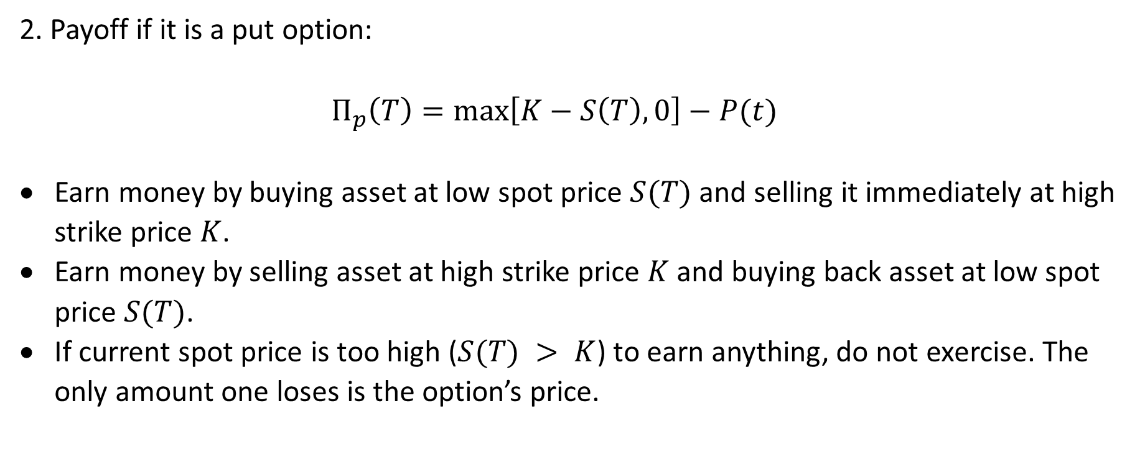
2.5 Payoff of Vanilla Options (cont’d)
2. Payoff if it is a put option:
$$Π_{p}\left(T\right)=\max\left[K−S\left(T\right),0\right]−P(t)$$
Earn money by buying asset at low spot price $S(T)$ and selling it immediately at high strike price $K$.
Earn money by selling asset at high strike price $K$ and buying back asset at low spot price $S(T)$.
If current spot price is too high ($S(T) > K$) to earn anything, do not exercise. The only amount one loses is the option’s price.

Slide 16
3. Arbitrage pricing model
3.1 The principle of no-arbitrage
The word “arbitrage” means “earning more without taking more risks”. It is basically investing nothing but being able to get a positive return without undergoing any risk at all, like getting a free meal without having to pay for it – which is avoided in pricing.
Therefore, the fundamental assumption of finance is the is the absence of long-term arbitrage – the payoff of any portfolio of the same level of risk should always be the same, or else there is arbitrage opportunity. Note that short-term arbitrage is possible since in reality the market is not completely efficient.

Slide 17
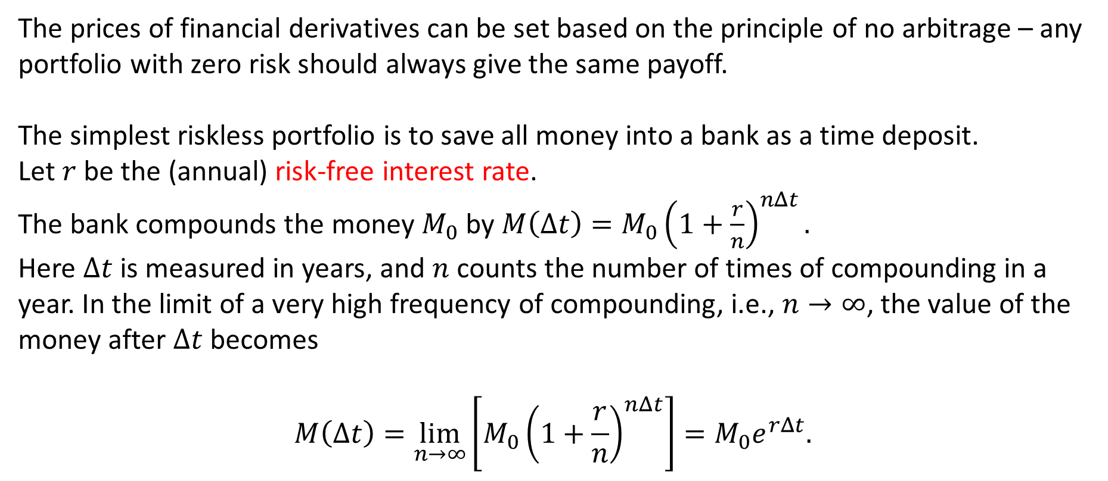
Risk-Free Interest Rate
The prices of financial derivatives can be set based on the principle of no arbitrage – any portfolio with zero risk should always give the same payoff.
The simplest riskless portfolio is to save all money into a bank as a time deposit.
Let $r$ be the (annual) risk-free interest rate.
The bank compounds the money $M_{0}$ by $M\left(Δt\right)=M_{0}{\left(1+\frac{r}{n}\right)}^{nΔt}.$
Here $Δt$is measured in years, and $n$ counts the number of times of compounding in a year. In the limit of a very high frequency of compounding, i.e., $n→∞$, the value of the money after $Δt$becomes
$$M\left(Δt\right)=\lim_{n→∞}\left[M_{0}{\left(1+\frac{r}{n}\right)}^{nΔt}\right]=M_{0}e^{rΔt}.$$

Slide 18
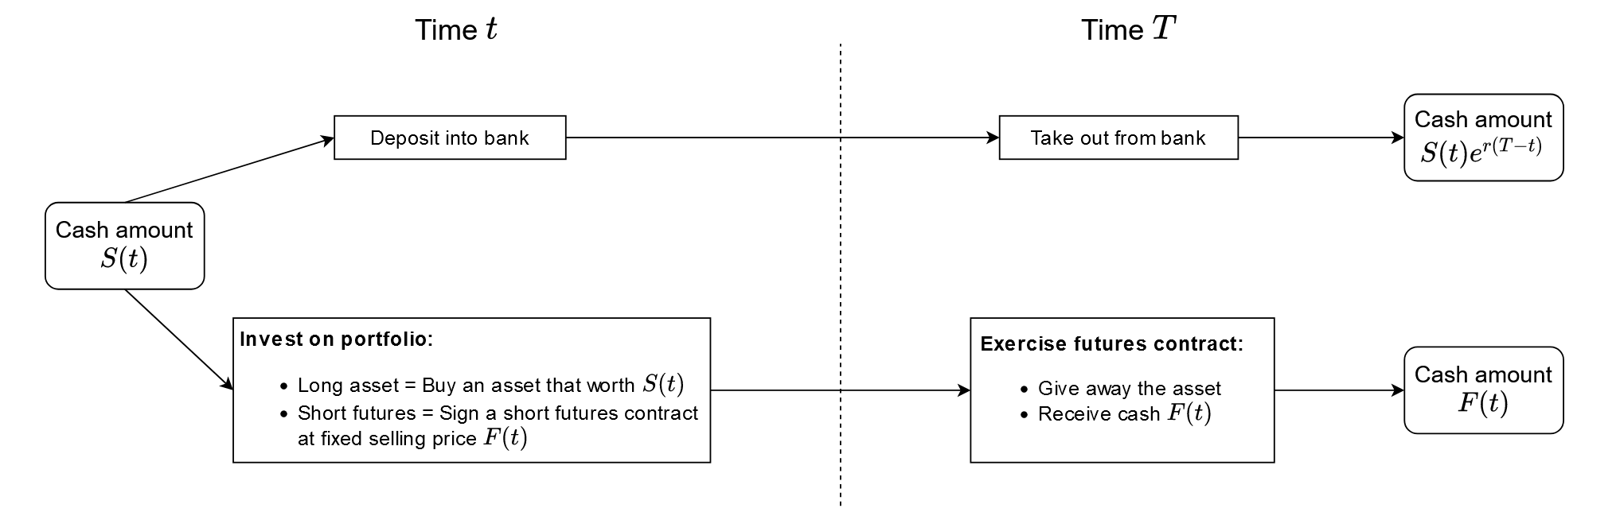
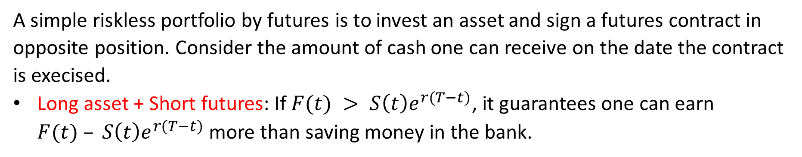
3.2 Forward price in futures
A simple riskless portfolio by futures is to invest an asset and sign a futures contract in opposite position. Consider the amount of cash one can receive on the date the contract is execised.
Long asset + Short futures: If $F(t) > S\left(t\right)e^{r(T−t)}$, it guarantees one can earn $F(t) – S\left(t\right)e^{r(T−t)}$more than saving money in the bank.

Slide 19
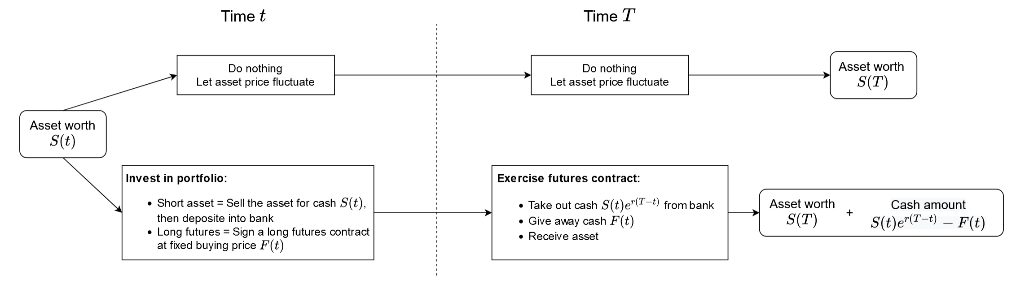
Similarly, …
Short asset + Long futures: If $F(t) < S\left(t\right)e^{r(T−t)}$, it guarantees one can earn $S\left(t\right)e^{r(T−t)}− F(t)$ more than saving money in the bank.

Slide 20
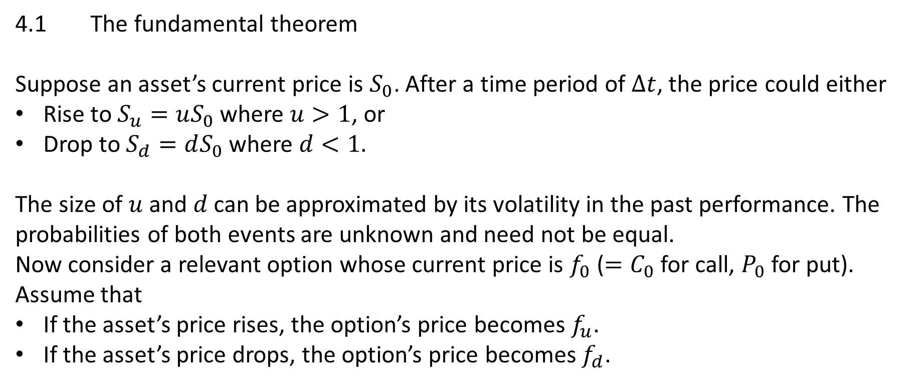
4. Binomial pricing model
4.1 The fundamental theorem
Suppose an asset’s current price is $S_{0}$. After a time period of $Δt$, the price could either
Rise to $S_{u}=uS_{0}$ where $u>1$, or
Drop to $S_{d}=dS_{0}$where $d<1.$
The size of $u$ and $d$ can be approximated by its volatility in the past performance. The probabilities of both events are unknown and need not be equal.
Now consider a relevant option whose current price is $f_{0}$ ($=C_{0}$ for call, $P_{0}$ for put). Assume that
If the asset’s price rises, the option’s price becomes $f_{u}$.
If the asset’s price drops, the option’s price becomes $f_{d}$.

Slide 21
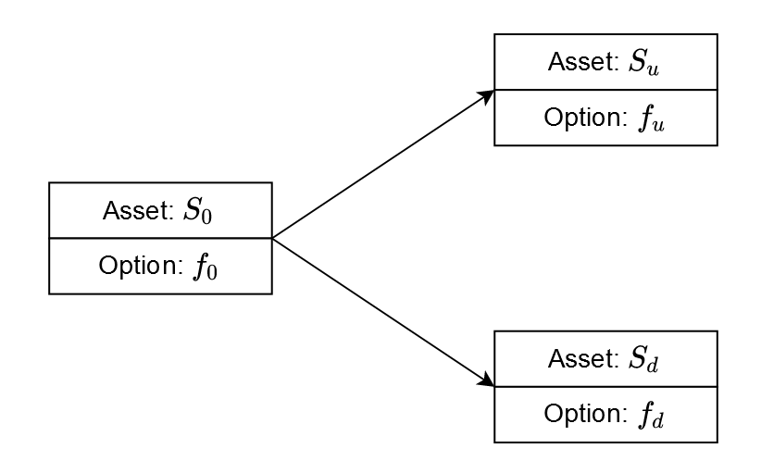
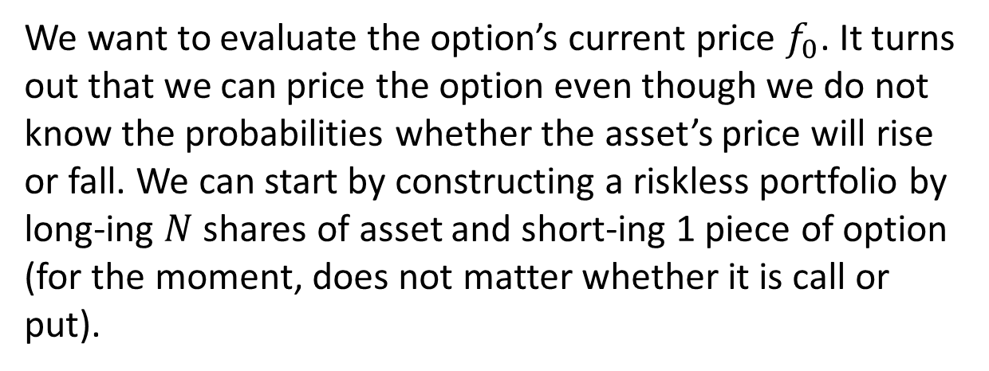
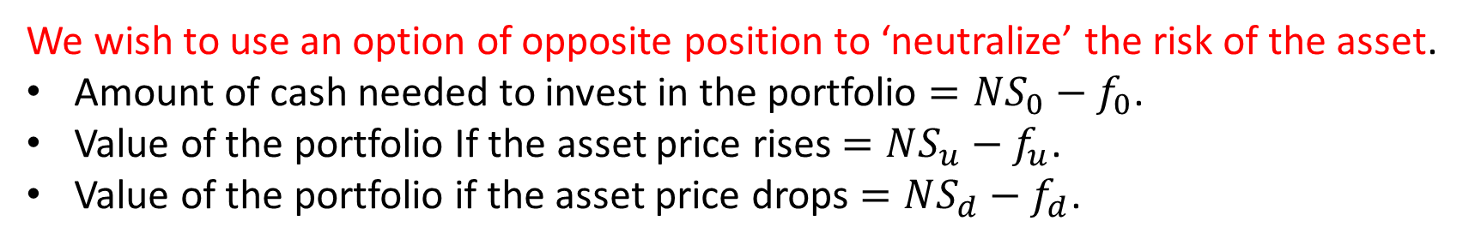
A Riskless Portfolio
We want to evaluate the option’s current price $f_{0}$. It turns out that we can price the option even though we do not know the probabilities whether the asset’s price will rise or fall. We can start by constructing a riskless portfolio by long-ing $N$ shares of asset and short-ing 1 piece of option (for the moment, does not matter whether it is call or put).
We wish to use an option of opposite position to ‘neutralize’ the risk of the asset.
Amount of cash needed to invest in the portfolio $=NS_{0}−f_{0}$.
Value of the portfolio If the asset price rises $=NS_{u}−f_{u}$.
Value of the portfolio if the asset price drops $=NS_{d}−f_{d}$.

Slide 22
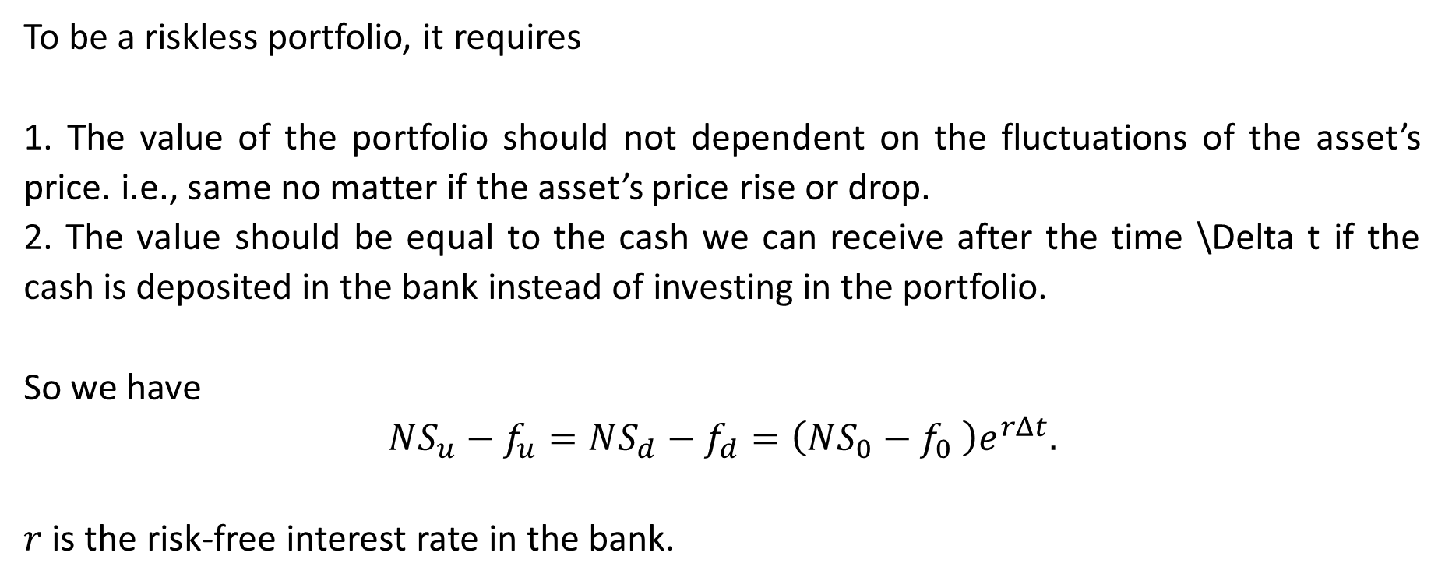
Requirements for No Risk
To be a riskless portfolio, it requires
1. The value of the portfolio should not dependent on the fluctuations of the asset’s price. i.e., same no matter if the asset’s price rise or drop.
2. The value should be equal to the cash we can receive after the time \Delta t if the cash is deposited in the bank instead of investing in the portfolio.
So we have
$$NS_{u}−f_{u}=NS_{d}−f_{d}=\left(NS_{0}−f_{0} \right)e^{rΔt}.$$
$r$ is the risk-free interest rate in the bank.

Slide 23
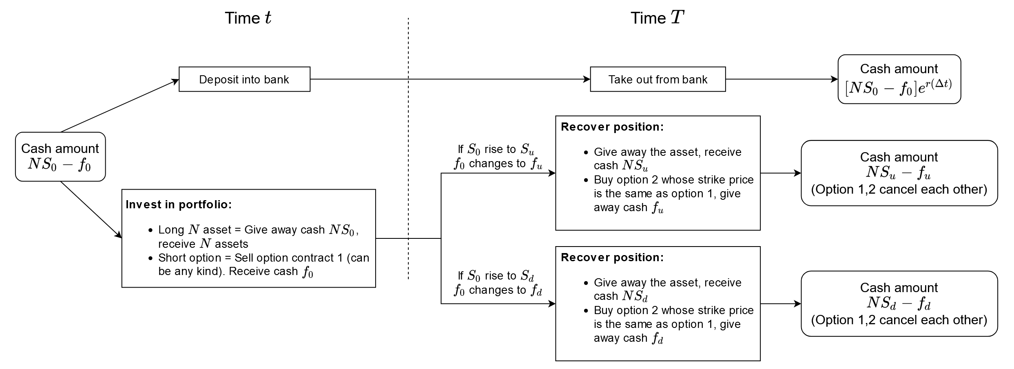
The Three Cases

Slide 24

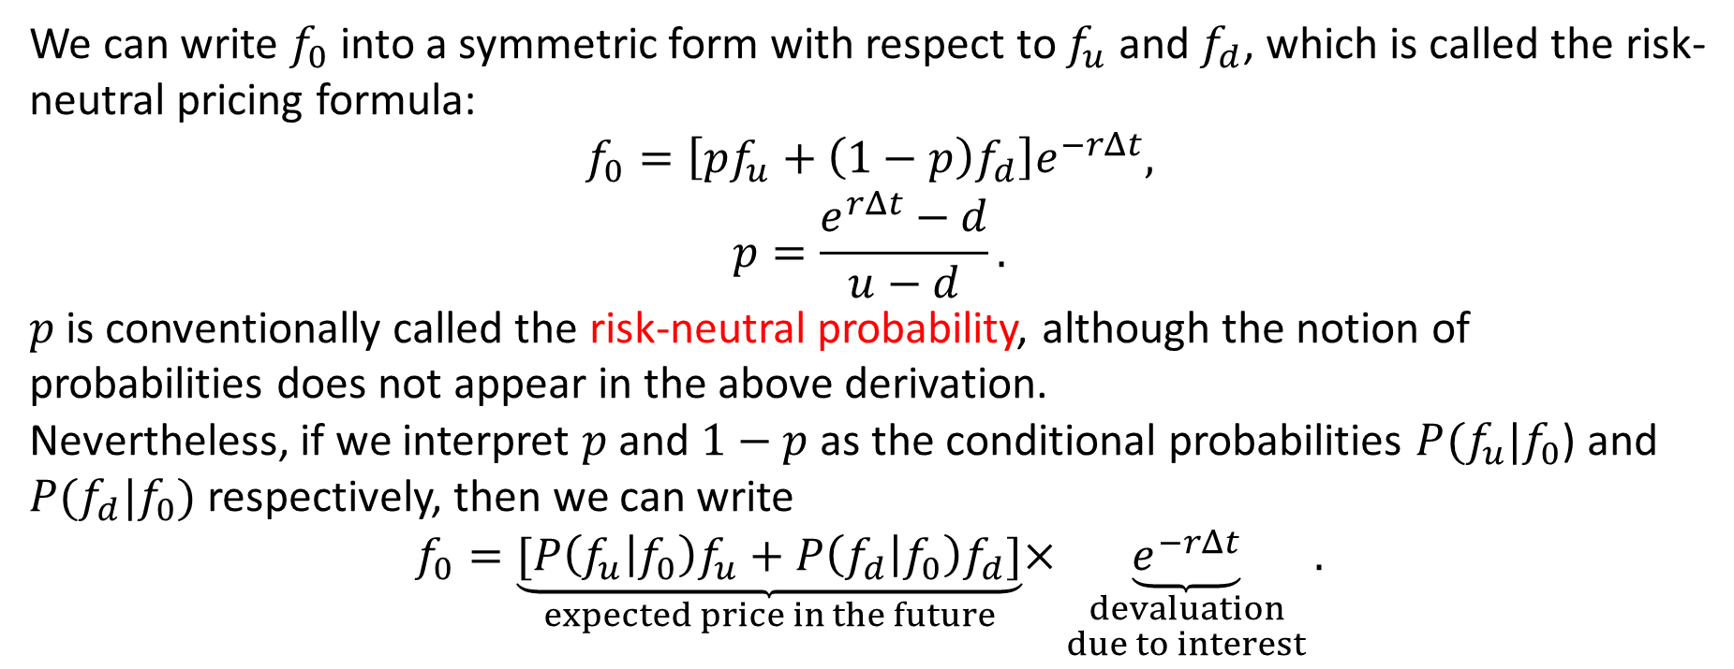

Risk-Neutal Pricing Formula
We can write $f_{0}$ into a symmetric form with respect to $f_{u}$ and $f_{d}$, which is called the risk-neutral pricing formula:
$$f_{0}=\left[pf_{u}+\left(1−p\right)f_{d}\right]e^{−rΔt},$$
$$p=\frac{e^{rΔt}−d}{u−d}.$$
$p$ is conventionally called the risk-neutral probability, although the notion of probabilities does not appear in the above derivation.
Nevertheless, if we interpret $p$ and $1−p$ as the conditional probabilities $P(f_{u}|f_{0}$) and $P(f_{d}|f_{0})$respectively, then we can write
$$f_{0}=\underset{expected price in the future}{\underbrace{[P\left(f_{u} | f_{0}\right)f_{u}+P\left(f_{d} | f_{0}\right)f_{d}]}}×\underset{\begin{aligned}devaluation \\ due to interest\end{aligned}}{\underbrace{e^{−rΔt}}}.$$
d
1
e^{rΔt}
u
$$P\left(f_{d} | f_{0}\right)$$
$$P\left(f_{u} | f_{0}\right)$$

Slide 25
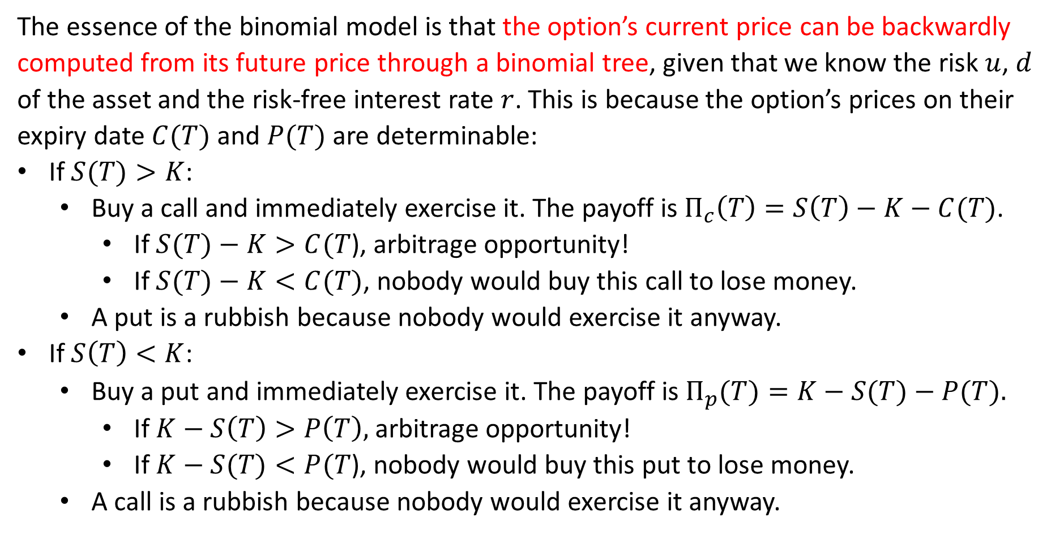
Backward Computation
The essence of the binomial model is that the option’s current price can be backwardly computed from its future price through a binomial tree, given that we know the risk $u$, $d$ of the asset and the risk-free interest rate $r$. This is because the option’s prices on their expiry date $C(T)$ and $P(T)$ are determinable:
If $S(T)>K$:
Buy a call and immediately exercise it. The payoff is $Π_{c}\left(T\right)=S\left(T\right)−K−C(T)$.
If $S(T)−K>C(T$), arbitrage opportunity!
If $S(T)−K<C(T)$, nobody would buy this call to lose money.
A put is a rubbish because nobody would exercise it anyway.
If $S\left(T\right)<K$:
Buy a put and immediately exercise it. The payoff is $Π_{p}(T)=K−S(T)−P(T).$
If $K−S\left(T\right)>P\left(T\right),$arbitrage opportunity!
If $K−S(T)<P(T$), nobody would buy this put to lose money.
A call is a rubbish because nobody would exercise it anyway.

Slide 26
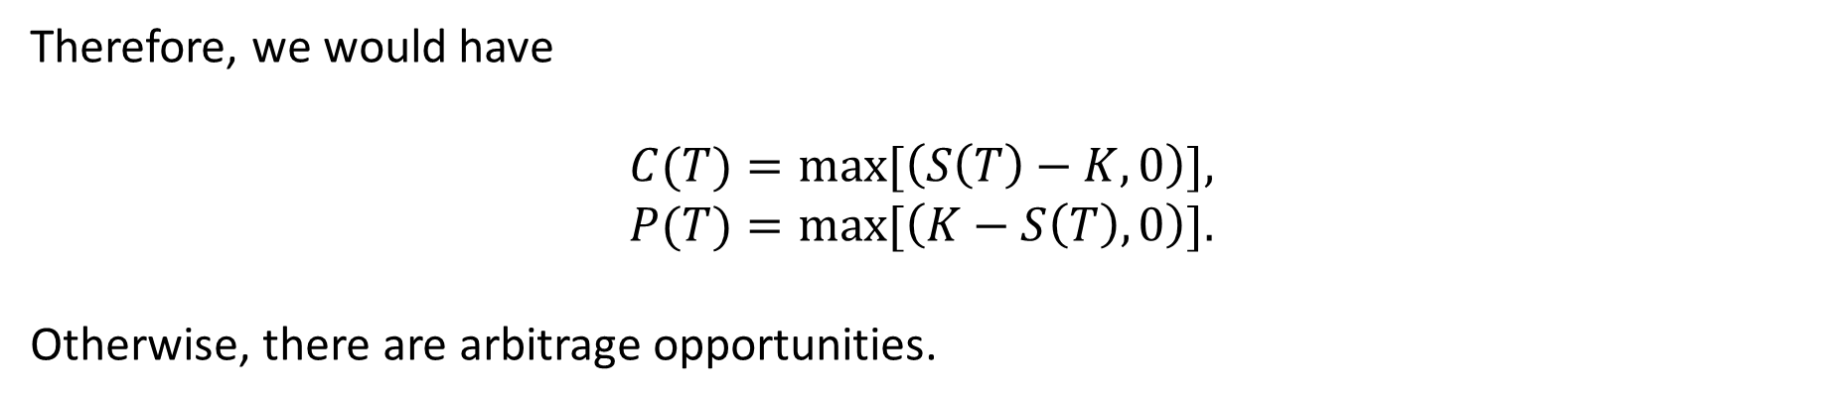
Values of Call and Put
Therefore, we would have
$$C(T)=max⁡[\left(S\left(T\right)−K,0\right)],$$
$$P(T)=max⁡[\left(K−S\left(T\right),0\right)].$$
Otherwise, there are arbitrage opportunities.

Slide 27
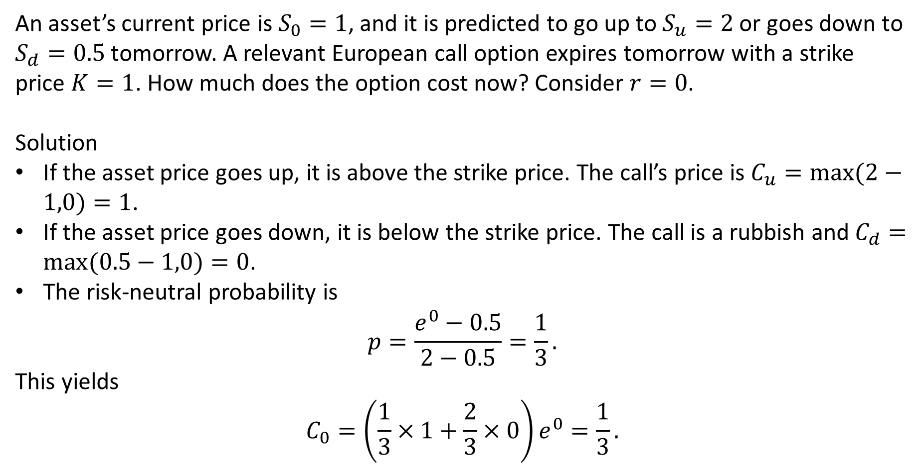
Example 1: A One-Step European Call
An asset’s current price is $S_{0}=1$, and it is predicted to go up to $S_{u}=2$ or goes down to $S_{d}=0.5$tomorrow. A relevant European call option expires tomorrow with a strike price $K=1$. How much does the option cost now? Consider $r=0$.
Solution
If the asset price goes up, it is above the strike price. The call’s price is $C_{u}=max⁡(2−1,0)=1$.
If the asset price goes down, it is below the strike price. The call is a rubbish and $C_{d}=max⁡(0.5−1,0)=0$.
The risk-neutral probability is
$$p=\frac{e^{0}−0.5}{2−0.5}=\frac{1}{3}.$$
This yields
$$C_{0}=\left(\frac{1}{3}×1+\frac{2}{3}×0\right)e^{0}=\frac{1}{3}.$$

Slide 28
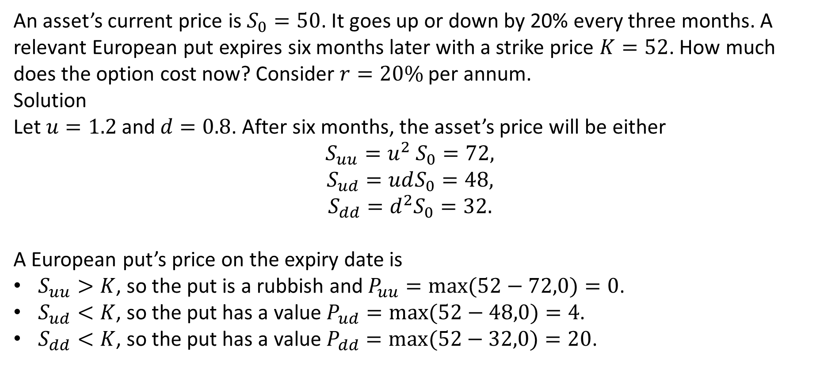
Example 2: A Two-Step European Put
An asset’s current price is $S_{0}=50$. It goes up or down by 20% every three months. A relevant European put expires six months later with a strike price $K=52$. How much does the option cost now? Consider $r=20\%$per annum.
Solution
Let $u=1.2$and $d=0.8$. After six months, the asset’s price will be either
$$S_{uu}=u^{2} S_{0}=72,$$
$$S_{ud}=udS_{0}=48,$$
$$S_{dd}=d^{2}S_{0}=32.$$
A European put’s price on the expiry date is
$S_{uu}>K$, so the put is a rubbish and $P_{uu}=max⁡(52−72,0)=0$.
$S_{ud}<K$, so the put has a value $P_{ud}=max⁡(52−48,0)=4$.
$S_{dd}<K$, so the put has a value $P_{dd}=max⁡(52−32,0)=20$.

Slide 29
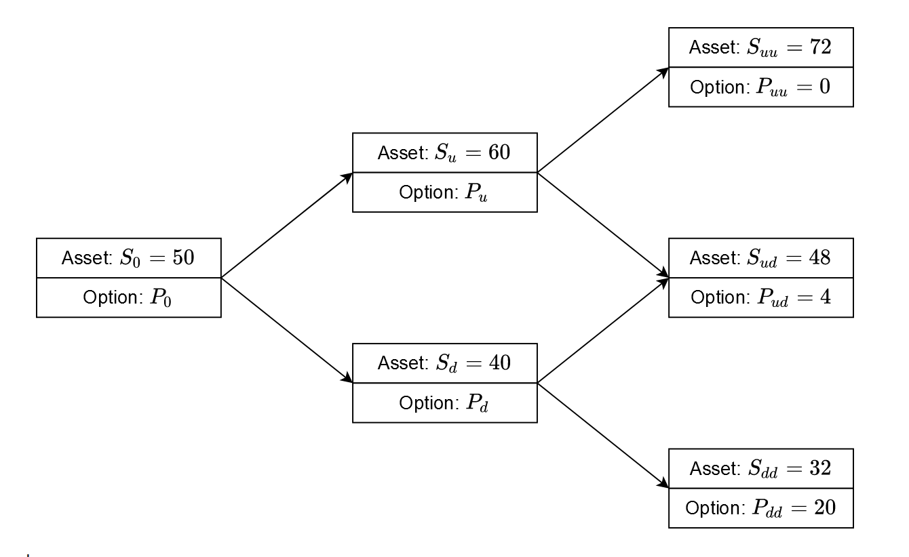
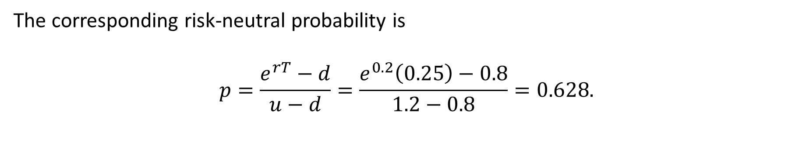
The corresponding risk-neutral probability is
$$p=\frac{e^{rT}−d}{u−d}=\frac{e^{0.2}\left(0.25\right)−0.8}{1.2−0.8}=0.628.$$

Slide 30
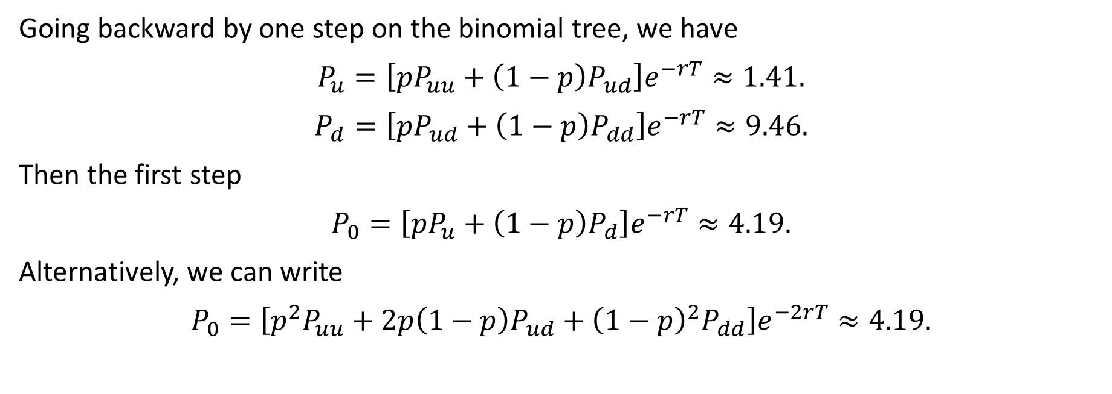
Going backward by one step on the binomial tree, we have
$$P_{u}=\left[pP_{uu}+\left(1−p\right)P_{ud}\right]e^{−rT}≈1.41.$$
$$P_{d}=\left[pP_{ud}+\left(1−p\right)P_{dd}\right]e^{−rT}≈9.46.$$
Then the first step
$$P_{0}=\left[pP_{u}+\left(1−p\right)P_{d}\right]e^{−rT}≈4.19.$$
Alternatively, we can write
$$P_{0}=\left[p^{2}P_{uu}+2p\left(1−p\right)P_{ud}+{\left(1−p\right)}^{2}P_{dd}\right]e^{−2rT}≈4.19.$$

Slide 31
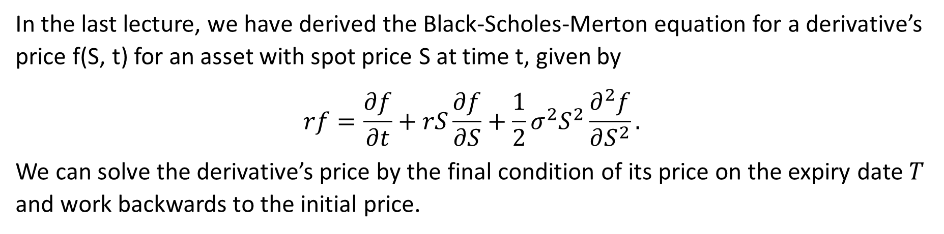
5. Black-Scholes-Merton Model
In the last lecture, we have derived the Black-Scholes-Merton equation for a derivative’s price f(S, t) for an asset with spot price S at time t, given by
$$rf=\frac{∂f}{∂t}+rS\frac{∂f}{∂S}+\frac{1}{2}σ^{2}S^{2}\frac{∂^{2}f}{∂S^{2}}.$$
We can solve the derivative’s price by the final condition of its price on the expiry date $T$ and work backwards to the initial price.

Slide 32
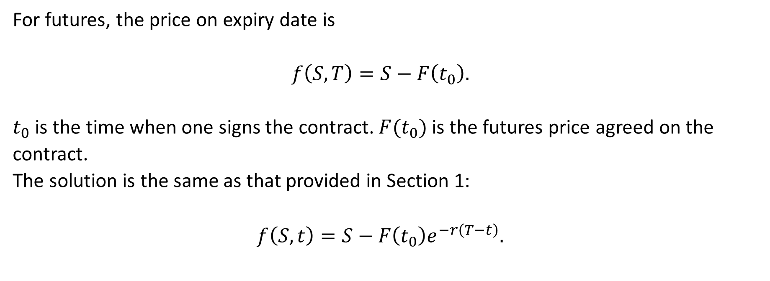
BSM Model for Futures
For futures, the price on expiry date is
$$f\left(S,T\right)=S−F\left(t_{0}\right).$$
$t_{0}$ is the time when one signs the contract. $F(t_{0})$is the futures price agreed on the contract.
The solution is the same as that provided in Section 1:
$$f\left(S,t\right)=S−F\left(t_{0}\right)e^{−r\left(T−t\right)}.$$

Slide 33
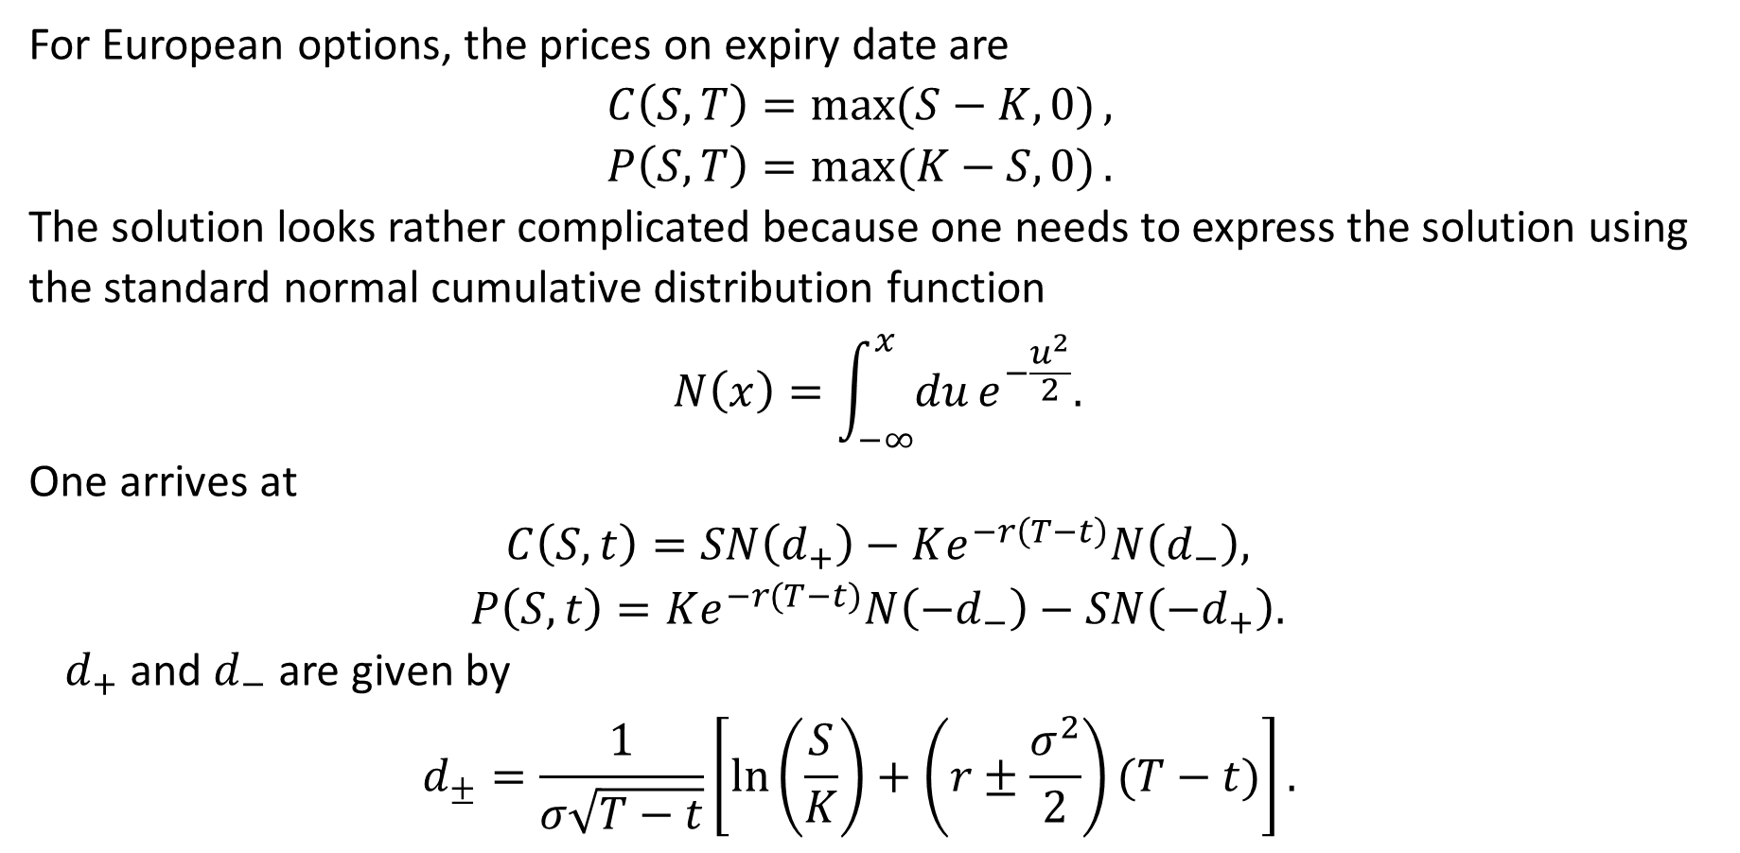
BSM Model for European Options
For European options, the prices on expiry date are
$$C\left(S,T\right)=\max{(S−K,0)},$$
$$P\left(S,T\right)=\max{(K−S,0)}.$$
The solution looks rather complicated because one needs to express the solution using the standard normal cumulative distribution function
$$N\left(x\right)=\int_{−∞}^{x}{du}e^{−\frac{u^{2}}{2}}.$$
One arrives at
$$C\left(S,t\right)=SN\left(d_{+}\right)−Ke^{−r\left(T−t\right)}N\left(d_{−}\right),$$
$$P\left(S,t\right)=Ke^{−r(T−t)}N\left(−d_{−}\right)−SN\left(−d_{+}\right).$$
$d_{+}$ and $d_{−}$ are given by
$$d_{±}=\frac{1}{σ\sqrt{T−t}}\left[\ln\left(\frac{S}{K}\right)+\left(r±\frac{σ^{2}}{2}\right)(T−t)\right].$$

Slide 34
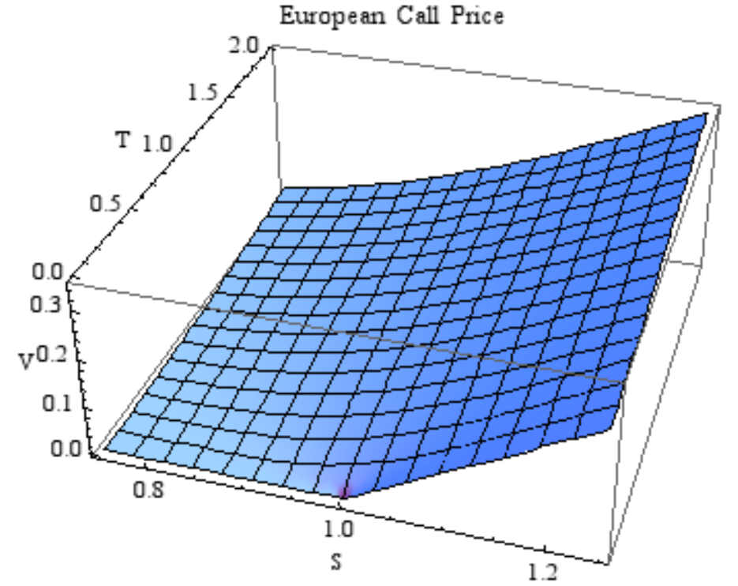

$C(S,t)$Curves

