Slide 1
Week 10 Tutorial Autocorrelation Power Spectral Density Regression Detrended Fluctuation Analysis

Slide 2
Autocorrelation Function (1)
The autocorrelation function is computed using: matplotlib.pyplot.acorr (plt.acorr)
The inputs of plt.acorr are:
the series
maxlags: the number of lags to be computed
other arguments for plotting
The outputs of plt.acorr are:
0: Array of lags [–maxlags, …, 0, maxlags]
1: Array of autocorrelation functions
Remark: plt.acorr assumes that the mean of the series = 0. The programmer needs to subtract the mean from the series before input.

Slide 3
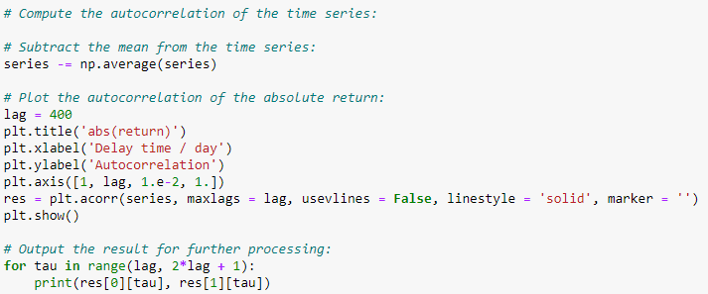
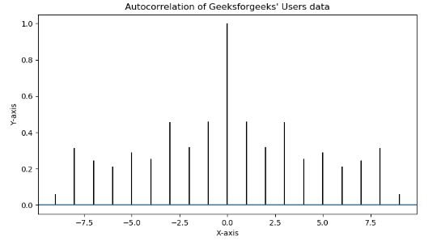
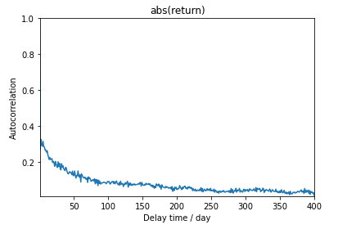
Autocorrelation Function (2)
Output using “usevlines=True” (default)
Output using “usevlines=False, linestyle=‘solid’, marker=‘’)”

Slide 4

Power Spectral Density in Excel (1)
The power spectral density is calculated by applying Fourier transform to the autocorrelation function.
In Excel, we use Fast Fourier Transform:
Data > Data analysis > Fourier analysis
Example: Mixed signal with periods 5, 10 and 25.
$$x=2sin\left(\frac{2πt}{5}\right)+\sin\left(\frac{2πt}{10}\right)+0.5\sin\left(\frac{2πt}{25}\right)$$

Slide 5
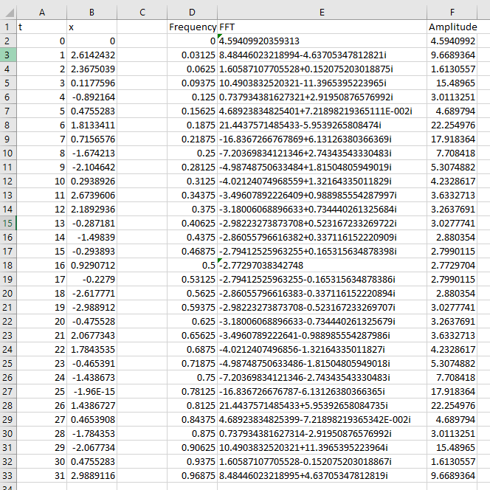
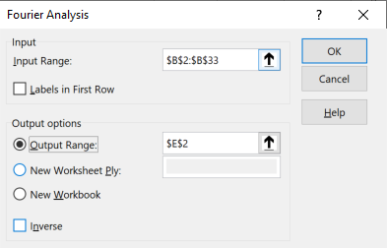
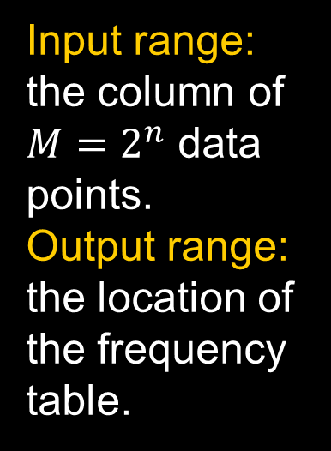
Input range: the column of $M=2^{n}$ data points.
Output range: the location of the frequency table.

Slide 6
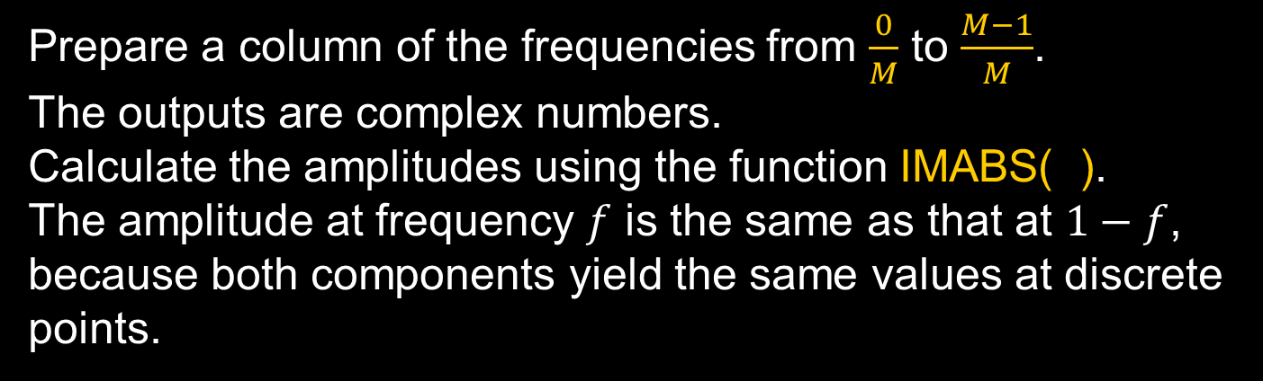
Power Spectral Density in Excel (3)
Prepare a column of the frequencies from $\frac{0}{M}$ to $\frac{M−1}{M}$.
The outputs are complex numbers.
Calculate the amplitudes using the function IMABS( ).
The amplitude at frequency $f$ is the same as that at $1−f$, because both components yield the same values at discrete points.

Slide 7
Power Spectral Density in Excel (4)
We will only need to show the left half of the spectrum (from 0 to 0.5).
The unit of frequency is cycles per tick.
The solution shows the peaks at f = 0.03125 ≈ 1/25, 0.09375 ≈ 1/10, 0.1875 and 0.21875 ≈ 1/5.

Slide 8

Classwork
The file tut10.xlsx contains the autocorrelation of the absolute returns of the Hang Seng Index from 0 to 750 days.
Download the file and plot the autocorrelation versus time delay in Excel.
Suggest a value of the maximum lag such that the truncated time series can be used to compute the power spectral density.
Compute the power spectral density of the autocorrelation using Fast Fourier Transform.
Plot the power spectral density using a log-log plot. Compute the exponent $β$ where $S\left(f\right)∝f^{−β}.$

Slide 9

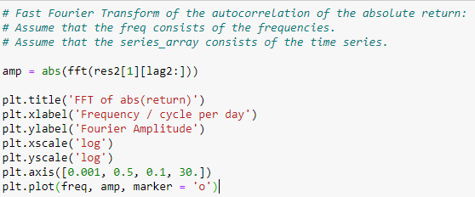
Power Spectral Density in Python
To use fft in numpy, add the following line to import the package from the numpy library:
The data series can be of any size, not restricted to 2^{n}.
Prepare the frequency array.
Prepare the complex fft array using fft( ).
Calculate the amplitude array using abs( ).
Plot the spectrum.

Slide 10
Power Spectral Density in Python
To use fft in numpy, add the following line to import the package from the numpy library:
The data series can be of any size, not restricted to 2^{n}.
Prepare the frequency array.
Prepare the complex fft array using fft( ).
Calculate the amplitude array using abs( ).
Plot the spectrum.

Slide 11

Power Law Regression
Power law regression is done by taking the logarithms of the inputs and outputs and fit them by linear regression.
Linear regression can be done by packages such as scikit-learn or scipy.
For installation, type Windows command:
At the top of the program, add:
$$>pip install scikit−learn$$

Slide 12
Preparing the Arrays for Regression
Suppose we want to perform a linear regression of the points (5, 5), (15, 28), (25, 14), (35, 32), (45, 22), (55, 38).
Prepare the arrays:
x = np.array([5, 15, 25, 35, 45, 55]).reshape((-1, 1))
y = np.array([5, 20, 14, 32, 22, 38])
Remark: Reshaping x changes it to have one column and as many rows as necessary. The original x with 6 columns may be confused with multiple linear regression.

Slide 13
Fitting the Regression Model
To find the regression model:
To get the fitted values:
To predict the outputs of a test set, replace x by xtest.
To find R²:
To find the slope and intercept:

Slide 14
Good Practice in Program Writing
Write the date.
Write your name (protect yourself!)
Write a few sentences explaining the purpose of the program.
Define all parameters and print them out.
Add a comment every ~10 lines.
Use a seed number to generate the random numbers.
For long programs, compute the execution time.
See the example in the next slide.

Slide 15
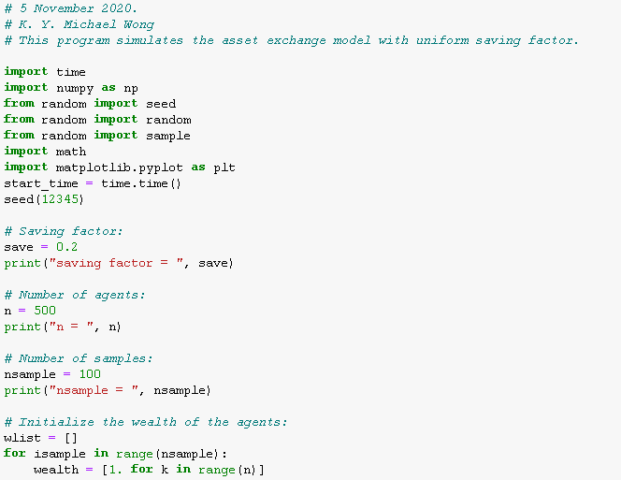

Slide 16
Detrended Fluctuation Analysis
The details are explained in the question paper of Problem Set 5B.

