Slide 1
Tutorial 11 Simulation of the Asset Exchange Model

Slide 2
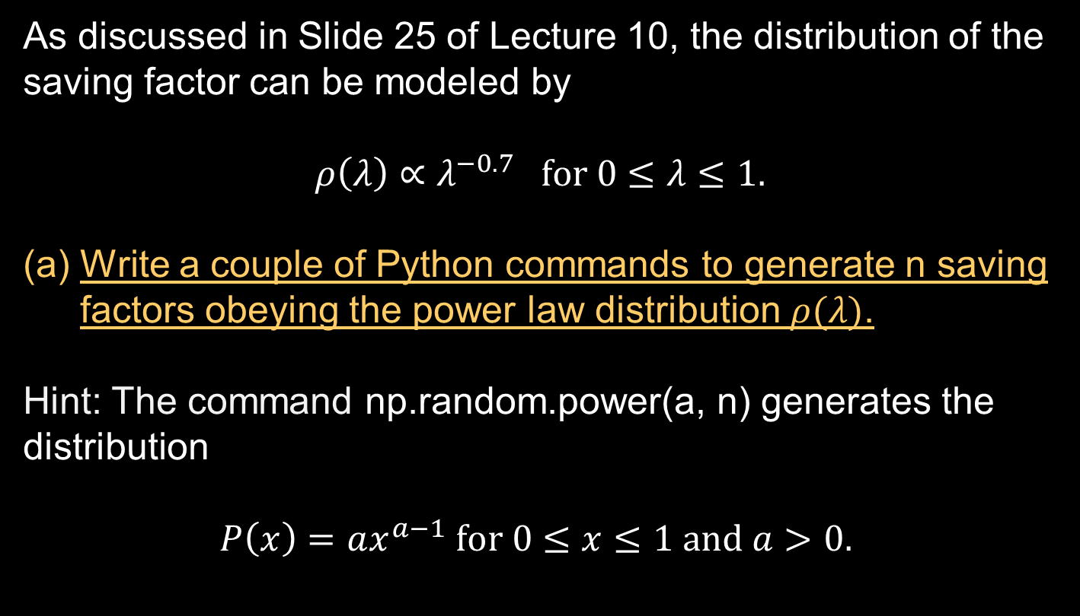
Generation of the Distribution of Saving Factors (1)
As discussed in Slide 25 of Lecture 10, the distribution of the saving factor can be modeled by
$$ρ\left(λ\right)∝λ^{−0.7} for 0≤λ≤1.$$
Write a couple of Python commands to generate n saving factors obeying the power law distribution $ρ(λ)$.
Hint: The command np.random.power(a, n) generates the distribution
$$P\left(x\right)=ax^{a−1} for 0≤x≤1 and a>0.$$

Slide 3

Pairing the Agents for the Transactions
At each iteration, the $N$ agents in the market are randomly grouped into pairs and exchange their wealth through transactions.
In Python, random shuffling can be done by the commands random.shuffle() or random.sample():
random.shuffle replaces the list with a shuffled one
random.sample generates a new list
In random.sample(population, k), population is a list of length k or longer, k is the number of elements to be sampled.

Slide 4
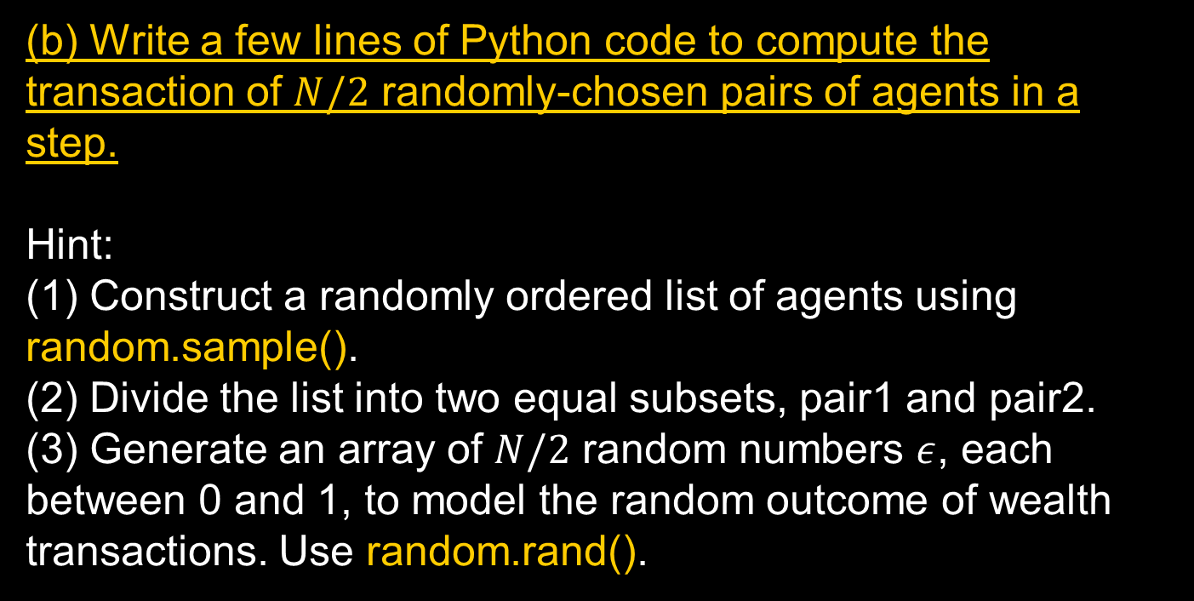
Computing the Wealth Changes (1)
(b) Write a few lines of Python code to compute the transaction of $N/2$ randomly-chosen pairs of agents in a step.
Hint:
(1) Construct a randomly ordered list of agents using random.sample().
(2) Divide the list into two equal subsets, pair1 and pair2.
(3) Generate an array of $N/2$ random numbers $ε$, each between 0 and 1, to model the random outcome of wealth transactions. Use random.rand().

Slide 5

Computing the Wealth Changes (2)
(4) Using the following arrays:
save = the array of saving factors of the agents
wealth = the array of wealth of the agents
pair1 = the array of first agents in the transaction pairs
pair2 = the array of second agents in the transaction pairs
Compute the gain of first agents in a transaction using
$$gain=\left(ε−1\right)\left(1−λ_{i}\right)m_{i}\left(t\right)+ε\left(1−λ_{j}\right)m_{j}\left(t\right).$$
(5) Compute the wealth of first agents after the transactions.
(6) Compute the wealth of second agents after the transactions.

Slide 6
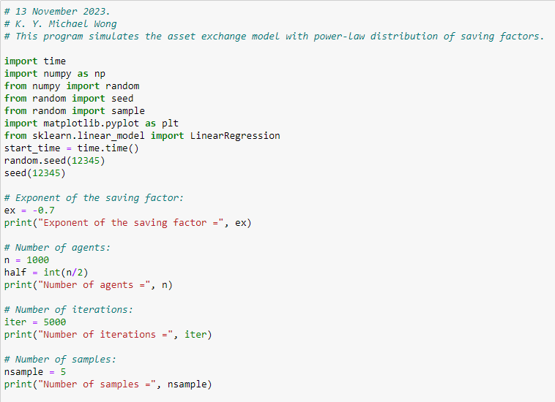
Front Matters

Slide 7

Import of ‘random’ in Front Matters
To use random.seed(), random.power(), and random.rand(), we insert in the front matters:
However, pilot running of the program showed that random.sample() did not give the desired result. In the front matters, we have to add:
In the program, the command should be sample() instead of random.sample().
To ensure that the program is repeatable, both random.seed() and seed() should be executed.

Slide 8
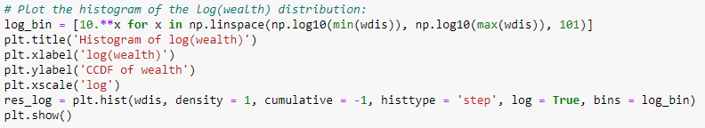
Log-log plot using plt.hist
wdis is a list containing the wealth of all agents k.
density = 1: Normalized distribution
(output = counts / sum(counts) / bin width)
(density = 0 means output = counts)
cumulative = -1: cumulative distribution from the right end
(cumulative = True: cumulative from the left end)
histtype = ‘step’: for curves instead of bars
(Other choices: ‘bar’, ‘barstacked’, ‘stepfilled’
“log = True”: distribution in log scale along the vertical axis
The horizontal axis of plt.hist is given by 100 bin_edges spaced exponentially. It should be plotted using log scale.

Slide 9
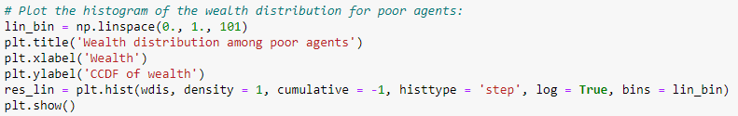
Log-linear plot using plt.hist
A log-linear plot is used to verify the exponential distribution of wealth for the poor agents.
wdis is a list containing wealth[k] for all agents k.
Since only the poor agents (with wealth less than 1) are considered, a sequence of bin_edges is provided to ‘bins’.

Slide 10
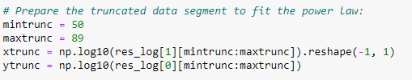
Histogram output from plt.hist
To prepare the truncated data segment to fit the power law, we have to export the results from plt.hist to LinearRegression.
In the above example, res_log is the output of plt.hist. Its 0th output is a column of bin edges. Its 1st output is a column of the counts.

