Slide 1
Week 9 Tutorial Python Techniques for Principal Component Analysis

Slide 2
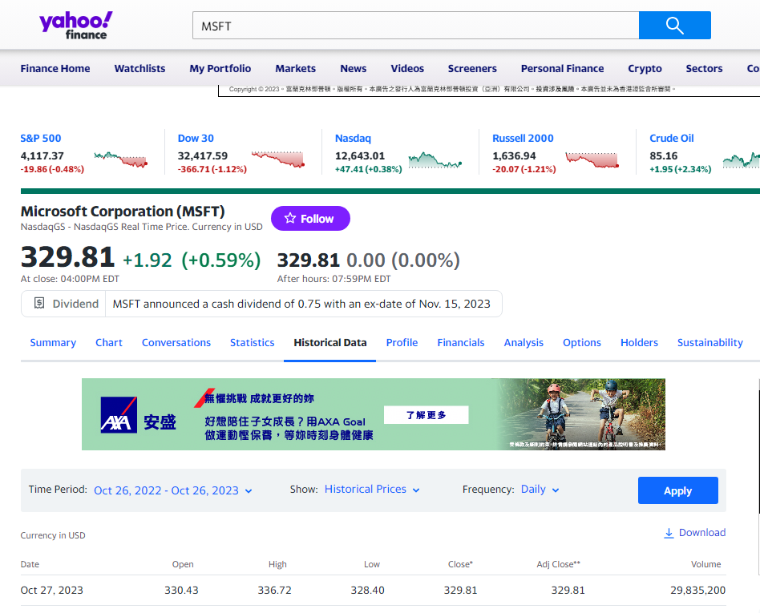
Downloading Data from Yahoo!Finance

Slide 3
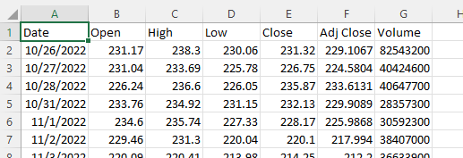
Format of the data files
The data files are stored in the directory /S&P500.
Opening the file /S&P500/MSFT.csv using Excel:
We will read the column into the program with the title ‘Adj Close’ using pandas.

Slide 4


Reading data using pandas
pandas is a useful tool for reading in and writing out data into data files.
Please install pandas if you have not done so. In Windows command prompt, type:
At the top of the program, add:
To read the adjusted close prices into the program, and to measure the number of trading days in the file:
$$>pip install pandas$$

Slide 5

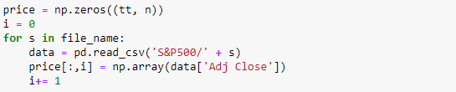
Constructing the price matrix
First prepare a list of file names. Each file name is a string.
To read the data into a price matrix, in which each of the tt rows consists of the prices on a trading day, and each of the n columns correspond to a company:

Slide 6


Vectorizing the computation of the return
Note the use of “:” in vectorizing the computation of the returns:
An even simpler way is to write:

Slide 7


Vectorization in computing the mean, std, corr
Note that vectorization can be applied to compute:
The mean of each stock using np.mean
The standard deviation of each stock using np.std
The standardized return (std_ret) from ret, mean and sd
What should be the “?”?
Furthermore, the correlation function can be computed from matrix product of the return vectors:
$$C\left(i,j\right)=\frac{1}{T−1}\sum_{t}{ret\left(t,i\right)ret\left(t,j\right)}=\frac{1}{T−1}\left[{\left(ret\right)}^{T}\left(ret\right)\right]\left(i,j\right).$$

Slide 8



Visualization of the correlation matrix
np.printoptions() maintains the orderly display of the matrix:
Without np.printoptions, the matrix cannot be displayed orderly:

Slide 9


Computing the eigenvalues and eigenvectors
The eigenvalues and eigenvectors are computed by the function np.linalg.eig():
To sort the eigenvalues in ascending order, use:
To sort the eigenvalues in descending order, use:

