Slide 1
심장초음파를 활용한 여러 예측과 딥러닝
김수용

Slide 2
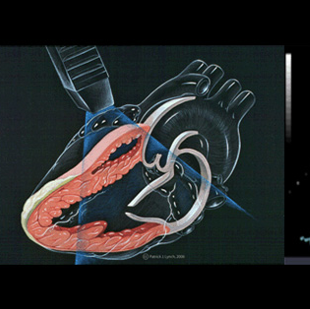
심장초음파
경흉부 심장초음파
경식도 심장초음파
스트레스 심장초음파
3차원 심장초음파

Slide 3
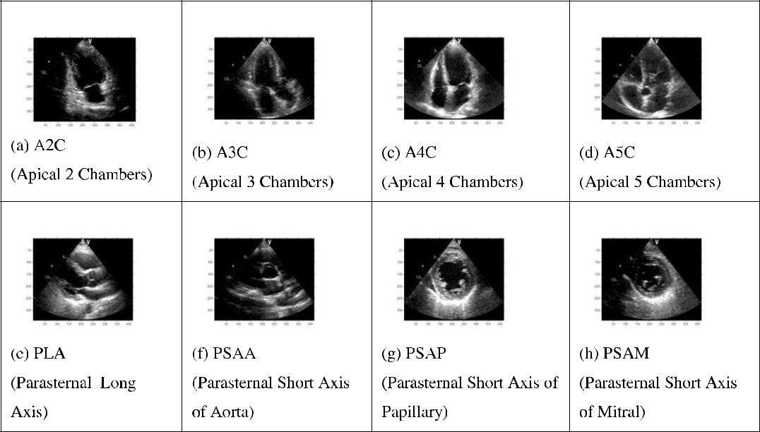
8 viewpoints & classification
1. A2C ~ A5C (첫 행 1-4열)
=>한위치에서 positioning 각도에 따라 나온 4가지 이미지
2. PLA (두 번째 행 1열)
=>한위치에서 나온 한 이미지
3. PSAA, PSAP, PSAM (두 번째 행 2-4열)
한위치에서 나온 3가지 이미지

Slide 4
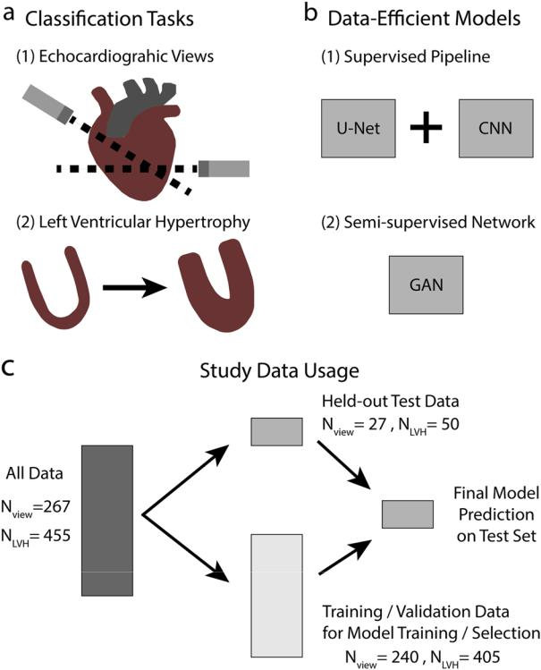
Data-efficient supervised & Semi-supervised
Supervised
U-Net + CNN
15 view still image => 94.4 %
Binary left ventricular hypertrophy => 91.2 %
Semi-supervised
GAN, end to end
15 view still image => more than 80 %
Binary left ventricular hypertrophy => 92.3 %

Slide 5
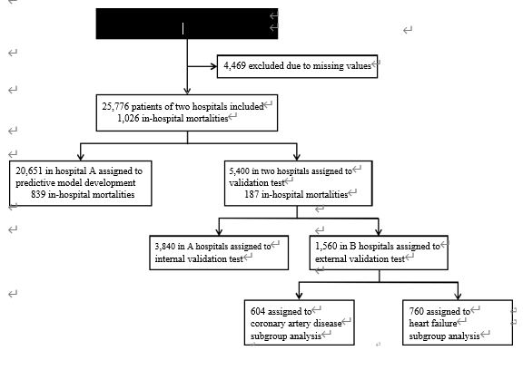
Prediction in Mortality for Heart Disease
30,245 in-hospital patients who underwent echocardiography during the study period
Predicting in-­hospital mortality for HD during internal validation of hospital A
DL (AUROC: 0.912)
RF (AUROC: 0.893)
LR (AUROC: 0.875)
Predicting in-­hospital mortality for HD during external validation of hospital B
DL (AUROC: 0.898)
RF (AUROC: 0.848)
LR (AUROC: 0.841)

Slide 6
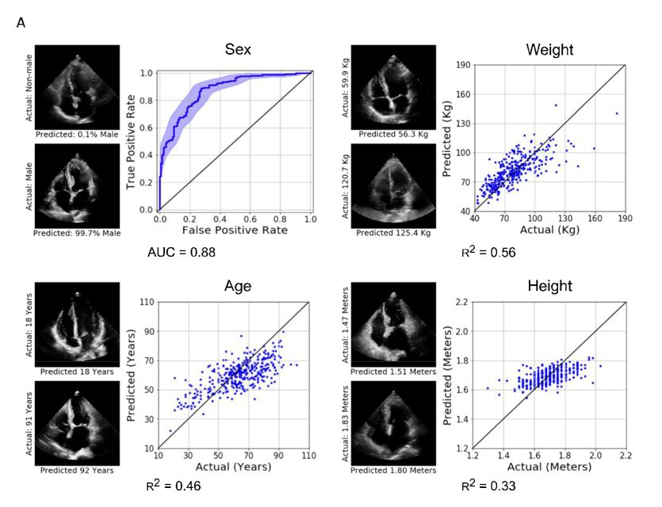
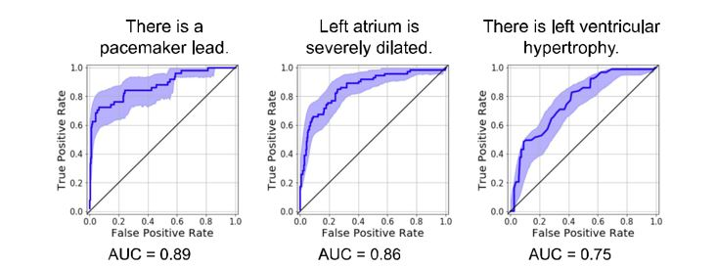
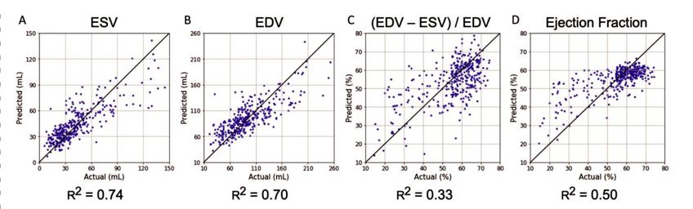
Deep learning interpretation of
Structure, Function, Systemic Phenotypes

Slide 7
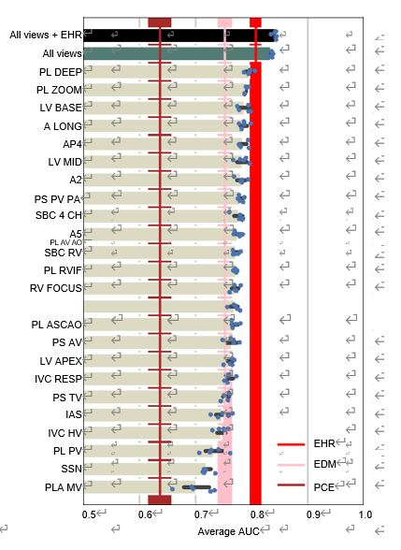
Predictions of All-cause mortality
Four Architecutures
- 2D CNN with LSTM
- 2D CNN with GAP
- 3D CNN
- 3D CNN with GAP
Performance (AUC)
- All video views combined : 0.83
All views and the 158 EHR-derived measurements : 0.84
58 EDMs : 0.75
- 58 EDMs and 100 additional clinical variables from the HER: 0.81

Slide 8
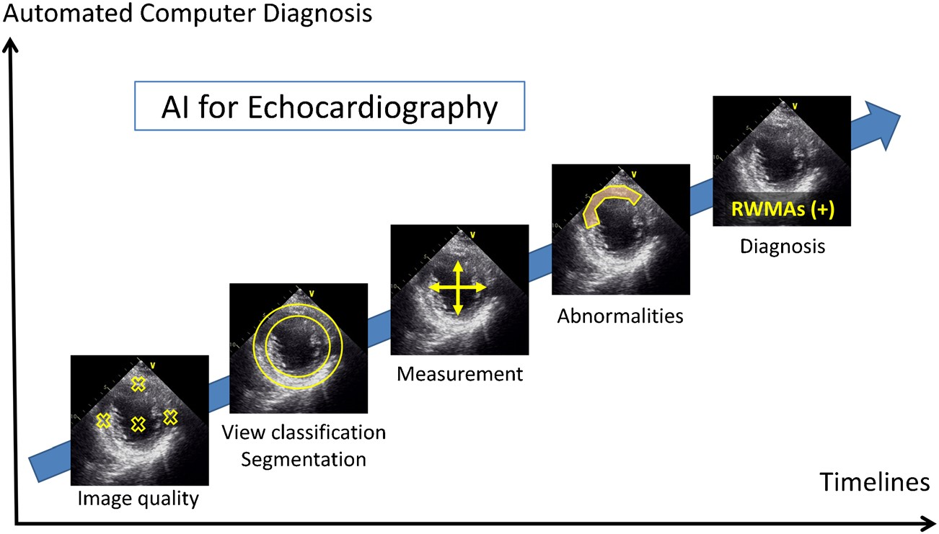
Radiomics in Echocardiography

Slide 9
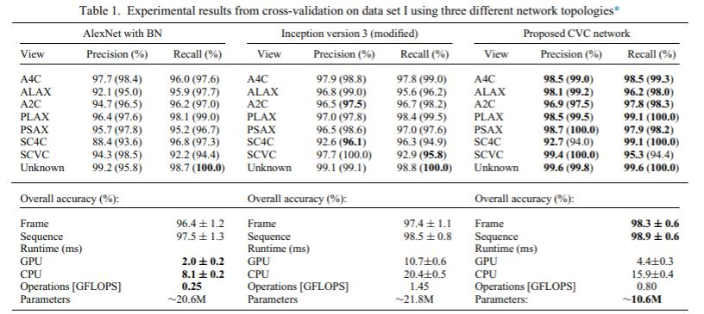
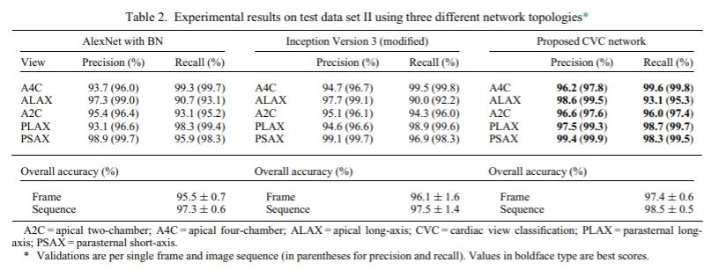
REAL-TIME STANDARD VIEW CLASSIFICATION IN TRANSTHORACIC ECHOCARDIOGRAPHY USING CNN (2D)

Slide 10
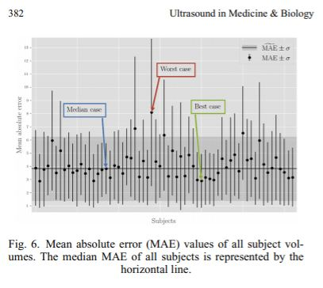
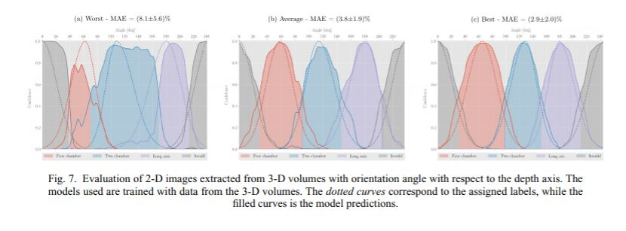
REAL-TIME STANDARD VIEW CLASSIFICATION IN TRANSTHORACIC ECHOCARDIOGRAPHY USING CNN (3D)

Slide 11
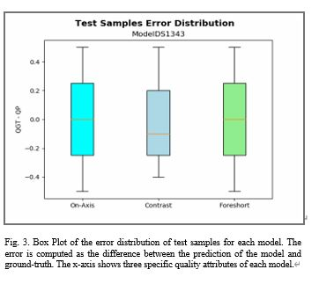
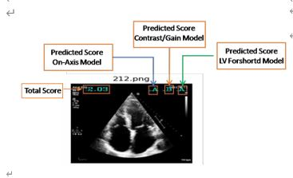
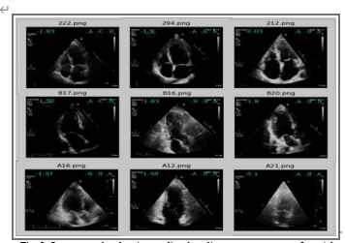
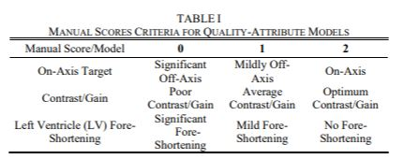
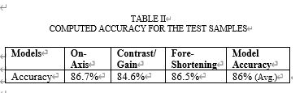
Automated Assessment of Image Quality in 2D

Slide 12
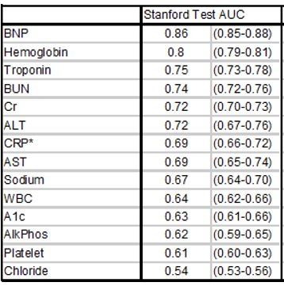
Deep Learning Prediction of Biomarkers from Echocardiogram Videos
EchoNet-Labs

Slide 13
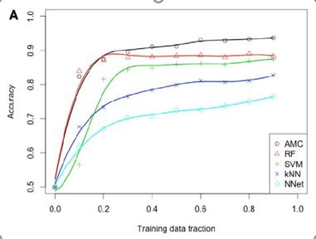
Cognitive Machine-Learning Algorithm for Cardiac Imaging (AMC)
AMC (averaged classification accuracy 93.7%, AUC 96.2%)
Random Forest (averaged classification accuracy 88.3%, AUC 94.2%)
Support Vec-tor Machines (averaged classification accuracy 87.4%, AUC 92.2%)
For AMC, the accuracy at a high training fraction was relatively flat and asymptotically approached 90% after a training fraction of 0·3
At all training fractions, the diagnostic accuracy of AMC remained superior as compared with the other machine-learning algorithms

Slide 14
Thank You !

