Slide 1
Masked RCNN 코드 분석
2021.05.17
작성자 윤경섭 수석

Slide 2
model.py
주요 흐름 블록도
ProposalLayer
DetectionTargetLayer
detection_targets_graph
rois는 proposal이고
나머지는 그때의 gt 값이다
rois: [batch, TRAIN_ROIS_PER_IMAGE, (y1, x1, y2, x2)]
target_class_ids: [batch, TRAIN_ROIS_PER_IMAGE]. Integer class IDs.
target_deltas: [batch, TRAIN_ROIS_PER_IMAGE, (dy, dx, log(dh), log(dw)]
target_mask: [batch, TRAIN_ROIS_PER_IMAGE, height, width]
fpn_classifier_graph
PyramidROIAlign
rois로 부터 각 P2 ~ P5에 해당하는 레벨을 구하고 7x7 크기로 freaturemap에서 corp and resize한 영상 pool을 리턴한다.
mrcnn_class_logits 구함
Shape: [batch, num_rois, POOL_SIZE, POOL_SIZE, channels]

Slide 3
model.py
주요 흐름 블록도
mrcnn_prob 구함
mrcnn_bbox 구함
build_fpn_mask_graph
피라미드 네트워크를 build 구성
loss 함수 정의
rpn_class_loss_graph
rpn_bbox_loss_graph
mrcnn_class_loss_graph
mrcnn_bbox_loss_graph
mrcnn_mask_loss_graph

Slide 4
MakRCNN build
build
input_image의 shape는 1개 차원이 늘어난다. 아마도 batch 차원이 늘어나는 것 같음. shape (None, None, None, 3)
input_image = KL.Input(
shape=[None, None, config.IMAGE_SHAPE[2]], name="input_image")
height
width
channel
batch

Slide 5
model.py
input_image의 shape는 1개 차원이 늘어난다. 아마도 batch 차원이 늘어나는 것 같음. shape (None, None, None, 3)
Norm_boxes_graph
input_gt_masks
MINI_MASK를 사용시
input_gt_masks : shape=(None, 56, 56, None) dtype=bool
Python - callable(), 호출 가능한 object 즉 object가 함수형태로 호출가능한가 여부
h
box
1
box
좌표변환
w
1
resnet_graph
residual net 계층을 만드는 함수
_, C2, C3, C4, C5 = resnet_graph(input_image, config.BACKBONE,
stage5=True, train_bn=config.TRAIN_BN)
residual net 계층을 만드는 것으로 BACKBON에 이름이, state5까지 사용여부, batch normalization freeze 사용 여부이다. C1 ~ C5까지는 각 stage에서의 레이어 값을 볼 수있게 했다.
☞ keras에서 기본적으로 제공되는 resNet을 사용하지 않고 직접 레이어를 만들었는데, 이부분이 어떤 차이가 있는지 확인 해볼 필요가 있다.
return

Slide 6
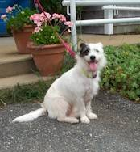
resnet_graph
resnet_graph
residual net 계층을 만드는 함수
x = KL.ZeroPadding2D((3, 3))(input_image)
3 zeros
(None, None, None, 3)
Conv2D 블록 함수 참고
x = KL.Conv2D(64, (7, 7), strides=(2, 2), name='conv1', use_bias=True)(x)
x = BatchNorm(name='bn_conv1')(x, training=train_bn)
x = KL.Activation('relu')(x)
C1 = x = KL.MaxPooling2D((3, 3), strides=(2, 2), padding="same")(x)

Slide 7
model.py
# Size of the top-down layers used to build the feature pyramid
TOP_DOWN_PYRAMID_SIZE = 256
import keras.layers as KL
P5 = KL.Conv2D(config.TOP_DOWN_PYRAMID_SIZE, (1, 1), name='fpn_c5p5')(C5)
P4 = KL.Add(name="fpn_p4add")([
KL.UpSampling2D(size=(2, 2), name="fpn_p5upsampled")(P5),
KL.Conv2D(config.TOP_DOWN_PYRAMID_SIZE, (1, 1), name='fpn_c4p4')(C4)])
P3 = KL.Add(name="fpn_p3add")([
KL.UpSampling2D(size=(2, 2), name="fpn_p4upsampled")(P4),
KL.Conv2D(config.TOP_DOWN_PYRAMID_SIZE, (1, 1), name='fpn_c3p3')(C3)])
P2 = KL.Add(name="fpn_p2add")([
KL.UpSampling2D(size=(2, 2), name="fpn_p3upsampled")(P3),
KL.Conv2D(config.TOP_DOWN_PYRAMID_SIZE, (1, 1), name='fpn_c2p2')(C2)])
# Attach 3x3 conv to all P layers to get the final feature maps.
P2 = KL.Conv2D(config.TOP_DOWN_PYRAMID_SIZE, (3, 3), padding="SAME", name="fpn_p2")(P2)
P3 = KL.Conv2D(config.TOP_DOWN_PYRAMID_SIZE, (3, 3), padding="SAME", name="fpn_p3")(P3)
P4 = KL.Conv2D(config.TOP_DOWN_PYRAMID_SIZE, (3, 3), padding="SAME", name="fpn_p4")(P4)
P5 = KL.Conv2D(config.TOP_DOWN_PYRAMID_SIZE, (3, 3), padding="SAME", name="fpn_p5")(P5)
c:256
c:256
C1
C2
C3
C4
C5
P5
3x3 Conv
P5
1x1 Conv
2x2 Up
2x2 Up
3x3 Conv
P4
P4
1x1 Conv
P3
2x2 Up
3x3 Conv
P3
1x1 Conv
1x1 Conv
P2
3x3 Conv
P2
P5
max pooling
P6
P6는 RPN에서 사용

Slide 8
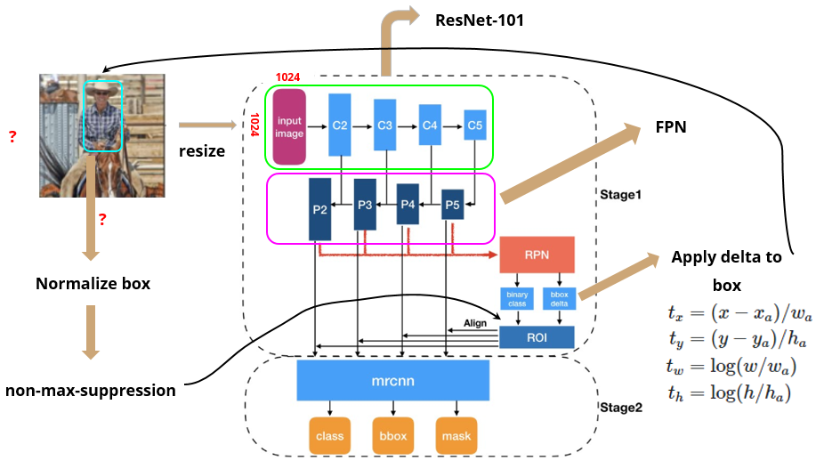
model.py
N x N 사이즈의 인풋 이미지가 주어졌을때 Mask R-CNN의 process는 다음과 같다.

Slide 9
model.py
image_shape
array([1024, 1024, 3])
self.IMAGE_RESIZE_MODE = 'square'
anchors = self.get_anchors(config.IMAGE_SHAPE)
self.BATCH_SIZE = self.IMAGES_PER_GPU * self.GPU_COUNT
normalize 된 좌표 앵커들의 텐서이다.
anchors = np.broadcast_to(anchors, (config.BATCH_SIZE,) + anchors.shape)
anchors = AnchorsLayer(anchors, name="anchors")(input_image)
(config.BATCH_SIZE,) + anchors.shape = (1, 261888, 4) →와 같이 텐서 모양을 변환
텐서플로 형으로 변환
self.config.RPN_ANCHOR_RATIOS =[0.5, 1, 2]
rpn = build_rpn_model(config.RPN_ANCHOR_STRIDE = 1,
len(config.RPN_ANCHOR_RATIOS), config.TOP_DOWN_PYRAMID_SIZE)
config.TOP_DOWN_PYRAMID_SIZE = 256
layer_outputs = [] # list of lists
for p in rpn_feature_maps:
layer_outputs.append(rpn([p]))
layer_outputs=
rpn[P2]
rpn[P3]
rpn[P4]
rpn[P5]
rpn[P6]
outputs = list(zip(*layer_outputs))

Slide 10
model.py
outputs = list(zip(*layer_outputs))
rpn[P2], rpn[P3], rpn[P4], rpn[P5], rpn[P6]
하나 하나를 zip 하여 리스트로 만드는 동작을 한다.
outputs=
rpn.rpn_class_logists[P2,P3,...,P6]
rpn.rpn_class[P2,P3,...,P6]
rpn.rpn_bbox[P2,P3...,P6]
outputs[0]
outputs[1]
outputs[2]
outputs = [KL.Concatenate(axis=1, name=n)(list(o))
for o, n in zip(outputs, output_names)]
리스트[(튜플)]을 리스트[[리스트]]로 만드는 과정?
rpn_class_logits = outputs[0] = <KerasTensor: shape=(None, None, 2) dtype=float32 (created by layer 'rpn_class_logits')>
rpn_class_logits[0] 가 아마도 rpn[p2]의 rpn_class_logits가 아닐까?
rpn_class = outputs[1] = <KerasTensor: shape=(None, None, 2) dtype=float32 (created by layer 'rpn_class')>
# Concatenate layer outputs
# Convert from list of lists of level outputs to list of lists
# of outputs across levels.
# e.g. [[a1, b1, c1], [a2, b2, c2]] => [[a1, a2], [b1, b2], [c1, c2]]
rpn_bbox = outputs[2] = <KerasTensor: shape=(None, None, 4) dtype=float32 (created by layer 'rpn_bbox')>
앵커의 F/B
앵커의 확률
앵커의 박스
rpn_class_logits
rpn_class
rpn_bbox
Layout

Slide 11
if config.USE_MINI_MASK:
input_gt_masks = KL.Input(
shape=[config.MINI_MASK_SHAPE[0],
config.MINI_MASK_SHAPE[1], None],
name="input_gt_masks", dtype=bool)
else:
input_gt_masks = KL.Input(
shape=[config.IMAGE_SHAPE[0], config.IMAGE_SHAPE[1], None],
name="input_gt_masks", dtype=bool)
input_gt_masks: USE_MINI_MASK가 true이면
축소된 마스크를 아니면 이미지 크기와 동일한
마스크를 사용한다.
model.py
rpn_rois = ProposalLayer(
proposal_count=proposal_count=2000,
nms_threshold=config.RPN_NMS_THRESHOLD =0.7,
name="ROI",
config=config)([rpn_class, rpn_bbox, anchors])
self.IMAGE_META_SIZE = 1 + 3 + 3 + 4 + 1 + self.NUM_CLASSES
input_image_meta = KL.Input(shape=[config.IMAGE_META_SIZE],
name="input_image_meta")
CLASS_NAMES = ['BG', 'person', 'bicycle', 'car', 'motorcycle', 'airplane', 'bus', 'train', 'truck', 'boat', 'traffic light', 'fire hydrant', 'stop sign', 'parking meter', 'bench', 'bird', 'cat', 'dog', 'horse', 'sheep', 'cow', 'elephant', 'bear', 'zebra', 'giraffe', 'backpack', 'umbrella', 'handbag', 'tie', 'suitcase', 'frisbee', 'skis', 'snowboard', 'sports ball', 'kite', 'baseball bat', 'baseball glove', 'skateboard', 'surfboard', 'tennis racket', 'bottle', 'wine glass', 'cup', 'fork', 'knife', 'spoon', 'bowl', 'banana', 'apple', 'sandwich', 'orange', 'broccoli', 'carrot', 'hot dog', 'pizza', 'donut', 'cake', 'chair', 'couch', 'potted plant', 'bed', 'dining table', 'toilet', 'tv', 'laptop', 'mouse', 'remote', 'keyboard', 'cell phone', 'microwave', 'oven', 'toaster', 'sink', 'refrigerator', 'book', 'clock', 'vase', 'scissors', 'teddy bear', 'hair drier', 'toothbrush']
ProposalLayer를 통해서 rpn roi를 구하고
if mode == "training":
# Class ID mask to mark class IDs supported by the dataset the image
# came from.
active_class_ids = KL.Lambda(
lambda x: parse_image_meta_graph(x)["active_class_ids"]
)(input_image_meta)
if not config.USE_RPN_ROIS:
# Ignore predicted ROIs and use ROIs provided as an input.
input_rois = KL.Input(shape=[config.POST_NMS_ROIS_TRAINING, 4],
name="input_roi", dtype=np.int32)
# Normalize coordinates
target_rois = KL.Lambda(lambda x: norm_boxes_graph(
x, K.shape(input_image)[1:3]))(input_rois)
else:
target_rois = rpn_rois
true
batch 형태의 결과 class dictionary
# 1. GT Class IDs (zero padded)
input_gt_class_ids = KL.Input(
shape=[None], name="input_gt_class_ids", dtype=tf.int32)
# Generate detection targets
# Subsamples proposals and generates target outputs for training
# Note that proposal class IDs, gt_boxes, and gt_masks are zero
# padded. Equally, returned rois and targets are zero padded.
rois, target_class_ids, target_bbox, target_mask =\
DetectionTargetLayer(config, name="proposal_targets")([
target_rois, input_gt_class_ids, gt_boxes, input_gt_masks])
gt_boxes = KL.Lambda(lambda x: norm_boxes_graph(
x, K.shape(input_image)[1:3]))(input_gt_boxes)
gt_boxes : groud truth box의 normalized 값이다.
DetectionTargetLayer를 통해서 제안하는 roi, 여기에 대응하는 gt class id, bounding box mask를 구한다.

Slide 12
model.py
class의 갯수
TRAIN_BN = False # Defaulting to False since batch size is often small
# Size of the fully-connected layers in the classification graph
FPN_CLASSIF_FC_LAYERS_SIZE = 1024
# Network Heads
# TODO: verify that this handles zero padded ROIs
mrcnn_class_logits, mrcnn_class, mrcnn_bbox =\
fpn_classifier_graph(rois, mrcnn_feature_maps, input_image_meta,
config.POOL_SIZE, config.NUM_CLASSES,
train_bn=config.TRAIN_BN,
fc_layers_size=config.FPN_CLASSIF_FC_LAYERS_SIZE)
mrcnn_feature_maps = [P2, P3, P4, P5]
POOL_SIZE = 7
mrcnn_mask = build_fpn_mask_graph(rois, mrcnn_feature_maps,
input_image_meta,
config.MASK_POOL_SIZE,
config.NUM_CLASSES,
train_bn=config.TRAIN_BN)
# Losses
*x 는 가변인수이다.
rpn_class_loss = KL.Lambda(lambda x: rpn_class_loss_graph(*x), name="rpn_class_loss")(
[input_rpn_match, rpn_class_logits])
rpn_bbox_loss = KL.Lambda(lambda x: rpn_bbox_loss_graph(config, *x), name="rpn_bbox_loss")(
[input_rpn_bbox, input_rpn_match, rpn_bbox])
class_loss = KL.Lambda(lambda x: mrcnn_class_loss_graph(*x), name="mrcnn_class_loss")(
[target_class_ids, mrcnn_class_logits, active_class_ids])
bbox_loss = KL.Lambda(lambda x: mrcnn_bbox_loss_graph(*x), name="mrcnn_bbox_loss")(
[target_bbox, target_class_ids, mrcnn_bbox])
mask_loss = KL.Lambda(lambda x: mrcnn_mask_loss_graph(*x), name="mrcnn_mask_loss")(
[target_mask, target_class_ids, mrcnn_mask])
rpn 출력(F/B)
rpn 입력

Slide 13
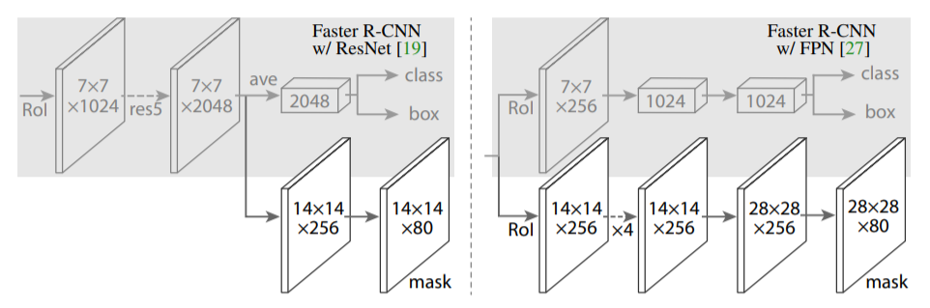
model.py
def build_fpn_mask_graph(rois, feature_maps, image_meta,pool_size, num_classes, train_bn=True):
# Shape: [batch, num_rois, MASK_POOL_SIZE, MASK_POOL_SIZE, channels]
x = PyramidROIAlign([pool_size, pool_size],
name="roi_align_mask")([rois, image_meta] + feature_maps)
fpn_classifier_graph
와 다르게 pool_size가 MASK_POOL_SIZE = 14이다.
# Conv layers
x = KL.TimeDistributed(KL.Conv2D(256, (3, 3), padding="same"),
name="mrcnn_mask_conv1")(x)
x = KL.TimeDistributed(BatchNorm(),
name='mrcnn_mask_bn1')(x, training=train_bn)
x = KL.Activation('relu')(x)
x = KL.TimeDistributed(KL.Conv2D(256, (3, 3), padding="same"),
name="mrcnn_mask_conv2")(x)
x = KL.TimeDistributed(BatchNorm(),
name='mrcnn_mask_bn2')(x, training=train_bn)
x = KL.Activation('relu')(x)
x = KL.TimeDistributed(KL.Conv2D(256, (3, 3), padding="same"),
name="mrcnn_mask_conv3")(x)
x = KL.TimeDistributed(BatchNorm(),
name='mrcnn_mask_bn3')(x, training=train_bn)
x = KL.Activation('relu')(x)
x = KL.TimeDistributed(KL.Conv2D(256, (3, 3), padding="same"),
name="mrcnn_mask_conv4")(x)
x = KL.TimeDistributed(BatchNorm(),
name='mrcnn_mask_bn4')(x, training=train_bn)
x = KL.Activation('relu')(x)
x = KL.TimeDistributed(KL.Conv2DTranspose(256, (2, 2), strides=2, activation="relu"),
name="mrcnn_mask_deconv")(x)
x = KL.TimeDistributed(KL.Conv2D(num_classes, (1, 1), strides=1, activation="sigmoid"),
name="mrcnn_mask")(x)
pool_size=14,num_classes=2
x.shape= ([1, None, 14, 14, 256])
x.shape=([1, None, 28, 28, 256])
x.shape=([1, None, 28, 28, 2])

Slide 14
model.py
def rpn_class_loss_graph(rpn_match, rpn_class_logits):
def rpn_class_loss_graph(rpn_match, rpn_class_logits):
"""RPN anchor classifier loss.
rpn_match: [batch, anchors, 1]. Anchor match type. 1=positive,
-1=negative, 0=neutral anchor.
rpn_class_logits: [batch, anchors, 2]. RPN classifier logits for BG/FG.
"""
# Squeeze last dim to simplify
rpn_match = tf.squeeze(rpn_match, -1)
# Get anchor classes. Convert the -1/+1 match to 0/1 values.
anchor_class = K.cast(K.equal(rpn_match, 1), tf.int32)
# Positive and Negative anchors contribute to the loss,
# but neutral anchors (match value = 0) don't.
indices = tf.where(K.not_equal(rpn_match, 0))
# Pick rows that contribute to the loss and filter out the rest.
rpn_class_logits = tf.gather_nd(rpn_class_logits, indices)
anchor_class = tf.gather_nd(anchor_class, indices)
# Cross entropy loss
loss = K.sparse_categorical_crossentropy(target=anchor_class,
output=rpn_class_logits,
from_logits=True)
loss = K.switch(tf.size(loss) > 0, K.mean(loss), tf.constant(0.0))
return loss
rpn 결과에서 실제 BG/FB 인 것만 구한다.
rpn 입력에서 BG/FB 인 것만 구한다.
rpn_match가 정답이고, rpn_class_logits가 비슷하게 가도록 한다
return

Slide 15
model.py
def rpn_bbox_loss_graph(config, target_bbox, rpn_match, rpn_bbox):
"""Return the RPN bounding box loss graph.
config: the model config object.
target_bbox: [batch, max positive anchors, (dy, dx, log(dh), log(dw))].
Uses 0 padding to fill in unsed bbox deltas.
rpn_match: [batch, anchors, 1]. Anchor match type. 1=positive,
-1=negative, 0=neutral anchor.
rpn_bbox: [batch, anchors, (dy, dx, log(dh), log(dw))]
"""
# Positive anchors contribute to the loss, but negative and
# neutral anchors (match value of 0 or -1) don't.
rpn_match = K.squeeze(rpn_match, -1)
indices = tf.where(K.equal(rpn_match, 1)) #실제 FG인 것인 것의 앵커 인덱스
# Pick bbox deltas that contribute to the loss
rpn_bbox = tf.gather_nd(rpn_bbox, indices) # 아마도 rpn_bbox가 예측되는 box인것 같다. GT anchor와 동일한 인덱스의 rpn_bbox 만 추출한다.
# Trim target bounding box deltas to the same length as rpn_bbox.
batch_counts = K.sum(K.cast(K.equal(rpn_match, 1), tf.int32), axis=1) # GT positive 앵커 box 개수 [1,1]
target_bbox = batch_pack_graph(target_bbox, batch_counts, #타겟박스에서 batch_counts 개수 만큼의 target_box를 가져온다.
config.IMAGES_PER_GPU)
loss = smooth_l1_loss(target_bbox, rpn_bbox)
loss = K.switch(tf.size(loss) > 0, K.mean(loss), tf.constant(0.0))
return loss
return

Slide 16
model.py
def batch_pack_graph(x, counts, num_rows):
"""Picks different number of values from each row
in x depending on the values in counts.
"""
outputs = []
for i in range(num_rows):
outputs.append(x[i, :counts[i]])
return tf.concat(outputs, axis=0)
return

Slide 17
model.py
def rpn_class_loss_graph(rpn_match, rpn_class_logits):
"""RPN anchor classifier loss.
rpn_match: [batch, anchors, 1]. Anchor match type. 1=positive,
-1=negative, 0=neutral anchor.
rpn_class_logits: [batch, anchors, 2]. RPN classifier logits for BG/FG.
"""
# Squeeze last dim to simplify
rpn_match = tf.squeeze(rpn_match, -1)
# Get anchor classes. Convert the -1/+1 match to 0/1 values.
anchor_class = K.cast(K.equal(rpn_match, 1), tf.int32)
# Positive and Negative anchors contribute to the loss,
# but neutral anchors (match value = 0) don't.
indices = tf.where(K.not_equal(rpn_match, 0)) # GT에서 0이 아닌거니까 사물 아니면 배경인 것의 인덱스만 구함
# Pick rows that contribute to the loss and filter out the rest.
rpn_class_logits = tf.gather_nd(rpn_class_logits, indices) #rpn에서 구한 것중 배경과 사물 인것만 추림.
anchor_class = tf.gather_nd(anchor_class, indices) #GT에서 사물과 배경인것만 추림
# Cross entropy loss
loss = K.sparse_categorical_crossentropy(target=anchor_class,
output=rpn_class_logits,
from_logits=True)
#loss의 평균을 리턴한다.
loss = K.switch(tf.size(loss) > 0, K.mean(loss), tf.constant(0.0)) #t = tf.constant([[[1, 1, 1], [2, 2, 2]], [[3, 3, 3], [4, 4, 4]]]) tf.size(t) # 12
return loss
return

Slide 18
model.py
def smooth_l1_loss(y_true, y_pred):
"""Implements Smooth-L1 loss.
y_true and y_pred are typically: [N, 4], but could be any shape.
"""
diff = K.abs(y_true - y_pred)
less_than_one = K.cast(K.less(diff, 1.0), "float32") #tf.keras.backend.less Element-wise truth value of (x < y). A bool tensor.
loss = (less_than_one * 0.5 * diff**2) + (1 - less_than_one) * (diff - 0.5) # 오차가 1보다 작으면 1/2(dLoss)^2 이 되고 크면 (dloss -0.5) 가 된다.
return loss
return

Slide 19
model.py
def mrcnn_class_loss_graph(target_class_ids, pred_class_logits,active_class_ids):
def mrcnn_class_loss_graph(target_class_ids, pred_class_logits,
active_class_ids):
"""Loss for the classifier head of Mask RCNN.
target_class_ids: [batch, num_rois]. Integer class IDs. Uses zero
padding to fill in the array.
pred_class_logits: [batch, num_rois, num_classes]
active_class_ids: [batch, num_classes]. Has a value of 1 for
classes that are in the dataset of the image, and 0
for classes that are not in the dataset.
"""
# During model building, Keras calls this function with
# target_class_ids of type float32. Unclear why. Cast it
# to int to get around it.
target_class_ids = tf.cast(target_class_ids, 'int64')
# Find predictions of classes that are not in the dataset.
pred_class_ids = tf.argmax(pred_class_logits, axis=2) # 예측 가장 확율이 큰 클래스의 인덱스 값을 얻어옴?
# TODO: Update this line to work with batch > 1. Right now it assumes all
# images in a batch have the same active_class_ids
pred_active = tf.gather(active_class_ids[0], pred_class_ids) #그러면 예측 클래스를 얻겠지.
# Loss
loss = tf.nn.sparse_softmax_cross_entropy_with_logits(
labels=target_class_ids, logits=pred_class_logits) #target_class_ids 가 타겟이고, pred_class_logits가 예측이다.
# Erase losses of predictions of classes that are not in the active
# classes of the image.
loss = loss * pred_active #pred_active가 loss의 필터 역할을 하는 것 같음.
# Computer loss mean. Use only predictions that contribute
# to the loss to get a correct mean.
loss = tf.reduce_sum(loss) / tf.reduce_sum(pred_active)
return loss
return

Slide 20
model.py
def mrcnn_bbox_loss_graph(target_bbox, target_class_ids, pred_bbox):
def mrcnn_bbox_loss_graph(target_bbox, target_class_ids, pred_bbox):
"""Loss for Mask R-CNN bounding box refinement.
target_bbox: [batch, num_rois, (dy, dx, log(dh), log(dw))]
target_class_ids: [batch, num_rois]. Integer class IDs.
pred_bbox: [batch, num_rois, num_classes, (dy, dx, log(dh), log(dw))]
"""
# Reshape to merge batch and roi dimensions for simplicity.
target_class_ids = K.reshape(target_class_ids, (-1,))
target_bbox = K.reshape(target_bbox, (-1, 4))
pred_bbox = K.reshape(pred_bbox, (-1, K.int_shape(pred_bbox)[2], 4))
# Only positive ROIs contribute to the loss. And only
# the right class_id of each ROI. Get their indices.
positive_roi_ix = tf.where(target_class_ids > 0)[:, 0]
positive_roi_class_ids = tf.cast(
tf.gather(target_class_ids, positive_roi_ix), tf.int64) # GT에 해당하는 객체 class id를 구한다.
indices = tf.stack([positive_roi_ix, positive_roi_class_ids], axis=1) # 객체의 인덱스와 class id의 조합 의 인덱스
# Gather the deltas (predicted and true) that contribute to loss
target_bbox = tf.gather(target_bbox, positive_roi_ix)
pred_bbox = tf.gather_nd(pred_bbox, indices)
# Smooth-L1 Loss
loss = K.switch(tf.size(target_bbox) > 0,
smooth_l1_loss(y_true=target_bbox, y_pred=pred_bbox),
tf.constant(0.0))
loss = K.mean(loss)
return loss
return

Slide 21
model.py
def mrcnn_bbox_loss_graph(target_bbox, target_class_ids, pred_bbox):
def mrcnn_mask_loss_graph(target_masks, target_class_ids, pred_masks):
"""Mask binary cross-entropy loss for the masks head.
target_masks: [batch, num_rois, height, width].
A float32 tensor of values 0 or 1. Uses zero padding to fill array.
target_class_ids: [batch, num_rois]. Integer class IDs. Zero padded.
pred_masks: [batch, proposals, height, width, num_classes] float32 tensor
with values from 0 to 1.
"""
# Reshape for simplicity. Merge first two dimensions into one.
target_class_ids = K.reshape(target_class_ids, (-1,))
mask_shape = tf.shape(target_masks)
target_masks = K.reshape(target_masks, (-1, mask_shape[2], mask_shape[3])) #[N, height, width]
pred_shape = tf.shape(pred_masks)
pred_masks = K.reshape(pred_masks,
(-1, pred_shape[2], pred_shape[3], pred_shape[4])) #[N, height, width, num_classes]
# Permute predicted masks to [N, num_classes, height, width]
pred_masks = tf.transpose(pred_masks, [0, 3, 1, 2])
# Only positive ROIs contribute to the loss. And only
# the class specific mask of each ROI.
positive_ix = tf.where(target_class_ids > 0)[:, 0]
positive_class_ids = tf.cast(
tf.gather(target_class_ids, positive_ix), tf.int64) # 객체 인것에 대한 GT class id를 구한다.
indices = tf.stack([positive_ix, positive_class_ids], axis=1) #예측한 객체의 인덱스를 구한다.
# Gather the masks (predicted and true) that contribute to loss
y_true = tf.gather(target_masks, positive_ix)
y_pred = tf.gather_nd(pred_masks, indices)
# Compute binary cross entropy. If no positive ROIs, then return 0.
# shape: [batch, roi, num_classes]
loss = K.switch(tf.size(y_true) > 0,
K.binary_crossentropy(target=y_true, output=y_pred),
tf.constant(0.0))
loss = K.mean(loss)
return loss
return

Slide 22
model.py
def get_anchors(self, image_shape):
caller
anchors = self.get_anchors(config.IMAGE_SHAPE)
backbone_shapes = compute_backbone_shapes(self.config, image_shape)
backbone_shape = array([[256, 256], [128, 128], [ 64, 64], [ 32, 32], [ 16, 16]])
영상의 크기의 가로 세로의 크기를 각각 4,8,16,32,64 로 나누어진 것의 어레이를 만든다.
if not hasattr(self, "_anchor_cache"):
self._anchor_cache = {}
# cls에 b라는 멤버가 있는지 확인
>>> hasattr(cls, 'b')
image_shape
array([1024, 1024, 3])
self.config.RPN_ANCHOR_SCALES = (32, 64, 128, 256, 512)
앵커를 만듬.
앵커박스 크기
a = utils.generate_pyramid_anchors(
self.config.RPN_ANCHOR_SCALES,
self.config.RPN_ANCHOR_RATIOS,
backbone_shapes,
self.config.BACKBONE_STRIDES,
self.config.RPN_ANCHOR_STRIDE)
self.config.RPN_ANCHOR_RATIOS =[0.5, 1, 2]
self.config.BACKBONE_STRIDES = [4, 8, 16, 32, 64]
몇 개의 싸이즈로 옮겨가며 찾을 것인가?
self.config.RPN_ANCHOR_STRIDE = 1
a.shape = (261888, 4)
# TODO: Remove this after the notebook are refactored to not use it
self.anchors = a
# Normalize coordinates
self._anchor_cache[tuple(image_shape)] = utils.norm_boxes(a, image_shape[:2])
return MaskedRCNN.Build
self._anchor_cache[(1024,1024,3)].shape = (261888, 4)

Slide 23
model.py
def generate_pyramid_anchors(scales, ratios, feature_shapes, feature_strides, anchor_stride):
anchors = []
for i in range(len(scales)): scale = [32,64,128,256]
anchors.append(generate_anchors(scales[i], ratios, feature_shapes[i],
feature_strides[i], anchor_stride))
return np.concatenate(anchors, axis=0)
[256, 256]
[16, 16]
(0,0)
(0,0)
16개
256개
(1023,1023)
(1023,1023)
256개
16개
shape의 크기를 줄이고 격자의 간격을 늘려가는 구조 이다

Slide 24
model.py
격자 가 256인 경우
32/sqr(2)
☞격자 가 조밀한 경우에는
자세히 search 한다
32
32*sqr(2)
32*sqr(2)
4
(0,0)
image
32/sqr(2)
32
4

Slide 25
model.py
격자 가 16인 경우
512/sqr(2)
☞ 격자 가 큰 경우에는
큰 구역으로 search 한다
512
512*sqr(2)
512*sqr(2)
64
512
(0,0)
image
512/sqr(2)
64

Slide 26
model.py
앵커 구조
512/sqr(2)
16
16
32
64
128
256
256
return def get_anchors
앵커의 구조는 중간 중간 단계의 격자에서의 중심에 있는 사각형의 좌표들의 집합니다.

Slide 27
ratios flatten 수행 후
array([0.5, 1. , 2. ])
scales flatten 수행 후
array([32, 32, 32])
model.py
scales= (32, 64, 128, 256, 512)
shape =[256,256]
anchor_stride = [1]
def generate_anchors(scales, ratios, shape, feature_stride, anchor_stride):
ratios=[0.5, 1, 2]
feature_stride = [4, 8, 16, 32, 64]
# Get all combinations of scales and ratios
scales, ratios = np.meshgrid(np.array(scales), np.array(ratios))
scales = scales.flatten()
ratios = ratios.flatten()
# Enumerate heights and widths from scales and ratios
heights = scales / np.sqrt(ratios)
widths = scales * np.sqrt(ratios)
# Enumerate shifts in feature space
shifts_y = np.arange(0, shape[0], anchor_stride=1) * feature_stride
shifts_x = np.arange(0, shape[1], anchor_stride=1) * feature_stride
shifts_x, shifts_y = np.meshgrid(shifts_x, shifts_y)
# Enumerate combinations of shifts, widths, and heights
box_widths, box_centers_x = np.meshgrid(widths, shifts_x)
box_heights, box_centers_y = np.meshgrid(heights, shifts_y)
# Reshape to get a list of (y, x) and a list of (h, w)
sclae이 32인 경우 256x256 격자와 3가지의 박스이므로 중심 좌표는
256x256x3개의 중심 좌표가 생긴다.
box_centers = np.stack(
[box_centers_y, box_centers_x], axis=2).reshape([-1, 2])
box_sizes = np.stack([box_heights, box_widths], axis=2).reshape([-1, 2])
# Convert to corner coordinates (y1, x1, y2, x2)
boxes = np.concatenate([box_centers - 0.5 * box_sizes,
box_centers + 0.5 * box_sizes], axis=1)
return boxes
각 스케일 별로 32,64 ~ 512 이런식으로 수행 된다.
scales = array([[32], [32], [32]])
ratios= array([[0.5], [1. ], [2. ]])
3x1
3x1
1x1
1x3
1차원 치환함수
x = np.arange(0,10,1)
x
Out[21]: array([0, 1, 2, 3, 4, 5, 6, 7, 8, 9])
x = np.arange(0,10,1)*2
x
Out[23]: array([ 0, 2, 4, 6, 8, 10, 12, 14, 16, 18])
heights = array([45.254834, 32. , 22.627417])
widths = array([22.627417, 32. , 45.254834])
매번 바뀜
shifts_x = 256*256
array([
[ 0, 4, 8, ..., 1012, 1016, 1020],
[ 0, 4, 8, ..., 1012, 1016, 1020],
[ 0, 4, 8, ..., 1012, 1016, 1020],
...,
[ 0, 4, 8, ..., 1012, 1016, 1020],
[ 0, 4, 8, ..., 1012, 1016, 1020],
[ 0, 4, 8, ..., 1012, 1016, 1020]])
box_widths.shape = (65536, 3)
box_centers.shape
(196608, 2)
shifts_y
array([
[ 0, 0, 0, ..., 0, 0, 0],
[ 4, 4, 4, ..., 4, 4, 4],
[ 8, 8, 8, ..., 8, 8, 8],
...,
[1012, 1012, 1012, ..., 1012, 1012, 1012],
[1016, 1016, 1016, ..., 1016, 1016, 1016],
[1020, 1020, 1020, ..., 1020, 1020, 1020]])

Slide 28
model.py
def generate_anchors(scales, ratios, shape, feature_stride, anchor_stride):
box_centers_x
array([
[ 0, 0, 0],
[ 4, 4, 4],
[ 8, 8, 8],
...,
[1012, 1012, 1012],
[1016, 1016, 1016],
[1020, 1020, 1020]])
box_centers
array([
[ 0, 0],
[ 0, 0],
[ 0, 0],
...,
[1020, 1020],
[1020, 1020],
[1020, 1020]])
box_widths
array([
[22.627417, 32. , 45.254834],
[22.627417, 32. , 45.254834],
[22.627417, 32. , 45.254834],
...,
[22.627417, 32. , 45.254834],
[22.627417, 32. , 45.254834],
[22.627417, 32. , 45.254834]])
box_centers_x.shape= (65536, 3)
이런 앵커의 크기 3개가 256x265개가 있다.
box_heights
array([
[45.254834, 32. , 22.627417],
[45.254834, 32. , 22.627417],
[45.254834, 32. , 22.627417],
...,
[45.254834, 32. , 22.627417],
[45.254834, 32. , 22.627417],
[45.254834, 32. , 22.627417]])
box_centers_y = 65535*3
array([
[ 0, 0, 0],
[ 0, 0, 0],
[ 0, 0, 0],
...,
[1020, 1020, 1020],
[1020, 1020, 1020],
[1020, 1020, 1020]])
box_sizes
array([
[45.254834, 22.627417],
[32. , 32. ],
[22.627417, 45.254834],
...,
[45.254834, 22.627417],
[32. , 32. ],
[22.627417, 45.254834]])
box_sizes.shape = (196608, 2)
boxes
array([
[ -22.627417 , -11.3137085, 22.627417 , 11.3137085],
[ -16. , -16. , 16. , 16. ],
[ -11.3137085, -22.627417 , 11.3137085, 22.627417 ],
...,
[ 997.372583 , 1008.6862915, 1042.627417 , 1031.3137085],
[1004. , 1004. , 1036. , 1036. ],
[1008.6862915, 997.372583 , 1031.3137085, 1042.627417 ]])
boxes.shape = (196608, 4)
반환 결과 텐서
return def generate_pyramid_anchors

Slide 29
meshgrid example
box_centers_x = np.array([[0,4],[0,4]])
box_centers_y = np.array([[0,0],[4,4]])
test = box_centers = np.stack([box_centers_y, box_centers_x], axis=2)
box_centers = np.stack([box_centers_y, box_centers_x], axis=2).reshape([-1, 2])
x = np.array([1,2,3])
y = np.array([[5,6],[7,8]])
x1,y1 = np.meshgrid(x, y)
x1
Out[16]:
array([[1, 2, 3],
[1, 2, 3],
[1, 2, 3],
[1, 2, 3]])
y1
Out[17]:
array([[5, 5, 5],
[6, 6, 6],
[7, 7, 7],
[8, 8, 8]])
test
Out[21]:
array([[[0, 0],
[0, 4]],
[[4, 0],
[4, 4]]])
box_centers
Out[22]:
array([[0, 0],
[0, 4],
[4, 0],
[4, 4]])

Slide 30
np.stack example
box_centers_x = np.array([[0,4],[0,4]])
box_centers_y = np.array([[0,0],[4,4]])
test = box_centers = np.stack([box_centers_y, box_centers_x], axis=2)
box_centers = np.stack([box_centers_y, box_centers_x], axis=2).reshape([-1, 2])
test
Out[21]:
array([[[0, 0],
[0, 4]],
[[4, 0],
[4, 4]]])
box_centers
Out[22]:
array([[0, 0],
[0, 4],
[4, 0],
[4, 4]])

Slide 31
model.py
rpn = build_rpn_model(config.RPN_ANCHOR_STRIDE = 1,
len(config.RPN_ANCHOR_RATIOS), config.TOP_DOWN_PYRAMID_SIZE)
def build_rpn_model(anchor_stride, anchors_per_location, depth):
import keras.models as KM
RPN_ANCHOR_RATIOS = [0.5, 1, 2]
TOP_DOWN_PYRAMID_SIZE = 256
input_feature_map = KL.Input(shape=[None, None, depth],
name="input_rpn_feature_map")
outputs = rpn_graph(input_feature_map, anchors_per_location, anchor_stride)
return KM.Model([input_feature_map], outputs, name="rpn_model")
= [None,None, None, 256]
= 3
= 1
return MaskedRCNN.Build

Slide 32
model.py
outputs = rpn_graph(input_feature_map, anchors_per_location, anchor_stride)
def rpn_graph(feature_map, anchors_per_location=3, anchor_stride=1):
shared = KL.Conv2D(512, (3, 3), padding='same', activation='relu',
strides=anchor_stride,
name='rpn_conv_shared')(feature_map)
# Anchor Score. [batch, height, width, anchors per location * 2].
x = KL.Conv2D(2 * anchors_per_location=3, (1, 1), padding='valid',
activation='linear', name='rpn_class_raw')(shared)
# Reshape to [batch, anchors, 2]
rpn_class_logits = KL.Lambda(
lambda t: tf.reshape(t, [tf.shape(t)[0], -1, 2]))(x)
# Softmax on last dimension of BG/FG.
rpn_probs = KL.Activation(
"softmax", name="rpn_class_xxx")(rpn_class_logits)
# Bounding box refinement. [batch, H, W, anchors per location * depth]
# where depth is [x, y, log(w), log(h)]
x = KL.Conv2D(anchors_per_location * 4, (1, 1), padding="valid",
activation='linear', name='rpn_bbox_pred')(shared)
# Reshape to [batch, anchors, 4]
rpn_bbox = KL.Lambda(lambda t: tf.reshape(t, [tf.shape(t)[0], -1, 4]))(x)
return [rpn_class_logits, rpn_probs, rpn_bbox]
feature_map = <KerasTensor: shape=(None, None, None, 256)
각 포인트 마다 앵커는 3개인데 FG/BG로 나누려고 2를 곱함.
shared = <KerasTensor: shape=(None, None, None, 512)
x = <KerasTensor: shape=(None, None, None, 6)
rpn_class_logits = <KerasTensor: shape=(None, None, 2)
4차원을 줄여서 width X height X anchor 하면 앵커의
갯수가 나옴.
regression layer
return build_rpn_model
class layer

Slide 33
rpn을 통하여 ROI를 찾는 역할을 수행한다.
rpn_rois = ProposalLayer(
proposal_count=proposal_count=2000,
nms_threshold=config.RPN_NMS_THRESHOLD,
name="ROI",
config=config)([rpn_class, rpn_bbox, anchors])
class ProposalLayer(KE.Layer): cont
# Bounding box refinement standard deviation for RPN and final detections.
RPN_BBOX_STD_DEV = np.array([0.1, 0.1, 0.2, 0.2])
scores = inputs[0][:, :, 1]
# Box deltas [batch, num_rois, 4]
deltas = inputs[1]
deltas = deltas * np.reshape(self.config.RPN_BBOX_STD_DEV, [1, 1, 4]) #텐서를 array([[[0.1, 0.1, 0.2, 0.2]]]) 로 바꾼후 deltas와 곱한다.
# Anchors
anchors = inputs[2]
표준편차 항
# Improve performance by trimming to top anchors by score
# and doing the rest on the smaller subset.
pre_nms_limit = tf.minimum(self.config.PRE_NMS_LIMIT=6000, tf.shape(anchors)[1])
ix = tf.nn.top_k(scores, pre_nms_limit, sorted=True,
name="top_anchors").indices
scores = utils.batch_slice([scores, ix], lambda x, y: tf.gather(x, y),
self.config.IMAGES_PER_GPU)
deltas = utils.batch_slice([deltas, ix], lambda x, y: tf.gather(x, y),
self.config.IMAGES_PER_GPU)
pre_nms_anchors = utils.batch_slice([anchors, ix], lambda a, x: tf.gather(a, x),
self.config.IMAGES_PER_GPU,
names=["pre_nms_anchors"])
anchor 갯수
1등 부터 순서대로 값이 나옴
foreground의 가장큰 인덱스를 얻음
IMAGES_PER_GPU는 1또는 2
score는 큰 값 순서로 정렬하고, score의 인덱스로 delta와 pre_nms_anchors를 뽑는다.
tf.math.top_k는 1차 백터의 가장 큰 값과 인덱스를 알려준다.
result = tf.math.top_k([1, 2, 98, 1, 1, 99, 3, 1, 3, 96, 4, 1], k=3) result.values.numpy() array([99,98,96],dtype=int32) result.indices.numpy() array([5,2,9], dtype=int32)

Slide 34




model.py
apply_box_deltas_graph deltas를 반영한 새로운 박스를 만들어 리턴한다.
class ProposalLayer(KE.Layer): cont
def apply_box_deltas_graph(boxes, deltas):
"""Applies the given deltas to the given boxes.
boxes: [N, (y1, x1, y2, x2)] boxes to update
deltas: [N, (dy, dx, log(dh), log(dw))] refinements to apply
"""
# Convert to y, x, h, w
height = boxes[:, 2] - boxes[:, 0]
width = boxes[:, 3] - boxes[:, 1]
center_y = boxes[:, 0] + 0.5 * height
center_x = boxes[:, 1] + 0.5 * width
# Apply deltas
center_y += deltas[:, 0] * height
center_x += deltas[:, 1] * width
height *= tf.exp(deltas[:, 2])
width *= tf.exp(deltas[:, 3])
# Convert back to y1, x1, y2, x2
y1 = center_y - 0.5 * height
x1 = center_x - 0.5 * width
y2 = y1 + height
x2 = x1 + width
result = tf.stack([y1, x1, y2, x2], axis=1, name="apply_box_deltas_out")
return result
boxes = utils.batch_slice([pre_nms_anchors, deltas],
lambda x, y: apply_box_deltas_graph(x, y),
self.config.IMAGES_PER_GPU,
names=["refined_anchors"])
boxes 값은 델타 값을 적용하여 업데이트 함.
window = np.array([0, 0, 1, 1], dtype=np.float32)
boxes = utils.batch_slice(boxes,
lambda x: clip_boxes_graph(x, window),
self.config.IMAGES_PER_GPU,
names=["refined_anchors_clipped"])
$∆h=log⁡(\frac{h^{′}}{h}$)
$∆w=log⁡(\frac{w^{′}}{w}$)
$$h^{′}=h exp(∆h)$$
$$w^{′}=w exp(∆w)$$
import tensorflow as tf
import numpy as np
def clip_boxes_graph(boxes, window):
"""
boxes: [N, (y1, x1, y2, x2)]
window: [4] in the form y1, x1, y2, x2
"""
# Split
wy1, wx1, wy2, wx2 = tf.split(window, 4)
y1, x1, y2, x2 = tf.split(boxes, 4, axis=1)
# Clip
y1 = tf.maximum(tf.minimum(y1, wy2), wy1)
x1 = tf.maximum(tf.minimum(x1, wx2), wx1)
y2 = tf.maximum(tf.minimum(y2, wy2), wy1)
x2 = tf.maximum(tf.minimum(x2, wx2), wx1)
clipped = tf.concat([y1, x1, y2, x2], axis=1, name="clipped_boxes")
clipped.set_shape((clipped.shape[0], 4))
return clipped
window = np.array([0, 0, 1, 1], dtype=np.float32)
#window = np.array([[0, 0, 1, 1],[0, 0, 1, 1],[0, 0, 1, 1]], dtype=np.float32)
#boxes = np.array([0.1,0.1,0.5,0.5])
boxes = np.array([[0.1,0.1,0.5,0.5],[0.2,0.2,0.6,0.6],[0.3,0.3,0.7,0.7]],dtype=np.float32)
#boxes = np.array([(0.1,0.1,0.5,0.5),(0.2,0.2,0.6,0.6),(0.3,0.3,0.7,0.7)])
boxes = clip_boxes_graph(boxes, window)
print(boxes)
clip_boxes_graph 예제소스
0,0,1,1 박스내에 box 좌표가 들어가도록 자른다.
즉 0보다작은 것은 0으로 1보다 큰것은 1로한다.
def clip_boxes_graph(boxes, window):
"""
boxes: [N, (y1, x1, y2, x2)]
window: [4] in the form y1, x1, y2, x2
"""
# Split
wy1, wx1, wy2, wx2 = tf.split(window, 4)
y1, x1, y2, x2 = tf.split(boxes, 4, axis=1)
# Clip
y1 = tf.maximum(tf.minimum(y1, wy2), wy1)
x1 = tf.maximum(tf.minimum(x1, wx2), wx1)
y2 = tf.maximum(tf.minimum(y2, wy2), wy1)
x2 = tf.maximum(tf.minimum(x2, wx2), wx1)
clipped = tf.concat([y1, x1, y2, x2], axis=1, name="clipped_boxes")
clipped.set_shape((clipped.shape[0], 4))
return clipped
[0] [0] [1] [1]
window 를 n개의 sub 텐서로 나눈다.

Slide 35
model.py
class ProposalLayer(KE.Layer):
Non-max supression
1D 인덱스
pad 예제
t = tf.constant([[1, 2, 3], [4, 5, 6]]) paddings = tf.constant([[1, 1,], [2, 2]]) # 'constant_values' is 0. # rank of 't' is 2. tf.pad(t, paddings, "CONSTANT") # [[0, 0, 0, 0, 0, 0, 0], # [0, 0, 1, 2, 3, 0, 0], # [0, 0, 4, 5, 6, 0, 0], # [0, 0, 0, 0, 0, 0, 0]]
# Non-max suppression
def nms(boxes, scores):
indices = tf.image.non_max_suppression(
boxes, scores, self.proposal_count,
self.nms_threshold, name="rpn_non_max_suppression")
proposals = tf.gather(boxes, indices)
# Pad if needed
padding = tf.maximum(self.proposal_count - tf.shape(proposals)[0], 0)
proposals = tf.pad(proposals, [(0, padding), (0, 0)])
return proposals
proposals = utils.batch_slice([boxes, scores], nms,
self.config.IMAGES_PER_GPU)
return proposals
추천 박스들
박스를 조금 크게 만드는 효과?
return

Slide 36
model.py
def parse_image_meta_graph(meta):
파싱된 속성을 딕셔너리로 만들어 리턴함.
def parse_image_meta_graph(meta):
"""Parses a tensor that contains image attributes to its components.
See compose_image_meta() for more details.
meta: [batch, meta length] where meta length depends on NUM_CLASSES
Returns a dict of the parsed tensors.
"""
image_id = meta[:, 0]
original_image_shape = meta[:, 1:4]
image_shape = meta[:, 4:7]
window = meta[:, 7:11] # (y1, x1, y2, x2) window of image in in pixels
scale = meta[:, 11]
active_class_ids = meta[:, 12:]
return {
"image_id": image_id,
"original_image_shape": original_image_shape,
"image_shape": image_shape,
"window": window,
"scale": scale,
"active_class_ids": active_class_ids,
}
return MaskedRCNN.Build
0 | 1 | 2 | 3 | 4 | 5 | 6 | 7 | 8 | 9 | 10 | 11 | 12~
image_id | original_image_shape |  |  | image_shape |  |  | window |  |  |  | scale | active_class_ids
batch
0 | 1 | 2 | 3 | 4 | 5 | 6 | 7 | 8 | 9 | 10 | 11 | 12~
image_id | original_image_shape |  |  | image_shape |  |  | window |  |  |  | scale | active_class_ids

Slide 37
utils.py
def batch_slice(inputs, graph_fn, batch_size, names=None):
def batch_slice(inputs, graph_fn, batch_size, names=None):
"""Splits inputs into slices and feeds each slice to a copy of the given
computation graph and then combines the results. It allows you to run a
graph on a batch of inputs even if the graph is written to support one
instance only.
inputs: list of tensors. All must have the same first dimension length
graph_fn: A function that returns a TF tensor that's part of a graph.
batch_size: number of slices to divide the data into.
names: If provided, assigns names to the resulting tensors.
"""
if not isinstance(inputs, list):
inputs = [inputs] //input은 앵커 데이터이다. input이 리스트가 아니면 리스트 형태로 만든다.
outputs = []
for i in range(batch_size):
inputs_slice = [x[i] for x in inputs]
output_slice = graph_fn(*inputs_slice)
if not isinstance(output_slice, (tuple, list)):
output_slice = [output_slice]
outputs.append(output_slice)
# Change outputs from a list of slices where each is
# a list of outputs to a list of outputs and each has
# a list of slices
outputs = list(zip(*outputs))
if names is None:
names = [None] * len(outputs)
result = [tf.stack(o, axis=0, name=n)
for o, n in zip(outputs, names)]
if len(result) == 1:
result = result[0]
return result
IPdb [3]: names = [None] * 4
IPdb [4]: names
[None, None, None, None]
return class ProposalLayer

Slide 38
input_gt_class_ids = KL.Input(
shape=[None], name="input_gt_class_ids", dtype=tf.int32)
utils.py
class DetectionTargetLayer(KE.Layer):
rois, target_class_ids, target_bbox, target_mask =\
DetectionTargetLayer(config, name="proposal_targets")([
target_rois, input_gt_class_ids, gt_boxes, input_gt_masks])
def call(self, inputs):
proposals = inputs[0]
gt_class_ids = inputs[1]
gt_boxes = inputs[2]
gt_masks = inputs[3]
# Slice the batch and run a graph for each slice
# TODO: Rename target_bbox to target_deltas for clarity
names = ["rois", "target_class_ids", "target_bbox", "target_mask"]
outputs = utils.batch_slice(
[proposals, gt_class_ids, gt_boxes, gt_masks],
lambda w, x, y, z: detection_targets_graph(
w, x, y, z, self.config),
self.config.IMAGES_PER_GPU, names=names)
return outputs
gt_boxes: [batch, MAX_GT_INSTANCES, (y1, x1, y2, x2)] in normalized
coordinates.
# [batch, height, width, MAX_GT_INSTANCES]
if config.USE_MINI_MASK:
input_gt_masks = KL.Input(
shape=[config.MINI_MASK_SHAPE[0],
config.MINI_MASK_SHAPE[1], None],
name="input_gt_masks", dtype=bool)
else:
input_gt_masks = KL.Input(
shape=[config.IMAGE_SHAPE[0], config.IMAGE_SHAPE[1], None],
name="input_gt_masks", dtype=bool)
Returns: Target ROIs and corresponding class IDs, bounding box shifts,
and masks.
rois: [TRAIN_ROIS_PER_IMAGE, (y1, x1, y2, x2)] in normalized coordinates
class_ids: [TRAIN_ROIS_PER_IMAGE]. Integer class IDs. Zero padded.
deltas: [TRAIN_ROIS_PER_IMAGE, (dy, dx, log(dh), log(dw))]
masks: [TRAIN_ROIS_PER_IMAGE, height, width]. Masks cropped to bbox
boundaries and resized to neural network output size.
def compute_output_shape(self, input_shape):
return [
(None, self.config.TRAIN_ROIS_PER_IMAGE, 4), # rois
(None, self.config.TRAIN_ROIS_PER_IMAGE), # class_ids
(None, self.config.TRAIN_ROIS_PER_IMAGE, 4), # deltas
(None, self.config.TRAIN_ROIS_PER_IMAGE, self.config.MASK_SHAPE[0],
self.config.MASK_SHAPE[1]) # masks
]
def compute_mask(self, inputs, mask=None):
return [None, None, None, None]
return

Slide 39
utils.py
def detection_targets_graph(proposals, gt_class_ids, gt_boxes, gt_masks, config):
asserts = [
tf.Assert(tf.greater(tf.shape(proposals)[0], 0), [proposals],
name="roi_assertion"),
]
with tf.control_dependencies(asserts):
proposals = tf.identity(proposals)
# Remove zero padding
proposals, _ = trim_zeros_graph(proposals, name="trim_proposals")
gt_boxes, non_zeros = trim_zeros_graph(gt_boxes, name="trim_gt_boxes")
gt_class_ids = tf.boolean_mask(gt_class_ids, non_zeros,
name="trim_gt_class_ids")
gt_masks = tf.gather(gt_masks, tf.where(non_zeros)[:, 0], axis=2,
name="trim_gt_masks")
# Handle COCO crowds
# A crowd box in COCO is a bounding box around several instances. Exclude
# them from training. A crowd box is given a negative class ID.
# crowd box는 여러 인스턴스가 있는 것으로 음수 값을 갖는다.
crowd_ix = tf.where(gt_class_ids < 0)[:, 0]
non_crowd_ix = tf.where(gt_class_ids > 0)[:, 0]
crowd_boxes = tf.gather(gt_boxes, crowd_ix)
gt_class_ids = tf.gather(gt_class_ids, non_crowd_ix)
gt_boxes = tf.gather(gt_boxes, non_crowd_ix)
gt_masks = tf.gather(gt_masks, non_crowd_ix, axis=2)
# non_crowd box에 대하여 id 와 box mask를 추려낸다.
# Compute overlaps matrix [proposals, gt_boxes]
overlaps = overlaps_graph(proposals, gt_boxes)
# IOU를 계산한다. with crowd boxes [proposals, crowd_boxes]
crowd_overlaps = overlaps_graph(proposals, crowd_boxes)
crowd_iou_max = tf.reduce_max(crowd_overlaps, axis=1)
no_crowd_bool = (crowd_iou_max < 0.001)
# Determine positive and negative ROIs
roi_iou_max = tf.reduce_max(overlaps, axis=1)
# 1. Positive ROIs are those with >= 0.5 IoU with a GT box
positive_roi_bool = (roi_iou_max >= 0.5)
positive_indices = tf.where(positive_roi_bool)[:, 0]
# 2. Negative ROIs are those with < 0.5 with every GT box. Skip crowds.
negative_indices = tf.where(tf.logical_and(roi_iou_max < 0.5, no_crowd_bool))[:, 0]
# Subsample ROIs. Aim for 33% positive
# Positive ROIs
positive_count = int(config.TRAIN_ROIS_PER_IMAGE *
config.ROI_POSITIVE_RATIO)
positive_indices = tf.random.shuffle(positive_indices)[:positive_count]
positive_count = tf.shape(positive_indices)[0]
# Negative ROIs. Add enough to maintain positive:negative ratio.
r = 1.0 / config.ROI_POSITIVE_RATIO
negative_count = tf.cast(r * tf.cast(positive_count, tf.float32), tf.int32) - positive_count
negative_indices = tf.random.shuffle(negative_indices)[:negative_count]
☞ proposal와 gt_boxe와의 IOU를 구한다.
입력과 동일한 크기와 내용의 텐서를 만든다.
0 크기의 박스를 삭제 한다.
[:,0]을 보는 것은 non_zeros의 인덱스를 구한다.
☞tf.where에서 컨디션 조건만 있으면, 인덱스를 리턴한다.
☞tf.where(non_zeros) [:, 0] non_zeros =[N,bool] 형태이므로
bool 값을 알려면 [:,0]으로 캐스팅 해준다.
☞ gt_class_ids = tf.boolean_mask(gt_class_ids, non_zeros,
name="trim_gt_class_ids")
gt_class_ids 중 0이 아닌것만 구한다.
☞ positive와 negative 인덱스를 구하고 이에 해당하는 IOU를 구한다.
gt_class_ids: [N] int. Ground truth class IDs

Slide 40
utils.py
def detection_targets_graph(proposals, gt_class_ids, gt_boxes, gt_masks, config):
# Gather selected ROIs
positive_rois = tf.gather(proposals, positive_indices)
negative_rois = tf.gather(proposals, negative_indices)
# Assign positive ROIs to GT boxes.
positive_overlaps = tf.gather(overlaps, positive_indices)
roi_gt_box_assignment = tf.cond(
tf.greater(tf.shape(positive_overlaps)[1], 0),
true_fn = lambda: tf.argmax(positive_overlaps, axis=1),
false_fn = lambda: tf.cast(tf.constant([]),tf.int64)
)
roi_gt_boxes = tf.gather(gt_boxes, roi_gt_box_assignment)
roi_gt_class_ids = tf.gather(gt_class_ids, roi_gt_box_assignment)
# Compute bbox refinement for positive ROIs
deltas = utils.box_refinement_graph(positive_rois, roi_gt_boxes)
deltas /= config.BBOX_STD_DEV
# Assign positive ROIs to GT masks
# Permute masks to [N, height, width, 1]
transposed_masks = tf.expand_dims(tf.transpose(gt_masks, [2, 0, 1]), -1)
# Pick the right mask for each ROI
roi_masks = tf.gather(transposed_masks, roi_gt_box_assignment)
# Compute mask targets
boxes = positive_rois
if config.USE_MINI_MASK:
# Transform ROI coordinates from normalized image space
# to normalized mini-mask space.
y1, x1, y2, x2 = tf.split(positive_rois, 4, axis=1)
gt_y1, gt_x1, gt_y2, gt_x2 = tf.split(roi_gt_boxes, 4, axis=1)
gt_h = gt_y2 - gt_y1
gt_w = gt_x2 - gt_x1
y1 = (y1 - gt_y1) / gt_h
x1 = (x1 - gt_x1) / gt_w
y2 = (y2 - gt_y1) / gt_h
x2 = (x2 - gt_x1) / gt_w
boxes = tf.concat([y1, x1, y2, x2], 1)
box_ids = tf.range(0, tf.shape(roi_masks)[0])
masks = tf.image.crop_and_resize(tf.cast(roi_masks, tf.float32), boxes,
box_ids,
config.MASK_SHAPE)
# Remove the extra dimension from masks.
masks = tf.squeeze(masks, axis=3)
# Threshold mask pixels at 0.5 to have GT masks be 0 or 1 to use with
# binary cross entropy loss.
masks = tf.round(masks)
# Append negative ROIs and pad bbox deltas and masks that
# are not used for negative ROIs with zeros.
rois = tf.concat([positive_rois, negative_rois], axis=0)
N = tf.shape(negative_rois)[0]
P = tf.maximum(config.TRAIN_ROIS_PER_IMAGE - tf.shape(rois)[0], 0)
rois = tf.pad(rois, [(0, P), (0, 0)])
roi_gt_boxes = tf.pad(roi_gt_boxes, [(0, N + P), (0, 0)])
roi_gt_class_ids = tf.pad(roi_gt_class_ids, [(0, N + P)])
deltas = tf.pad(deltas, [(0, N + P), (0, 0)])
masks = tf.pad(masks, [[0, N + P], (0, 0), (0, 0)])
return rois, roi_gt_class_ids, deltas, masks
# max IOU를 갖는 box와 gt_box사이의 차이를 계산하여 리턴한다.
#BBOX_STD_DEV = np.array([0.1, 0.1, 0.2, 0.2])
조건에 근거하여 참이면 참 함수를 아니면 거짓함수를 실행함
tf.cond( pred, true_fn=None, false_fn=None, name=None )
☞ roi_masks에서 boxes에 해당하는 tensor를 리턴한다.
rois는 제안하는 rois이다.
# 좌우로는 pad가 없고 rois 이후 pad를 P 만큼 추가 한다. 그래서 총 200개의 rois를 만든다.
return class DetectionTargetLayer

Slide 41
model.py
def trim_zeros_graph(boxes, name='trim_zeros'):
def trim_zeros_graph(boxes, name='trim_zeros'):
"""Often boxes are represented with matrices of shape [N, 4] and
are padded with zeros. This removes zero boxes.
boxes: [N, 4] matrix of boxes.
non_zeros: [N] a 1D boolean mask identifying the rows to keep
박스에서 [0,0,0,0] 인 박스는 제거 하고 숫자가 있는 박스와 그 인덱스만을 구하여 리턴하는 함수
"""
non_zeros = tf.cast(tf.reduce_sum(tf.abs(boxes), axis=1), tf.bool) #박스의 각 4개 좌표를 더하면 어떤 값이 있으면 빈 박스가 아니다. 이걸 bool로 바꾸면 non_zero mask가 구해진다.
boxes = tf.boolean_mask(boxes, non_zeros, name=name)
return boxes, non_zeros
non_zeros = [N,bool] 형태 일 것이다.
return def detection_targets_graph

Slide 42
utils.py
def overlaps_graph(box1, box2):
def overlaps_graph(boxes1, boxes2):
"""Computes IoU overlaps between two sets of boxes.
boxes1, boxes2: [N, (y1, x1, y2, x2)].
"""
# 1. Tile boxes2 and repeat boxes1. This allows us to compare
# every boxes1 against every boxes2 without loops.
# TF doesn't have an equivalent to np.repeat() so simulate it
# using tf.tile() and tf.reshape.
b1 = tf.reshape(tf.tile(tf.expand_dims(boxes1, 1),
[1, 1, tf.shape(boxes2)[0]]), [-1, 4])
b2 = tf.tile(boxes2, [tf.shape(boxes1)[0], 1])
# 2. Compute intersections
b1_y1, b1_x1, b1_y2, b1_x2 = tf.split(b1, 4, axis=1)
b2_y1, b2_x1, b2_y2, b2_x2 = tf.split(b2, 4, axis=1)
y1 = tf.maximum(b1_y1, b2_y1)
x1 = tf.maximum(b1_x1, b2_x1)
y2 = tf.minimum(b1_y2, b2_y2)
x2 = tf.minimum(b1_x2, b2_x2)
intersection = tf.maximum(x2 - x1, 0) * tf.maximum(y2 - y1, 0)
# 3. Compute unions
b1_area = (b1_y2 - b1_y1) * (b1_x2 - b1_x1)
b2_area = (b2_y2 - b2_y1) * (b2_x2 - b2_x1)
union = b1_area + b2_area - intersection
# 4. Compute IoU and reshape to [boxes1, boxes2]
iou = intersection / union
overlaps = tf.reshape(iou, [tf.shape(boxes1)[0], tf.shape(boxes2)[0]])
return overlaps
return def detection_targets_graph

Slide 43
호출측
mrcnn_class_logits, mrcnn_class, mrcnn_bbox =\
fpn_classifier_graph(rois, mrcnn_feature_maps, input_image_meta,
config.POOL_SIZE, config.NUM_CLASSES,
train_bn=config.TRAIN_BN,
fc_layers_size=config.FPN_CLASSIF_FC_LAYERS_SIZE)
model.py
def fpn_classifier_graph(rois, feature_maps, image_meta, pool_size, num_classes=2, train_bn=True,fc_layers_size=1024):
def fpn_classifier_graph(rois, feature_maps, image_meta,
pool_size=7, num_classes, train_bn=True,
fc_layers_size=1024):
# ROI Pooling
# Shape: [batch, num_rois, POOL_SIZE, POOL_SIZE, channels]
x = PyramidROIAlign([pool_size, pool_size],
name=“roi_align_classifier”)([rois, image_meta] + feature_maps)
# Two 1024 FC layers (implemented with Conv2D for consistency)
x = KL.TimeDistributed(KL.Conv2D(fc_layers_size, (pool_size, pool_size), padding=“valid”),
name=“mrcnn_class_conv1”)(x)
x = KL.TimeDistributed(BatchNorm(), name=‘mrcnn_class_bn1’)(x, training=train_bn)
x = KL.Activation(‘relu’)(x)
x = KL.TimeDistributed(KL.Conv2D(fc_layers_size, (1, 1)),
name=“mrcnn_class_conv2”)(x)
x = KL.TimeDistributed(BatchNorm(), name=‘mrcnn_class_bn2’)(x, training=train_bn)
x = KL.Activation(‘relu’)(x)
#shared = KL.Lambda(lambda x: K.squeeze(K.squeeze(x, 3), 2),
# name=“pool_squeeze”)(x)
shared = MapLayer(K.squeeze,name=“pool_squeeze”)(x)
# Classifier head
mrcnn_class_logits = KL.TimeDistributed(KL.Dense(num_classes),
name=‘mrcnn_class_logits’)(shared)
mrcnn_probs = KL.TimeDistributed(KL.Activation(“softmax”),
name=“mrcnn_class”)(mrcnn_class_logits)
# Bbox head
# [batch, num_rois, NUM_CLASSES * (dy, dx, log(dh), log(dw))]
x = KL.TimeDistributed(KL.Dense(num_classes * 4, activation=‘linear’),
name=‘mrcnn_bbox_fc’)(shared)
# Reshape to [batch, num_rois, NUM_CLASSES, (dy, dx, log(dh), log(dw))]
s = K.int_shape(x)
#mrcnn_bbox = KL.Reshape((s[1], num_classes, 4), name=“mrcnn_bbox”)(x)
if s[1] is None:
mrcnn_bbox = KL.Reshape((-1, num_classes, 4), name=“mrcnn_bbox”)(x)
else:
mrcnn_bbox = KL.Reshape((s[1], num_classes, 4), name="mrcnn_bbox")(x)
return mrcnn_class_logits, mrcnn_probs, mrcnn_bbox
list로 바뀜
rois =shape=(1, None, 4)
image_meta=shape=(None, 14)
feature_maps = list
x.shape = ([1, None, 7, 7, 256])
x.shape = ([1, None, 1, 1, 1024])
name 결과 | shape
roi_align_classifier | [1, None, 7, 7, 256]
mrcnn_class_conv1 | [1, None, 1, 1, 1024]
mrcnn_class_bn1 | [1, None, 1, 1, 1024]
relu | [1, None, 1, 1, 1024]
mrcnn_class_conv2 | [1, None, 1, 1, 1024]
mrcnn_class_bn2 | [1, None, 1, 1, 1024]
shared | [1,None,1024]
mrcnn_class_logits | ([1, None, 2])
mrcnn_probs | ([1, None, 2])
mrcnn_bbox_fc, s =x | ([1, None, 8])
mrcnn_bbox | (1, None, 2, 4)
class 확율을 구함
return
이건 예 (2)
shape=(1, None, 2)
shape=(1, None, 2)
shape=(1, None, 2(?), 4)

Slide 44
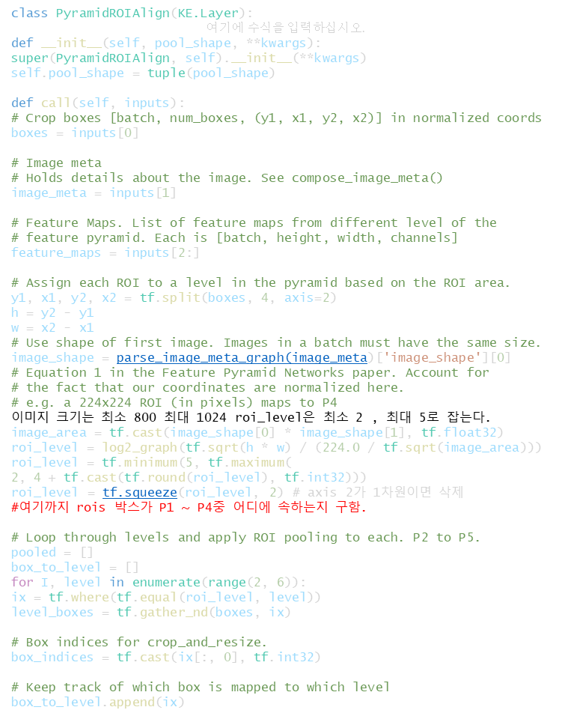
utils.py
호출
x = PyramidROIAlign([pool_size, pool_size],
name="roi_align_classifier")([rois, image_meta] + feature_maps)
class PyramidROIAlign(KE.Layer):
# Stop gradient propogation to ROI proposals
level_boxes = tf.stop_gradient(level_boxes)
box_indices = tf.stop_gradient(box_indices)
# Crop and Resize
# From Mask R-CNN paper: "We sample four regular locations, so
# that we can evaluate either max or average pooling. In fact,
# interpolating only a single value at each bin center (without
# pooling) is nearly as effective."
#
# Here we use the simplified approach of a single value per bin,
# which is how it's done in tf.crop_and_resize()
# Result: [batch * num_boxes, pool_height, pool_width, channels]
pooled.append(tf.image.crop_and_resize(
feature_maps[i], level_boxes, box_indices, self.pool_shape,
method="bilinear"))
# Pack pooled features into one tensor
pooled = tf.concat(pooled, axis=0)
# Pack box_to_level mapping into one array and add another
# column representing the order of pooled boxes
box_to_level = tf.concat(box_to_level, axis=0)
box_range = tf.expand_dims(tf.range(tf.shape(box_to_level)[0]), 1)
box_to_level = tf.concat([tf.cast(box_to_level, tf.int32), box_range],
axis=1)
# Rearrange pooled features to match the order of the original boxes
# Sort box_to_level by batch then box index
# TF doesn't have a way to sort by two columns, so merge them and sort.
sorting_tensor = box_to_level[:, 0] * 100000 + box_to_level[:, 1]
ix = tf.nn.top_k(sorting_tensor, k=tf.shape(
box_to_level)[0]).indices[::-1]
ix = tf.gather(box_to_level[:, 2], ix)
pooled = tf.gather(pooled, ix)
# Re-add the batch dimension
shape = tf.concat([tf.shape(boxes)[:2], tf.shape(pooled)[1:]], axis=0)
pooled = tf.reshape(pooled, shape)
return pooled
def compute_output_shape(self, input_shape):
return input_shape[0][:2] + self.pool_shape + (input_shape[2][-1], )
class PyramidROIAlign(KE.Layer):
def __init__(self, pool_shape, **kwargs):
super(PyramidROIAlign, self).__init__(**kwargs)
self.pool_shape = tuple(pool_shape)
def call(self, inputs):
# Crop boxes [batch, num_boxes, (y1, x1, y2, x2)] in normalized coords
boxes = inputs[0]
# Image meta
# Holds details about the image. See compose_image_meta()
image_meta = inputs[1]
# Feature Maps. List of feature maps from different level of the
# feature pyramid. Each is [batch, height, width, channels]
feature_maps = inputs[2:]
# Assign each ROI to a level in the pyramid based on the ROI area.
y1, x1, y2, x2 = tf.split(boxes, 4, axis=2)
h = y2 - y1
w = x2 - x1
# Use shape of first image. Images in a batch must have the same size.
image_shape = parse_image_meta_graph(image_meta)['image_shape'][0]
# Equation 1 in the Feature Pyramid Networks paper. Account for
# the fact that our coordinates are normalized here.
# e.g. a 224x224 ROI (in pixels) maps to P4
이미지 크기는 최소 800 최대 1024 roi_level은 최소 2 , 최대 5로 잡는다.
image_area = tf.cast(image_shape[0] * image_shape[1], tf.float32)
roi_level = log2_graph(tf.sqrt(h * w) / (224.0 / tf.sqrt(image_area)))
roi_level = tf.minimum(5, tf.maximum(
2, 4 + tf.cast(tf.round(roi_level), tf.int32)))
roi_level = tf.squeeze(roi_level, 2) # axis 2가 1차원이면 삭제
#여기까지 rois 박스가 P1 ~ P4중 어디에 속하는지 구함.
# Loop through levels and apply ROI pooling to each. P2 to P5.
pooled = []
box_to_level = []
for I, level in enumerate(range(2, 6)):
ix = tf.where(tf.equal(roi_level, level))
level_boxes = tf.gather_nd(boxes, ix)
# Box indices for crop_and_resize.
box_indices = tf.cast(ix[:, 0], tf.int32)
# Keep track of which box is mapped to which level
box_to_level.append(ix)
h=224이면 앞항은 0
$$k=\log_{2}{\frac{\sqrt{hw}\sqrt{image_area}}{224}=\log_{2}{\frac{\sqrt{hw}}{224}+\log_{2}{\sqrt{image_area}}=\log_{2}{\frac{\sqrt{hw}}{224}+k_{0}}}}$$
#ix 순서 즉 P2 ~ P5 순서때로 crop and resize된 박스 Pool을 구한다.
#level은 2 ~ 5 i는 0 ~ 3
P2 ~ P5 순으로 feature 맵에서 7x7로 자른 pool을 리턴한다.[batch, num_boxes, pool_height, pool_width, channels]
어떤게 P2이고 어떤게 P5인지 알수 있는가?

Slide 45
utils.py
class PyramidROIAlign(KE.Layer):
tf.image.crop_and_resize
기능:
freature map에서 같은 해당 레벨에 해당
하는 rois를 구하여 영역을 7x7로 잘라 낸다.
7
256
7
256
return def build_fpn_mask_graph

Slide 46
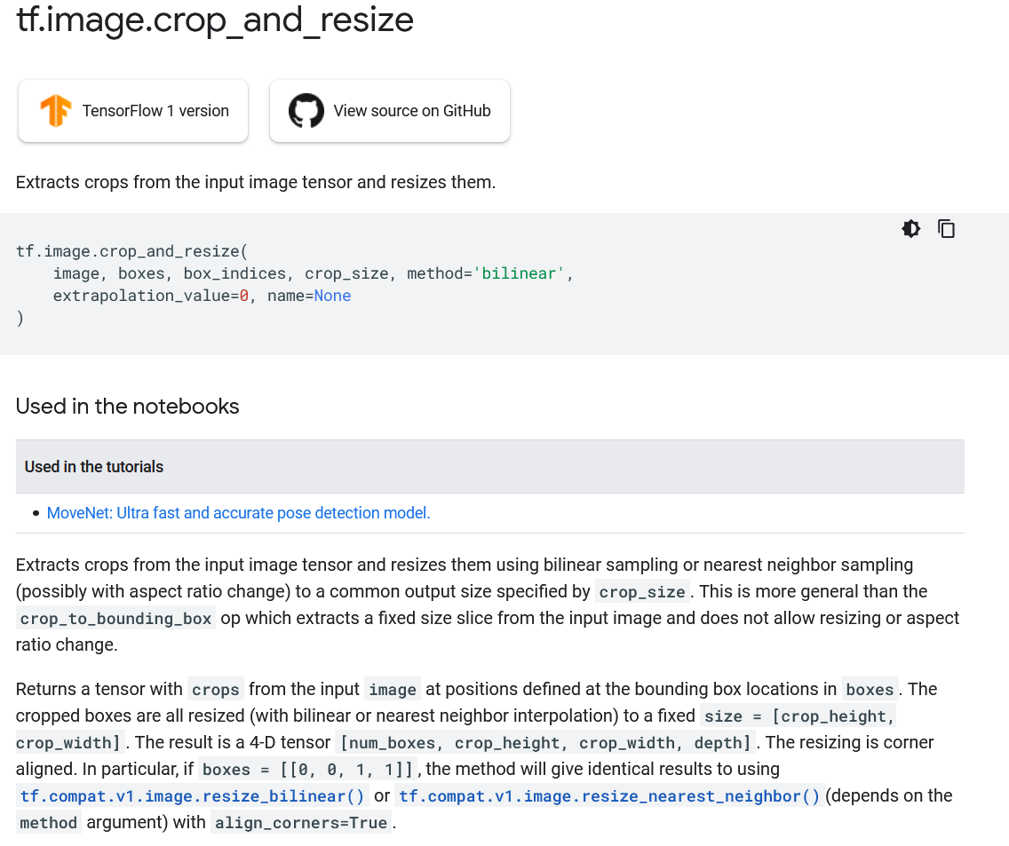
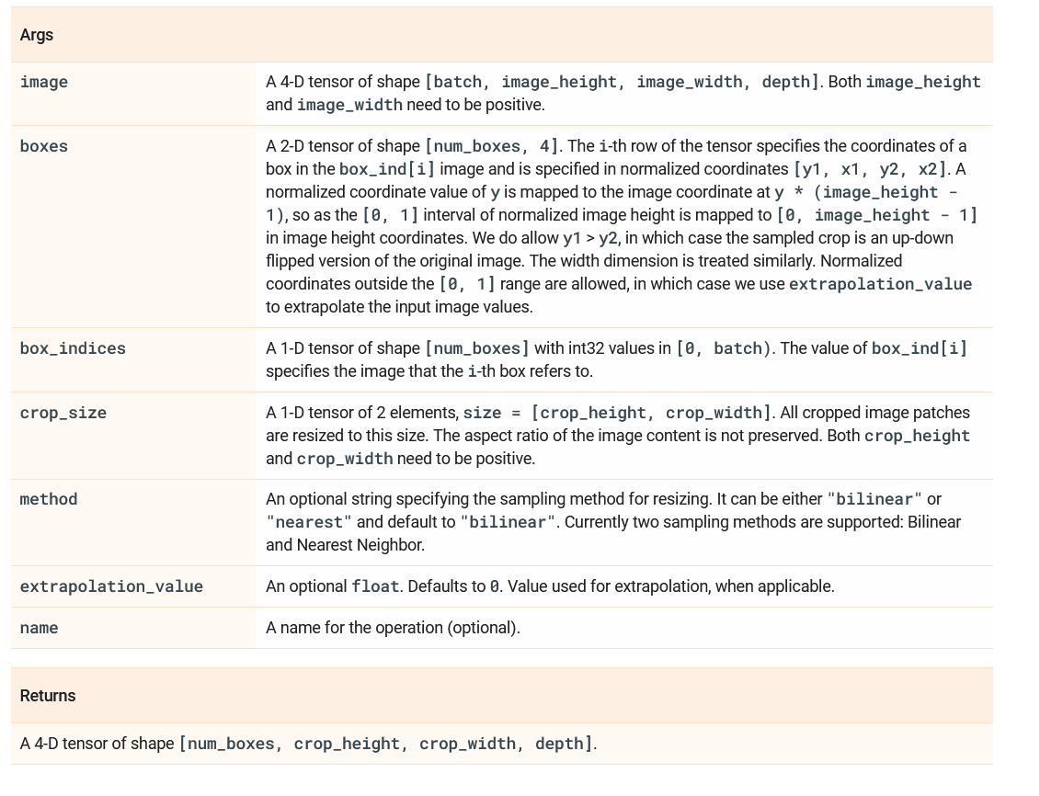
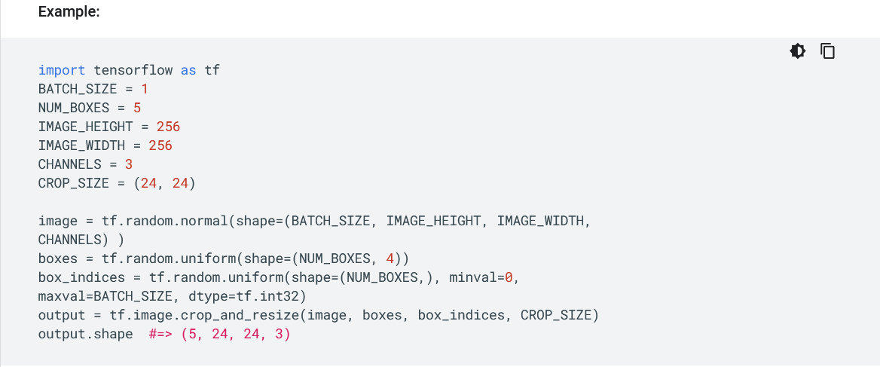
tf.image.crop_and_resize
return def detection_targets_graph

Slide 47
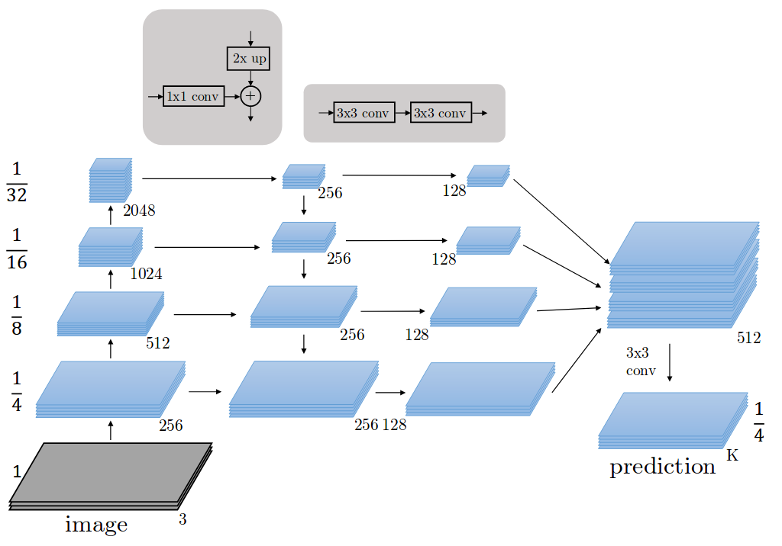
model.py
Feature Pyramid Network
return

Slide 48
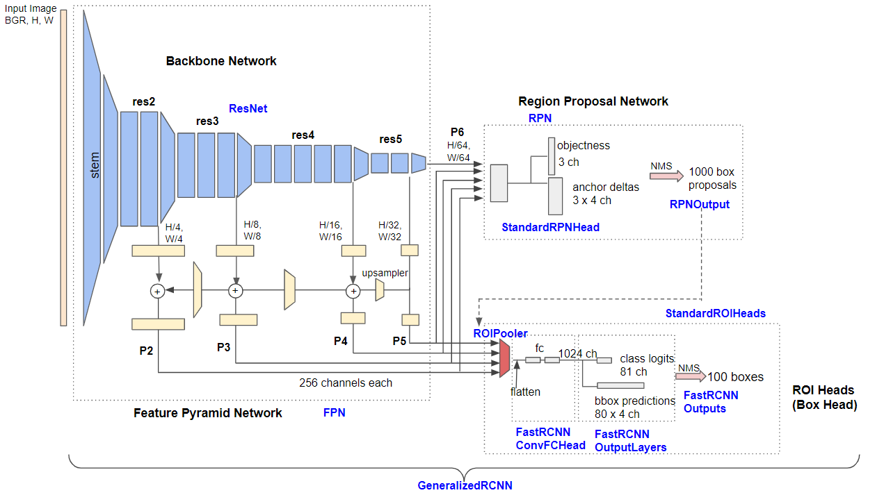
model.py
Training ResNet + Faster R-CNN with FPN

Slide 49
model.py
model summary
__________________________________________________________________________________________________
Layer (type) Output Shape Param # Connected to
==================================================================================================
input_image (InputLayer) [(None, None, None, 0
__________________________________________________________________________________________________
zero_padding2d (ZeroPadding2D) (None, None, None, 3 0 input_image[0][0]
__________________________________________________________________________________________________
conv1 (Conv2D) (None, None, None, 6 9472 zero_padding2d[0][0]
__________________________________________________________________________________________________
bn_conv1 (BatchNorm) (None, None, None, 6 256 conv1[0][0]
__________________________________________________________________________________________________
activation (Activation) (None, None, None, 6 0 bn_conv1[0][0]
__________________________________________________________________________________________________
max_pooling2d (MaxPooling2D) (None, None, None, 6 0 activation[0][0]
__________________________________________________________________________________________________
res2a_branch2a (Conv2D) (None, None, None, 6 4160 max_pooling2d[0][0]
__________________________________________________________________________________________________
bn2a_branch2a (BatchNorm) (None, None, None, 6 256 res2a_branch2a[0][0]
__________________________________________________________________________________________________
activation_1 (Activation) (None, None, None, 6 0 bn2a_branch2a[0][0]
__________________________________________________________________________________________________
res2a_branch2b (Conv2D) (None, None, None, 6 36928 activation_1[0][0]
__________________________________________________________________________________________________
bn2a_branch2b (BatchNorm) (None, None, None, 6 256 res2a_branch2b[0][0]
__________________________________________________________________________________________________
activation_2 (Activation) (None, None, None, 6 0 bn2a_branch2b[0][0]
__________________________________________________________________________________________________
res2a_branch2c (Conv2D) (None, None, None, 2 16640 activation_2[0][0]
__________________________________________________________________________________________________
res2a_branch1 (Conv2D) (None, None, None, 2 16640 max_pooling2d[0][0]
__________________________________________________________________________________________________
bn2a_branch2c (BatchNorm) (None, None, None, 2 1024 res2a_branch2c[0][0]
__________________________________________________________________________________________________
bn2a_branch1 (BatchNorm) (None, None, None, 2 1024 res2a_branch1[0][0]
__________________________________________________________________________________________________
add (Add) (None, None, None, 2 0 bn2a_branch2c[0][0]
bn2a_branch1[0][0]

Slide 50
model.py
__________________________________________________________________________________________________
res2a_out (Activation) (None, None, None, 2 0 add[0][0]
__________________________________________________________________________________________________
res2b_branch2a (Conv2D) (None, None, None, 6 16448 res2a_out[0][0]
__________________________________________________________________________________________________
bn2b_branch2a (BatchNorm) (None, None, None, 6 256 res2b_branch2a[0][0]
__________________________________________________________________________________________________
activation_3 (Activation) (None, None, None, 6 0 bn2b_branch2a[0][0]
__________________________________________________________________________________________________
res2b_branch2b (Conv2D) (None, None, None, 6 36928 activation_3[0][0]
__________________________________________________________________________________________________
bn2b_branch2b (BatchNorm) (None, None, None, 6 256 res2b_branch2b[0][0]
__________________________________________________________________________________________________
activation_4 (Activation) (None, None, None, 6 0 bn2b_branch2b[0][0]
__________________________________________________________________________________________________
res2b_branch2c (Conv2D) (None, None, None, 2 16640 activation_4[0][0]
__________________________________________________________________________________________________
bn2b_branch2c (BatchNorm) (None, None, None, 2 1024 res2b_branch2c[0][0]
__________________________________________________________________________________________________
add_1 (Add) (None, None, None, 2 0 bn2b_branch2c[0][0]
res2a_out[0][0]
__________________________________________________________________________________________________
res2b_out (Activation) (None, None, None, 2 0 add_1[0][0]
__________________________________________________________________________________________________
res2c_branch2a (Conv2D) (None, None, None, 6 16448 res2b_out[0][0]
__________________________________________________________________________________________________
bn2c_branch2a (BatchNorm) (None, None, None, 6 256 res2c_branch2a[0][0]
__________________________________________________________________________________________________
activation_5 (Activation) (None, None, None, 6 0 bn2c_branch2a[0][0]
__________________________________________________________________________________________________
res2c_branch2b (Conv2D) (None, None, None, 6 36928 activation_5[0][0]
__________________________________________________________________________________________________
bn2c_branch2b (BatchNorm) (None, None, None, 6 256 res2c_branch2b[0][0]
__________________________________________________________________________________________________
activation_6 (Activation) (None, None, None, 6 0 bn2c_branch2b[0][0]
__________________________________________________________________________________________________
res2c_branch2c (Conv2D) (None, None, None, 2 16640 activation_6[0][0]
__________________________________________________________________________________________________
bn2c_branch2c (BatchNorm) (None, None, None, 2 1024 res2c_branch2c[0][0]
__________________________________________________________________________________________________
add_2 (Add) (None, None, None, 2 0 bn2c_branch2c[0][0]
res2b_out[0][0]
model summary

Slide 51
model.py
__________________________________________________________________________________________________
res2c_out (Activation) (None, None, None, 2 0 add_2[0][0]
__________________________________________________________________________________________________
res3a_branch2a (Conv2D) (None, None, None, 1 32896 res2c_out[0][0]
__________________________________________________________________________________________________
bn3a_branch2a (BatchNorm) (None, None, None, 1 512 res3a_branch2a[0][0]
__________________________________________________________________________________________________
activation_7 (Activation) (None, None, None, 1 0 bn3a_branch2a[0][0]
__________________________________________________________________________________________________
res3a_branch2b (Conv2D) (None, None, None, 1 147584 activation_7[0][0]
__________________________________________________________________________________________________
bn3a_branch2b (BatchNorm) (None, None, None, 1 512 res3a_branch2b[0][0]
__________________________________________________________________________________________________
activation_8 (Activation) (None, None, None, 1 0 bn3a_branch2b[0][0]
__________________________________________________________________________________________________
res3a_branch2c (Conv2D) (None, None, None, 5 66048 activation_8[0][0]
__________________________________________________________________________________________________
res3a_branch1 (Conv2D) (None, None, None, 5 131584 res2c_out[0][0]
__________________________________________________________________________________________________
bn3a_branch2c (BatchNorm) (None, None, None, 5 2048 res3a_branch2c[0][0]
__________________________________________________________________________________________________
bn3a_branch1 (BatchNorm) (None, None, None, 5 2048 res3a_branch1[0][0]
__________________________________________________________________________________________________
add_3 (Add) (None, None, None, 5 0 bn3a_branch2c[0][0]
bn3a_branch1[0][0]
__________________________________________________________________________________________________
res3a_out (Activation) (None, None, None, 5 0 add_3[0][0]
__________________________________________________________________________________________________
res3b_branch2a (Conv2D) (None, None, None, 1 65664 res3a_out[0][0]
__________________________________________________________________________________________________
bn3b_branch2a (BatchNorm) (None, None, None, 1 512 res3b_branch2a[0][0]
__________________________________________________________________________________________________
activation_9 (Activation) (None, None, None, 1 0 bn3b_branch2a[0][0]
__________________________________________________________________________________________________
res3b_branch2b (Conv2D) (None, None, None, 1 147584 activation_9[0][0]
__________________________________________________________________________________________________
bn3b_branch2b (BatchNorm) (None, None, None, 1 512 res3b_branch2b[0][0]
__________________________________________________________________________________________________
activation_10 (Activation) (None, None, None, 1 0 bn3b_branch2b[0][0]
__________________________________________________________________________________________________
res3b_branch2c (Conv2D) (None, None, None, 5 66048 activation_10[0][0]
__________________________________________________________________________________________________
bn3b_branch2c (BatchNorm) (None, None, None, 5 2048 res3b_branch2c[0][0]
__________________________________________________________________________________________________
add_4 (Add) (None, None, None, 5 0 bn3b_branch2c[0][0]
res3a_out[0][0]
model summary

Slide 52
model.py
__________________________________________________________________________________________________
res3b_out (Activation) (None, None, None, 5 0 add_4[0][0]
__________________________________________________________________________________________________
res3c_branch2a (Conv2D) (None, None, None, 1 65664 res3b_out[0][0]
__________________________________________________________________________________________________
bn3c_branch2a (BatchNorm) (None, None, None, 1 512 res3c_branch2a[0][0]
__________________________________________________________________________________________________
activation_11 (Activation) (None, None, None, 1 0 bn3c_branch2a[0][0]
__________________________________________________________________________________________________
res3c_branch2b (Conv2D) (None, None, None, 1 147584 activation_11[0][0]
__________________________________________________________________________________________________
bn3c_branch2b (BatchNorm) (None, None, None, 1 512 res3c_branch2b[0][0]
__________________________________________________________________________________________________
activation_12 (Activation) (None, None, None, 1 0 bn3c_branch2b[0][0]
__________________________________________________________________________________________________
res3c_branch2c (Conv2D) (None, None, None, 5 66048 activation_12[0][0]
__________________________________________________________________________________________________
bn3c_branch2c (BatchNorm) (None, None, None, 5 2048 res3c_branch2c[0][0]
__________________________________________________________________________________________________
add_5 (Add) (None, None, None, 5 0 bn3c_branch2c[0][0]
res3b_out[0][0]
__________________________________________________________________________________________________
res3c_out (Activation) (None, None, None, 5 0 add_5[0][0]
__________________________________________________________________________________________________
res3d_branch2a (Conv2D) (None, None, None, 1 65664 res3c_out[0][0]
__________________________________________________________________________________________________
bn3d_branch2a (BatchNorm) (None, None, None, 1 512 res3d_branch2a[0][0]
__________________________________________________________________________________________________
activation_13 (Activation) (None, None, None, 1 0 bn3d_branch2a[0][0]
__________________________________________________________________________________________________
res3d_branch2b (Conv2D) (None, None, None, 1 147584 activation_13[0][0]
__________________________________________________________________________________________________
bn3d_branch2b (BatchNorm) (None, None, None, 1 512 res3d_branch2b[0][0]
__________________________________________________________________________________________________
activation_14 (Activation) (None, None, None, 1 0 bn3d_branch2b[0][0]
__________________________________________________________________________________________________
res3d_branch2c (Conv2D) (None, None, None, 5 66048 activation_14[0][0]
__________________________________________________________________________________________________
bn3d_branch2c (BatchNorm) (None, None, None, 5 2048 res3d_branch2c[0][0]
__________________________________________________________________________________________________
add_6 (Add) (None, None, None, 5 0 bn3d_branch2c[0][0]
res3c_out[0][0]
model summary

Slide 53
model.py
model summary
__________________________________________________________________________________________________
res3d_out (Activation) (None, None, None, 5 0 add_6[0][0]
__________________________________________________________________________________________________
res4a_branch2a (Conv2D) (None, None, None, 2 131328 res3d_out[0][0]
__________________________________________________________________________________________________
bn4a_branch2a (BatchNorm) (None, None, None, 2 1024 res4a_branch2a[0][0]
__________________________________________________________________________________________________
activation_15 (Activation) (None, None, None, 2 0 bn4a_branch2a[0][0]
__________________________________________________________________________________________________
res4a_branch2b (Conv2D) (None, None, None, 2 590080 activation_15[0][0]
__________________________________________________________________________________________________
bn4a_branch2b (BatchNorm) (None, None, None, 2 1024 res4a_branch2b[0][0]
__________________________________________________________________________________________________
activation_16 (Activation) (None, None, None, 2 0 bn4a_branch2b[0][0]
__________________________________________________________________________________________________
res4a_branch2c (Conv2D) (None, None, None, 1 263168 activation_16[0][0]
__________________________________________________________________________________________________
res4a_branch1 (Conv2D) (None, None, None, 1 525312 res3d_out[0][0]
__________________________________________________________________________________________________
bn4a_branch2c (BatchNorm) (None, None, None, 1 4096 res4a_branch2c[0][0]
__________________________________________________________________________________________________
bn4a_branch1 (BatchNorm) (None, None, None, 1 4096 res4a_branch1[0][0]
__________________________________________________________________________________________________
add_7 (Add) (None, None, None, 1 0 bn4a_branch2c[0][0]
bn4a_branch1[0][0]
__________________________________________________________________________________________________
res4a_out (Activation) (None, None, None, 1 0 add_7[0][0]
__________________________________________________________________________________________________
res4b_branch2a (Conv2D) (None, None, None, 2 262400 res4a_out[0][0]
__________________________________________________________________________________________________
bn4b_branch2a (BatchNorm) (None, None, None, 2 1024 res4b_branch2a[0][0]
__________________________________________________________________________________________________
activation_17 (Activation) (None, None, None, 2 0 bn4b_branch2a[0][0]
__________________________________________________________________________________________________
res4b_branch2b (Conv2D) (None, None, None, 2 590080 activation_17[0][0]
__________________________________________________________________________________________________
bn4b_branch2b (BatchNorm) (None, None, None, 2 1024 res4b_branch2b[0][0]
__________________________________________________________________________________________________
activation_18 (Activation) (None, None, None, 2 0 bn4b_branch2b[0][0]
__________________________________________________________________________________________________
res4b_branch2c (Conv2D) (None, None, None, 1 263168 activation_18[0][0]
__________________________________________________________________________________________________
bn4b_branch2c (BatchNorm) (None, None, None, 1 4096 res4b_branch2c[0][0]
__________________________________________________________________________________________________
add_8 (Add) (None, None, None, 1 0 bn4b_branch2c[0][0]
res4a_out[0][0]

Slide 54
model.py
__________________________________________________________________________________________________
res4b_out (Activation) (None, None, None, 1 0 add_8[0][0]
__________________________________________________________________________________________________
res4c_branch2a (Conv2D) (None, None, None, 2 262400 res4b_out[0][0]
__________________________________________________________________________________________________
bn4c_branch2a (BatchNorm) (None, None, None, 2 1024 res4c_branch2a[0][0]
__________________________________________________________________________________________________
activation_19 (Activation) (None, None, None, 2 0 bn4c_branch2a[0][0]
__________________________________________________________________________________________________
res4c_branch2b (Conv2D) (None, None, None, 2 590080 activation_19[0][0]
__________________________________________________________________________________________________
bn4c_branch2b (BatchNorm) (None, None, None, 2 1024 res4c_branch2b[0][0]
__________________________________________________________________________________________________
activation_20 (Activation) (None, None, None, 2 0 bn4c_branch2b[0][0]
__________________________________________________________________________________________________
res4c_branch2c (Conv2D) (None, None, None, 1 263168 activation_20[0][0]
__________________________________________________________________________________________________
bn4c_branch2c (BatchNorm) (None, None, None, 1 4096 res4c_branch2c[0][0]
__________________________________________________________________________________________________
add_9 (Add) (None, None, None, 1 0 bn4c_branch2c[0][0]
res4b_out[0][0]
__________________________________________________________________________________________________
res4c_out (Activation) (None, None, None, 1 0 add_9[0][0]
__________________________________________________________________________________________________
res4d_branch2a (Conv2D) (None, None, None, 2 262400 res4c_out[0][0]
__________________________________________________________________________________________________
bn4d_branch2a (BatchNorm) (None, None, None, 2 1024 res4d_branch2a[0][0]
__________________________________________________________________________________________________
activation_21 (Activation) (None, None, None, 2 0 bn4d_branch2a[0][0]
__________________________________________________________________________________________________
res4d_branch2b (Conv2D) (None, None, None, 2 590080 activation_21[0][0]
__________________________________________________________________________________________________
bn4d_branch2b (BatchNorm) (None, None, None, 2 1024 res4d_branch2b[0][0]
__________________________________________________________________________________________________
activation_22 (Activation) (None, None, None, 2 0 bn4d_branch2b[0][0]
__________________________________________________________________________________________________
res4d_branch2c (Conv2D) (None, None, None, 1 263168 activation_22[0][0]
__________________________________________________________________________________________________
bn4d_branch2c (BatchNorm) (None, None, None, 1 4096 res4d_branch2c[0][0]
__________________________________________________________________________________________________
add_10 (Add) (None, None, None, 1 0 bn4d_branch2c[0][0]
res4c_out[0][0]
model summary

Slide 55
model.py
res4d_out (Activation) (None, None, None, 1 0 add_10[0][0]
__________________________________________________________________________________________________
res4e_branch2a (Conv2D) (None, None, None, 2 262400 res4d_out[0][0]
__________________________________________________________________________________________________
bn4e_branch2a (BatchNorm) (None, None, None, 2 1024 res4e_branch2a[0][0]
__________________________________________________________________________________________________
activation_23 (Activation) (None, None, None, 2 0 bn4e_branch2a[0][0]
__________________________________________________________________________________________________
res4e_branch2b (Conv2D) (None, None, None, 2 590080 activation_23[0][0]
__________________________________________________________________________________________________
bn4e_branch2b (BatchNorm) (None, None, None, 2 1024 res4e_branch2b[0][0]
__________________________________________________________________________________________________
activation_24 (Activation) (None, None, None, 2 0 bn4e_branch2b[0][0]
__________________________________________________________________________________________________
res4e_branch2c (Conv2D) (None, None, None, 1 263168 activation_24[0][0]
__________________________________________________________________________________________________
bn4e_branch2c (BatchNorm) (None, None, None, 1 4096 res4e_branch2c[0][0]
__________________________________________________________________________________________________
add_11 (Add) (None, None, None, 1 0 bn4e_branch2c[0][0]
res4d_out[0][0]
__________________________________________________________________________________________________
res4e_out (Activation) (None, None, None, 1 0 add_11[0][0]
__________________________________________________________________________________________________
res4f_branch2a (Conv2D) (None, None, None, 2 262400 res4e_out[0][0]
__________________________________________________________________________________________________
bn4f_branch2a (BatchNorm) (None, None, None, 2 1024 res4f_branch2a[0][0]
__________________________________________________________________________________________________
activation_25 (Activation) (None, None, None, 2 0 bn4f_branch2a[0][0]
__________________________________________________________________________________________________
res4f_branch2b (Conv2D) (None, None, None, 2 590080 activation_25[0][0]
__________________________________________________________________________________________________
bn4f_branch2b (BatchNorm) (None, None, None, 2 1024 res4f_branch2b[0][0]
__________________________________________________________________________________________________
activation_26 (Activation) (None, None, None, 2 0 bn4f_branch2b[0][0]
__________________________________________________________________________________________________
res4f_branch2c (Conv2D) (None, None, None, 1 263168 activation_26[0][0]
__________________________________________________________________________________________________
bn4f_branch2c (BatchNorm) (None, None, None, 1 4096 res4f_branch2c[0][0]
__________________________________________________________________________________________________
add_12 (Add) (None, None, None, 1 0 bn4f_branch2c[0][0]
res4e_out[0][0]
model summary

Slide 56
model.py
__________________________________________________________________________________________________
res4f_out (Activation) (None, None, None, 1 0 add_12[0][0]
__________________________________________________________________________________________________
res4g_branch2a (Conv2D) (None, None, None, 2 262400 res4f_out[0][0]
__________________________________________________________________________________________________
bn4g_branch2a (BatchNorm) (None, None, None, 2 1024 res4g_branch2a[0][0]
__________________________________________________________________________________________________
activation_27 (Activation) (None, None, None, 2 0 bn4g_branch2a[0][0]
__________________________________________________________________________________________________
res4g_branch2b (Conv2D) (None, None, None, 2 590080 activation_27[0][0]
__________________________________________________________________________________________________
bn4g_branch2b (BatchNorm) (None, None, None, 2 1024 res4g_branch2b[0][0]
__________________________________________________________________________________________________
activation_28 (Activation) (None, None, None, 2 0 bn4g_branch2b[0][0]
__________________________________________________________________________________________________
res4g_branch2c (Conv2D) (None, None, None, 1 263168 activation_28[0][0]
__________________________________________________________________________________________________
bn4g_branch2c (BatchNorm) (None, None, None, 1 4096 res4g_branch2c[0][0]
__________________________________________________________________________________________________
add_13 (Add) (None, None, None, 1 0 bn4g_branch2c[0][0]
res4f_out[0][0]
__________________________________________________________________________________________________
res4g_out (Activation) (None, None, None, 1 0 add_13[0][0]
__________________________________________________________________________________________________
res4h_branch2a (Conv2D) (None, None, None, 2 262400 res4g_out[0][0]
__________________________________________________________________________________________________
bn4h_branch2a (BatchNorm) (None, None, None, 2 1024 res4h_branch2a[0][0]
__________________________________________________________________________________________________
activation_29 (Activation) (None, None, None, 2 0 bn4h_branch2a[0][0]
__________________________________________________________________________________________________
res4h_branch2b (Conv2D) (None, None, None, 2 590080 activation_29[0][0]
__________________________________________________________________________________________________
bn4h_branch2b (BatchNorm) (None, None, None, 2 1024 res4h_branch2b[0][0]
__________________________________________________________________________________________________
activation_30 (Activation) (None, None, None, 2 0 bn4h_branch2b[0][0]
__________________________________________________________________________________________________
res4h_branch2c (Conv2D) (None, None, None, 1 263168 activation_30[0][0]
__________________________________________________________________________________________________
bn4h_branch2c (BatchNorm) (None, None, None, 1 4096 res4h_branch2c[0][0]
__________________________________________________________________________________________________
add_14 (Add) (None, None, None, 1 0 bn4h_branch2c[0][0]
res4g_out[0][0]
model summary

Slide 57
model.py
__________________________________________________________________________________________________
res4h_out (Activation) (None, None, None, 1 0 add_14[0][0]
__________________________________________________________________________________________________
res4i_branch2a (Conv2D) (None, None, None, 2 262400 res4h_out[0][0]
__________________________________________________________________________________________________
bn4i_branch2a (BatchNorm) (None, None, None, 2 1024 res4i_branch2a[0][0]
__________________________________________________________________________________________________
activation_31 (Activation) (None, None, None, 2 0 bn4i_branch2a[0][0]
__________________________________________________________________________________________________
res4i_branch2b (Conv2D) (None, None, None, 2 590080 activation_31[0][0]
__________________________________________________________________________________________________
bn4i_branch2b (BatchNorm) (None, None, None, 2 1024 res4i_branch2b[0][0]
__________________________________________________________________________________________________
activation_32 (Activation) (None, None, None, 2 0 bn4i_branch2b[0][0]
__________________________________________________________________________________________________
res4i_branch2c (Conv2D) (None, None, None, 1 263168 activation_32[0][0]
__________________________________________________________________________________________________
bn4i_branch2c (BatchNorm) (None, None, None, 1 4096 res4i_branch2c[0][0]
__________________________________________________________________________________________________
add_15 (Add) (None, None, None, 1 0 bn4i_branch2c[0][0]
res4h_out[0][0]
__________________________________________________________________________________________________
res4i_out (Activation) (None, None, None, 1 0 add_15[0][0]
__________________________________________________________________________________________________
res4j_branch2a (Conv2D) (None, None, None, 2 262400 res4i_out[0][0]
__________________________________________________________________________________________________
bn4j_branch2a (BatchNorm) (None, None, None, 2 1024 res4j_branch2a[0][0]
__________________________________________________________________________________________________
activation_33 (Activation) (None, None, None, 2 0 bn4j_branch2a[0][0]
__________________________________________________________________________________________________
res4j_branch2b (Conv2D) (None, None, None, 2 590080 activation_33[0][0]
__________________________________________________________________________________________________
bn4j_branch2b (BatchNorm) (None, None, None, 2 1024 res4j_branch2b[0][0]
__________________________________________________________________________________________________
activation_34 (Activation) (None, None, None, 2 0 bn4j_branch2b[0][0]
__________________________________________________________________________________________________
res4j_branch2c (Conv2D) (None, None, None, 1 263168 activation_34[0][0]
__________________________________________________________________________________________________
bn4j_branch2c (BatchNorm) (None, None, None, 1 4096 res4j_branch2c[0][0]
__________________________________________________________________________________________________
add_16 (Add) (None, None, None, 1 0 bn4j_branch2c[0][0]
res4i_out[0][0]
model summary

Slide 58
model.py
__________________________________________________________________________________________________
res4j_out (Activation) (None, None, None, 1 0 add_16[0][0]
__________________________________________________________________________________________________
res4k_branch2a (Conv2D) (None, None, None, 2 262400 res4j_out[0][0]
__________________________________________________________________________________________________
bn4k_branch2a (BatchNorm) (None, None, None, 2 1024 res4k_branch2a[0][0]
__________________________________________________________________________________________________
activation_35 (Activation) (None, None, None, 2 0 bn4k_branch2a[0][0]
__________________________________________________________________________________________________
res4k_branch2b (Conv2D) (None, None, None, 2 590080 activation_35[0][0]
__________________________________________________________________________________________________
bn4k_branch2b (BatchNorm) (None, None, None, 2 1024 res4k_branch2b[0][0]
__________________________________________________________________________________________________
activation_36 (Activation) (None, None, None, 2 0 bn4k_branch2b[0][0]
__________________________________________________________________________________________________
res4k_branch2c (Conv2D) (None, None, None, 1 263168 activation_36[0][0]
__________________________________________________________________________________________________
bn4k_branch2c (BatchNorm) (None, None, None, 1 4096 res4k_branch2c[0][0]
__________________________________________________________________________________________________
add_17 (Add) (None, None, None, 1 0 bn4k_branch2c[0][0]
res4j_out[0][0]
__________________________________________________________________________________________________
res4k_out (Activation) (None, None, None, 1 0 add_17[0][0]
__________________________________________________________________________________________________
res4l_branch2a (Conv2D) (None, None, None, 2 262400 res4k_out[0][0]
__________________________________________________________________________________________________
bn4l_branch2a (BatchNorm) (None, None, None, 2 1024 res4l_branch2a[0][0]
__________________________________________________________________________________________________
activation_37 (Activation) (None, None, None, 2 0 bn4l_branch2a[0][0]
__________________________________________________________________________________________________
res4l_branch2b (Conv2D) (None, None, None, 2 590080 activation_37[0][0]
__________________________________________________________________________________________________
bn4l_branch2b (BatchNorm) (None, None, None, 2 1024 res4l_branch2b[0][0]
__________________________________________________________________________________________________
activation_38 (Activation) (None, None, None, 2 0 bn4l_branch2b[0][0]
__________________________________________________________________________________________________
res4l_branch2c (Conv2D) (None, None, None, 1 263168 activation_38[0][0]
__________________________________________________________________________________________________
bn4l_branch2c (BatchNorm) (None, None, None, 1 4096 res4l_branch2c[0][0]
__________________________________________________________________________________________________
add_18 (Add) (None, None, None, 1 0 bn4l_branch2c[0][0]
res4k_out[0][0]
model summary

Slide 59
model.py
__________________________________________________________________________________________________
res4l_out (Activation) (None, None, None, 1 0 add_18[0][0]
__________________________________________________________________________________________________
res4m_branch2a (Conv2D) (None, None, None, 2 262400 res4l_out[0][0]
__________________________________________________________________________________________________
bn4m_branch2a (BatchNorm) (None, None, None, 2 1024 res4m_branch2a[0][0]
__________________________________________________________________________________________________
activation_39 (Activation) (None, None, None, 2 0 bn4m_branch2a[0][0]
__________________________________________________________________________________________________
res4m_branch2b (Conv2D) (None, None, None, 2 590080 activation_39[0][0]
__________________________________________________________________________________________________
bn4m_branch2b (BatchNorm) (None, None, None, 2 1024 res4m_branch2b[0][0]
__________________________________________________________________________________________________
activation_40 (Activation) (None, None, None, 2 0 bn4m_branch2b[0][0]
__________________________________________________________________________________________________
res4m_branch2c (Conv2D) (None, None, None, 1 263168 activation_40[0][0]
__________________________________________________________________________________________________
bn4m_branch2c (BatchNorm) (None, None, None, 1 4096 res4m_branch2c[0][0]
__________________________________________________________________________________________________
add_19 (Add) (None, None, None, 1 0 bn4m_branch2c[0][0]
res4l_out[0][0]
__________________________________________________________________________________________________
res4m_out (Activation) (None, None, None, 1 0 add_19[0][0]
__________________________________________________________________________________________________
res4n_branch2a (Conv2D) (None, None, None, 2 262400 res4m_out[0][0]
__________________________________________________________________________________________________
bn4n_branch2a (BatchNorm) (None, None, None, 2 1024 res4n_branch2a[0][0]
__________________________________________________________________________________________________
activation_41 (Activation) (None, None, None, 2 0 bn4n_branch2a[0][0]
__________________________________________________________________________________________________
res4n_branch2b (Conv2D) (None, None, None, 2 590080 activation_41[0][0]
__________________________________________________________________________________________________
bn4n_branch2b (BatchNorm) (None, None, None, 2 1024 res4n_branch2b[0][0]
__________________________________________________________________________________________________
activation_42 (Activation) (None, None, None, 2 0 bn4n_branch2b[0][0]
__________________________________________________________________________________________________
res4n_branch2c (Conv2D) (None, None, None, 1 263168 activation_42[0][0]
__________________________________________________________________________________________________
bn4n_branch2c (BatchNorm) (None, None, None, 1 4096 res4n_branch2c[0][0]
__________________________________________________________________________________________________
add_20 (Add) (None, None, None, 1 0 bn4n_branch2c[0][0]
res4m_out[0][0]
model summary

Slide 60
model.py
__________________________________________________________________________________________________
res4n_out (Activation) (None, None, None, 1 0 add_20[0][0]
__________________________________________________________________________________________________
res4o_branch2a (Conv2D) (None, None, None, 2 262400 res4n_out[0][0]
__________________________________________________________________________________________________
bn4o_branch2a (BatchNorm) (None, None, None, 2 1024 res4o_branch2a[0][0]
__________________________________________________________________________________________________
activation_43 (Activation) (None, None, None, 2 0 bn4o_branch2a[0][0]
__________________________________________________________________________________________________
res4o_branch2b (Conv2D) (None, None, None, 2 590080 activation_43[0][0]
__________________________________________________________________________________________________
bn4o_branch2b (BatchNorm) (None, None, None, 2 1024 res4o_branch2b[0][0]
__________________________________________________________________________________________________
activation_44 (Activation) (None, None, None, 2 0 bn4o_branch2b[0][0]
__________________________________________________________________________________________________
res4o_branch2c (Conv2D) (None, None, None, 1 263168 activation_44[0][0]
__________________________________________________________________________________________________
bn4o_branch2c (BatchNorm) (None, None, None, 1 4096 res4o_branch2c[0][0]
__________________________________________________________________________________________________
add_21 (Add) (None, None, None, 1 0 bn4o_branch2c[0][0]
res4n_out[0][0]
__________________________________________________________________________________________________
res4o_out (Activation) (None, None, None, 1 0 add_21[0][0]
__________________________________________________________________________________________________
res4p_branch2a (Conv2D) (None, None, None, 2 262400 res4o_out[0][0]
__________________________________________________________________________________________________
bn4p_branch2a (BatchNorm) (None, None, None, 2 1024 res4p_branch2a[0][0]
__________________________________________________________________________________________________
activation_45 (Activation) (None, None, None, 2 0 bn4p_branch2a[0][0]
__________________________________________________________________________________________________
res4p_branch2b (Conv2D) (None, None, None, 2 590080 activation_45[0][0]
__________________________________________________________________________________________________
bn4p_branch2b (BatchNorm) (None, None, None, 2 1024 res4p_branch2b[0][0]
__________________________________________________________________________________________________
activation_46 (Activation) (None, None, None, 2 0 bn4p_branch2b[0][0]
__________________________________________________________________________________________________
res4p_branch2c (Conv2D) (None, None, None, 1 263168 activation_46[0][0]
__________________________________________________________________________________________________
bn4p_branch2c (BatchNorm) (None, None, None, 1 4096 res4p_branch2c[0][0]
__________________________________________________________________________________________________
add_22 (Add) (None, None, None, 1 0 bn4p_branch2c[0][0]
res4o_out[0][0]
model summary

Slide 61
model.py
__________________________________________________________________________________________________
res4p_out (Activation) (None, None, None, 1 0 add_22[0][0]
__________________________________________________________________________________________________
res4q_branch2a (Conv2D) (None, None, None, 2 262400 res4p_out[0][0]
__________________________________________________________________________________________________
bn4q_branch2a (BatchNorm) (None, None, None, 2 1024 res4q_branch2a[0][0]
__________________________________________________________________________________________________
activation_47 (Activation) (None, None, None, 2 0 bn4q_branch2a[0][0]
__________________________________________________________________________________________________
res4q_branch2b (Conv2D) (None, None, None, 2 590080 activation_47[0][0]
__________________________________________________________________________________________________
bn4q_branch2b (BatchNorm) (None, None, None, 2 1024 res4q_branch2b[0][0]
__________________________________________________________________________________________________
activation_48 (Activation) (None, None, None, 2 0 bn4q_branch2b[0][0]
__________________________________________________________________________________________________
res4q_branch2c (Conv2D) (None, None, None, 1 263168 activation_48[0][0]
__________________________________________________________________________________________________
bn4q_branch2c (BatchNorm) (None, None, None, 1 4096 res4q_branch2c[0][0]
__________________________________________________________________________________________________
add_23 (Add) (None, None, None, 1 0 bn4q_branch2c[0][0]
res4p_out[0][0]
__________________________________________________________________________________________________
res4q_out (Activation) (None, None, None, 1 0 add_23[0][0]
__________________________________________________________________________________________________
res4r_branch2a (Conv2D) (None, None, None, 2 262400 res4q_out[0][0]
__________________________________________________________________________________________________
bn4r_branch2a (BatchNorm) (None, None, None, 2 1024 res4r_branch2a[0][0]
__________________________________________________________________________________________________
activation_49 (Activation) (None, None, None, 2 0 bn4r_branch2a[0][0]
__________________________________________________________________________________________________
res4r_branch2b (Conv2D) (None, None, None, 2 590080 activation_49[0][0]
__________________________________________________________________________________________________
bn4r_branch2b (BatchNorm) (None, None, None, 2 1024 res4r_branch2b[0][0]
__________________________________________________________________________________________________
activation_50 (Activation) (None, None, None, 2 0 bn4r_branch2b[0][0]
__________________________________________________________________________________________________
res4r_branch2c (Conv2D) (None, None, None, 1 263168 activation_50[0][0]
__________________________________________________________________________________________________
bn4r_branch2c (BatchNorm) (None, None, None, 1 4096 res4r_branch2c[0][0]
__________________________________________________________________________________________________
add_24 (Add) (None, None, None, 1 0 bn4r_branch2c[0][0]
res4q_out[0][0]
model summary

Slide 62
model.py
__________________________________________________________________________________________________
res4r_out (Activation) (None, None, None, 1 0 add_24[0][0]
__________________________________________________________________________________________________
res4s_branch2a (Conv2D) (None, None, None, 2 262400 res4r_out[0][0]
__________________________________________________________________________________________________
bn4s_branch2a (BatchNorm) (None, None, None, 2 1024 res4s_branch2a[0][0]
__________________________________________________________________________________________________
activation_51 (Activation) (None, None, None, 2 0 bn4s_branch2a[0][0]
__________________________________________________________________________________________________
res4s_branch2b (Conv2D) (None, None, None, 2 590080 activation_51[0][0]
__________________________________________________________________________________________________
bn4s_branch2b (BatchNorm) (None, None, None, 2 1024 res4s_branch2b[0][0]
__________________________________________________________________________________________________
activation_52 (Activation) (None, None, None, 2 0 bn4s_branch2b[0][0]
__________________________________________________________________________________________________
res4s_branch2c (Conv2D) (None, None, None, 1 263168 activation_52[0][0]
__________________________________________________________________________________________________
bn4s_branch2c (BatchNorm) (None, None, None, 1 4096 res4s_branch2c[0][0]
__________________________________________________________________________________________________
add_25 (Add) (None, None, None, 1 0 bn4s_branch2c[0][0]
res4r_out[0][0]
__________________________________________________________________________________________________
res4s_out (Activation) (None, None, None, 1 0 add_25[0][0]
__________________________________________________________________________________________________
res4t_branch2a (Conv2D) (None, None, None, 2 262400 res4s_out[0][0]
__________________________________________________________________________________________________
bn4t_branch2a (BatchNorm) (None, None, None, 2 1024 res4t_branch2a[0][0]
__________________________________________________________________________________________________
activation_53 (Activation) (None, None, None, 2 0 bn4t_branch2a[0][0]
__________________________________________________________________________________________________
res4t_branch2b (Conv2D) (None, None, None, 2 590080 activation_53[0][0]
__________________________________________________________________________________________________
bn4t_branch2b (BatchNorm) (None, None, None, 2 1024 res4t_branch2b[0][0]
__________________________________________________________________________________________________
activation_54 (Activation) (None, None, None, 2 0 bn4t_branch2b[0][0]
__________________________________________________________________________________________________
res4t_branch2c (Conv2D) (None, None, None, 1 263168 activation_54[0][0]
__________________________________________________________________________________________________
bn4t_branch2c (BatchNorm) (None, None, None, 1 4096 res4t_branch2c[0][0]
__________________________________________________________________________________________________
add_26 (Add) (None, None, None, 1 0 bn4t_branch2c[0][0]
res4s_out[0][0]
model summary

Slide 63
model.py
__________________________________________________________________________________________________
res4t_out (Activation) (None, None, None, 1 0 add_26[0][0]
__________________________________________________________________________________________________
res4u_branch2a (Conv2D) (None, None, None, 2 262400 res4t_out[0][0]
__________________________________________________________________________________________________
bn4u_branch2a (BatchNorm) (None, None, None, 2 1024 res4u_branch2a[0][0]
__________________________________________________________________________________________________
activation_55 (Activation) (None, None, None, 2 0 bn4u_branch2a[0][0]
__________________________________________________________________________________________________
res4u_branch2b (Conv2D) (None, None, None, 2 590080 activation_55[0][0]
__________________________________________________________________________________________________
bn4u_branch2b (BatchNorm) (None, None, None, 2 1024 res4u_branch2b[0][0]
__________________________________________________________________________________________________
activation_56 (Activation) (None, None, None, 2 0 bn4u_branch2b[0][0]
__________________________________________________________________________________________________
res4u_branch2c (Conv2D) (None, None, None, 1 263168 activation_56[0][0]
__________________________________________________________________________________________________
bn4u_branch2c (BatchNorm) (None, None, None, 1 4096 res4u_branch2c[0][0]
__________________________________________________________________________________________________
add_27 (Add) (None, None, None, 1 0 bn4u_branch2c[0][0]
res4t_out[0][0]
__________________________________________________________________________________________________
res4u_out (Activation) (None, None, None, 1 0 add_27[0][0]
__________________________________________________________________________________________________
res4v_branch2a (Conv2D) (None, None, None, 2 262400 res4u_out[0][0]
__________________________________________________________________________________________________
bn4v_branch2a (BatchNorm) (None, None, None, 2 1024 res4v_branch2a[0][0]
__________________________________________________________________________________________________
activation_57 (Activation) (None, None, None, 2 0 bn4v_branch2a[0][0]
__________________________________________________________________________________________________
res4v_branch2b (Conv2D) (None, None, None, 2 590080 activation_57[0][0]
__________________________________________________________________________________________________
bn4v_branch2b (BatchNorm) (None, None, None, 2 1024 res4v_branch2b[0][0]
__________________________________________________________________________________________________
activation_58 (Activation) (None, None, None, 2 0 bn4v_branch2b[0][0]
__________________________________________________________________________________________________
res4v_branch2c (Conv2D) (None, None, None, 1 263168 activation_58[0][0]
__________________________________________________________________________________________________
bn4v_branch2c (BatchNorm) (None, None, None, 1 4096 res4v_branch2c[0][0]
__________________________________________________________________________________________________
add_28 (Add) (None, None, None, 1 0 bn4v_branch2c[0][0]
res4u_out[0][0]
model summary

Slide 64
model.py
model summary
__________________________________________________________________________________________________
res4v_out (Activation) (None, None, None, 1 0 add_28[0][0]
__________________________________________________________________________________________________
res4w_branch2a (Conv2D) (None, None, None, 2 262400 res4v_out[0][0]
__________________________________________________________________________________________________
bn4w_branch2a (BatchNorm) (None, None, None, 2 1024 res4w_branch2a[0][0]
__________________________________________________________________________________________________
activation_59 (Activation) (None, None, None, 2 0 bn4w_branch2a[0][0]
__________________________________________________________________________________________________
res4w_branch2b (Conv2D) (None, None, None, 2 590080 activation_59[0][0]
__________________________________________________________________________________________________
bn4w_branch2b (BatchNorm) (None, None, None, 2 1024 res4w_branch2b[0][0]
__________________________________________________________________________________________________
activation_60 (Activation) (None, None, None, 2 0 bn4w_branch2b[0][0]
__________________________________________________________________________________________________
res4w_branch2c (Conv2D) (None, None, None, 1 263168 activation_60[0][0]
__________________________________________________________________________________________________
bn4w_branch2c (BatchNorm) (None, None, None, 1 4096 res4w_branch2c[0][0]
__________________________________________________________________________________________________
add_29 (Add) (None, None, None, 1 0 bn4w_branch2c[0][0]
res4v_out[0][0]
__________________________________________________________________________________________________
res4w_out (Activation) (None, None, None, 1 0 add_29[0][0]
__________________________________________________________________________________________________
res5a_branch2a (Conv2D) (None, None, None, 5 524800 res4w_out[0][0]
__________________________________________________________________________________________________
bn5a_branch2a (BatchNorm) (None, None, None, 5 2048 res5a_branch2a[0][0]
__________________________________________________________________________________________________
activation_61 (Activation) (None, None, None, 5 0 bn5a_branch2a[0][0]
__________________________________________________________________________________________________
res5a_branch2b (Conv2D) (None, None, None, 5 2359808 activation_61[0][0]
__________________________________________________________________________________________________
bn5a_branch2b (BatchNorm) (None, None, None, 5 2048 res5a_branch2b[0][0]
__________________________________________________________________________________________________
activation_62 (Activation) (None, None, None, 5 0 bn5a_branch2b[0][0]
__________________________________________________________________________________________________
res5a_branch2c (Conv2D) (None, None, None, 2 1050624 activation_62[0][0]
__________________________________________________________________________________________________
res5a_branch1 (Conv2D) (None, None, None, 2 2099200 res4w_out[0][0]
__________________________________________________________________________________________________
bn5a_branch2c (BatchNorm) (None, None, None, 2 8192 res5a_branch2c[0][0]
__________________________________________________________________________________________________
bn5a_branch1 (BatchNorm) (None, None, None, 2 8192 res5a_branch1[0][0]
__________________________________________________________________________________________________
add_30 (Add) (None, None, None, 2 0 bn5a_branch2c[0][0]
bn5a_branch1[0][0]

Slide 65
model.py
__________________________________________________________________________________________________
res5a_out (Activation) (None, None, None, 2 0 add_30[0][0]
__________________________________________________________________________________________________
res5b_branch2a (Conv2D) (None, None, None, 5 1049088 res5a_out[0][0]
__________________________________________________________________________________________________
bn5b_branch2a (BatchNorm) (None, None, None, 5 2048 res5b_branch2a[0][0]
__________________________________________________________________________________________________
activation_63 (Activation) (None, None, None, 5 0 bn5b_branch2a[0][0]
__________________________________________________________________________________________________
res5b_branch2b (Conv2D) (None, None, None, 5 2359808 activation_63[0][0]
__________________________________________________________________________________________________
bn5b_branch2b (BatchNorm) (None, None, None, 5 2048 res5b_branch2b[0][0]
__________________________________________________________________________________________________
activation_64 (Activation) (None, None, None, 5 0 bn5b_branch2b[0][0]
__________________________________________________________________________________________________
res5b_branch2c (Conv2D) (None, None, None, 2 1050624 activation_64[0][0]
__________________________________________________________________________________________________
bn5b_branch2c (BatchNorm) (None, None, None, 2 8192 res5b_branch2c[0][0]
__________________________________________________________________________________________________
add_31 (Add) (None, None, None, 2 0 bn5b_branch2c[0][0]
res5a_out[0][0]
__________________________________________________________________________________________________
res5b_out (Activation) (None, None, None, 2 0 add_31[0][0]
__________________________________________________________________________________________________
res5c_branch2a (Conv2D) (None, None, None, 5 1049088 res5b_out[0][0]
__________________________________________________________________________________________________
bn5c_branch2a (BatchNorm) (None, None, None, 5 2048 res5c_branch2a[0][0]
__________________________________________________________________________________________________
activation_65 (Activation) (None, None, None, 5 0 bn5c_branch2a[0][0]
__________________________________________________________________________________________________
res5c_branch2b (Conv2D) (None, None, None, 5 2359808 activation_65[0][0]
__________________________________________________________________________________________________
bn5c_branch2b (BatchNorm) (None, None, None, 5 2048 res5c_branch2b[0][0]
__________________________________________________________________________________________________
activation_66 (Activation) (None, None, None, 5 0 bn5c_branch2b[0][0]
__________________________________________________________________________________________________
res5c_branch2c (Conv2D) (None, None, None, 2 1050624 activation_66[0][0]
__________________________________________________________________________________________________
bn5c_branch2c (BatchNorm) (None, None, None, 2 8192 res5c_branch2c[0][0]
__________________________________________________________________________________________________
add_32 (Add) (None, None, None, 2 0 bn5c_branch2c[0][0]
res5b_out[0][0]
model summary

Slide 66
model.py
model summary
__________________________________________________________________________________________________
res5c_out (Activation) (None, None, None, 2 0 add_32[0][0]
__________________________________________________________________________________________________
fpn_c5p5 (Conv2D) (None, None, None, 2 524544 res5c_out[0][0]
__________________________________________________________________________________________________
fpn_p5upsampled (UpSampling2D) (None, None, None, 2 0 fpn_c5p5[0][0]
__________________________________________________________________________________________________
fpn_c4p4 (Conv2D) (None, None, None, 2 262400 res4w_out[0][0]
__________________________________________________________________________________________________
fpn_p4add (Add) (None, None, None, 2 0 fpn_p5upsampled[0][0]
fpn_c4p4[0][0]
__________________________________________________________________________________________________
fpn_p4upsampled (UpSampling2D) (None, None, None, 2 0 fpn_p4add[0][0]
__________________________________________________________________________________________________
fpn_c3p3 (Conv2D) (None, None, None, 2 131328 res3d_out[0][0]
__________________________________________________________________________________________________
fpn_p3add (Add) (None, None, None, 2 0 fpn_p4upsampled[0][0]
fpn_c3p3[0][0]
__________________________________________________________________________________________________
fpn_p3upsampled (UpSampling2D) (None, None, None, 2 0 fpn_p3add[0][0]
__________________________________________________________________________________________________
fpn_c2p2 (Conv2D) (None, None, None, 2 65792 res2c_out[0][0]
__________________________________________________________________________________________________
fpn_p2add (Add) (None, None, None, 2 0 fpn_p3upsampled[0][0]
fpn_c2p2[0][0]
__________________________________________________________________________________________________
fpn_p5 (Conv2D) (None, None, None, 2 590080 fpn_c5p5[0][0]
__________________________________________________________________________________________________
fpn_p2 (Conv2D) (None, None, None, 2 590080 fpn_p2add[0][0]
__________________________________________________________________________________________________
fpn_p3 (Conv2D) (None, None, None, 2 590080 fpn_p3add[0][0]
__________________________________________________________________________________________________
fpn_p4 (Conv2D) (None, None, None, 2 590080 fpn_p4add[0][0]
__________________________________________________________________________________________________
fpn_p6 (MaxPooling2D) (None, None, None, 2 0 fpn_p5[0][0]

Slide 67
model.py
__________________________________________________________________________________________________
rpn_model (Functional) [(None, None, 2), (N 1189394 fpn_p2[0][0]
fpn_p3[0][0]
fpn_p4[0][0]
fpn_p5[0][0]
fpn_p6[0][0]
__________________________________________________________________________________________________
tf.compat.v1.shape (TFOpLambda) (4,) 0 input_image[0][0]
__________________________________________________________________________________________________
rpn_class (Concatenate) (None, None, 2) 0 rpn_model[0][1]
rpn_model[1][1]
rpn_model[2][1]
rpn_model[3][1]
rpn_model[4][1]
__________________________________________________________________________________________________
rpn_bbox (Concatenate) (None, None, 4) 0 rpn_model[0][2]
rpn_model[1][2]
rpn_model[2][2]
rpn_model[3][2]
rpn_model[4][2]
__________________________________________________________________________________________________
anchors (AnchorsLayer) (1, 261888, 4) 1047552 input_image[0][0]
__________________________________________________________________________________________________
input_gt_boxes (InputLayer) [(None, None, 4)] 0
__________________________________________________________________________________________________
tf.__operators__.getitem (Slici (2,) 0 tf.compat.v1.shape[0][0]
__________________________________________________________________________________________________
ROI (ProposalLayer) (1, None, 4) 0 rpn_class[0][0]
rpn_bbox[0][0]
anchors[0][0]
__________________________________________________________________________________________________
input_gt_class_ids (InputLayer) [(None, None)] 0
__________________________________________________________________________________________________
nboxlayers (NBoxLayer) (None, None, 4) 0 input_gt_boxes[0][0]
tf.__operators__.getitem[0][0]
__________________________________________________________________________________________________
input_gt_masks (InputLayer) [(None, 56, 56, None 0
__________________________________________________________________________________________________
proposal_targets (DetectionTarg [(1, None, 4), (1, N 0 ROI[0][0]
input_gt_class_ids[0][0]
nboxlayers[0][0]
input_gt_masks[0][0]
__________________________________________________________________________________________________
input_image_meta (InputLayer) [(None, 14)] 0
__________________________________________________________________________________________________
roi_align_mask (PyramidROIAlign (1, None, 14, 14, 25 0 proposal_targets[0][0]
input_image_meta[0][0]
fpn_p2[0][0]
fpn_p3[0][0]
fpn_p4[0][0]
fpn_p5[0][0]
model summary

Slide 68
model.py
__________________________________________________________________________________________________
mrcnn_mask_conv1 (TimeDistribut (1, None, 14, 14, 25 590080 roi_align_mask[0][0]
__________________________________________________________________________________________________
mrcnn_mask_bn1 (TimeDistributed (1, None, 14, 14, 25 1024 mrcnn_mask_conv1[0][0]
__________________________________________________________________________________________________
activation_70 (Activation) (1, None, 14, 14, 25 0 mrcnn_mask_bn1[0][0]
__________________________________________________________________________________________________
mrcnn_mask_conv2 (TimeDistribut (1, None, 14, 14, 25 590080 activation_70[0][0]
__________________________________________________________________________________________________
roi_align_classifier (PyramidRO (1, None, 7, 7, 256) 0 proposal_targets[0][0]
input_image_meta[0][0]
fpn_p2[0][0]
fpn_p3[0][0]
fpn_p4[0][0]
fpn_p5[0][0]
__________________________________________________________________________________________________
mrcnn_mask_bn2 (TimeDistributed (1, None, 14, 14, 25 1024 mrcnn_mask_conv2[0][0]
__________________________________________________________________________________________________
mrcnn_class_conv1 (TimeDistribu (1, None, 1, 1, 1024 12846080 roi_align_classifier[0][0]
__________________________________________________________________________________________________
activation_71 (Activation) (1, None, 14, 14, 25 0 mrcnn_mask_bn2[0][0]
__________________________________________________________________________________________________
mrcnn_class_bn1 (TimeDistribute (1, None, 1, 1, 1024 4096 mrcnn_class_conv1[0][0]
__________________________________________________________________________________________________
mrcnn_mask_conv3 (TimeDistribut (1, None, 14, 14, 25 590080 activation_71[0][0]
__________________________________________________________________________________________________
activation_67 (Activation) (1, None, 1, 1, 1024 0 mrcnn_class_bn1[0][0]
__________________________________________________________________________________________________
mrcnn_mask_bn3 (TimeDistributed (1, None, 14, 14, 25 1024 mrcnn_mask_conv3[0][0]
__________________________________________________________________________________________________
mrcnn_class_conv2 (TimeDistribu (1, None, 1, 1, 1024 1049600 activation_67[0][0]
__________________________________________________________________________________________________
activation_72 (Activation) (1, None, 14, 14, 25 0 mrcnn_mask_bn3[0][0]
__________________________________________________________________________________________________
mrcnn_class_bn2 (TimeDistribute (1, None, 1, 1, 1024 4096 mrcnn_class_conv2[0][0]
__________________________________________________________________________________________________
mrcnn_mask_conv4 (TimeDistribut (1, None, 14, 14, 25 590080 activation_72[0][0]
__________________________________________________________________________________________________
activation_68 (Activation) (1, None, 1, 1, 1024 0 mrcnn_class_bn2[0][0]
__________________________________________________________________________________________________
mrcnn_mask_bn4 (TimeDistributed (1, None, 14, 14, 25 1024 mrcnn_mask_conv4[0][0]
__________________________________________________________________________________________________
pool_squeeze (MapLayer) (1, None, 1024) 0 activation_68[0][0]
__________________________________________________________________________________________________
activation_73 (Activation) (1, None, 14, 14, 25 0 mrcnn_mask_bn4[0][0]
__________________________________________________________________________________________________
mrcnn_bbox_fc (TimeDistributed) (1, None, 8) 8200 pool_squeeze[0][0]
__________________________________________________________________________________________________
mrcnn_mask_deconv (TimeDistribu (1, None, 28, 28, 25 262400 activation_73[0][0]
model summary

Slide 69
model.py
model summary
rpn_class_logits (Concatenate) (None, None, 2) 0 rpn_model[0][0]
rpn_model[1][0]
rpn_model[2][0]
rpn_model[3][0]
rpn_model[4][0]
__________________________________________________________________________________________________
mrcnn_class_logits (TimeDistrib (1, None, 2) 2050 pool_squeeze[0][0]
__________________________________________________________________________________________________
mrcnn_bbox (Reshape) (1, None, 2, 4) 0 mrcnn_bbox_fc[0][0]
__________________________________________________________________________________________________
mrcnn_mask (TimeDistributed) (1, None, 28, 28, 2) 514 mrcnn_mask_deconv[0][0]
__________________________________________________________________________________________________
input_rpn_match (InputLayer) [(None, None, 1)] 0
__________________________________________________________________________________________________
input_rpn_bbox (InputLayer) [(None, None, 4)] 0
__________________________________________________________________________________________________
lambda_2 (Lambda) (None, 2) 0 input_image_meta[0][0]
__________________________________________________________________________________________________
mrcnn_class (TimeDistributed) (1, None, 2) 0 mrcnn_class_logits[0][0]
__________________________________________________________________________________________________
output_rois (Lambda) (1, None, 4) 0 proposal_targets[0][0]
__________________________________________________________________________________________________
rpn_class_loss (Lambda) () 0 input_rpn_match[0][0]
rpn_class_logits[0][0]
__________________________________________________________________________________________________
rpn_bbox_loss (Lambda) () 0 input_rpn_bbox[0][0]
input_rpn_match[0][0]
rpn_bbox[0][0]
__________________________________________________________________________________________________
mrcnn_class_loss (Lambda) () 0 proposal_targets[0][1]
mrcnn_class_logits[0][0]
lambda_2[0][0]
__________________________________________________________________________________________________
mrcnn_bbox_loss (Lambda) () 0 proposal_targets[0][2]
proposal_targets[0][1]
mrcnn_bbox[0][0]
__________________________________________________________________________________________________
mrcnn_mask_loss (Lambda) () 0 proposal_targets[0][3]
proposal_targets[0][1]
mrcnn_mask[0][0]
==================================================================================================
Total params: 64,780,958
Trainable params: 64,669,470
Non-trainable params: 111,488
__________________________________________________________________________________________________

Slide 70
resnet_graph
resnet_graph
x = conv_block(x, 3, [64, 64, 256], stage=2, block='a', strides=(1, 1), train_bn=train_bn)
x = identity_block(x, 3, [64, 64, 256], stage=2, block='b', train_bn=train_bn)
C2 = x = identity_block(x, 3, [64, 64, 256], stage=2, block='c', train_bn=train_bn)
x = conv_block(x, 3, [128, 128, 512], stage=3, block='a', train_bn=train_bn)
x = identity_block(x, 3, [128, 128, 512], stage=3, block='b', train_bn=train_bn)
x = identity_block(x, 3, [128, 128, 512], stage=3, block='c', train_bn=train_bn)
C3 = x = identity_block(x, 3, [128, 128, 512], stage=3, block='d', train_bn=train_bn)
if stage5:
x = conv_block(x, 3, [512, 512, 2048], stage=5, block='a', train_bn=train_bn)
x = identity_block(x, 3, [512, 512, 2048], stage=5, block='b', train_bn=train_bn)
C5 = x = identity_block(x, 3, [512, 512, 2048], stage=5, block='c', train_bn=train_bn)
else:
C5 = None
return [C1, C2, C3, C4, C5]

Slide 71
conv_block 함수
conv_block
def conv_block(input_tensor, kernel_size, filters, stage, block,
strides=(2, 2), use_bias=True, train_bn=True)
256
128
shortcut
64
2개의 결과를 합치는 구조
x.shape
TensorShape([None, None, None, 256])
256

Slide 72
identity_block 함수
identity_block
x = identity_block(x, 3, [64, 64, 256], stage=2, block='b', train_bn=train_bn)
def identity_block(input_tensor, kernel_size, filters, stage, block,
use_bias=True, train_bn=True):
1x1
3x3
1x1
256
64
64
x.shape
TensorShape([None, None, None, 256])

Slide 73
Python 기본
Callable
callable() : 호출 가능한 object 즉 object가 함수형태로 호출가능한가 여부
ZeroPadding2D
케라스의 ZeroPadding2D 레이어는 padding 인자 값을 int / tuple of 2ints / tuple of 2 tuples of 2 ints의 3가지 케이스로 받을 수 있다.
- padding=2로 주는 것은 width와 height의 크기를 2씩 늘린다. 100x100 -> 104x104가 됨
- padding=(2, 2)로 주는 것은 위의 케이스와 같다. 그렇지만 height, width에 주는 padding값을 다르게 지정해줄 수 있다.
- padding=((0,1), (0,1))과 같이 2개의 int를 가지고 있는 튜플을 2개 사용한다. ((top_pad, bottom_pad), (left_pad, right_pad))이기 때문에 내가 원하는 위치에만 패딩 값을 줄 수 있다.
numpy.broadcast_to(array, shape, subok=False)
배열을 새로운 모양으로 브로드 캐스트합니다.
Parameters
arrayarray_like
브로드 캐스트 할 배열입니다.
shapetuple
원하는 배열의 모양입니다.
subokbool, optional
True 인 경우 하위 클래스가 전달되고, 그렇지 않으면 반환 된 배열은 기본 클래스 배열이됩니다 (기본값).
Returns
broadcastarray

Slide 74
Python 기본
Zip 함수
alist = [[1,2,3], [4,5,6], [7,8,9]]
for i in zip(alist):
print(i)
([1, 2, 3],)
([4, 5, 6],)
([7, 8, 9],)
for i in zip(*alist):
print(i)
(1, 4, 7)
(2, 5, 8)
(3, 6, 9)
리스트의 각 항을 꺼내어 묶어줌.
tuple 형태로 나옴.
How to zip two lists in Python
Zipping two lists pairs elements from the first list with elements from the second list. For example, zipping [1, 2, 3] and [4, 5, 6] results in [(1, 4), (2, 5), (3, 6)].
Use zip() to zip lists together
Call zip(*iterables) with two lists as *iterables to construct a zip object. Use list() to convert the zip object to a list containing zipped pairs from the original two lists.
list1 = [1, 2, 3]
list2 = [4, 5, 6]
a_zip = zip(list1, list2)
Create zip object
zipped_list = list(a_zip)
Convert zip to list
print(zipped_list)
Output
[(1, 4), (2, 5), (3, 6)]
return list(zip(*layer_outputs))

Slide 75
Python 기본
bach_slice 함수
import numpy as np
import tensorflow as tf
def batch_slice(inputs, graph_fn, batch_size, names=None):
"""Splits inputs into slices and feeds each slice to a copy of the given
computation graph and then combines the results. It allows you to run a
graph on a batch of inputs even if the graph is written to support one
instance only.
inputs: list of tensors. All must have the same first dimension length
graph_fn: A function that returns a TF tensor that's part of a graph.
batch_size: number of slices to divide the data into.
names: If provided, assigns names to the resulting tensors.
"""
if not isinstance(inputs, list):
inputs = [inputs]
outputs = []
for i in range(batch_size):
inputs_slice = [x[i] for x in inputs]
output_slice = graph_fn(*inputs_slice)
if not isinstance(output_slice, (tuple, list)):
output_slice = [output_slice]
outputs.append(output_slice)
# Change outputs from a list of slices where each is
# a list of outputs to a list of outputs and each has
# a list of slices
outputs = list(zip(*outputs))
if names is None:
names = [None] * len(outputs)
result = [tf.stack(o, axis=0, name=n)
for o, n in zip(outputs, names)]
if len(result) == 1:
result = result[0]
return result
#scores = tf.constant([1, 2, 98, 1, 1, 99, 3, 1, 3, 96, 4, 1], dtype = tf.float64)
scores = tf.constant([[1, 2,3,4],[5,6,7,8]])
ix = tf.math.top_k(scores,k=3,sorted=True,name="top_anchors").indices
result = batch_slice([scores,ix],lambda x, y: tf.gather(x, y),2)
print(result[0].eval)
print(result[1].eval)
<bound method _EagerTensorBase.eval of <tf.Tensor: shape=(3,), dtype=int32, numpy=array([4, 3, 2])>>
<bound method _EagerTensorBase.eval of <tf.Tensor: shape=(3,), dtype=int32, numpy=array([8, 7, 6])>>
입력텐서가 주어질 때 가장 큰 값을 기준으로
순서 대로 뽑아 주는 함수이다.
만일 입력이 1차원이면
inputs_slice = [x for x in inputs]
수정 하여야 한다.

Slide 76
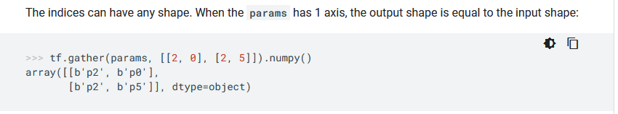
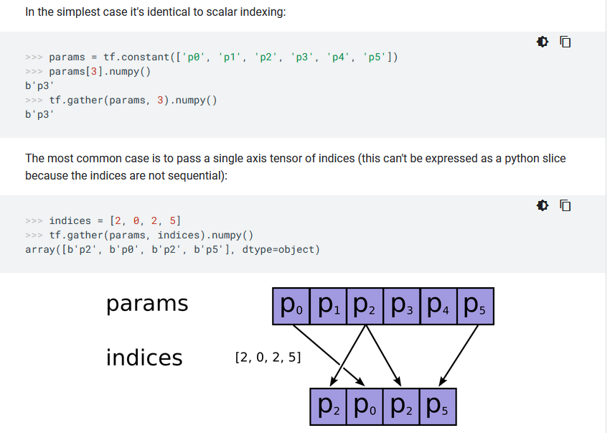
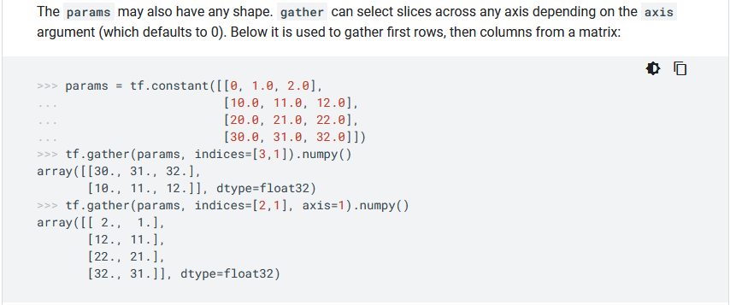
Python 기본
tf.gather 함수
Gather slices from params axis axis according to indices. (deprecated arguments)
tf.gather( params, indices, validate_indices=None, axis=None, batch_dims=0, name=None )
return class ProposalLayer(KE.Layer)

Slide 77
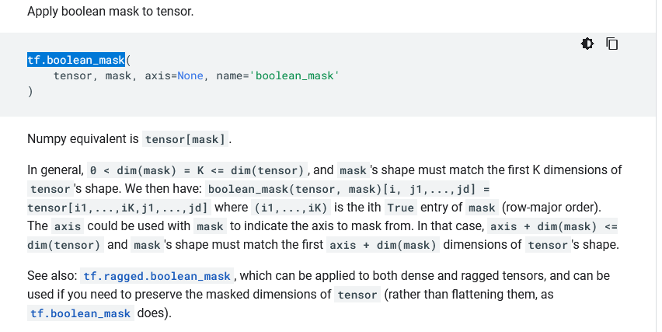
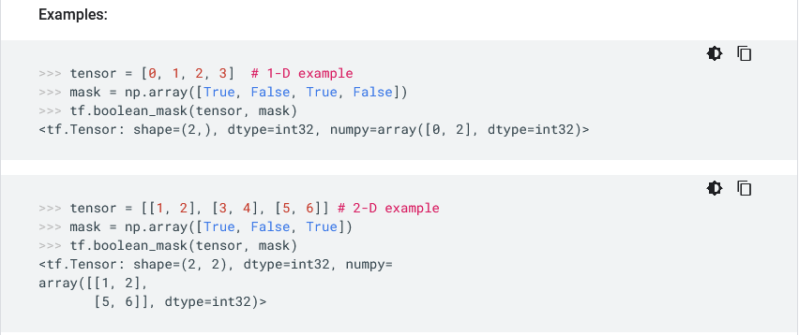
Python 기본
tf.boolean_mask 함수
return def detection_targets_graph:

Slide 78
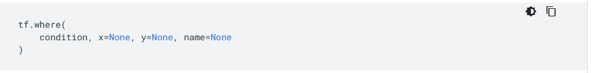
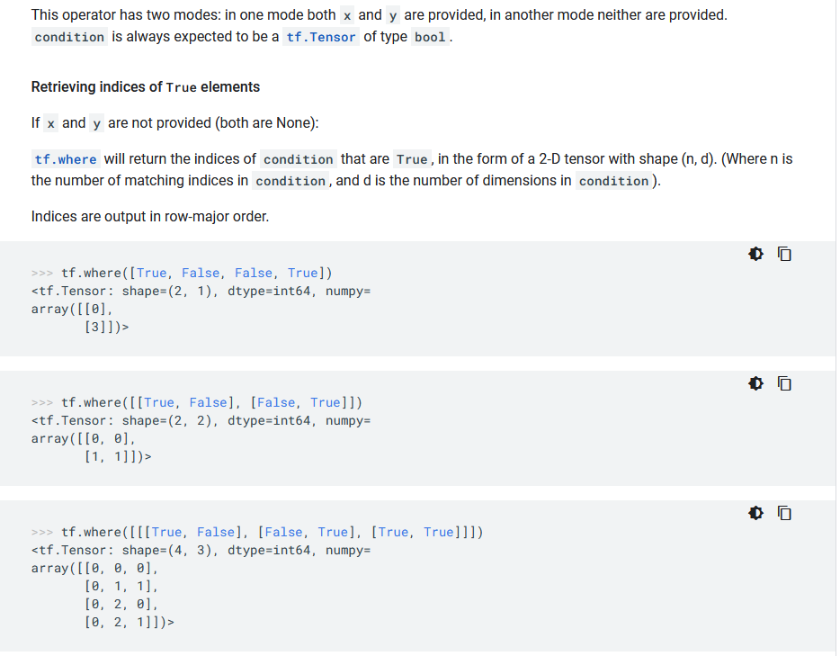
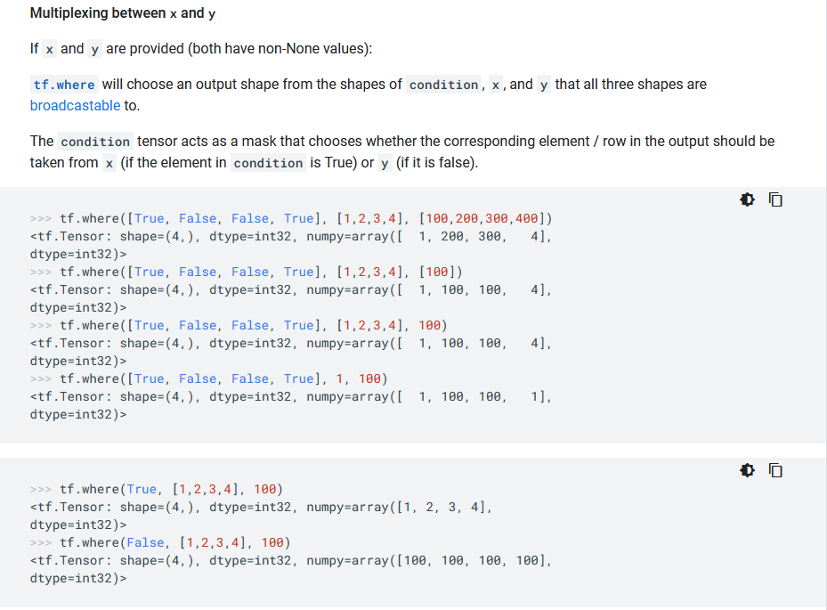
Python 기본
tf.where 함수
return def detection_targets_graph

Slide 79
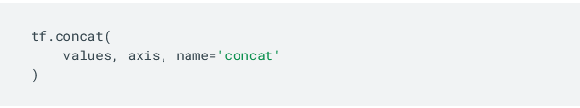
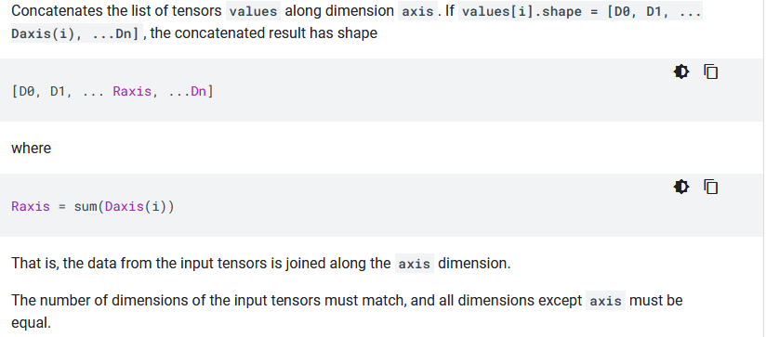
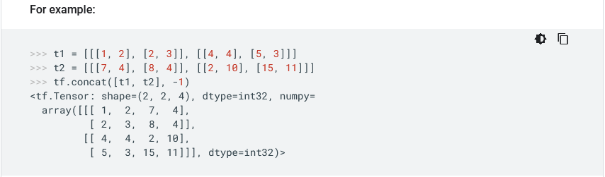
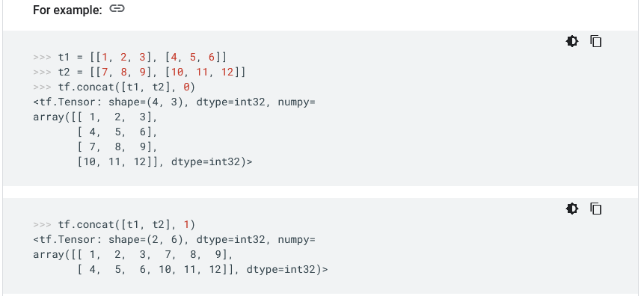
Python 기본
tf.concat 함수
return def detection_targets_graph

Slide 80
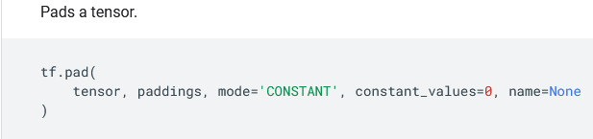
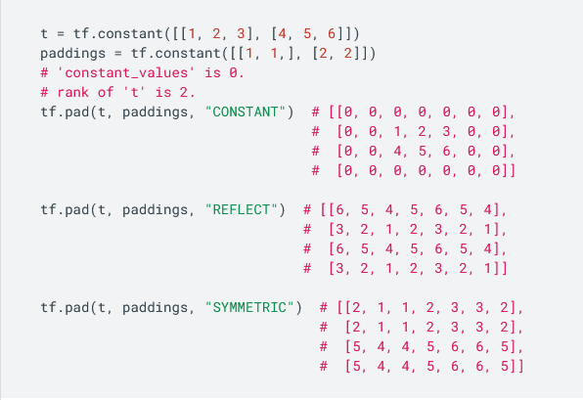
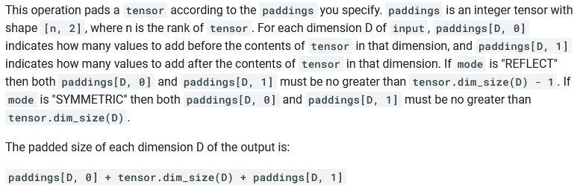
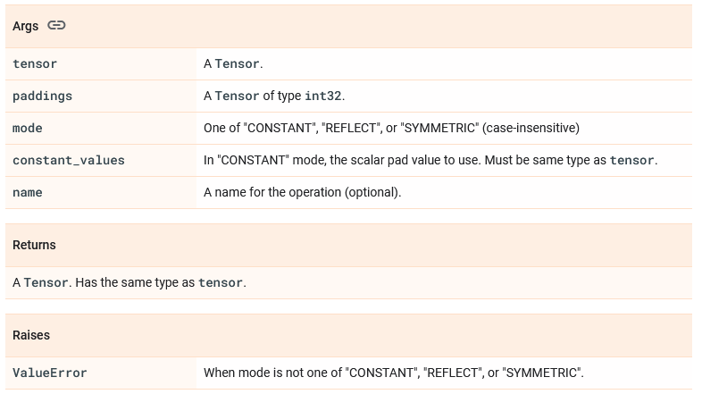
Python 기본
tf.pad 함수
[1,1] 시작전1 후1
[2,2] 시작전2,후2
return def detection_targets_graph

Slide 81
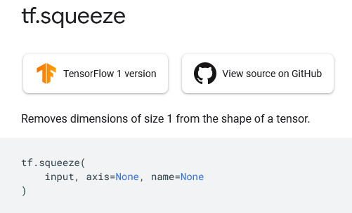
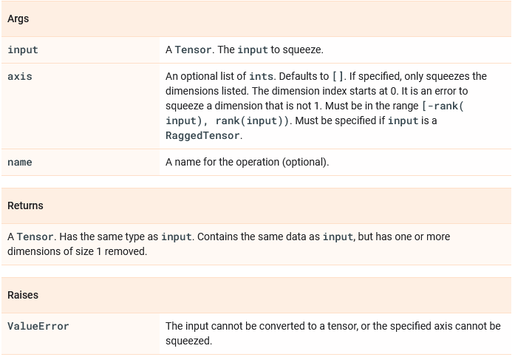
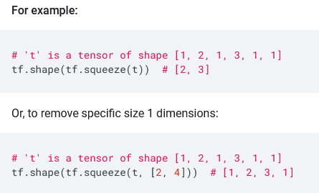
Python 기본
tf.squeeze 함수
텐서 중에서 1차원인 것들을 제거 한다.
return class PyramidROIAlign(KE.Layer):

Slide 82
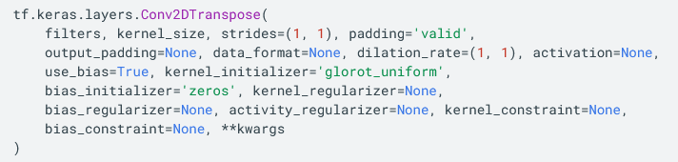
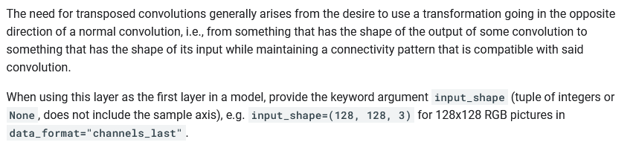
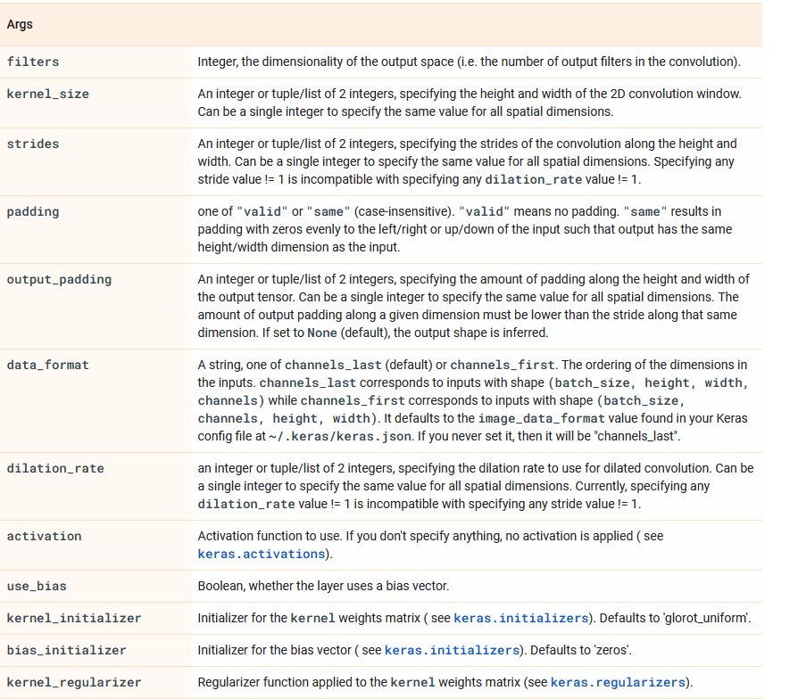
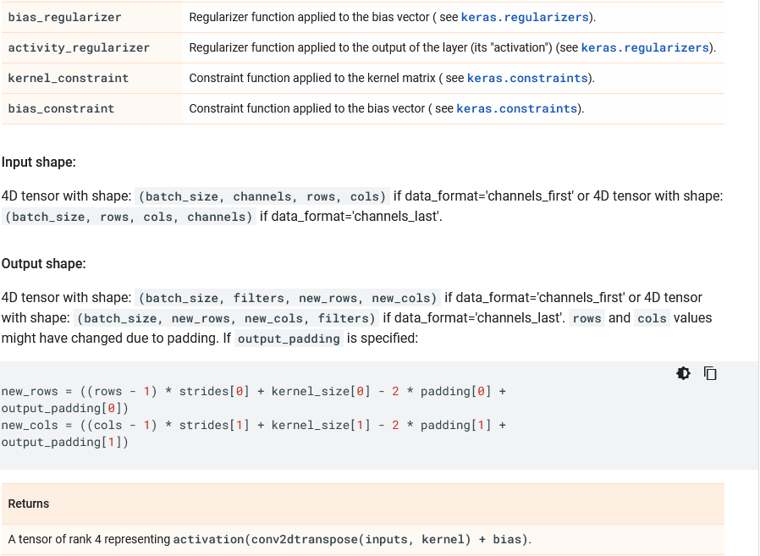
Python 기본
tf.keras.layers.Conv2DTranspose 함수
return build_fpn_mask_graph

Slide 83

마지막

