Slide 1
Allegro Data Cache
Fasttrack summary
Krzysztof Szawala
30.08.2016

Slide 2
AGENDA
Requirements
Analysis
Use Cases
Summary

Slide 3
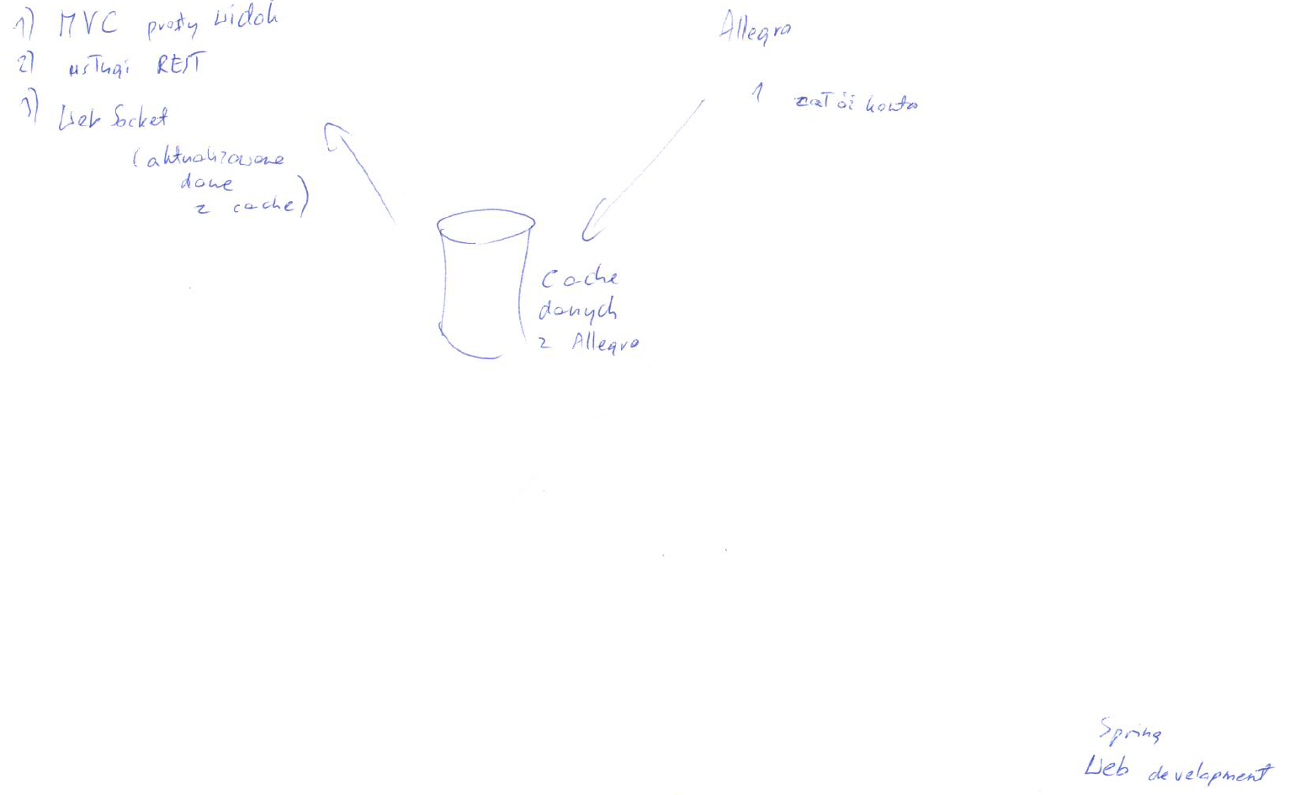
Functional / non-functional
Requirements
3
4
5
Functional
Allow for caching Allegro auction data.
Update cache when auction changes.
Non-functional
Spring MVC.
Allegro WebAPI.
REST WS.
WebSocket.
In-memory DB, eg. H2.
Allegro Sandbox/Production.
View Technology of choice.
Git Repository.
Learn Spring & Web Development.
2
1
6
2
1
3
4
5
6

Slide 4



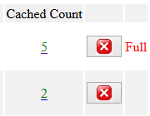

Key points
Analysis
JSP & Angular
RESTful service
Spring Boot
View Technology
Application Controller
@see AuctionContentController
Allows for HTTP GET/DELETE requests to the cached entries.
Self-contained deployment
Allegro WebAPI
Login & Auctions views – JSP, Cache view – Angular. Decided to mix technologies to learn more.
Reduced effort needed to run the application and hence greater focus on Web Development and Spring usage.
SOAP WebServices
WebSocket
@see CacheUpdateSchedulerImpl
Application Service
Client software is unable to be notified when changes happen. Need to poll for udpates.
@see WebSocketConfig
Cached Data
Source Code
Application Model
@see AuctionContent
Allegro REST API
Selected the most representative fields of Allegro Auction, eg. Current Price, Buy Now Price, Title, Hit Count, Num Of Bidders, etc.
Git
RESTful WebServices
@see Readme.md
@see AllegroClient
https://git.rulefinancial.com/public/projects/krzysztof.szawala/allegrocacheproto
New Allegro Initiative: https://developer.allegroapi.io/webapi.
Asynchronous update of the number of cached entries for each auction without reloading webpage.

Slide 5
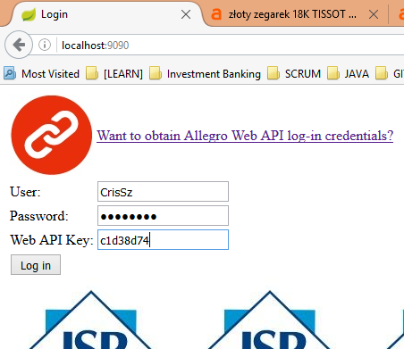
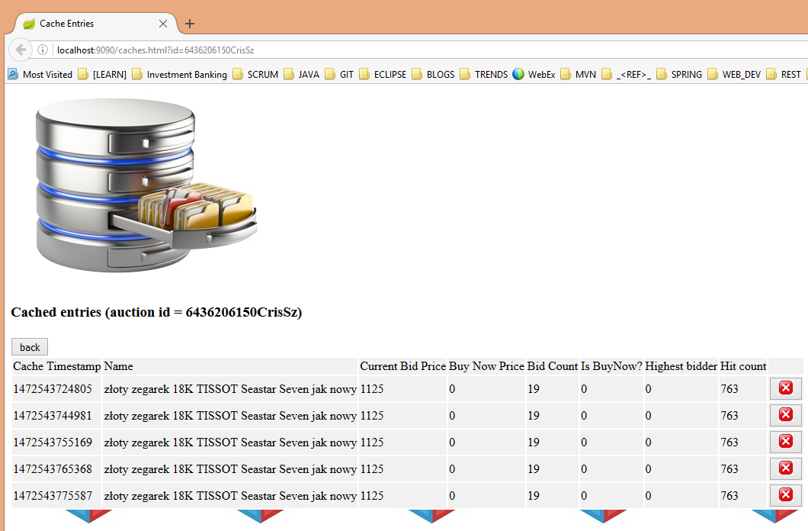
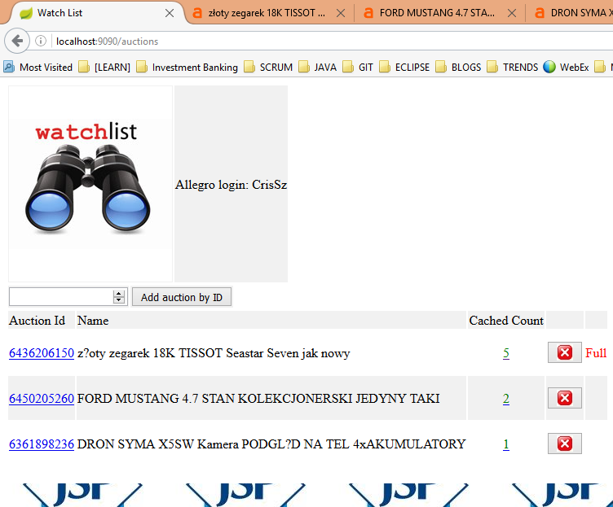
Overview
Use cases
navigate
1
3
delete
2
5
4
Login
Auctions
Cache Entries

Slide 6
Summary
Summary
Familiarized myself with Web Development and Spring related technologies – RESTful WS, WebSocket, JSP / AngularJS, Spring MVC.
Delivered a working prototype of Allegro Data Cache WebApplication.
Completed a number of Pluralsight courses, read numerous tutorials, resolved dozens of technical issues.

Slide 7
GFT Poland Sp. z o. o.
Krzysztof Szawala
Java Developer
Okraglak, Mielzynskiego 14
61-725 Poznan, Poland
krzysztof.szawala@gft.com

