Slide 1
CROSS SITE SCRIPTING ATTACKS
Kirsten and Lillian

Slide 2
1
2
5
3
4
What is an XSS attack?
Demo
Prevention
History and Development
JavaScript Examples

Slide 3
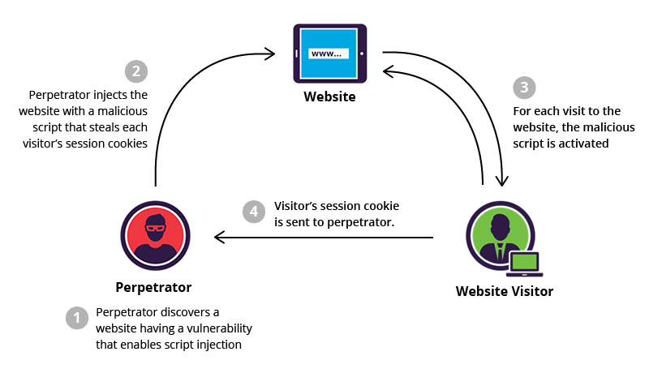
THE BASICS: WHAT IS AN XSS ATTACK?
Generally, there are three parties involved: attacker, client, and website.
Cross site scripting is a widely used technique to exploit vulnerabilities in trusted websites. It allows the attacker to execute malicious javascript in the target's browser, compromising their interaction. The goal is to steal the user’s sensitive data, whether it’s cookies, session tokens, or login credentials.
It is one of the common application level attacks used today.
In this example, the attacker is targeting the visitor’s cookies.

Slide 4
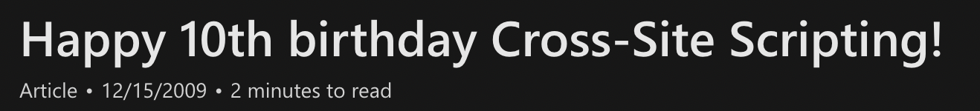
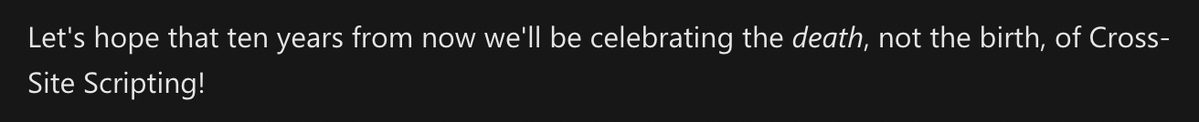
HISTORY
In January of 2000, Microsoft security engineers introduced the term “cross site scripting.” It referred to loading the attacked web application from an unrelated application through Javascript. The term XSS has now expanded, and Microsoft explains that the original XSS attack can be more specifically classified as the reflected/non-persistent form. XSS attacks also now more broadly include other types of code injections, including persistent vectors (that use Java, HTML, Flash, etc.).
Other name options at the time included Unauthorized Site Scripting, Unofficial Site Scripting, URL Parameter Script Insertion, Cross Site Scripting, Synthesized Scripting, Fraudulent Scripting.

Slide 5
825 million
The number of users potentially affected in 2018 in a large scale XSS attack that affected Reddit, Yelp, TicketMaster, Western Union, and many others. Big companies are not immune: Amazon has been affected in the past.

Slide 6
TYPES
STORED - Persistent/Type I
Typically the most damaging kind of attack.
How it works: attacker injects malicious code into the target application, where it could get permanently stored in a database, visitor log, comment field, etc. if there’s no input validation. When the victim opens the affected page in a browser, the XSS attack is served to the victim’s browser as part of the HTML code (like a legitimate comment) and the victims will execute the malicious script once they view the page in their browser.
PARTICULARLY dangerous because it could affect every user that visits the site
REFLECTED - Non-Persistent/Type II
Most common kind of attack
How it works: an attacker uses an unsafe link, phishing email, or some other kind of social engineering to lure the victim into making a request to the serve with the malicious code. The victim browser’s recieves a reply with the malicious code and executes it.
Notes:
https://owasp.org/www-community/Types_of_Cross-Site_Scripting
https://www.acunetix.com/websitesecurity/xss/

Slide 7
TYPES (cont.)
DOM BASED XSS - Type 0
The attack is executed as a result of changing the DOM “environment” in the victim’s browser, so they require no interaction with the server. It is a client (browser) side injection issue while reflected and stored XSS are server side attacks. Dom XSS means the attack is going to be injected into the application during runtime.

Slide 8
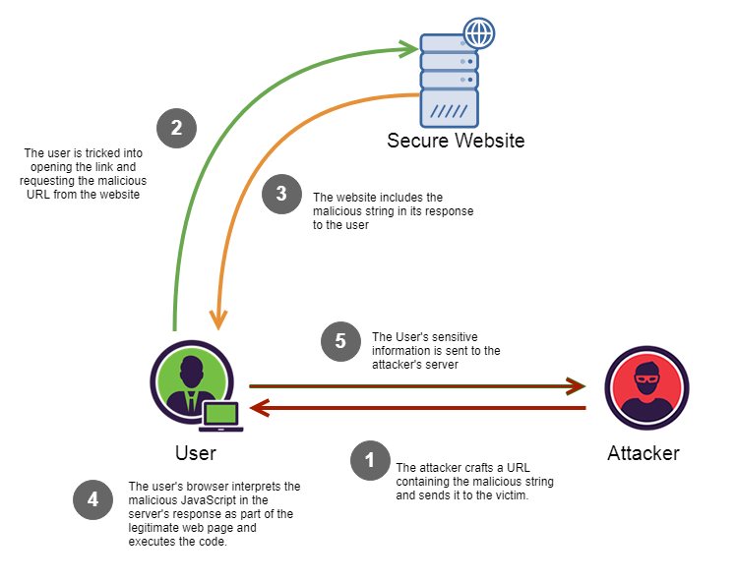
QUICK EXERCISE!
Notes:
https://medium.com/iocscan/reflected-cross-site-scripting-r-xss-b06c3e8d638a

Slide 9
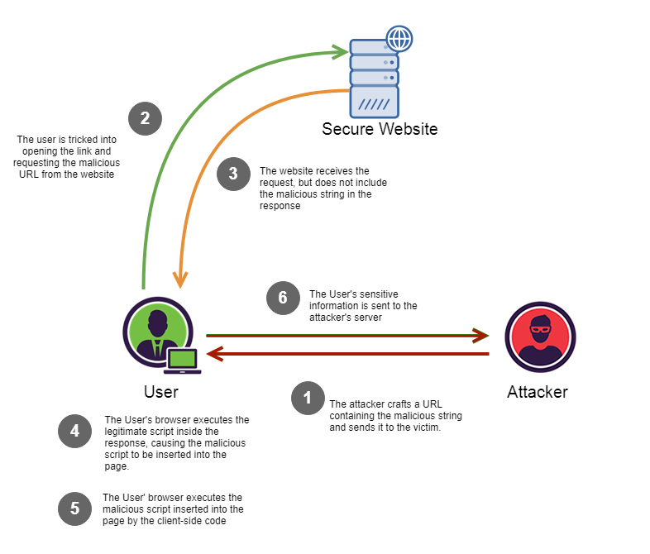
LAST ONE…

Slide 10
QUICK JAVASCRIPT EXAMPLES

Slide 11
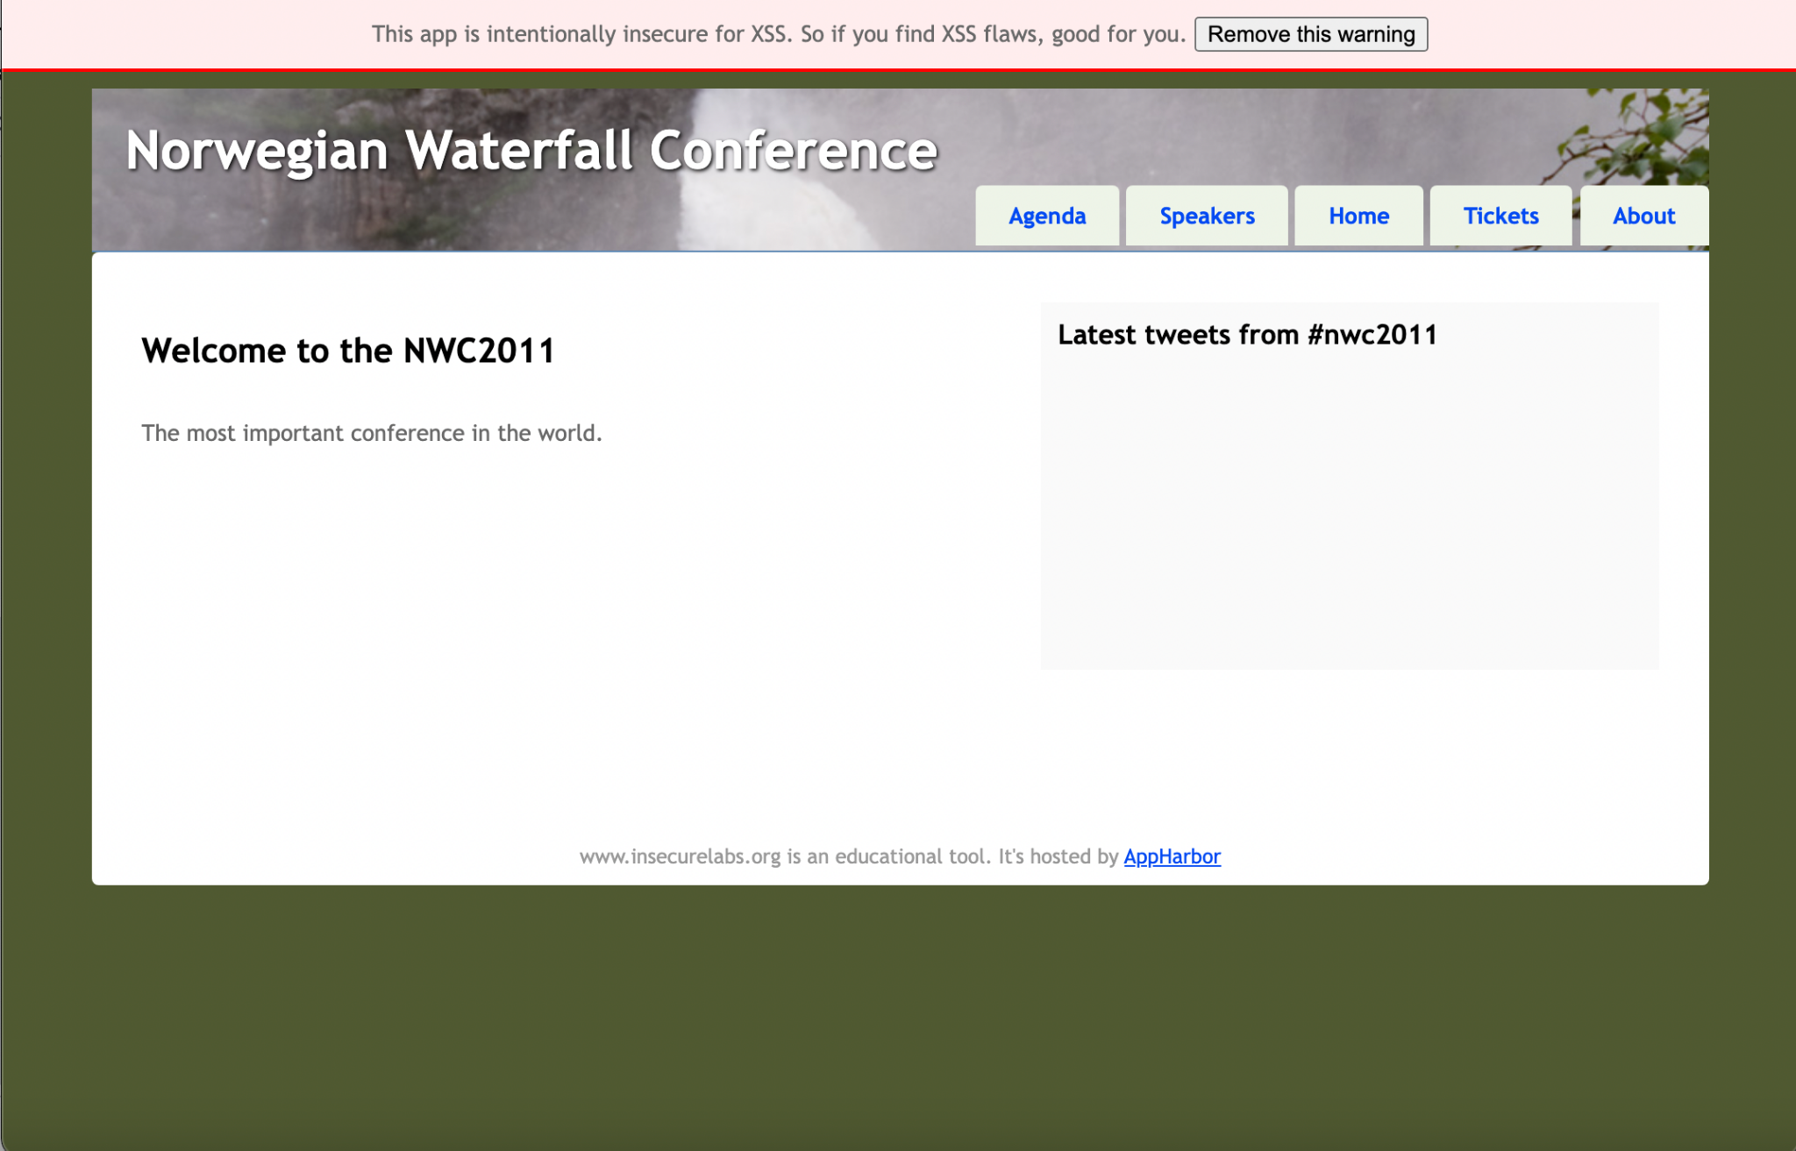
OUR DEMO

Slide 12
PREVENTION
There are several methods to prevent against an XSS attack:
This first one should not be a surprise as it’s probably good practice to prevent all kinds of vulnerabilities: make sure you install software updates. This can reduce the number of vulnerabilities that leave an app or site open to XSS attacks. It can also be helpful to get rid of applications you don’t really use often
Utilize a web application firewall. WAFs can filter bots and block malicious activity before any scripts actually get executed.
These generally apply to an owner of an application/site:
Screen AND validate information input into any data fields to prevent from a damaging persistent XSS attack. This means you SHOULD not insert untrusted data into scripts, HTML comments, attribute or tags, or directly into a CSS style sheet. Definitely don’t accepted JavaScript code from untrustworthy sources!!!
Have a Content Security Policy. These were standards introduced to prevent XSS attacks and other attacks that injected code into a web page. They are highly recommended regardless of the browser because they define a function a website can perform. This means they can prevent a website from taking in-line script. Experts say this is one of the strongest methods of prevention because they can either greatly reduce the chance of an XSS attack, or even completely block one .
.

Slide 13
Sources
https://owasp.org/www-community/Types_of_Cross-Site_Scripting
https://www.acunetix.com/websitesecurity/xss/

Slide 14
Thanks!
Questions?

