Slide 1
CROSS SITE SCRIPTING ATTACKS
Kirsten and Lillian

Slide 2
1
2
5
3
4
What is an XSS attack?
Demo
History and Development
Prevention
Examples

Slide 3
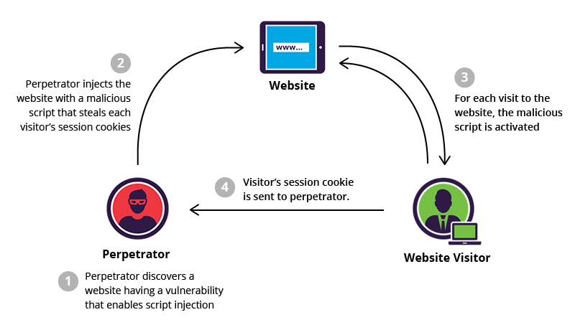
THE BASICS: WHAT IS AN XSS ATTACK?
There are three parties involved: attacker, client, and website.
Cross site scripting is a widely used technique to exploit vulnerabilities in trusted websites. It allows the attacker to execute malicious javascript in the target's browser, compromising their interaction. The goal is to steal the user’s sensitive data, whether it’s cookies, session tokens, or login credentials.
It is one of the common application level attacks used today.
In this example, the attacker is targeting the visitor’s cookies.

Slide 4
825 million
The number of users potentially affected in 2018 in a large scale XSS attack that affected Reddit, Yelp, TicketMaster, Western Union, and many others. Big companies are not immune: Amazon has been affected in the past.

Slide 5

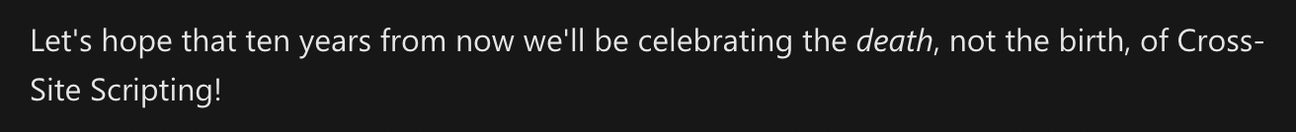
HISTORY
In January of 2000, Microsoft security engineers introduced the term “cross site scripting.” It referred to loading the attacked web application from an unrelated application through Javascript. The term XSS has now expanded, and Microsoft explains that the original XSS attack can be more specifically classified as the reflected/non-persistent form. XSS attacks also now more broadly include other types of code injections, including persistent vectors (that use Java, HTML, Flash, etc.).
Other name options at the time included Unauthorized Site Scripting, Unofficial Site Scripting, URL Parameter Script Insertion, Cross Site Scripting, Synthesized Scripting, Fraudulent Scripting.

Slide 6
TYPES
STORED - Persistent/Type I
“user input is stored on the target server, such as in a database, in a message forum, visitor log, comment field, etc. And then a victim is able to retrieve the stored data from the web application without that data being made safe to render in the browser”
REFLECTED - Non-Persistent/Type II
“ser input is immediately returned by a web application in an error message, search result, or any other response that includes some or all of the input provided by the user as part of the request, without that data being made safe to render in the browser, and without permanently storing the user provided data”
DOM BASED XSS - Type 0
“ the entire tainted data flow from source to sink takes place in the browser, i.e., the source of the data is in the DOM, the sink is also in the DOM, and the data flow never leaves the browser”
Notes:
https://owasp.org/www-community/Types_of_Cross-Site_Scripting

