Slide 1
Gamification utilizing beacons to pinpoint player locations or spawn interests with Augmented Reality on mobile devices.

Slide 2
Beacons to triangulate the player position.
Interesting game events to occur at beacon position.
Gameplay similar to Unreal Tournament/Quake.

Slide 3
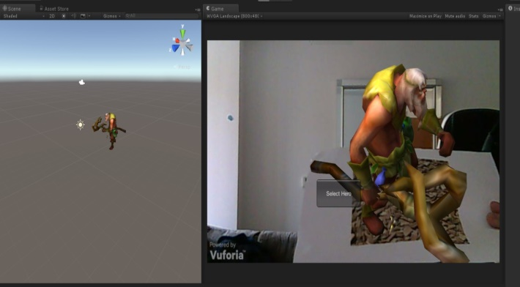
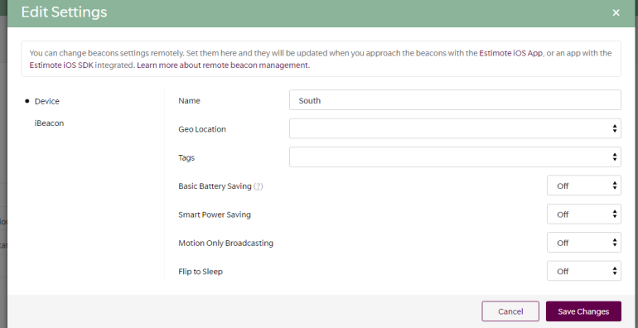
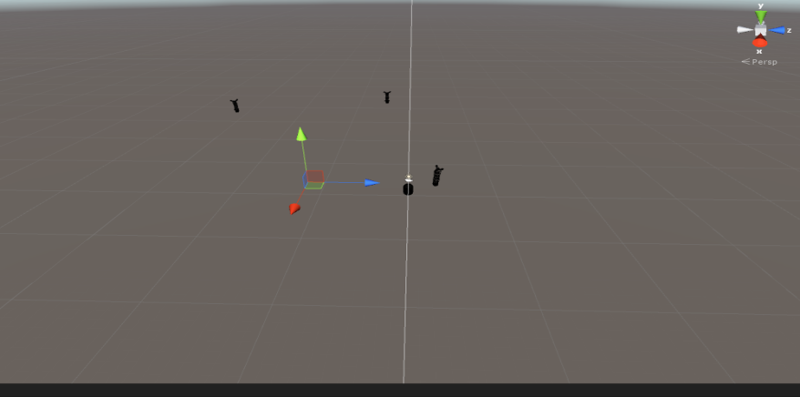
Vuforia Working!
Estimote Beacons Working!
Simple game mechanics working!

Slide 4
Essentially, should build and be awesome right?

Slide 5



Slide 6
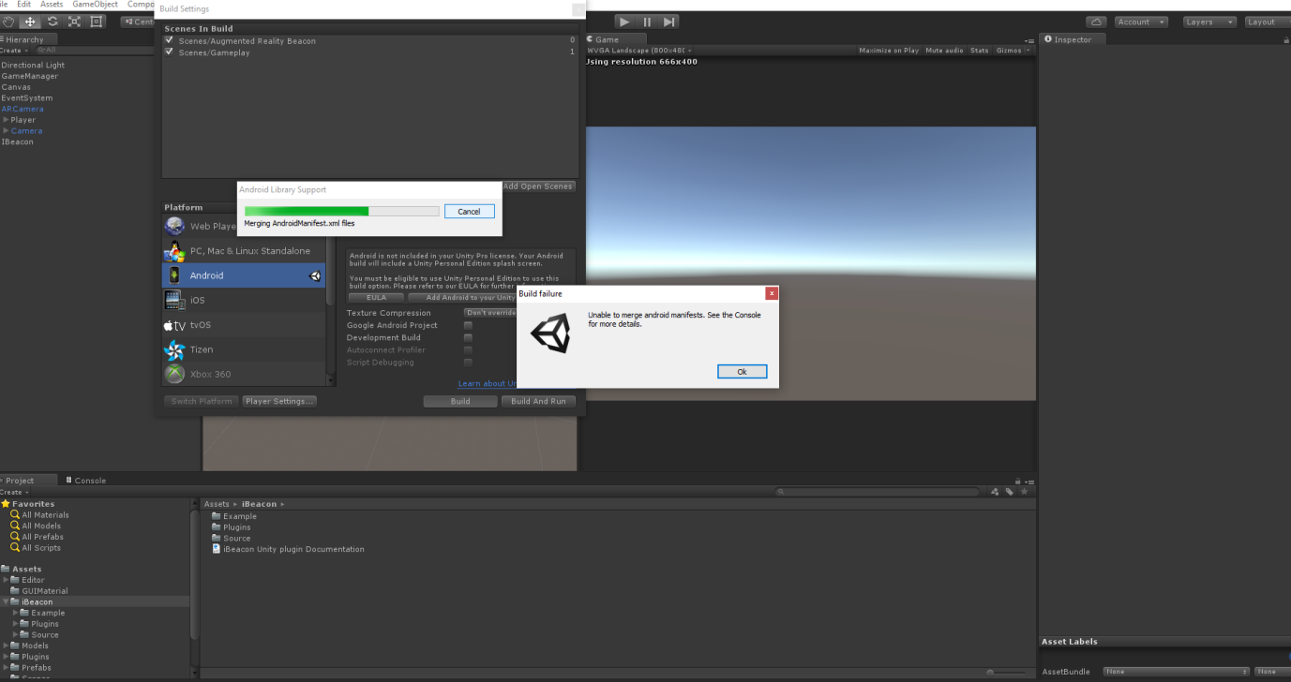

Slide 7
What did I have left?
https://www.youtube.com/watch?v=YRB3NVvJF-I

