Slide 1
The Clusters of Los Angeles AirBnB
Team Name: Insert Team Name Here
By: Kevin Tran, Kevin Pham, Yoshimi Kina, Sean O’Keefe

Slide 2

Introduction
Want to cluster to see the patterns of AirBnB hosts
Want to find out whether AirBnB hosts are abusing the platform
Use Airbnb as makeshift hotels and sell their rooms at a higher markup

Slide 3
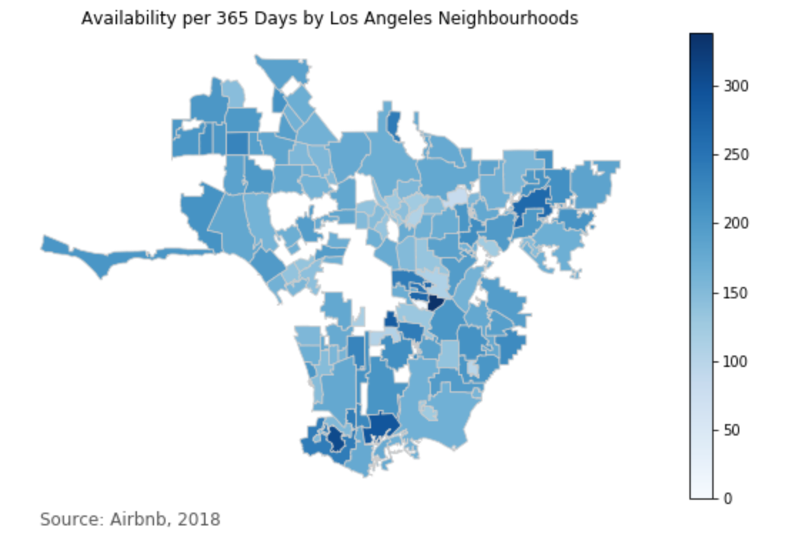
Descriptive Analysis
Exploring the distribution of key variables we think would play important roles in separating out potential clusters
Room Type
Price
Number of Listings
Listing Availability

Slide 4
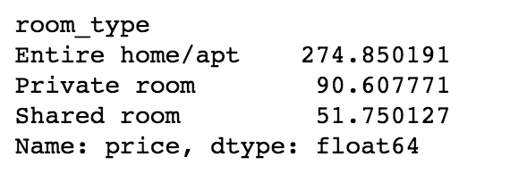
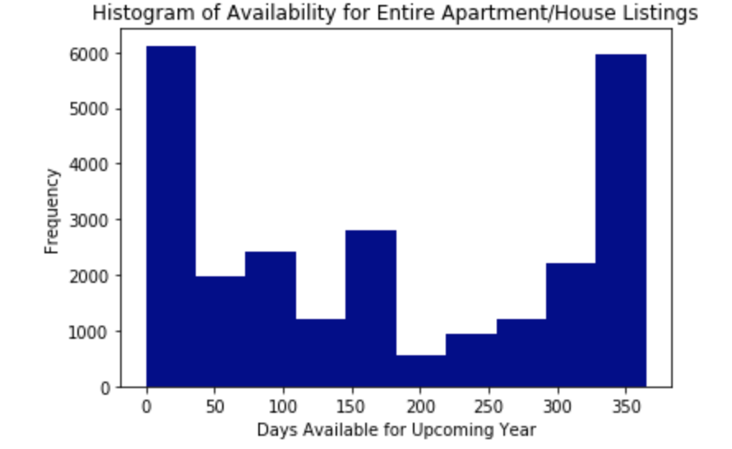
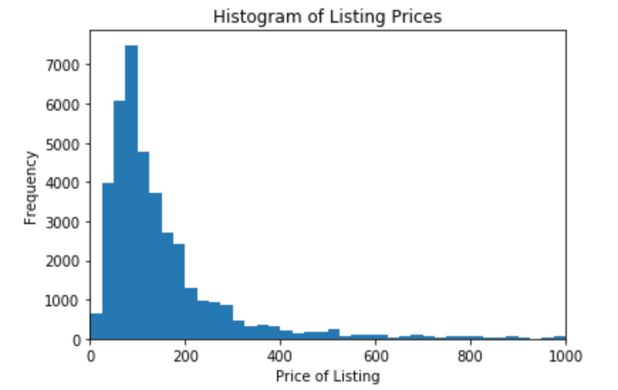
Descriptive Analysis Cont.

Slide 5
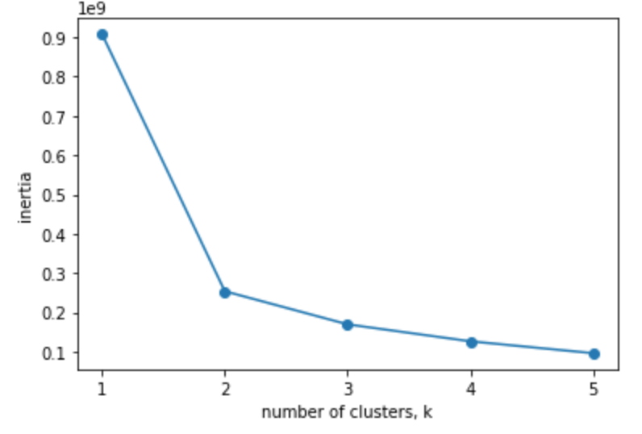
Modeling: K-means Clustering
We ended up using 8 predictors to determine our clusters
We chose to make 3 clusters

Slide 6
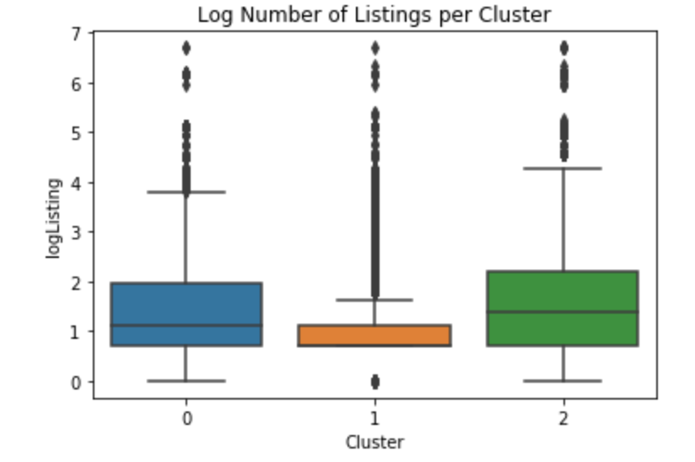
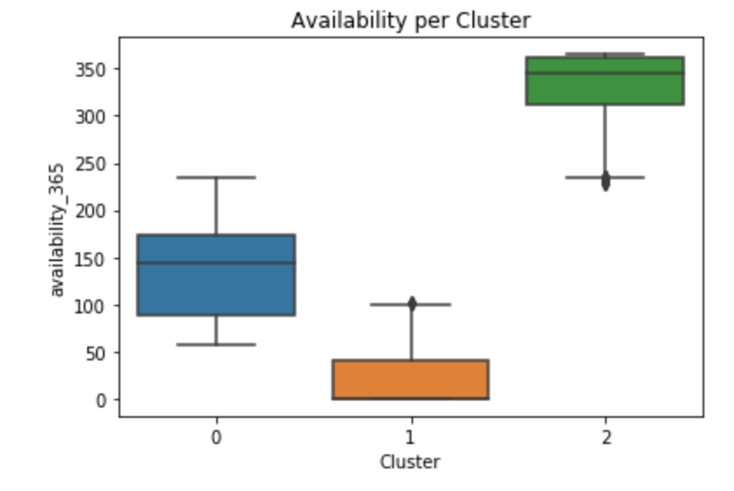
Results
The amount of listings each host has per year is significant in clustering our data.
The amount of listings per year for each host is significant

