Slide 1
Healthcare Dataset Challenge
Goh Yong Yu (Jerrett)

Slide 2
Data Cleaning
1

Slide 3
Merging bill data tables
bill_id.csv
bill_amount.csv
bill_id | patient_id | date_of_ admission
7968360812 | 1d21f2be18683991eb93d182d6b2d220 | 01-01-11
6180579974 | 62bdca0b95d97e99e1c712048fb9fd09 | 01-01-11
7512568183 | 1d21f2be18683991eb93d182d6b2d220 | 01-01-11
bill_id | amount
7968360812 | 1039.084883
6180579974 | 654.9697476
7512568183 | 646.7040557
bill_id | amount | patient_id | date_of_admission
7968360812 | 1039.084883 | 1d21f2be18683991eb93d182d6b2d220 | 01-01-11
6180579974 | 654.9697476 | 62bdca0b95d97e99e1c712048fb9fd09 | 01-01-11
7512568183 | 646.7040557 | 1d21f2be18683991eb93d182d6b2d220 | 01-01-11

Slide 4
Merging clinical data and demographics
Renamed column: id patient_id
Merged the remaining data on the condition where the same patient_id and date_of admission
Multiple bills during hospital stay
Combine those with same patient_id, date_of admission and discharge_date.
Sum amount during stay

Slide 5
Final Table
patient_id
gender
race
resident_status
date_of_birth
bill_id
amount
date_of_admission
date_of_discharge
medical_history_1
medical_history_2
medical_history_3
medical_history_4
medical_history_5
medical_history_6
medical_history_7
preop_medication_1
preop_medication_2
preop_medication_3
preop_medication_4
preop_medication_5
preop_medication_6
symptom_1
symptom_2
symptom_3
symptom_4
symptom_5
lab_result_1
lab_result_2
lab_result_3
weight
height
2898 rows × 32 columns
After removing null values

Slide 6
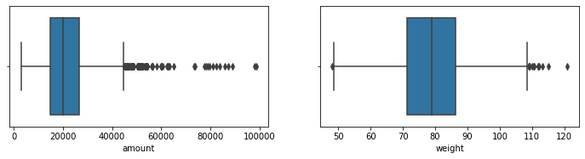
Outlier Detection

Slide 7
Feature Engineering
2

Slide 8
Columns
Change Values
['Female' 'Male' 'm' 'f']
['Chinese' 'India' 'Malay' 'Others' 'Indian' 'chinese']
['Singaporean' 'Singapore citizen' 'Foreigner' 'PR']
['0' 'No' '1' 'Yes']
Admission & discharge date Duration of Stay (days)
Date of Birth Age
Change Datatype
float, int, string

Slide 9
Data Exploration
3

Slide 10
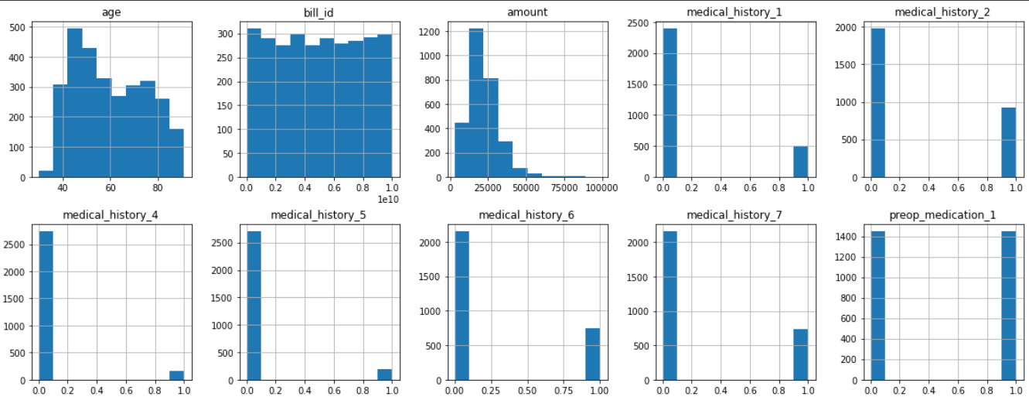
Distribution of Data

Slide 11
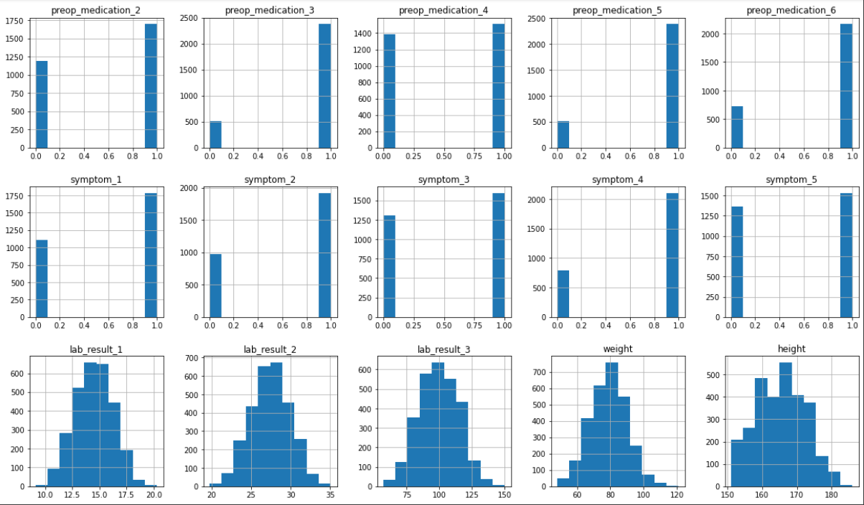

Slide 12
Target Variable Analysis
4

Slide 13
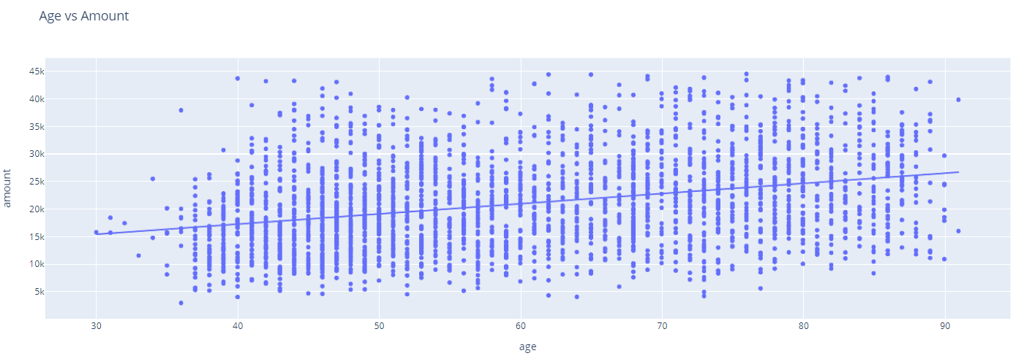
With age comes higher medical bills

Slide 14
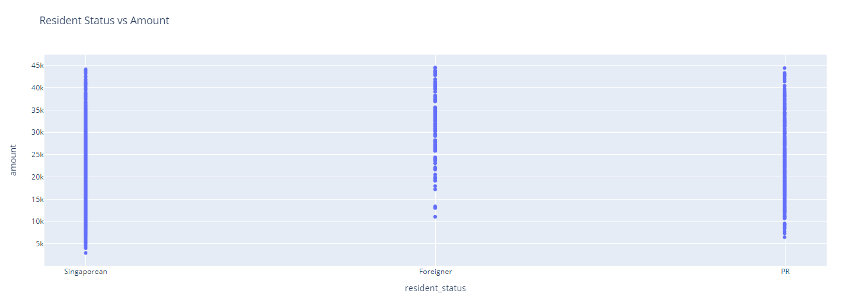
Subsidies with medical expenses

Slide 15
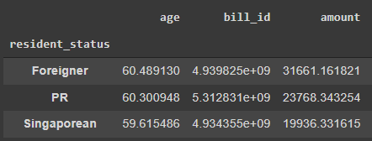
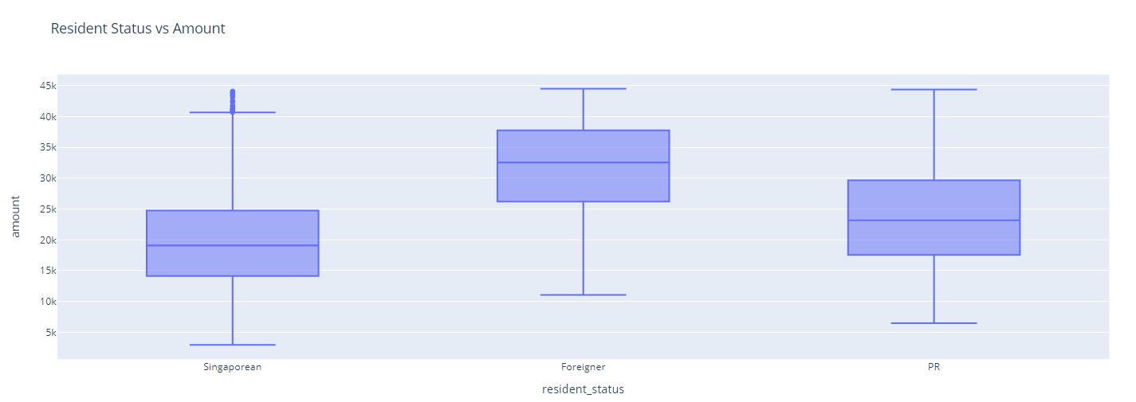
Boxplot

Slide 16
Bi-Variate Analysis
5

Slide 17
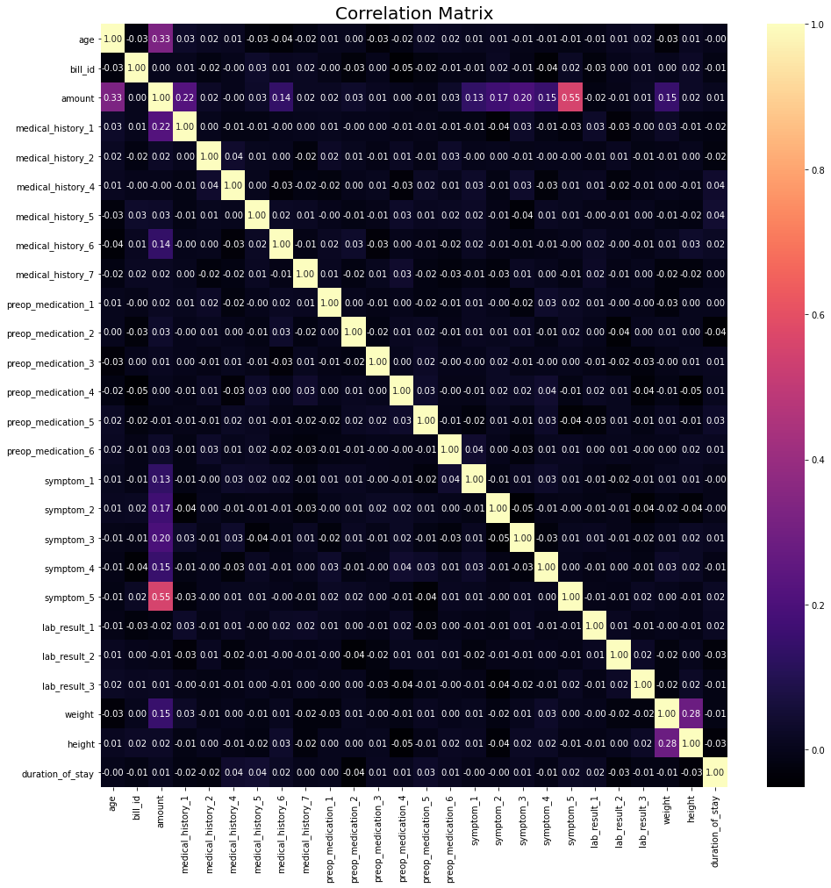
Biggest driver of cost

Slide 18
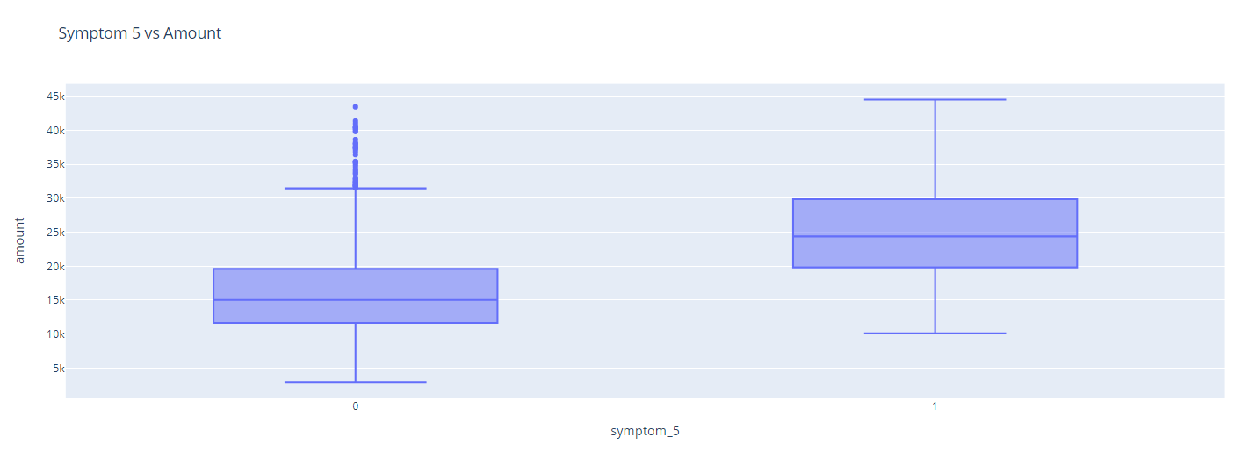
Biggest driver of Cost Symptom 5

Slide 19
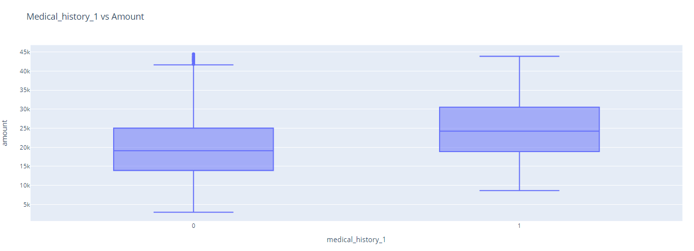
Medical History 1

Slide 20
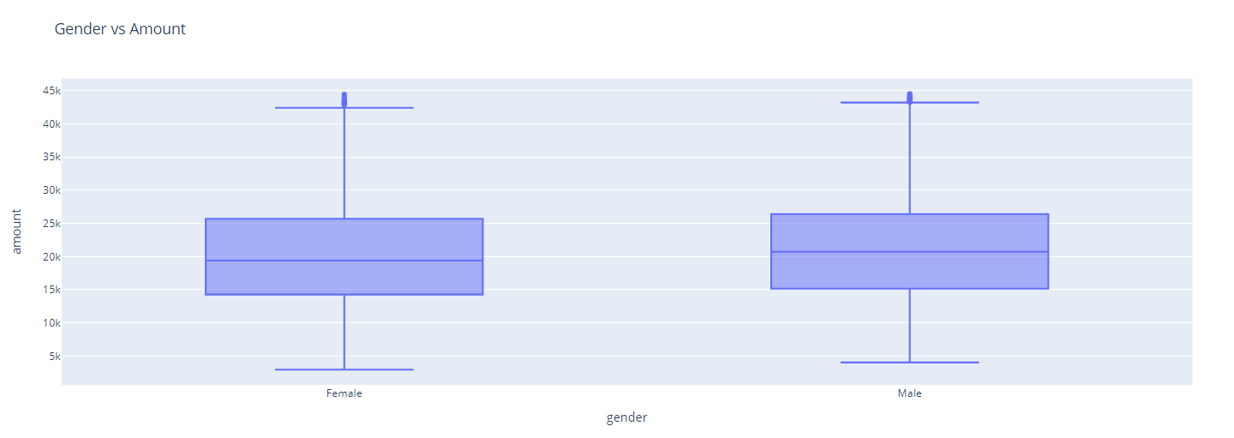
Categorical Data

Slide 21
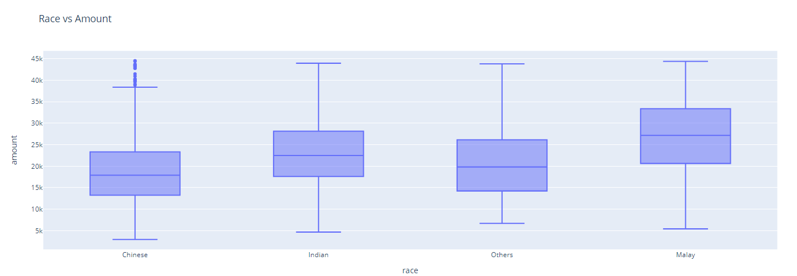

Slide 22
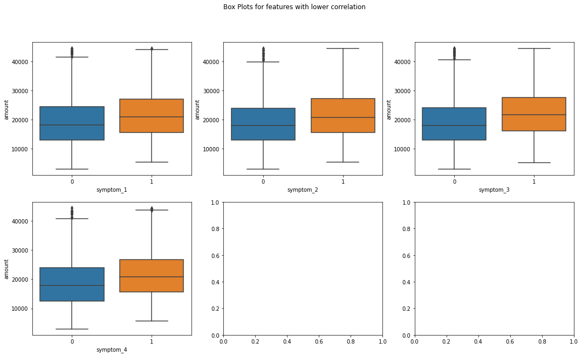
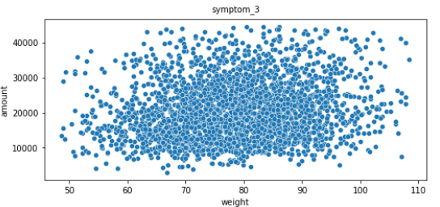
Features with some correlation

Slide 23
$9k more
$15k vs $26k
$20k vs $32k
Conclusion
Symptom 5
Aged 30s vs 80s
Resident_Status

Slide 24
Thank You

