Slide 1
Hackathon Project: Automated Kapa Quant Quality Control
Maxx Harvey

Slide 2
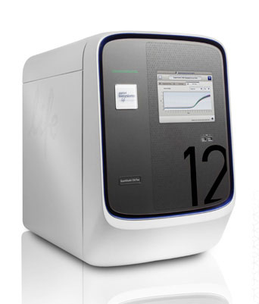
Background
The Quant Studio 12 (QS12) is a real-time quantitative PCR (qPCR) instrument
Kapa Quant: qPCR method for determining the concentration of samples
A standard curve consisting of 6 standards can be used to quantify samples
All samples and standards are ran in triplicate
Samples are normally ran at a 1:100,000 dilution
Automating quality control = higher throughput
Standard | Concentration (pmols) | log (concentration in pmols)
STD1 | 20 | 1.30
STD2 | 2 | 0.30
STD3 | .2 | -0.70
STD4 | .02 | -1.70
STD5 | .002 | -2.70
STD6 | .0002 | -3.70

Slide 3
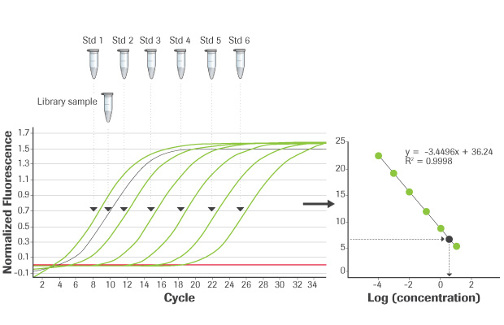
Kapa Quant Mechanism
Red Line = Threshold Line: Minimum signal that is > background
Ct Value: First PCR cycle at which sample signal > threshold
More concentrated samples have lower Ct values
A difference of 3.3 Ct = 1:10 difference

Slide 4
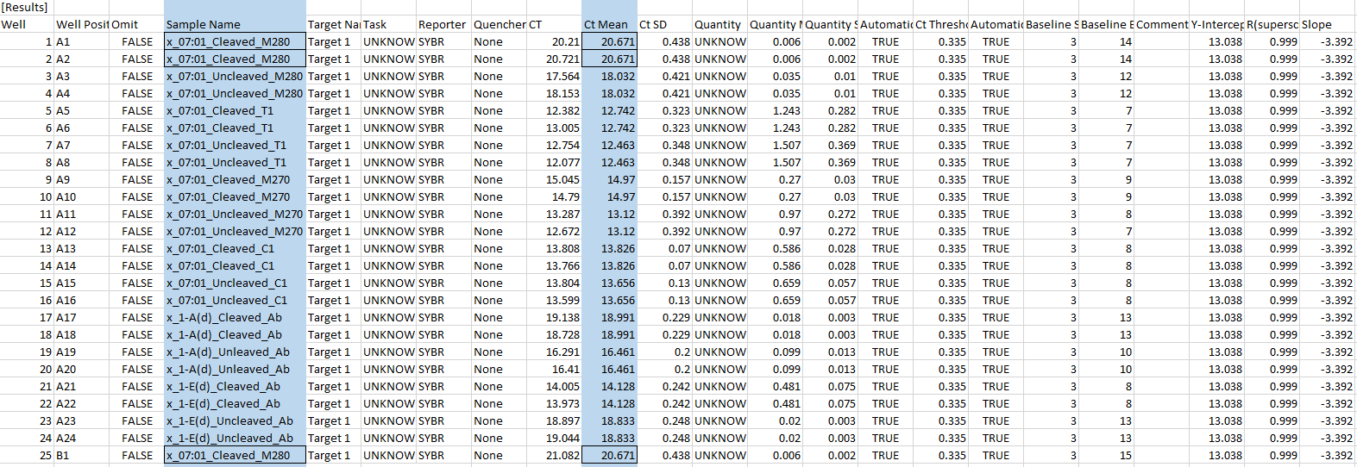
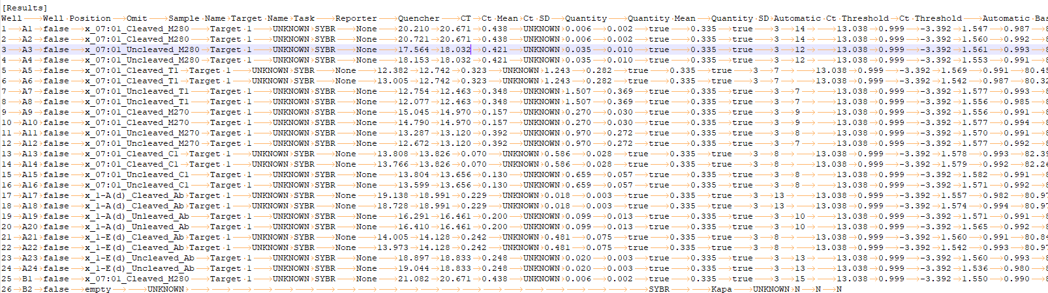
Only important columns are “Sample Name” and “Ct Mean”
3rd replicate is not next to the first 2
File also contains instrument parameters and melt curve data, which can be ignored

Slide 5
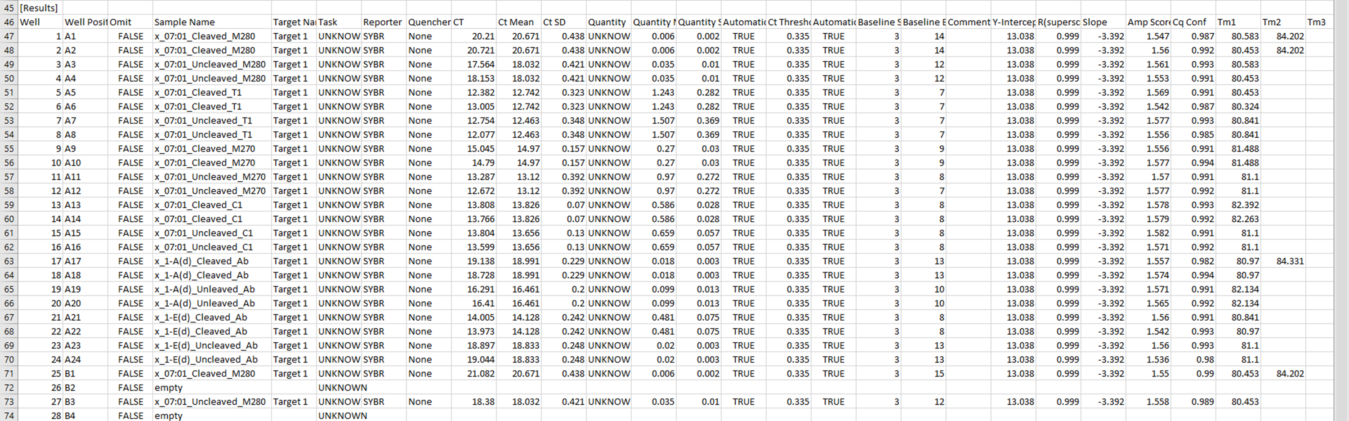

Input:
Output:
Raw QS 12 File
Linear Regression of Standards (Including R²)
Calculations + Plotting
Parsing / Organization
Script
Results Table:
Sample name | Concentration of undiluted library (pM) | Concentration of undiluted library (ng/µL)
C 0x | 4,078,555 | 504.03
C .2x | 873,640 | 107.96
C 1x | 2,218,919 | 274.21
NC 0x | 3,331,000 | 411.64
NC .2x | 4,116,182 | 508.68
NC 1x | 1,578,668 | 195.09
Index NTC | 0 | 0.00
Arguments / User Input:
Fragment Length (base pairs)
Sample Dilution Factor
Calculations + Writing Output File

