Slide 1
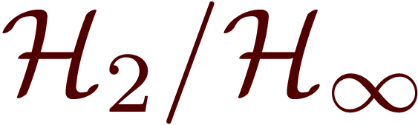
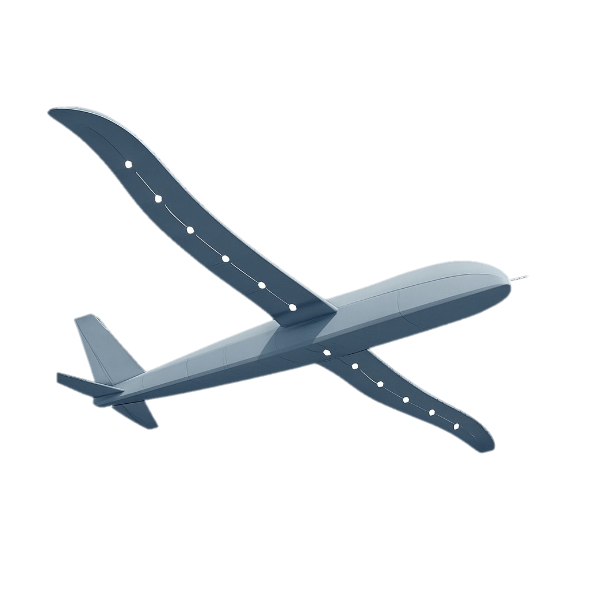



Sparse Actuation for LPV Systems with Full-State Feedback in Framework
Optimizing control for complex systems with fewer actuators, enhancing efficiency, and guaranteeing robustness
Tanay Kumar and Raktim Bhattacharya
Intelligent Systems Research Laboratory

Slide 2
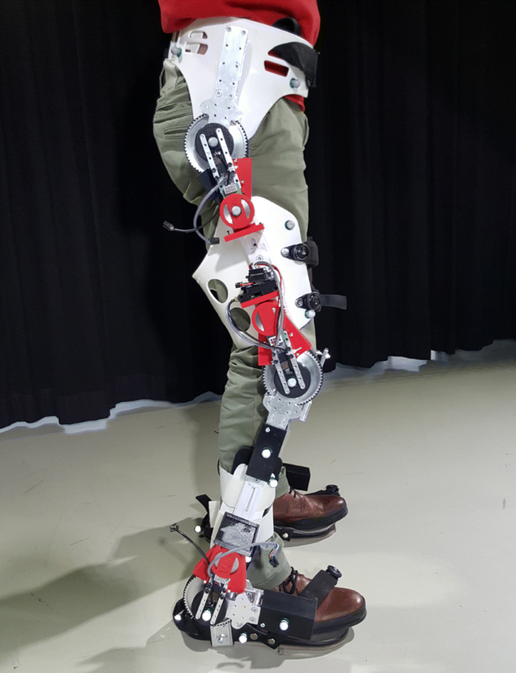
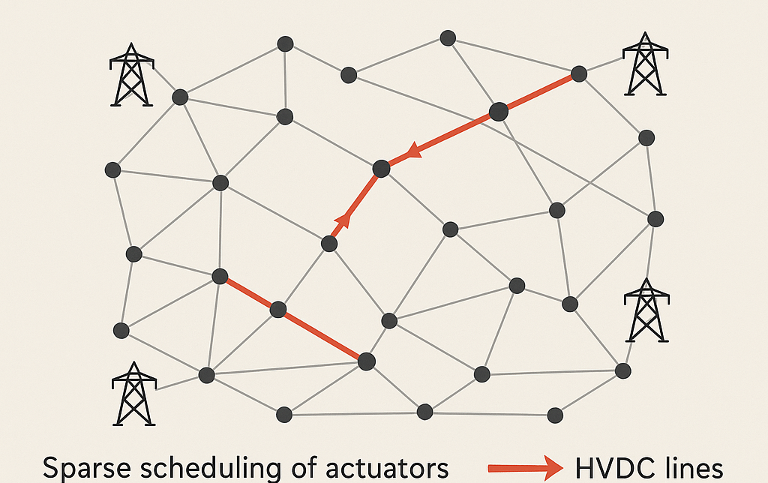
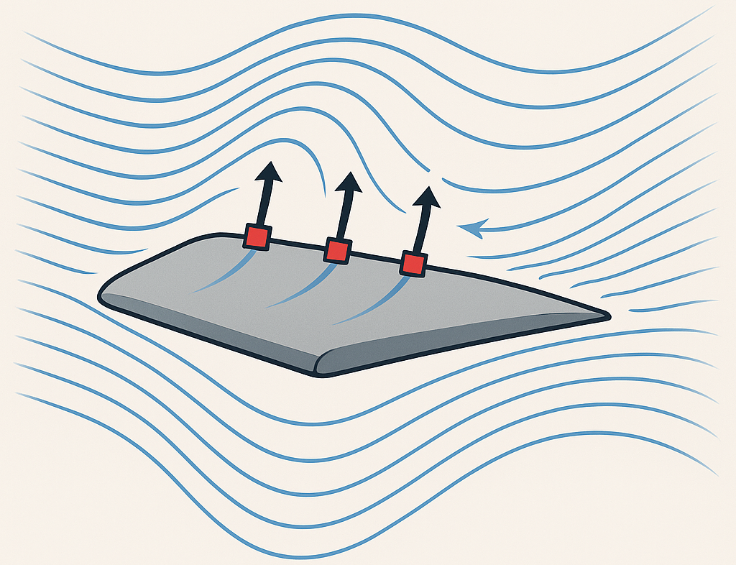
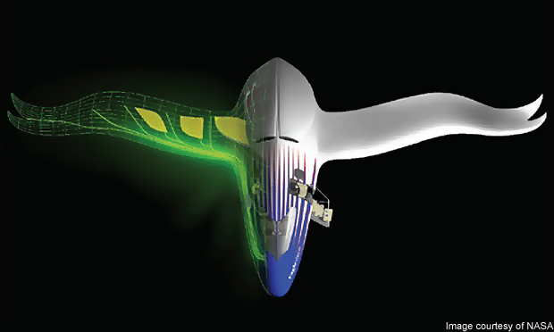

Motivation Why Sparse Actuation?
Reduces weight, complexity, and power consumption
Engineering Examples
Long-duration mission
Strategize actuator placement
Fault Tolerance
Minimize actuator count
Modularity
Efficient Maintenance
Position?
Orientation?
Magnitude Limits?
Power Systems and Smart Grid
Flow Control
Morphing Wings
Precision?
Wearable Robotics
Priority?
2
3
1

Slide 3
Motivation Why Sparse Actuation?
Sparse Actuation
Magnitude Limits?
Orientation?
Position?
Precision?
Priority?
Optimal Actuation Architecture
Limits of Fault Tolerance
Optimal Actuation Architecture
Limits of Fault Tolerance
Long-duration mission
Long-duration mission
Modularity
Modularity

Slide 4
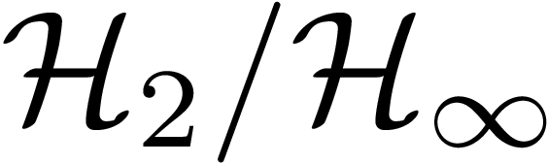
Literature Review
Dhingra et al. (2014)
Sparsity-inducing penalties in the controller gain matrix.
Only LTI systems.
Can be complex in high-dimensional problems.
Münz et al. (2014)
Uses optimization.
Considers only linear dynamics
Summers et al. (2016)
Emphasizes LTI systems.
Considers controllability metrics derived from the controllability Gramian.
Greedy algorithm limitations.
Reduces weight, complexity, and power consumption
Long-duration mission
Strategize actuator placement
Fault Tolerance
Minimize actuator count
Modularity
Efficient Maintenance
Nugroho et al. (2018)
Combinatorial optimization with mixed-integer nonlinear matrix inequality (MI-NMI) constraints
Computational challenges.
Zare et al. (2020)
Proximal gradient algorithms.
Assumes linear dynamics.
Non-convex problem ⇒ Global optimality isn’t guaranteed.
Manohar et al. (2022),
Emphasizes LTI systems.
Based on model reduction and QR pivoting.
Potential for suboptimality.
Deshpande et al. (2024)
Convex optimization for actuator bounds.
Restricted to LTI systems.
2
3
1

Slide 5
Paper Contributions
Integrated optimization framework for actuator limits and controller design for LPV System
2
Guaranteed specified closed-loop performance for LPV System
First for LPV Systems
1
3

Slide 6
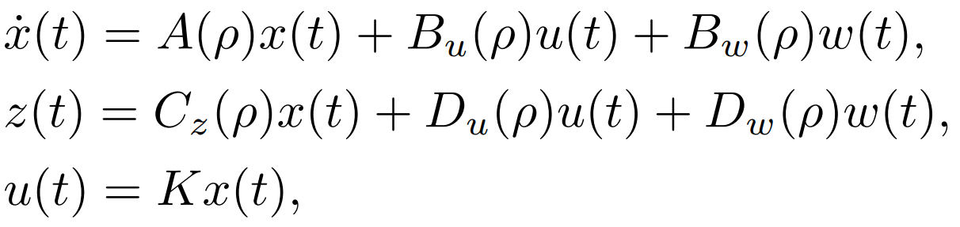
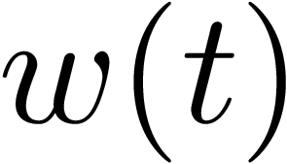
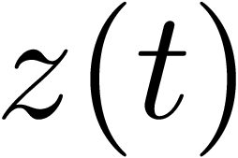
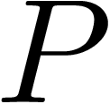
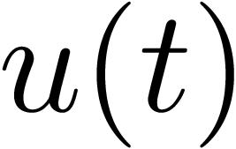
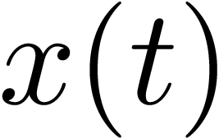
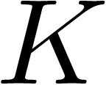


Problem Formulation Quasi-LPV Form from Nonlinear Dynamics
Controller design requirement
Given exogenous inputs , is bounded
Need to enforce sparseness on actuators

Slide 7
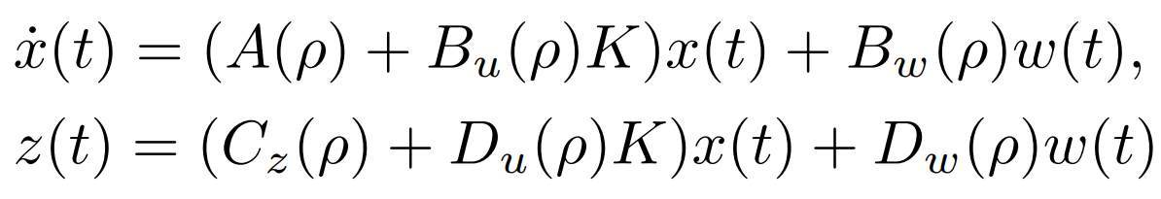

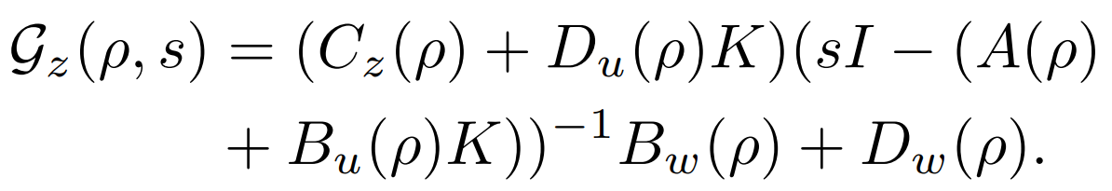

Problem Formulation Performance Specification
Closed-loop control with full state feedback
Transfer function from
Performance criteria on
(User Specified)

Slide 8
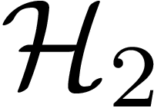
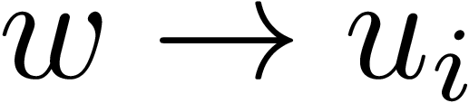
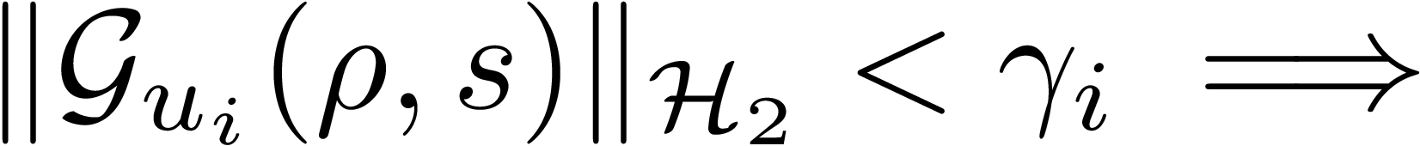
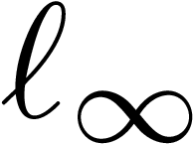
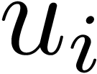
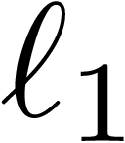
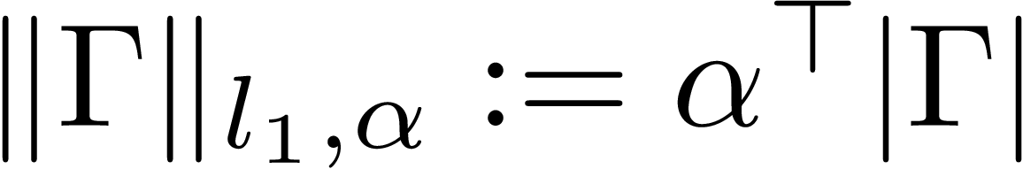
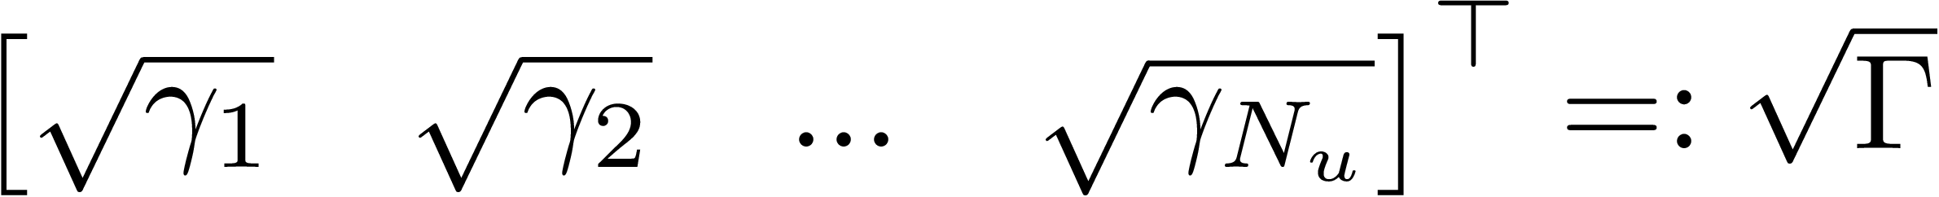
Problem Formulation How to Achieve Sparseness?
Idea: Minimize norm of the transfer function
Restrict: limit norm of
For each actuator
Optimization Problem: minimize weighted norm where,

Slide 9
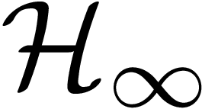
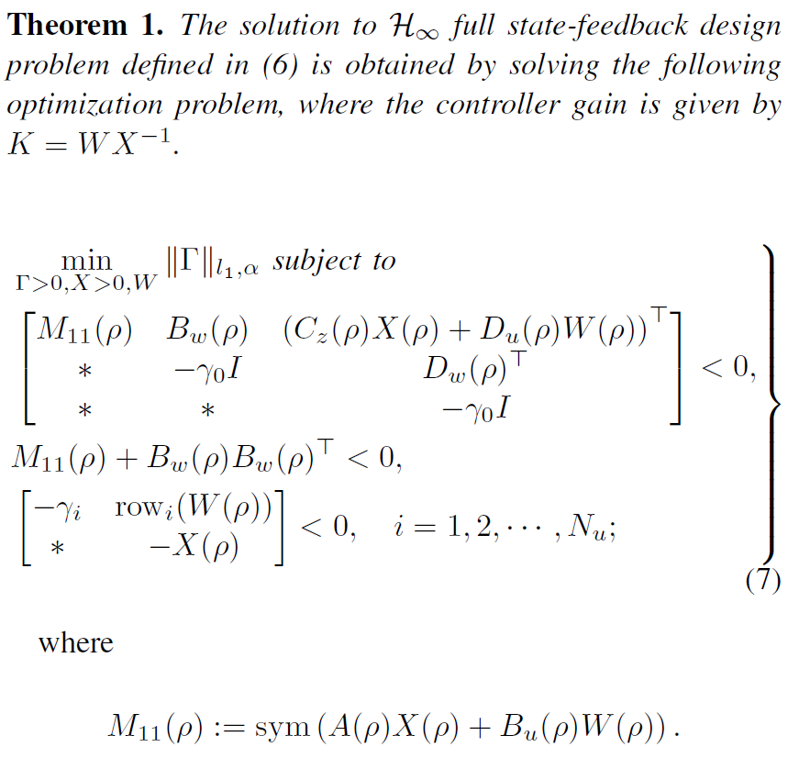
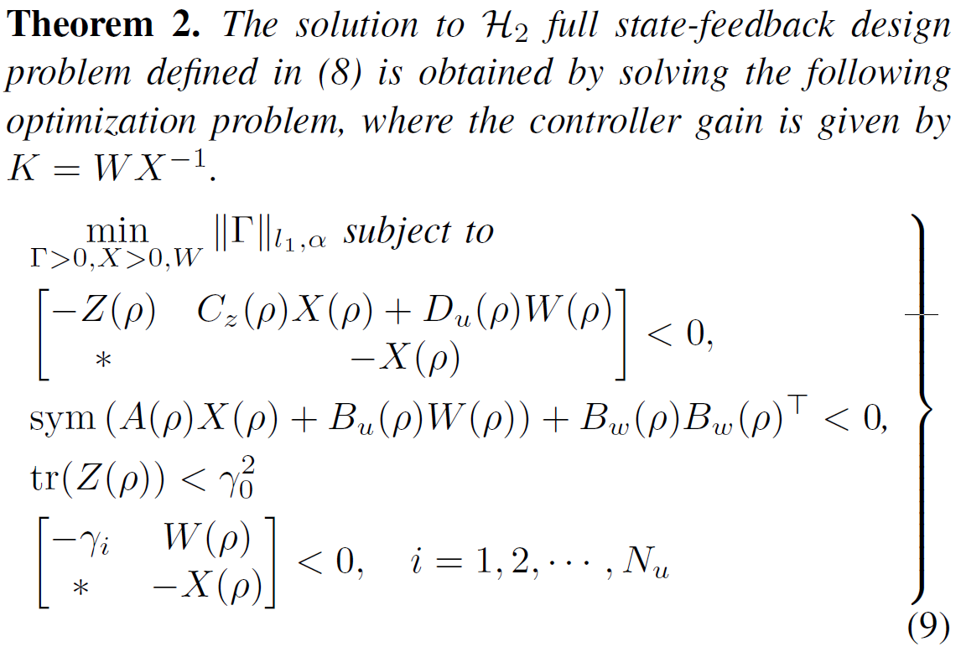
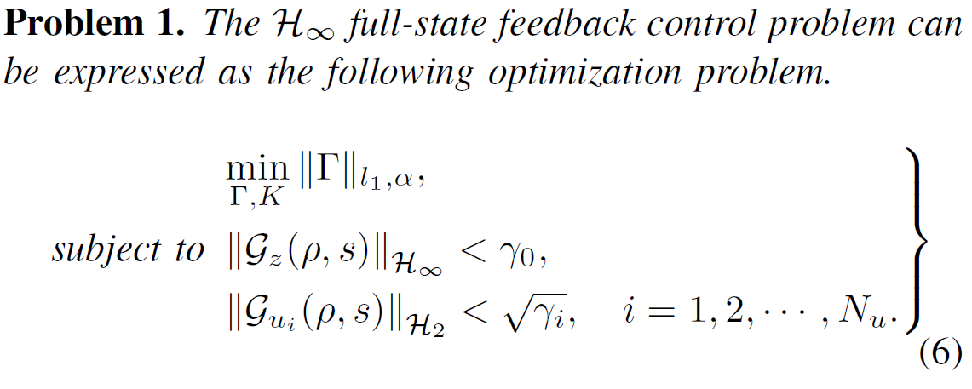
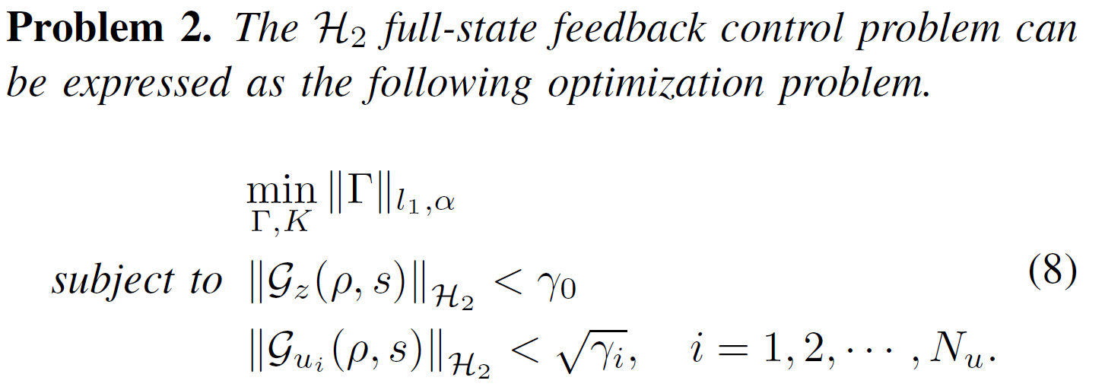
Problem Formulation Optimization Problem
Notes:
Final problems are proposed as follows
Left is H infinity for close loop performance and right is h2 for performance.
Performance can be H₂ or H∞, but sparsity is always enforced via H₂
These integrated problems can be solved as convex optimization problems using existing software. Proof is given in the paper.

Slide 10
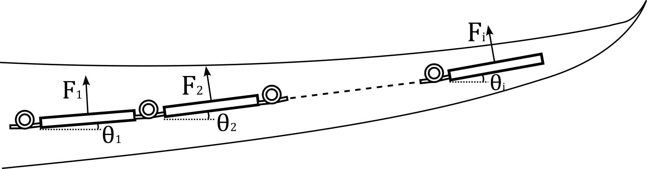
Case Example System Model
Dampen oscillations in an aircraft wing.
A series of bars connected with torsional springs.
External disturbances = wind gusts.
Dynamics derived using Lagrangian Mechanics in quasi-LPV form.

Slide 11
Case Example Design Goals
Design a closed-loop control law to satisfy
minimum actuated cantilevers
minimum oscillations with unsteady wing loading
performance criteria

Slide 12

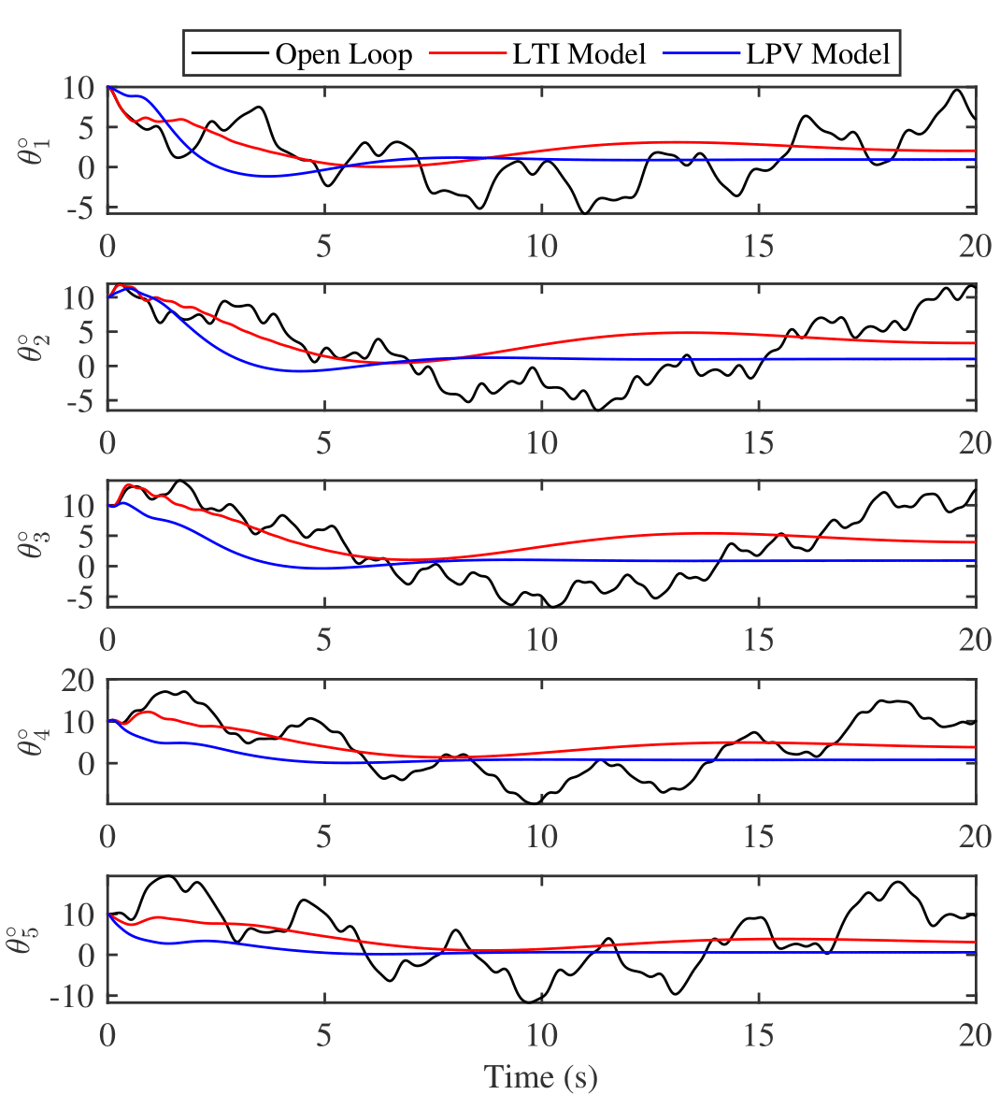
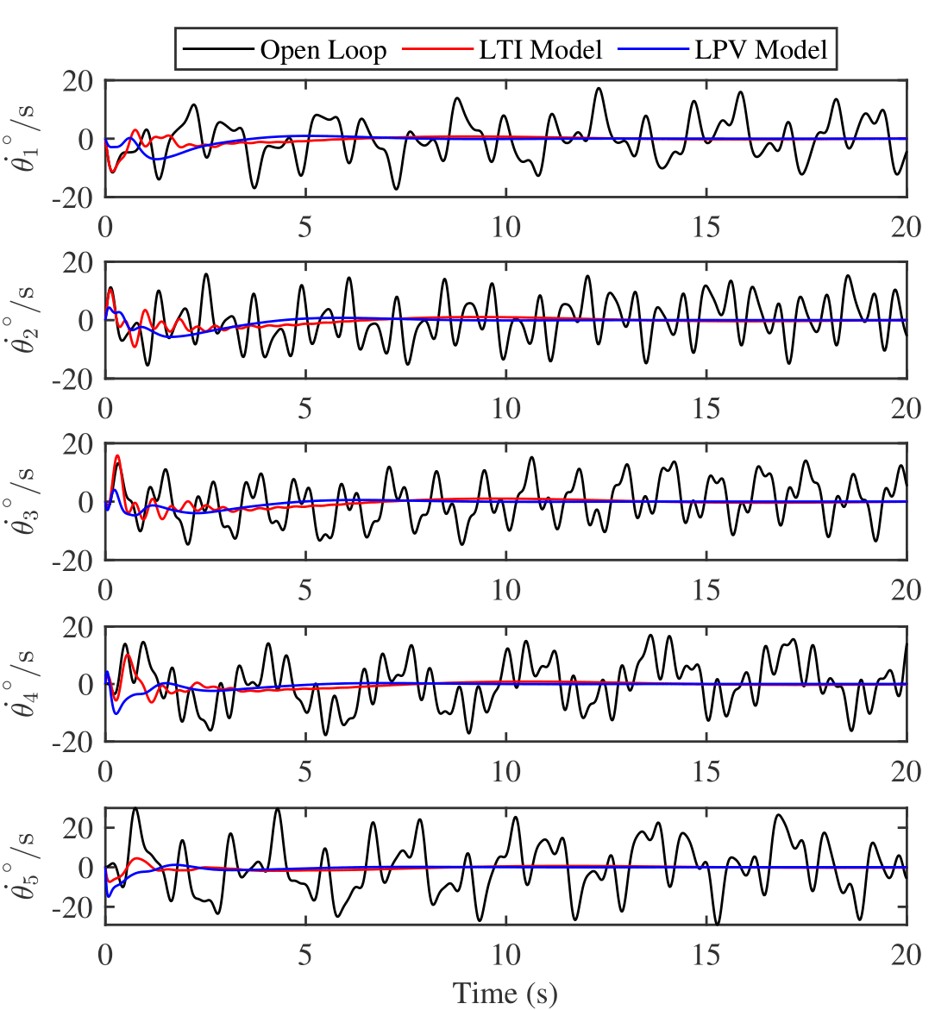
Results Full State Feedback
Fig. 1: Angular deflection trajectory
Fig. 2: Angular deflection rate trajectory

Slide 13
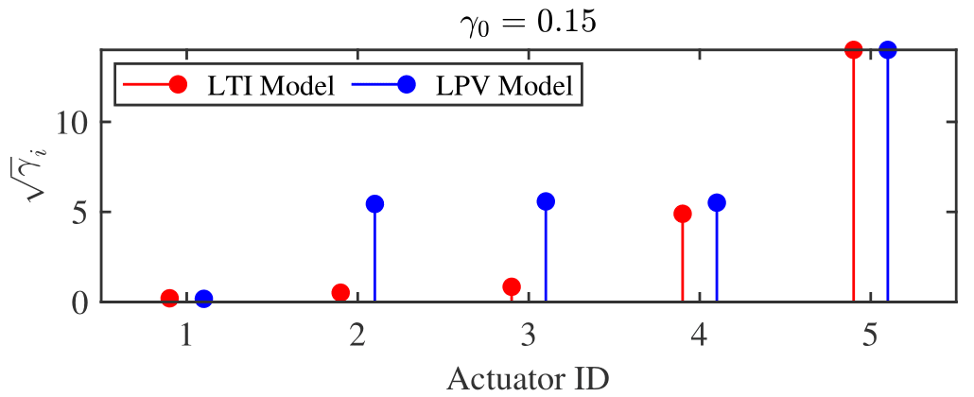
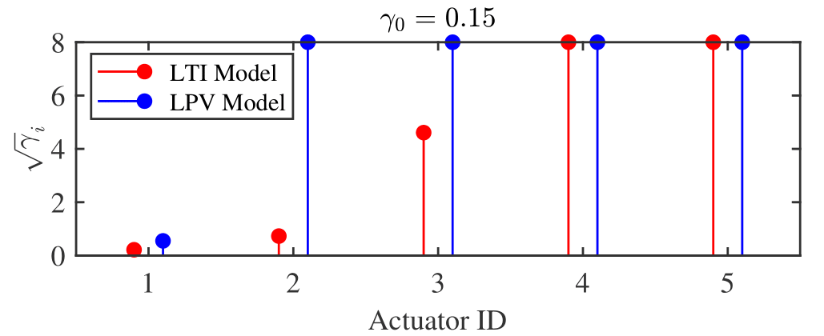
Results Full State Feedback
Full Actuation Needed
Lower Actuation
Fig. 3:Weak upper bound on actuator limits
Fig. 4:Strong upper bound on actuator limits
Redundant Actuator

Slide 14

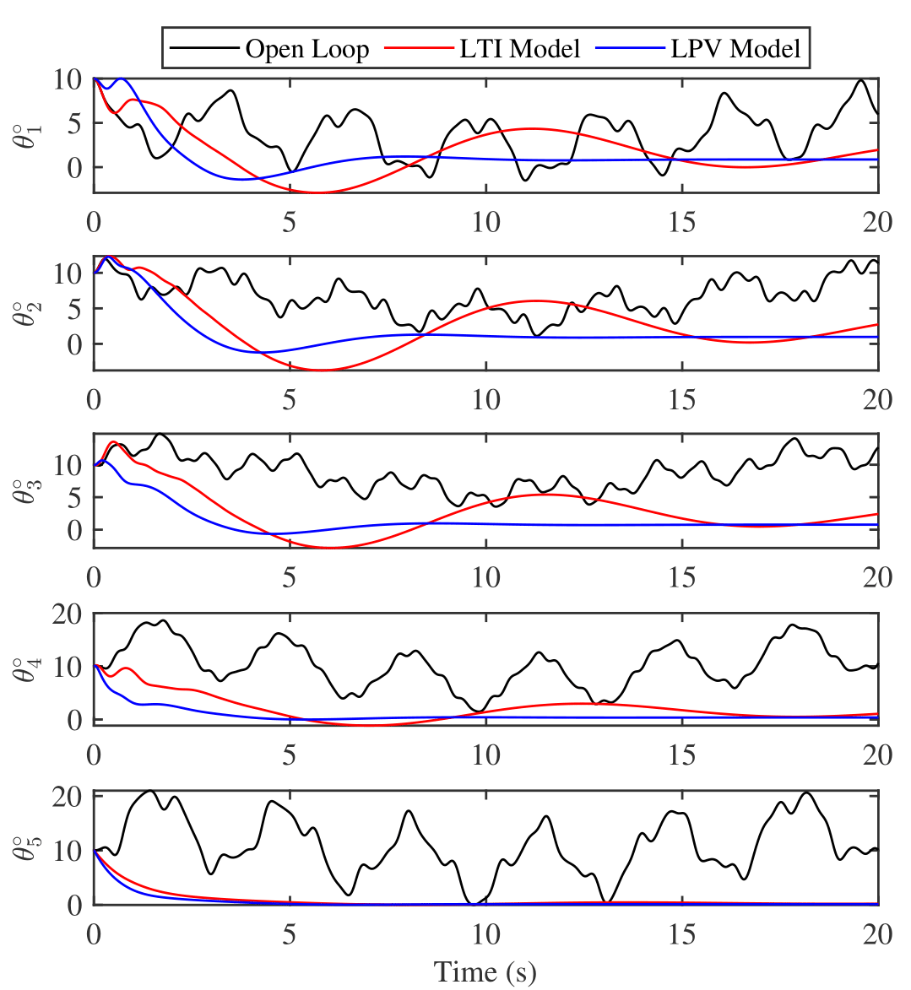
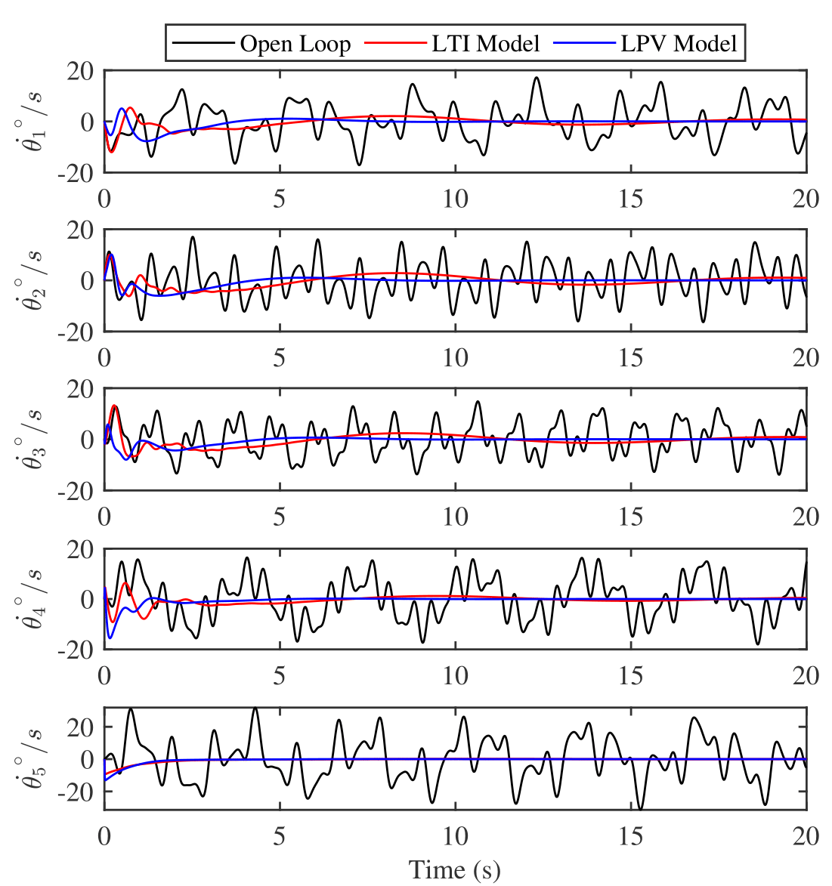
Results Full State Feedback
Fig. 5: Angular deflection trajectory
Fig. 6: Angular deflection rate trajectory

Slide 15
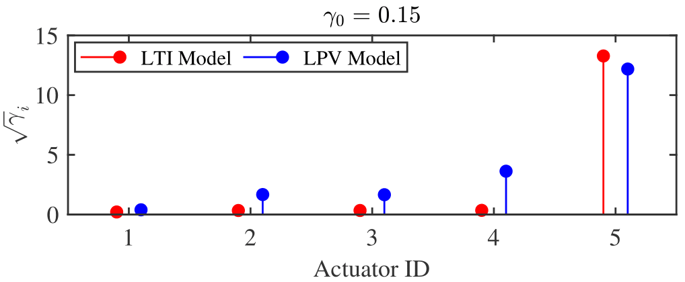
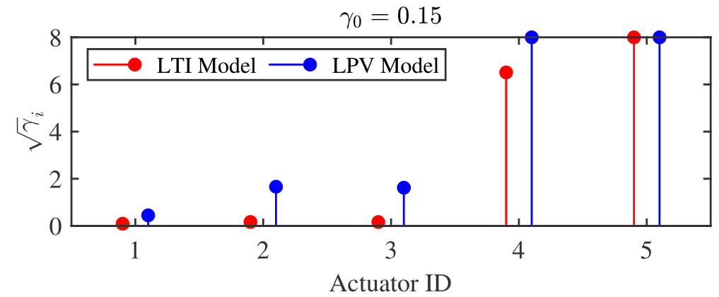
Results Full State Feedback
Cannot be discarded
Partial Actuation
Fig. 7:Weak upper bound on actuator limits
Fig. 8:Strong upper bound on actuator limits
Redundant Actuator
Low Contribution Potentially Redundant
Full Actuation Needed

Slide 16

Conclusions
Proposed convex optimization for joint actuator and controller design.
Ensured performance for nonlinear systems via LPV modelling.
Enabled sparse actuator selection through weighted minimization.
Validated on nonlinear model of flexible wing.
LPV-based sparse designs outperformed LTI-based approaches.

Slide 17


This is us!
Questions?
Thank You
ktanay@tamu.edu

