Slide 1
UNIX Shell
Advanced Research Computing Skills
Katherine Tansey, PhD

Slide 2
Transferable
Computing skills (along with statistics) are HIGHLY transferable
They are the skills that EVERYONE wants
UNIX, R and Python are used by most companies and corporations to do data analysis
It is IMPOSSIBLE to do biomedical research today without computational skills
Notes:
You aren't going to be considered failures just because they don't go on to work in academia.
There are satisfying areas of research outside of universities, and the students had been so walled-in after three years that they couldn't see that fact.
AW used the fact that I used to work in the Met Office as an example, and did interesting research and had papers published

Slide 3
There is a lot of work in this module
Learning 3 different programs in 5 weeks
UNIX
R
Python
All have different syntax and different structures
PRACTICE AT HOME

Slide 4
A computer is not clever
Only responds to precise commands.
Need to be explicit in everything you do
This can be frustrating
Always look at the computer’s response to your commands and think carefully about the differences between what you tried to get it to do and what it actually did do.
Notes:
A computer is a dumb tool like a hammer, just more complex. It can’t anticipate what you want, and can only respond to precise commands. So you need to be explicit in everything you do, and state exactly what is required in every circumstance. If you get the command wrong then the result will be different to what you expected, so always look at the computer’s response to your commands and think carefully about the differences between what you tried to get it to do and what it actually did do. The chances are that you didn’t express your intention correctly.

Slide 5
If you are into data…
Simply Statistics : https://simplystatistics.org/
Edwin Chen : http://blog.echen.me/
FiveThirtyEight : https://fivethirtyeight.com/
Flowingdata : http://flowingdata.com/
R bloggers : https://www.r-bloggers.com/

Slide 6
Format
Interactive
Lecturing about doing is impossible
Ask questions
Don’t be afraid of your computer – it can’t hurt you
Notes:
I always tell people not to be afraid of the machine.
I always tell people that if we've done our job correctly they shouldn't be able to break anything, so go ahead and try things out.
As you say, you learn interactively, and frequently by making mistakes. Ultimately, computers are fun!

Slide 7
Learning Objectives
Understand how to navigate files and directories
Learn basic Unix commands
Discover where to get help
Use a UNIX based text editor
Understand file permissions

Slide 8
Finding the Bash Shell

Slide 9
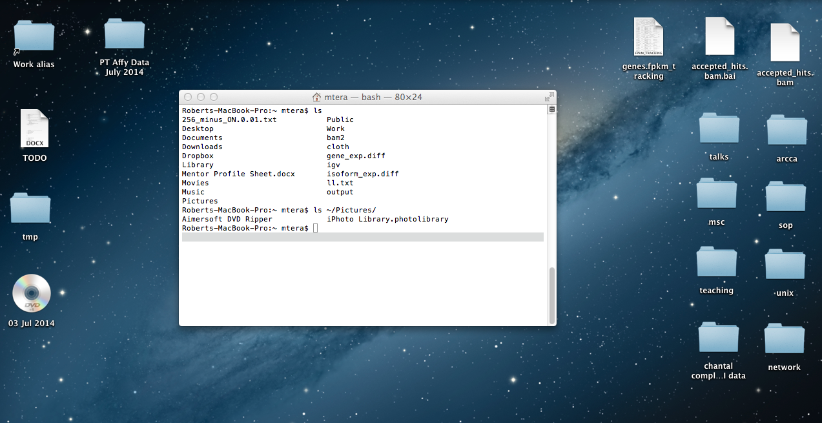
Graphical User Interface (GUI)
GUI is common to Windows/Mac/Linux (although slightly different in each one).
Interface permits you to access files and run commands/programs by clicking icon/apps, drag-and-drop.

Slide 10
UNIX shell
In simple terms, the window on the computer into which you type a command
Called the shell or terminal
Command line interface is often faster and more powerful than a GUI for programming tasks
Notes:
UNIX operating systems come with a collection of tools for manipulating files and performing actions.
The command line interface allows you to issue commands to these tools, where they will be executed immediately.
The GUI frequently uses these underlying tools, providing more straightforward interface for many of them.
However, in many cases the GUI only allows you perform a subset of the available operations, and directly accessing these tools from the command line offers an experienced user more power and flexibility.
Don’t expect to master all the commands immediately – it takes time to achieve a full grasp of the power of the command line.

Slide 11
UNIX Shell
Different operating systems have different slightly different terminals
Easiest to do from a Mac or Linux simply because the syntax is the same
Tools are available to do the same in Windows
Think of it like a portal to UNIX
within the command prompt you need to talk UNIX
even though the rest of the machine is talking Windows or Mac
Notes:
A lot of your work will be done on a UNIX based machine, simply because a lot of the tools used in Bioinformatics research are written for UNIX.
Generally you will connect to a dedicated UNIX cluster from your desktop or laptop, simply because they are centrally managed and generally more powerful.
It’s easiest to do from a Mac or Linux simply because the syntax is the same, but tools are available to do the same in Windows.
Think of it like a portal to UNIX – within the command prompt you need to talk UNIX, even though the rest of the machine is talking Windows.

Slide 12
Finding the Terminal Window
MAC : Applications → Utilities → Terminal
Windows : MobaXTerm

Slide 13
Terminal
Dollar sign ($) is a prompt
Terminal is waiting for input
This might be different depending on system/program
Other common options:
>
If prompt not at the beginning of the line, still working on the previous command
Notes:
echo "hello world”

Slide 14
Navigating Files and Directories

Slide 15
Directory structure
Root directory
Holds everything else
/
bin/ home/ etc/ lib/ tmp/ usr/ var/
bin/ etc/ lib/ local/
bin/ etc/ lib/ sbin/
user/ setup/
Organizing things hierarchically helps keep track of work
Notes:
A good analogy that just came to me is the concept of floors and stairs. You go down a flight of stairs to get to a lower floor, where there may be things, including another set of stairs down. This would be useful when talking about relative paths later - go up a flight of stairs and then down the fire escape!

Slide 16
Full (absolute) pathnames
Do not use spaces for names
Unix pathnames are similar to those in Windows
Except directory names are separated with a / instead of a \
Include entire path from the root directory
Any path that starts with / is an absolute path
Written in relation to the root of the filesystem
/
/usr/local/bin/my_file.txt
usr/
local/
NOTICE: there are two meanings for /
At the front of a file or directory name ➔ root directory
Inside a name ➔ just a separator
bin/
my_file.txt

Slide 17
Relative pathnames
Paths relative to the directory that you are currently in
Do not start with a forward slash /
Find location from where we are, rather than from the root of the file system
Directory above the current directory is given the name dot dot (..)
home/
starting in user/
going up one directory and back down into another directory
../setup/
user/
setup/

Slide 18
PRACTICAL
pwd (print working directory)
Where are you when you open your terminal?
NOTICE: If you are EVER unsure of where you are, type pwd
Notes:
A good couple of lifelines to mention at some point are $HOME and $USER. The former represents your home directory location and the latter could be useful when going to somewhere like /scratch/$USER on Raven.

Slide 19
Home Directory
Everyone has their own home directory
Home directory path will look different on different operating systems
tilde (~) is a shortcut for referring to the home directory
Only works if it is the first character in the path
cd ~
Automatically take you to your home directory
Also occurs by typing cd without any arguments

Slide 20
PRACTICAL
cd ~
Where are you?
What is considered your home directory on your computer?

Slide 21
Command line syntax
syntax = the structure of statements in a computing language
“I like computers”
(pronoun, verb, noun)
ls –al ~
(command, options, arguments)

Slide 22
Command line syntax
NOTE: the command line is:
(i) case-sensitive;
(ii) “words” in syntax are delimited by spaces
ls –al ~
command name
options
arguments
Command name tells the computer the operation/program/job to perform.
ALWAYS a single word
A command can take options
Although not always, they are optional
Usually preceded by a dash
Change the behaviour of the command: usually the style in which the output is given.
Arguments gives the computer the required input
Usually file or directory names
Not always required

Slide 23
What happens when we run a UNIX command
ls
Finds a program called ls
Runs that program
Displays that program’s output
Displays a new prompt to tell us that it’s ready for more commands

Slide 24
Moving up and down within a UNIX filesystem
cd ➔ change directory
Take you to a different place within the filesystem
Command used to move about
cd ../
.. is a special directory name meaning “the directory containing this one”, aka the parent of the current directory
the argument ../ will take you up (..) a directory level

Slide 25
PRACTICAL
Moving around on your computer

Slide 26
Getting help

Slide 27
Getting help
man ➔ manual
Before the days of Google, man to get help with command syntax
man cut

Slide 28
Getting help – man command
NAME:
command name and one-line description
SYNOPSIS:
geeky syntax description (what to type)
DESCRIPTION:
description
OPTIONS:
(probably the most useful part)
EXAMPLE:
(google for recipes instead)

Slide 29
Getting help – --help
Add --help after most commands
cut --help
If --help does not work using -h instead
bash built-in, providing help for bash commands only

Slide 30
Getting help – info
info ➔ another documentation system for commands
info cut

Slide 31
Getting help - Google
https://unix.stackexchange.com/
http://stackoverflow.com/

Slide 32
PRACTICAL
Get help

Slide 33
File permissions and privacy

Slide 34
File permissions and privacy
UNIX splits file permission into three sections
user: the file/directory owner
group: a group of individuals permitted to read the file
other: everyone
Each section is then granted 3 types of permission
r: permission to read
w: permission to write (edit and delete)
x: permission to execute

Slide 35
File permissions and privacy
When you long list (ls -l) files, you will see their permissions
-rw-r--r-- 1 mtera staff 17895 24 Feb 10:49 256_minus_ON.0.01.txt
drwx------ 39 mtera staff 1326 6 Aug 10:14 Desktop
file name
permissions
file size
owner login
group
# files in the directory
date stamp

Slide 36
File permissions and privacy
user (u)
group (g)
other (o)
-rw-r--r--
drwx------
no permission
- = file
d = directory
write (w)
read (r)
execute (x)

Slide 37
File permissions and privacy
UNIX splits file permission into three sections
user the file/directory owner
group a group of individuals permitted to read the file
other everyone
The second of these sections (group) enables group access the same files and directories. The groups command will show you which groups you belong to. A UNIX administrator will create these groups for you.
groups

Slide 38
File permissions and privacy
chmod ➔ change mode
Change the permissions of your files and directories
chmod ug+r myFile.txt
The syntax works in 3’s
u/g/o user/group/other
+/- enable/disable
r/w/x read/write/execute

Slide 39
File permissions and privacy – number system
chmod ug+r myFile.txt
chmod 0404 myFile.txt
--- : No permissions; corresponds to 0
--x : Execute only permission; corresponds to 1
-w- : Write only permissions; corresponds to 2
-wx : Write and execute permissions; corresponds to 3
r-- : Read only permissions; corresponds to 4
r-x : Read and execute permissions; corresponds to 5
rw- : Read and write permissions; corresponds to 6
rwx : Read, write, and execute permissions; corresponds to 7

Slide 40
PRACTICAL
Changing permissions on files and directories

Slide 41
Wrapping Up

Slide 42
Key Points
/ on its own is the root directory of the whole file system
A relative path specifies a location starting from the current location
A full (absolute) path specifies a location from the root of the file system
.. means ‘the directory above the current one’
. on its own means ‘the current directory’
Up-arrow to scroll up through previous commands to edit and repeat them
history to display recent commands
!number to repeat a command by number
There is no trash bin: once something is deleted, it is gone

Slide 43
REMEMBER
Do not use spaces, quotes, special characters, or wildcard characters such as ‘*’ or ‘?’ in filenames, as it complicates variable expansion.

