Slide 1
Data manipulation with dplyr
Katherine Tansey, PhD
Data Scientist @ Admiral Group
https://github.com/ktansey

Slide 2
Aims of workshop:
Learn the main dplyr verbs
Understand how pipes work

Slide 3
How the practical works?
Practical is on Rstudio cloud : https://rstudio.cloud/project/42122
You can use the Rscript or the Rmarkdown file
Whatever you are most comfortable with

Slide 4
The data we are going to be working with
1 ) gapminder
“An excerpt of the data available at Gapminder.org. For each of 142 countries, the package provides values for life expectancy, GDP per capita, and population, every five years, from 1952 to 2007.”
For more information : https://www.gapminder.org/
2) msleep
Sleep times and weights for mammals
For more information: V. M. Savage and G. B. West. A quantitative, theoretical framework for understanding mammalian sleep. Proceedings of the National Academy of Sciences, 104 (3):1051-1056, 2007.

Slide 5
Why dplyr?
It’s fast
Simple clear syntax
Chain commands together
Connects with external databases

Slide 6
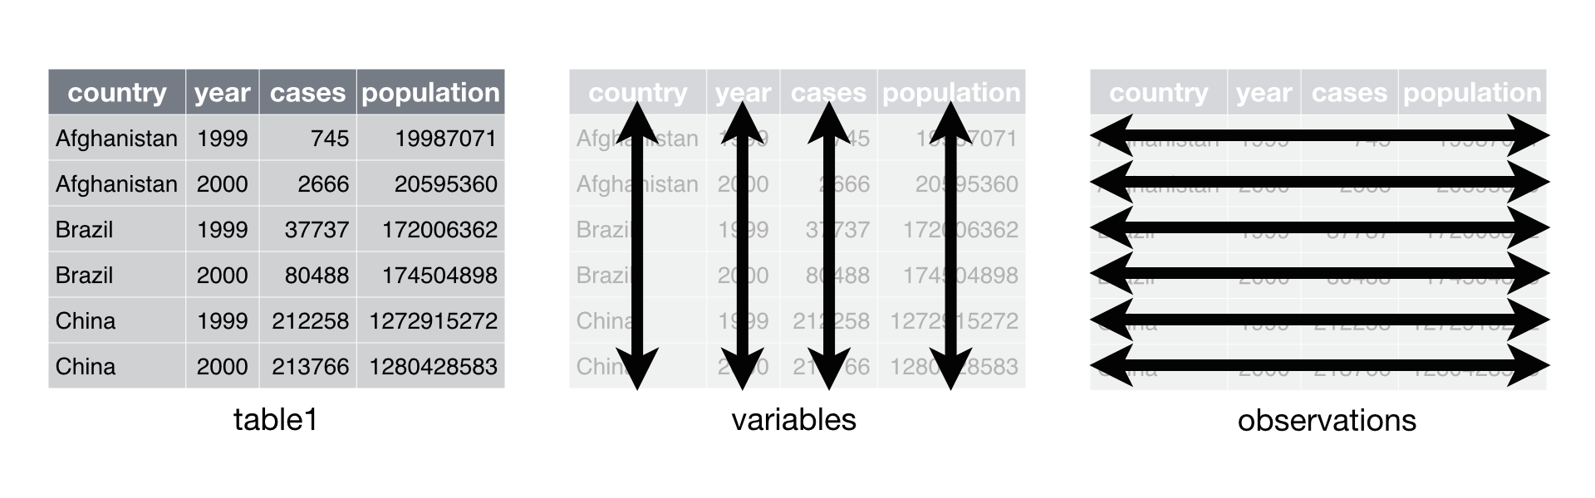
Tidy Data
What is "tidy" data?
Observations as rows
Variables as columns
One type of observational unit per table
Each value belongs to a variable and an observation
Column headers are variable names not variables

Slide 7
Understanding the structure of your data
Various functions exist to look at the data and give you basic information about it.
head(df) → prints to screen first few rows of data
tail(df) → prints to screen last few rows of data
class(df) → class of data
dim(df) → how many rows and columns
colnames(df) → column names
str(df) → data preview, and column data types
summary(df) → summary of data
* df = the name of your dataframe

Slide 8
Let’s a look at the practical

Slide 9
dplyr ‘verbs’
6 main “verbs” in dplyr
filter() → return rows with matching conditions
select() → select variables by name
mutate() → create new variables
group_by() → return grouping variables
summarise() → reduces multiple values down to a single value
arrange() → arrange rows by variables

Slide 10
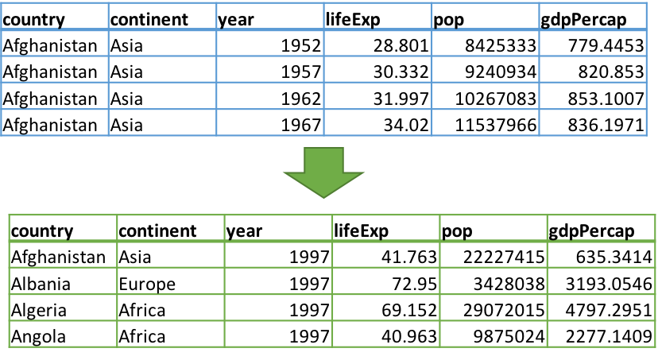
filter() → filter rows
# single filter
filter(gapminder, year == 1997)
filter(gapminder, continent == “Asia”)
# multiple filters
filter(gapminder,
year == 1997 & gdpPercap > 1000)
filter(gapminder,
year == 1997 | year == 1967)
Use filter to keep or remove certain rows from a data set.
Use conditionals to keep only the rows that match the criteria.

Slide 11
filter() options
Relational Operations | Outputs TRUE or FALSE based on the validity of the statement…
a == b | a is equal to b
a != b | a is not equal to b
a > b | a is greater than b
a < b | a is less than b
a >= b | a is greater than or equal to b
a <= b | a is less than or equal to b
a %in% b | a is an element in b
Logical Operations | Outputs TRUE or FALSE based on the validity of the statement…
a & b, a && b | Both a and b are TRUE
a | b, a
!a | a is not TRUE (take everything else but a)
xor(a, b) | Either a or b is TRUE, but not both.
all(a,b,c,...) | a, b, c, … are all TRUE.
any(a,b,c,...) | Any one of a, b, c, … is TRUE.

Slide 12
Let’s try filter()
# single filter
filter(gapminder, year == 1997)
filter(gapminder, continent == “Asia”)
# multiple filters
filter(gapminder, year == 1997 & gdpPercap > 1000)
filter(gapminder, year == 1997 | year == 1967)
Column names must match EXACLTY to the dataframe
Observations that are strings (characters/words) need quotes
R is case sensitive!

Slide 13
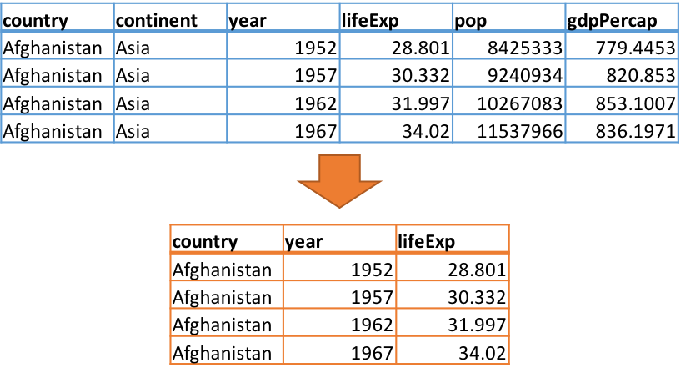
select() → select columns
select(gapminder, country, year, lifeExp)
# vectorized
select(gapminder, country:year)
# select all columns from country to year
# Not select a column
select(gapminder, -country)
# select all columns BUT country
Use select to keep or remove certain columns from a data sets.

Slide 14
select() helper functions
Make it easier to select multiple columns
starts_with("Hap") → ALL column names that start with "Hap"
ends_with("ppy") → ALL column names that end with "ppy"
contains("app") → ALL column names that contain "app"
matches("^(SNP|CHR)_") → ALL column names that match a regular expression
num_range("x", 1980:1983) → ALL column names x1980, x1981, x1982, and x1983
one_of(character_vector) → ALL column names that appear in character_vector

Slide 15
How to use helper functions?
country | continent | year | lifeExp | pop | gdpPercap
Afghanistan | Asia | 1952 | 28.8 | 8425333 | 779. 2
Afghanistan | Asia | 1957 | 30.3 | 9240934 | 821. 3
Afghanistan | Asia | 1962 | 32.0 | 10267083 | 853. 4
Afghanistan | Asia | 1967 | 34.0 | 11537966 | 836. 5
select(gapminder, contains(“co”) )
select(gapminder, starts_with(“co”) )
country | continent
Afghanistan | Asia
Afghanistan | Asia
Afghanistan | Asia
Afghanistan | Asia

Slide 16
Let’s try select()
select(gapminder, country, year, lifeExp)
# vectorized
select(gapminder, country:year)
# select all columns from country to year
# Not select a column
select(gapminder, -country)
# select all columns BUT country
select(gapminder, contains(“co”))

Slide 17
Introducing the pipe %>%
Take the output from the previous command as the input the next command
Commands in dplyr can be piped together
Saves on writing coding and saving intermediate steps
NOTE: input data information for each command is now missing, and the subsequent "piped" commands are indented. The indentation makes it easier to follow the trail of commands within the pipe.
new_df <- fitler(gapminder, year == 1997)
gap1997 <- select(new_df, -year)
VS.
gap1997 <- gapminder %>%
filter(year == 1997) %>%
select(-year)

Slide 18
pipe %>%
When to not use a pipe:
Multiple inputs or outputs
Pipes should focus on one clear task for one object
More than 10 steps
If you need a circular step
Pipes are linear, they don’t loop back round!

Slide 19
Let’s try the pipe %>%
gap1997 <- gapminder %>%
filter(year == 1997) %>%
select(-year)
There is no more input data information for each command
Indentation makes it easier to follow the trail of commands within the pipe.

Slide 20
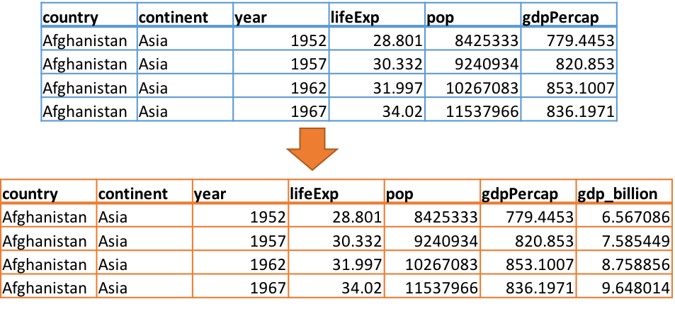
mutate() → Mutate existing columns to make new columns.
# single variables
mutate(gapminder, gdp_billion = gdpPercap*pop/10^9)
# multiple variables
mutate(dataset1, rate = NUM1/100, norm = Value2 - 50)

Slide 21
Let’s try mutate()
# single variables
mutate(gapminder, gdp_billion = gdpPercap*pop/10^9)
# multiple variables
mutate(dataset1, rate = NUM1/100, norm = Value2 - 50)
REMEMBER to name your new columns!
Practical will build on previous verbs and the pipe!

Slide 22
group_by() → Group by factor/category
# single variables
group_by(gapminder, continent)
# multiple variables
group_by(gapminder, country, continent)
Group together rows of data by some factor within the dataset.
This command does very little on its own, but is very useful and powerful once combined with summarise.

Slide 23
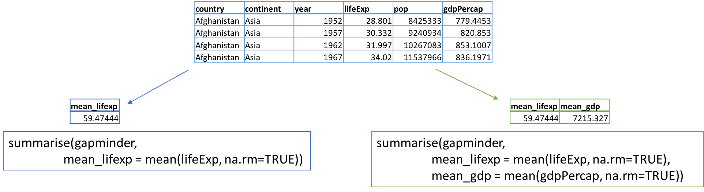
summarise() → Create summary statistics from data sets
# get mean of life expectancy
summarise(gapminder, mean_lifexp = mean(lifeExp))
# get mean of life expectancy and mean of GDP
summarise(gapminder, mean_lifexp = mean(lifeExp), mean_gdp = mean(gdpPercap))

Slide 24
group_by() & summarise()
country | continent | year | lifeExp | pop | gdpPercap
Afghanistan | Asia | 1952 | 28.8 | 8425333 | 779. 2
Afghanistan | Asia | 1957 | 30.3 | 9240934 | 821. 3
Afghanistan | Asia | 1962 | 32.0 | 10267083 | 853. 4
Afghanistan | Asia | 1967 | 34.0 | 11537966 | 836. 5
gapaminder %>%
group_by(continent) %>%
summarise(mean_lifeExp = mean(lifeExp),
median_gdp = median(gdpPercap))
continent | mean_lifeExp | median_gdp
Africa | 48.9 | 1192
Americas | 64.7 | 5466
Asia | 60.1 | 2647
Europe | 71.9 | 12082
Oceania | 74.3 | 17983

Slide 25
Let’s try group_by() & summarise()
gapminder %>%
group_by(continent) %>%
summarise(mean_lifeExp = mean(lifeExp),
median_gdp = median(gdpPercap))
REMEMBER to name your new columns!
Practical will build on previous verbs and the pipe!

Slide 26
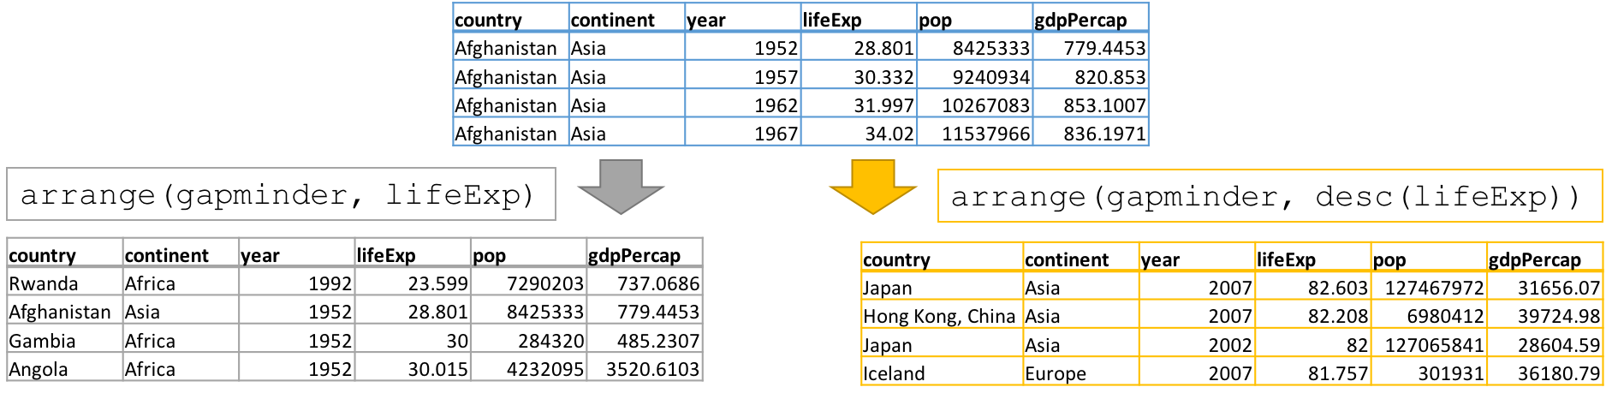
arrange() → arrange rows
# single parameter ascending arrange
arrange(gapminder, lifeExp)
# single parameter descending arrange
arrange(gapminder, desc(lifeExp))
# multiple parameter arrange
arrange(gapminder, desc(lifeExp), pop)

Slide 27
Multiple parameter arrange
In a multiple parameter arrange,
the order is important!
In the example above, the gapminder data is:
first sorted by desc(lifeExp) (descending life expectancy)
any ties broken by value of pop (ascending population)
# multiple parameter arrange
arrange(gapminder, desc(lifeExp), pop)

Slide 28
Let’s try arrange()
# single parameter ascending arrange
arrange(gapminder, lifeExp)
# single parameter descending arrange
arrange(gapminder, desc(lifeExp))
# multiple parameter arrange
arrange(gapminder, desc(lifeExp), pop)
Practical will build on previous verbs and the pipe!

