Slide 1
Introduction to R
Katherine Tansey, PhD

Slide 2
Learning Objectives
Get familiar and comfortable with RStudio and Rmarkdown
Understand the basic syntax of R
Learn where to find help

Slide 3
Why R?
Open Source
More than 5,000 publicly released R packages
You too can write and release an R package
Huge online community
Means you can get help easily!
GREAT for statistical analysis
EXCELLENT for making plots
Integrates well with other computer languages (C++, Java, C)

Slide 4
Introduction to Basics

Slide 5
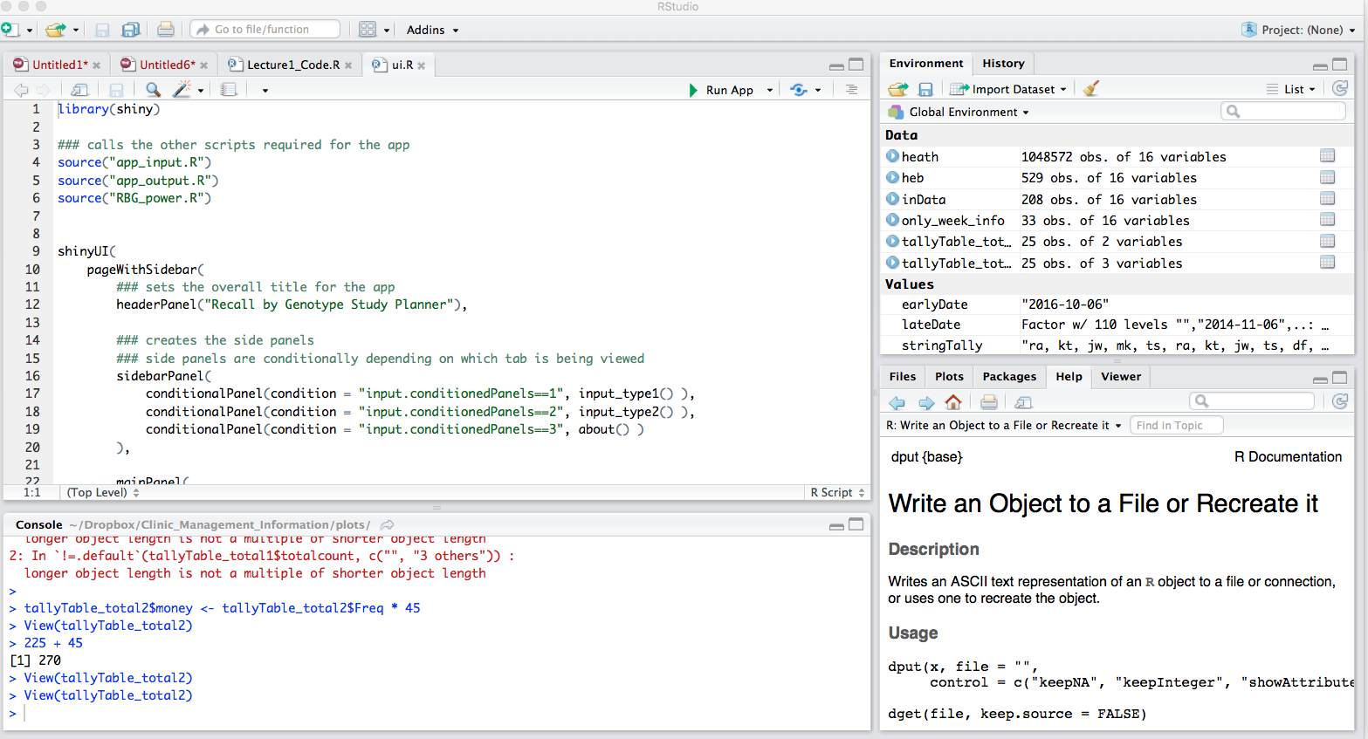
R Studio
Code Editor
Workspace
History
Plots
Files
Help
R Console

Slide 6
Ways to use RStudio
Interactive R console
Test out code in the console and copy it into a file for saving later
Not effective or efficient
Easy to “lose” steps/code by forgetting to copy over key pieces
Write an .R file
Select and run commands from file in the interactive R console
ALL code is saved

Slide 7
R likes math
Addition: +
Subtraction: -
Multiplication: *
Division: /
Exponentiation: ^
Modulo: %%
Trig functions : sin()
Natural log : log()
Base-10 log : log10()
Exponential : exp()

Slide 8
PRACTICAL
Do math

Slide 9
R prompt
>
Prompt
Know R is awaiting input and nothing is currently running
+
R is waiting for you to complete a command
Cancel a command by hitting Esc
Command line R → cancel command with Ctrl+C

Slide 10

Comments
#
R ignores everything after a #
Use these to make comments in the code

Slide 11
Assigning values to variables
A variable stores a value or an object
Use variable’s name to easily access the value or the object that is stored within this variable
Variable names can not contain spaces or special characters
<- used to assign values to variables
x <- 43
y <- “hello”

Slide 12
PRACTICAL
Assign some stuff to variables

Slide 13
Variable naming
Types of variable naming conventions
this_is_called_snake_case
whileThisIsCamelCase
sometimes.there.be.periods
Or_thereAre.thoseThat_Annoy.everyone
Can not start with a number
Can only contain letters, numbers, ., _

Slide 14
Variable naming
Best practice:
Make the variable names meaningful
Do not make them too long

Slide 15
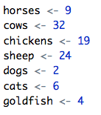
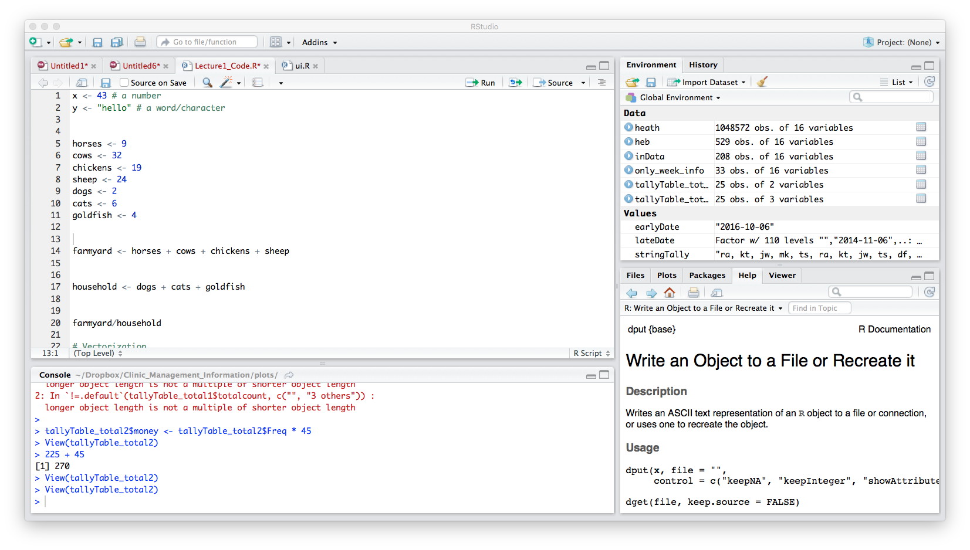
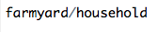
Variables can be used like values
How many farmyard animals are there?
How many house pets are there?
Ratio of farmyard animals to house pets

Slide 16
Displaying values of variables
2 ways to do this:
Type variable name into R console
Use print() function

Slide 17
PRACTICAL
Print values to console

Slide 18
Tab completion!
RStudio will tab complete previously defined variable names
Very handy!
Particularly for longer variable names
Or complicated names
Because harder to get wrong if R is helping you complete the name
Remember with computers: You MUAT ALWAYS be completely precise in your instructions

Slide 19
Getting help

Slide 20
Getting help in R
? before function name
?mean
Documentation on how to use the mean function
??function_name
When you don’t completely remember the function name
help()
help(mean)
Documentation on how to use the mean function
Both get you the same documentation
NOT always very helpful

Slide 21
The internet is your friend
Quick-R : http://www.statmethods.net/
Cookbook for R : http://www.cookbook-r.com/
R-bloggers : https://www.r-bloggers.com/
Stackoverflow : http://stackoverflow.com/tags/r/info
CrossValidated : https://stats.stackexchange.com/
Google

Slide 22
Wrapping Up

Slide 23
Key points
R has the usual arithmetic operators and mathematical functions
<- assign values to variables

Slide 24
REMEMBER
Do not use spaces, quotes, special characters, or wildcard characters such as ‘*’ or ‘?’ in filenames, as it complicates variable expansion.
Give files consistent names that make logical sense, reflect what the data is and that are easy to match with wildcard patterns to make it easy to select them for looping.
THIS IS THE SAME AS WHEN WE TALK ABOUT UNIX!!!!

Slide 25
CHEAT SHEETS!
RStudio : https://www.rstudio.com/wp-content/uploads/2016/01/rstudio-IDE-cheatsheet.pdf
R Markdown : https://www.rstudio.com/wp-content/uploads/2016/03/rmarkdown-cheatsheet-2.0.pdf
R Markdown Reference Guide : https://www.rstudio.com/wp-content/uploads/2015/03/rmarkdown-reference.pdf

