Slide 1
R Markdown
Katherine Tansey, PhD

Slide 2
Project management

Slide 3
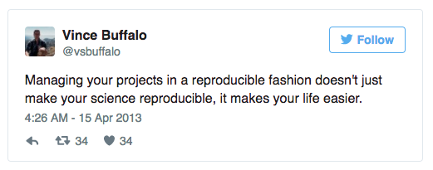
Project management
A good project management will ultimately make your life easier:
Help ensure data integrity
Makes it simpler to share code
Easily upload code with manuscript submission
Easier to pick the project back up after a break

Slide 4
PRACTICAL Use RStudio to Project Manage
Create a new project in RStudio:
Click the “File” menu button, then “New Project”
Click “New Directory”
Click “Empty Project”
Type in the name of the directory to store the projectMake sure that the checkbox for “Create a git repository” is selected
Click the “Create Project” button

Slide 5
Best Practice for project management
Treat data as read-only
Original data is always left in an untouched state
Treat generated output as disposable
All outputs should be able to be regenerated from scripts
Separate function definition and application
Reusable chunks get pulled into their own functions
Separate these into separate folders
Useful functions reused across analyses and projects
Analysis scripts

Slide 6
Structure
my_project
bin/ input/ output/ doc/ qc/ resources/ src/
Put each project in its own directory
Named after the project!
Text documents associated with the project in the doc directory
Raw data and metadata in the input directory
Files generated during cleanup and analysis in a output directory
Source for the project’s scripts and programs in the src directory
Programs brought in from elsewhere or compiled locally in the bin directory.
Name all files to reflect their content or function
This is flexible – but best to GET ORGANIZED

Slide 7
REMEMBER
Do not use spaces, quotes, special characters, or wildcard characters such as ‘*’ or ‘?’ in filenames, as it complicates variable expansion.
Give files consistent names that make logical sense, reflect what the data is and that are easy to match with wildcard patterns to make it easy to select them for looping.
THIS IS THE SAME AS WHEN WE TALK ABOUT UNIX!!!!

Slide 8
Git integration
RStudio connects to git
Very limited in what it can do
Might have to also access git via Unix

Slide 9
Using Markdown

Slide 10
Why?
Supplement R code with narration
Comments!!!
Fully reproducible
Integrate in UNIX (Bash), Python, SQL, and more
Output in various formats (HTML, PDF, Word, SlideShows)
Links easily with Shiny

Slide 11
Markdown
Plain text
Simple formatting
Use instructions to build HTML, PDF or Word documents
Need to learn simple formatting
Reference guide: http://www.rstudio.com/wp-content/uploads/2015/03/rmarkdown-reference.pdf

Slide 12
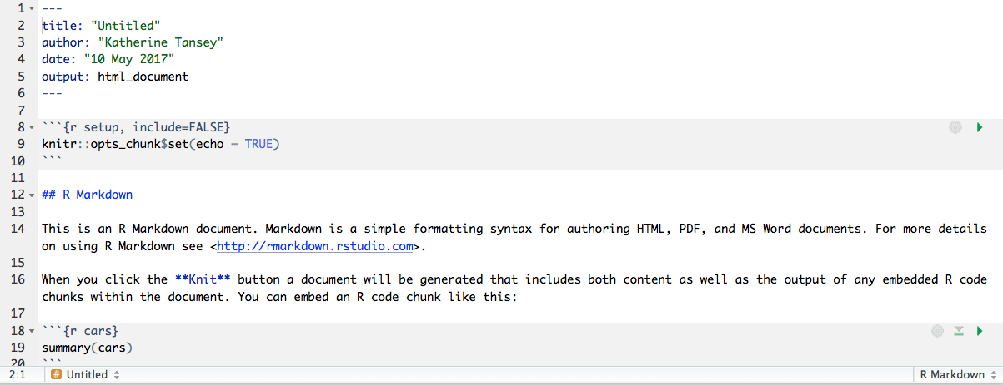
Let’s look at a Markdown file
YAML header with some metadata
R code
chunks
Narrative
Text
R code
chunks

Slide 13
PRACTICAL
Examine Markdown HTML file and Rmd to compare

Slide 14
Basics to Markdown
# First level header
## Second level header
### Third level header
*italics*
**bold**
`code`
[RStudio](www.rstudio.com)

Slide 15
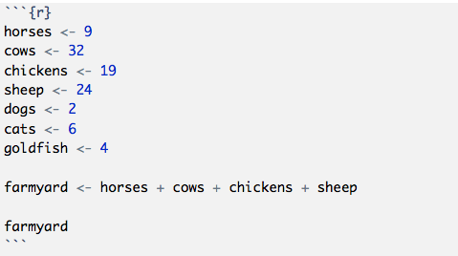
R code chunks
Code chunk options:
warning == FALSE → don’t output warnings
message == FALSE → don’t output messages
error == FALSE → don’t output error reporting
echo == FALSE → don’t output R code in document
Common for when making plots
eval == FALSE → don’t run the code or include its results
results == ‘hide’ → don’t display results of the code
fig.height == ## → set a height for a plot
fig.width == ## → set a width for a plot

Slide 16
PRACTICAL
Altering a markdown file

Slide 17
From here forward
Everything you do should be written in Markdown
The practicals are written in markdown!
Write yourselves comments in the plain text to describe what we are doing and why
Your assignments for this module with have to be done in Markdown

Slide 18
Wrapping Up

Slide 19
A lot covered
Use Rstudio
Markdown, project management, git!

Slide 20
Key points
Treat raw data as read-only
Treat generated output as disposable
Separate function definition and application

Slide 21
REMEMBER
Do not use spaces, quotes, special characters, or wildcard characters such as ‘*’ or ‘?’ in filenames, as it complicates variable expansion.
Give files consistent names that make logical sense, reflect what the data is and that are easy to match with wildcard patterns to make it easy to select them for looping.
THIS IS THE SAME AS WHEN WE TALK ABOUT UNIX!!!!

Slide 22
CHEAT SHEETS!
RStudio : https://www.rstudio.com/wp-content/uploads/2016/01/rstudio-IDE-cheatsheet.pdf
R Markdown : https://www.rstudio.com/wp-content/uploads/2016/03/rmarkdown-cheatsheet-2.0.pdf
R Markdown Reference Guide : https://www.rstudio.com/wp-content/uploads/2015/03/rmarkdown-reference.pdf

