Slide 1
Data
Katherine Tansey, PhD

Slide 2
Data Types

Slide 3
Data Types
x <- 43
y <- “hello”
43 and “hello” are not treated the same by R
Variables inherit their type from what they contain
Use class() to see a variables types
Data Type | Example
Numeric | 1000.4, 85.6 (numbers with decimals)
Character | “hello”, “23.4”, “True”, “a”
Integer | 3L, 42L, 0L (natural numbers)
Logical | TRUE, FALSE

Slide 4
Coercion

Slide 5
Sometimes R gets it wrong
Each column of a data frame must be a single data type
Because each column of a data frame is stored as a vector
Join columns together with two different data types, R will make a choice
Character + Anything_Else ➔ Character
Number + Integer or Logical ➔ Number
Integer + Logical ➔ Integer

Slide 6
Forcing data types
as.numeric(data$column)
as.character(data$column)
as.vector(data$column)
as.data.frame(data)

Slide 7
Issues with Factors
Example: Sex
Stored as Numbers: 0, 1
Displayed as Labels: Male, Female
as.character(Sex)
R returns labels as strings
as.numeric(Sex)
R returns numbers
Coercion can when combing data types
You might not get what you think as output!

Slide 8
Data structures

Slide 9
Data structures
Vector
Data Frame
Factor
Not going to go over but read about them for self directed learning
Matrix
Tables
List

Slide 10
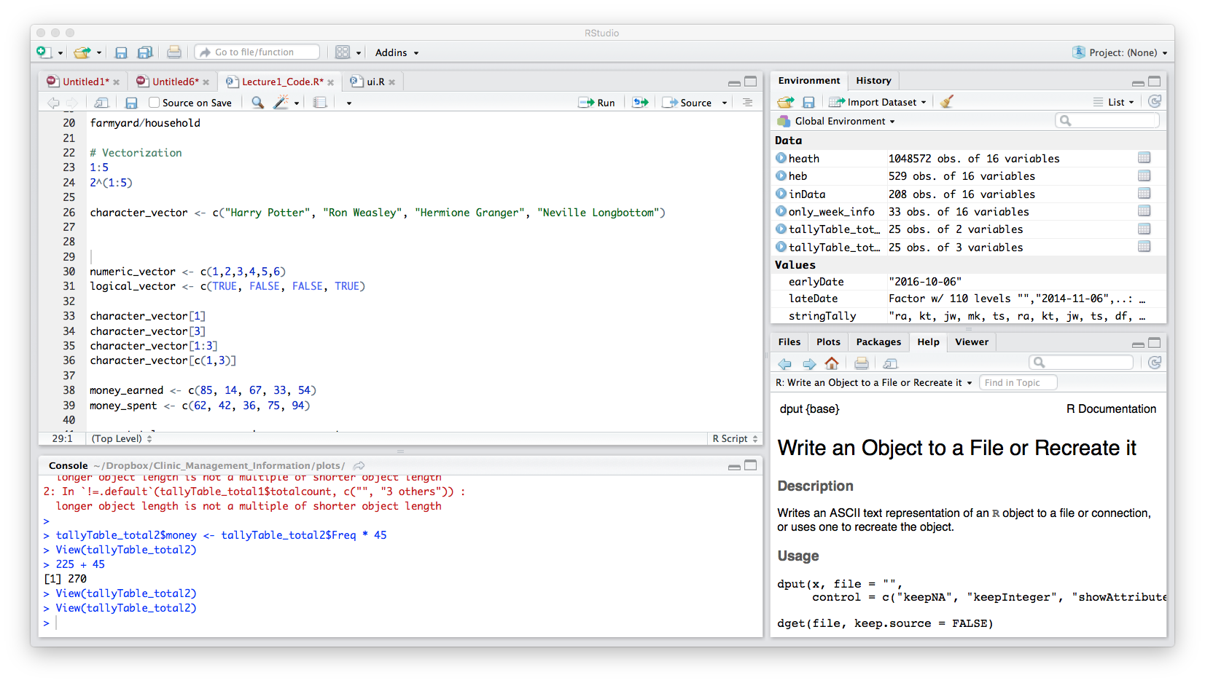
Vectors
R counts from 1
Collections of values of the same type
One-dimensional arrays
c() ➔ combine values into a vector
Retrieve individual elements from a vector
character_vector[1] → “Harry Potter”
character_vector[3] → “Hermione Granger”
character_vector[1:3] →
character_vector[c(1,3)] →

Slide 11
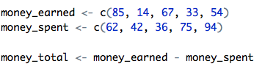
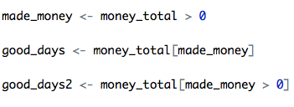
Math with numeric vectors
Addition (+), subtraction (-), multiplication (*), division (/)
Selection

Slide 12
PRACTICAL
Play with vectors

Slide 13
Factor
Stores categorical data
Sex <- c(“Female”, “Male”)
factor() ➔ function to encode a vector as a factor
Can be ordered (ordinal data)

Slide 14
PRACTICAL
Factors

Slide 15
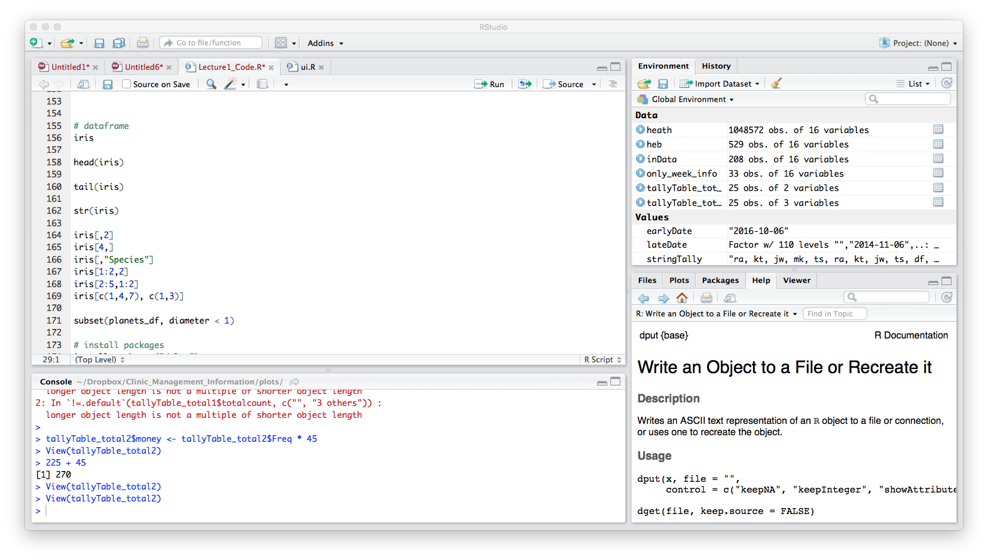
Data Frame
Variables of a data set as columns and the observations as rows
Two-dimensional array
Similar to a matrix
Each column can have a different data type
data.frame()➔ function to make dataframe
str() ➔ structure of data set

Slide 16
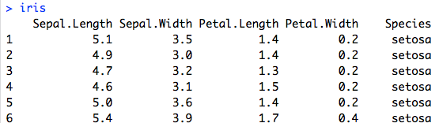
Data Frame
R counts from 1
Retrieve elements from a dataframe
iris[,2]
iris[4,]
iris[,“Species”]
iris$Species
iris[1:2,2]
iris[2:5,1:2]
iris[c(1,4,7), c(1,3)]

Slide 17
PRACTICAL
Data frames

Slide 18
Dataframe size
nrow()
Number of rows in the dataframe
dim()
Number of dimensions
Columns and rows
colnames()
Gets the column names of the dataframe

Slide 19
PRACTICAL
Data frames

