Slide 1
TEAM ID : TECH_0_65 TEAM NAME : HUNTERS
Theme : - Crime Control
Team Members : Rahul Thapliyal
Taranjeet Kaur
Vivek Kumar

Slide 2

CRIME LOGGER
AND
ALERT SYSTEM

Slide 3
PROBLEM STATEMENT
1.There is no timely alert or update of crimes to the civilians near the crime locations.
2. There is no provision for locals to help in
locating wanted criminals.

Slide 4
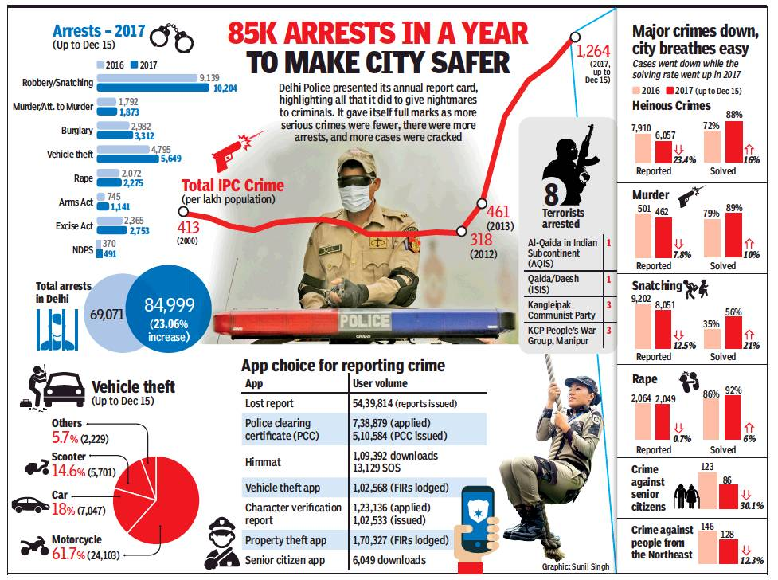

Slide 6
SOLUTION APPROACH
A Website which provides
Provision for nation's law enforcement agencies to alert the civilians
Provide information about the active crimes occurring in the area
Timely alert to ensure safety.
Citizen engagement in locating wanted criminals
Transparency to all the citizens about crimes and criminals.

Slide 7
SOLUTIONS
Platform to log crimes
Search crime logs according to location specified by user
Suggestion on the security measures to be taken in order to help others in review section.
Users can browse the criminal database of any area.

Slide 8
ARCHITECTURE
Signup for new Users : Verification using OTP
Login for existing ones using password
Search for crime incidents : Location pointed on Map.
Report a crime incident
Alert to all nearby users about the incident
Authentication of reported crimes by the security authorities.

Slide 9
ARCHITECTURE
Submit a crime tip to your local agency or Crime Stoppers program to help keep your community safe.
Feedback/Suggestion by users after the crime incident has been updated by authority

Slide 10
TECHNOLOGIES USED
Backend Development : Django
Frontend Development : HTML, CSS, Javascript, Bootstrap.
APIs : Google Maps, 2-factor SMS API and other APIs.

