Slide 1

Martial Arts Club
“Join the MAC!
Martial Arts Questions? Take It To The MACs!”

Slide 2
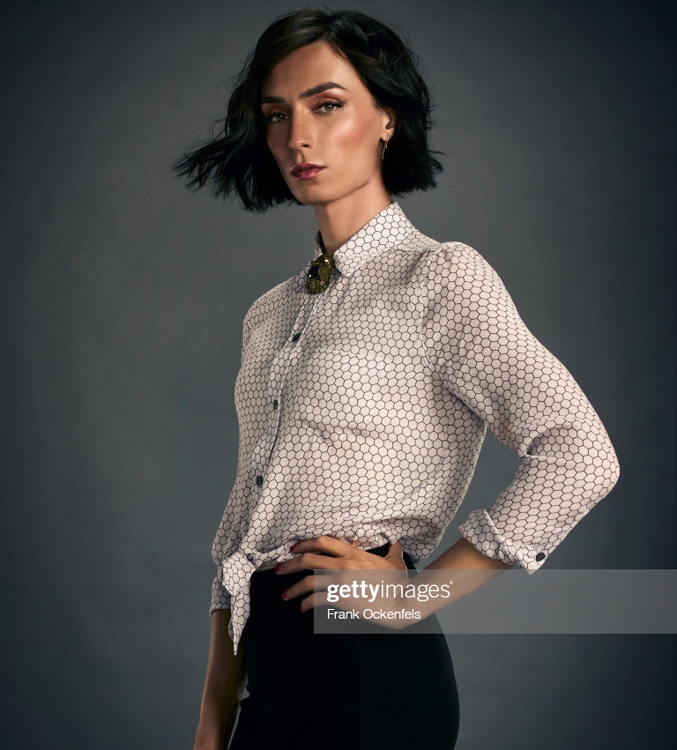
Faculty Advisor: Ms Fiona Sharpe
They are from Idaho originally
They came to Halcyon to start a new life in their teens.
They survived on the streets where they mastered a totally unique martial arts style called “Streetwise” which became their hero name.
They became a teacher when Dr. Alexander offered a chance to help students without powers in particular.
She has a very low level power: Precognitive Reflexes and will only teach those with low power skills.
She teaches Political Science and Ethics in the school.

Slide 3
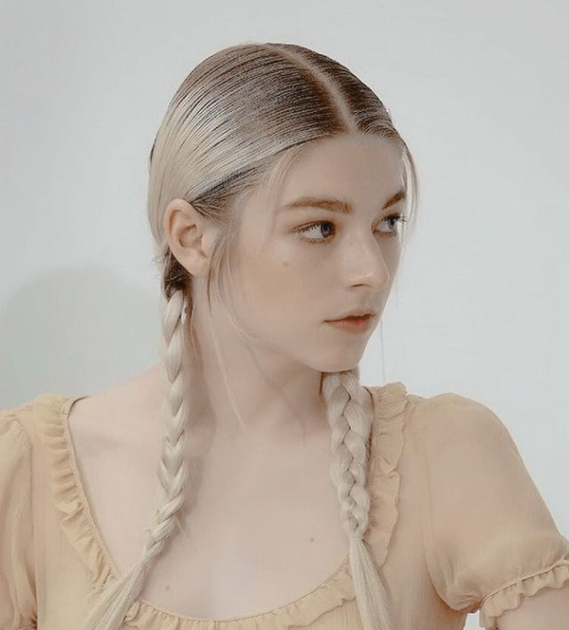
Chairwoman Sigrún Herjasdottir
A Norwegian-American, her father was a reporter from Minessota and her mother was a Valkyrie and superheroine.
Her mother died battling The Incursion (4th Dimensional Aliens) and so her powers passed on to her 10 year old child.
Sigrún possesses superhuman strength and durability, a sense for danger and death magical armor with impressive capabilities.
She is a third degree black belt in karate and did a circuit as Valerie Valkyrie on the Wrestling Heartlands Union for Performative Power (WHUPP)
She is an openly transwoman and an avid and active member of the GSA/Quiltbag community and society.

Slide 4
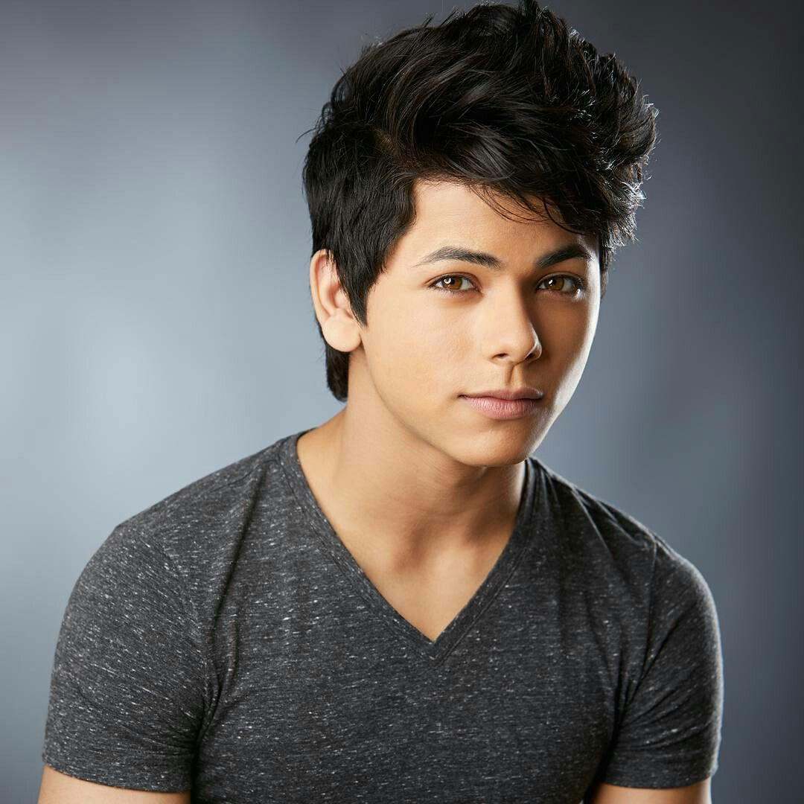
Secretary Dhanvin Doshagya Laghari
His father is a diplomat from Northern India, his mother is a former Bollywood Star who is now an international affairs correspondent.
He has the power of fire manipulation and is trained in using traditional Indian martial arts and fighting styles
He give great back rubs
He is huge fan of the gardening club
He and Sigrún occasionally date but are always good friends

Slide 5
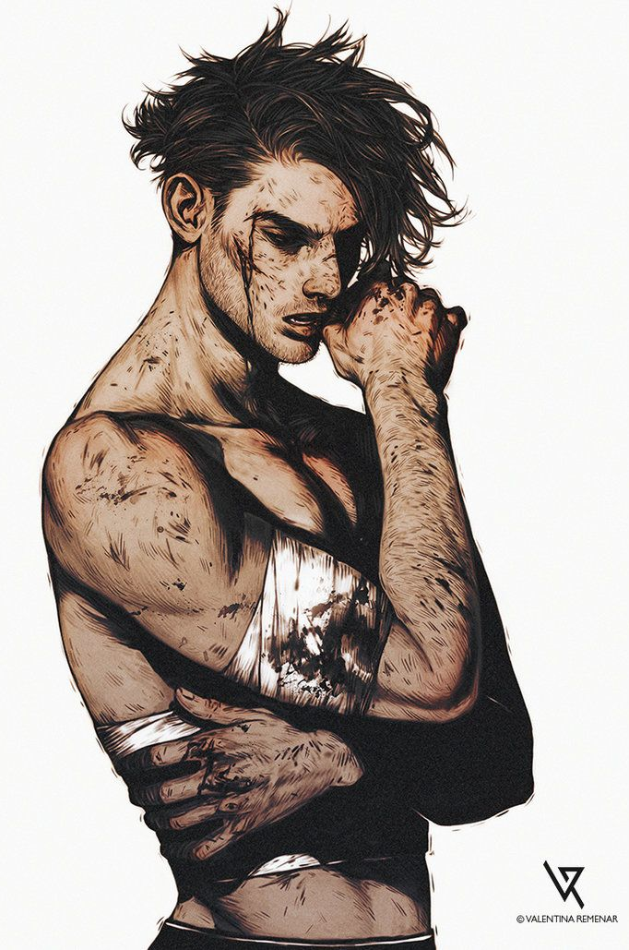
Equipment Manager Milosz Kreusz
Milosz is one of the toughest martial artists around, he keeps to himself as he feels the constant need to keep up an image is pointless.
He is a huge fan of Dungeons and Dragons
He was raised in Eastern Europe and nearly killed in actions by PRAXIS when he was 12
He lived on the streets but was given a chance 4 years ago when he was found by Dr. Alexander after he started beating up organized gang members and got a hit put on his head.
He is sponsored in America by the Silver Aged hero “Wild Star” who is retired but sees much in the boy.
He has no powers only an exceptional physique and capability to endure without any superhuman edges.

Slide 6
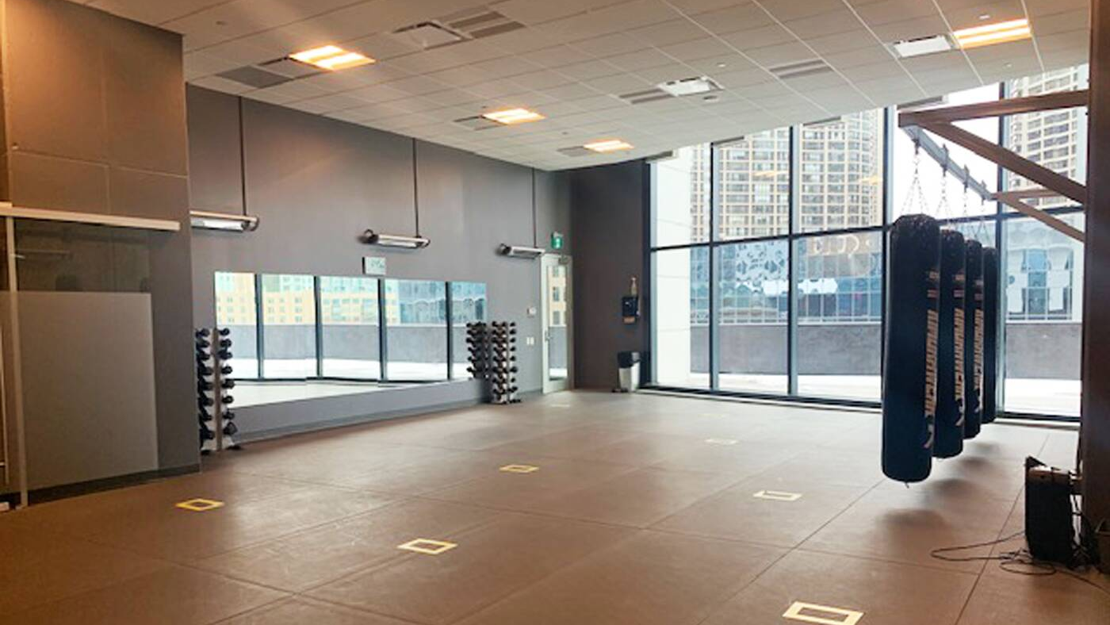
Club Room

Slide 7
The Martial Arts Challenge
The challenge uses the Training Room and relies on an individual using pure skill and technique to demonstrate force and/or precision against a testing dummy.
The Dummy scores the character’s To Hit DC 10 is a glancing Blow, DC 15 is a Solid Hit and DC20 Is a Perfect Strike
The Dummy has Toughness 20 and will not register any attack that targets any other score.
It then subtracts any modifications from Powers or Enhanced Advantages, the total level is the Power Modifier, thus it is subtracted to give the final score and see who has the best Raw Talent

Slide 8
Occult Club
“Aliquid penitus profunde in Latino”

Slide 9
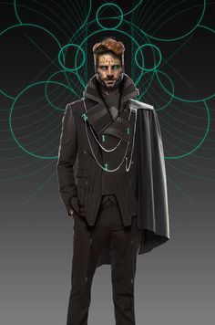
Faculty Advisor: Dominic Blaise
Rumor has it he’s shacked up with Mr. Young
Also teaches Latin
A former member of the Investigations Bureau of the High Covens in Europe
Has worked in Halcyon High for Four years after being head hunted by Dr. Alexander

Slide 10
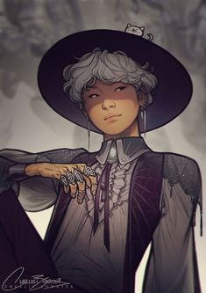
Quaestor Pri Val
The Club President is called the Quaestor by tradition
Pri is a skilled practitioner of one of the most complex magics in the world, the Art of The Word, allowing them to animate and control things through use of their True Name.
This power is exceptionally powerful against demons and fey but requires years of study to use and imagination to apply.
They are already receiving approaches by various magical groups across the globe for when they graduate.

Slide 11
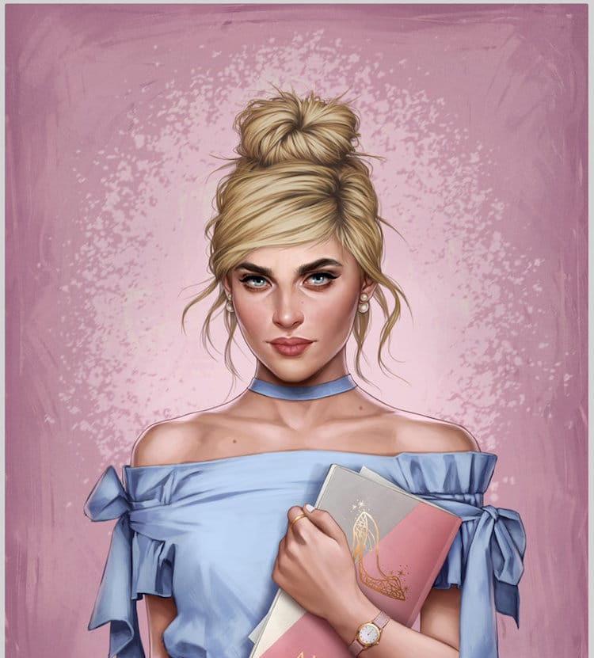
Legate (Vice President) Ella deVries
Ella is a charming, bubbly, social girl…however she was blessed by a fairy godmother.
A real fairy godmother – so she has several “blessings” that can be curses
She draws power from the fairytale blessings – unfortunately they can be unpredictable.
She tried for Cheer Squad last year but her fairies caused a bit of havoc

Slide 12
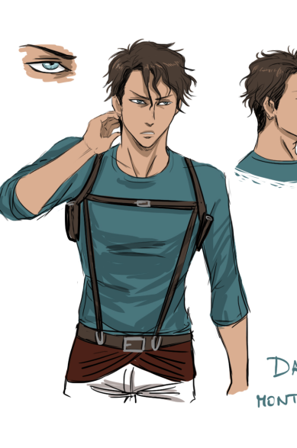
Archivist Francisco Santiago Forte Silva
Has no powers but uses a collection of Relics and magical tools due to his innate talent for understanding and wielding them.
Trained extensively as part of his familial legacy. Exceptionally athletic and intelligent
A daredevil for sure.
Originally from Brazil

Slide 13
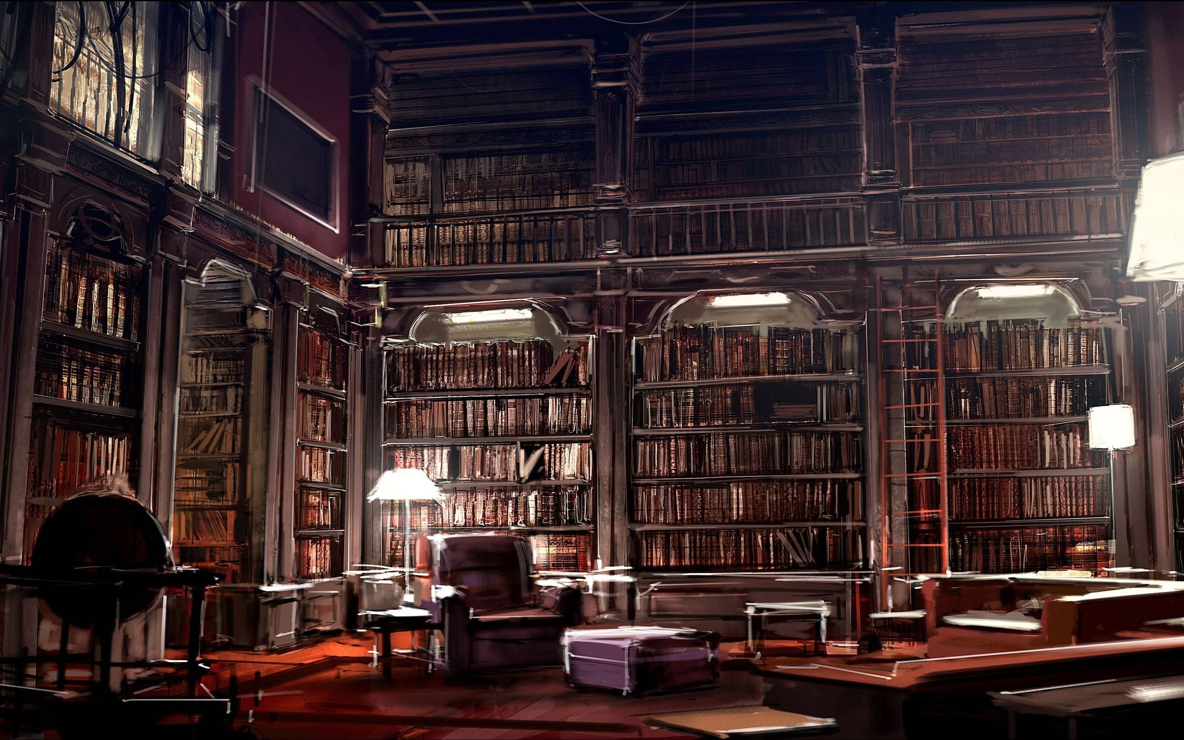
Club Room

Slide 14
Fashion Club
“When you’re In you’re In”

Slide 15
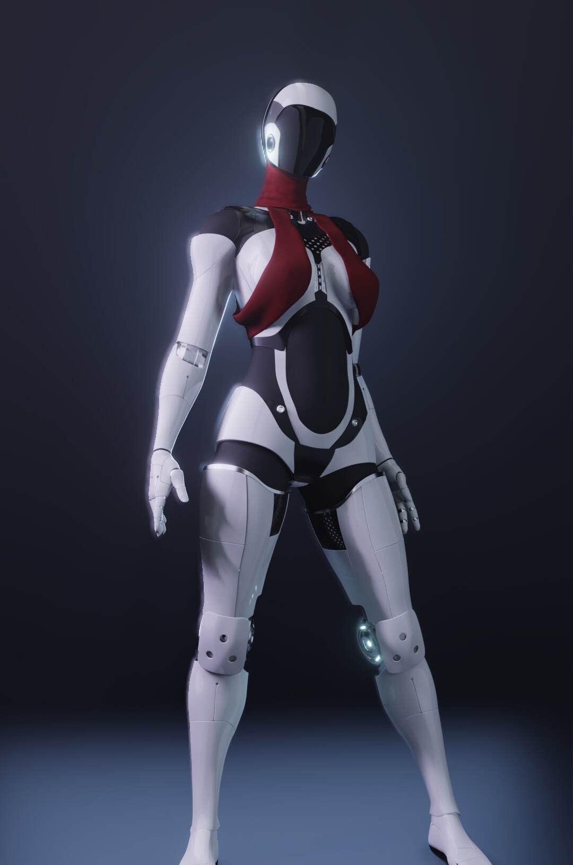
Faculty Advisor: Aixia Kell
Aixia comes from the Pegasus System her species are living energy beings.
She crashed to earth in the 70s and as a living being of light she found an anchoring for herself in crystals that were built into a robot by a scientist she befriended
Since the scientist died about 10 years ago she has been working for the school as a teacher of Astronomy and Advanced Physics.
Her robotic form can channel light energy from her body to manipulate light.
She has little perception of time and relies quite heavily on the HUD of her robotic visor

Slide 16

Club Room

