Slide 1
Data Science Skills
The Data Bootcamp (Supplemental Slides)

Slide 2
Skills Learned in this Bootcamp
Web
APIs
JSON/HTML/XML
Flask
Programming
Python
Javascript
R
VBA
Visualization and Processing of Structured Data
Excel (VBA)
Tableau
Pandas (Python)
SQL/NoSQL
Big Data (High performance computing)
Map Reduce
Pyspark
Hadoop
Applied Statistics and Machine Learning
Hypothesis testing
Exploratory Analysis (Mean/median/mode)
Linear Regression
Logistic Regression

Slide 3
Skills Learned in this Bootcamp
Web
APIs
JSON/HTML/XML
Flask
Programming
Python
Javascript
R
VBA
Visualization and Processing of Structured Data
Excel (VBA)
Tableau
Javascript/D3
Pandas (Python)
SQL/NoSQL
Big Data (High performance computing)
Map Reduce
Pyspark
Hadoop
Applied Statistics and Machine Learning
Hypothesis testing
Exploratory Analysis (Mean/median/mode)
Linear Regression
Logistic Regression
Pays the Bills
Great to have
Good to Know
No comment

Slide 4
Different Career Paths: Which Groups of Skills To Master?
Data Analyst/Business Analyst/Business Intelligence
Visualization and Processing of Structured Data
Applied Statistics and Machine Learning
User Interface/Visualization/Front-end Developer
Web
Programming
Visualization and Processing of Structured Data
Data Engineer/Software Developer
Programming
Web
Big Data (High performance computing)
Data Scientist
Programming
Visualization and Processing of Structured Data
Applied Statistics and Machine Learning
Web
Big Data (High performance computing)

Slide 5
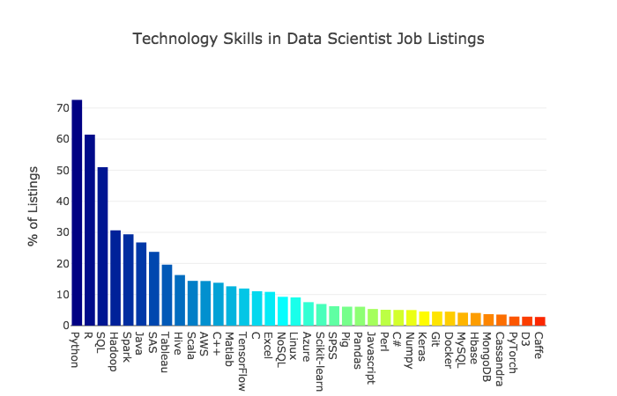

Slide 6
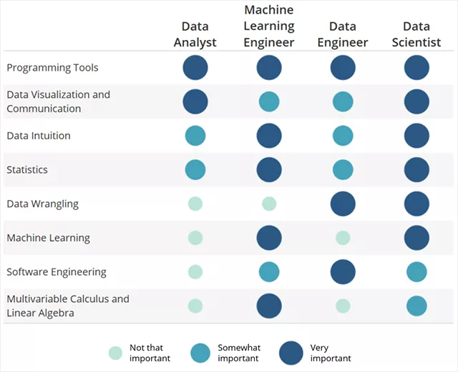

Slide 7
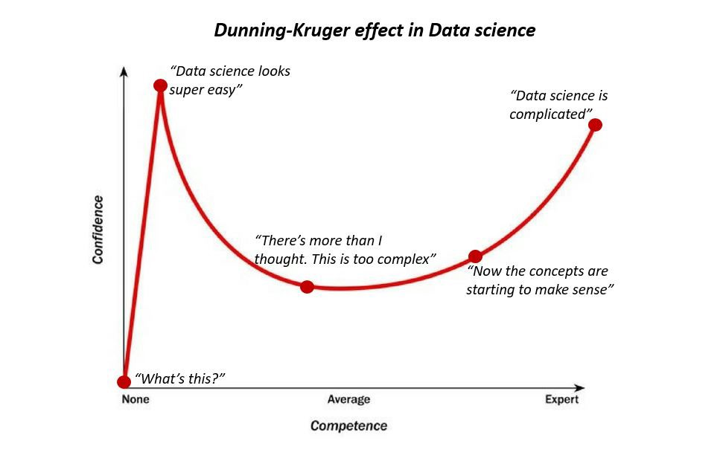

Slide 8
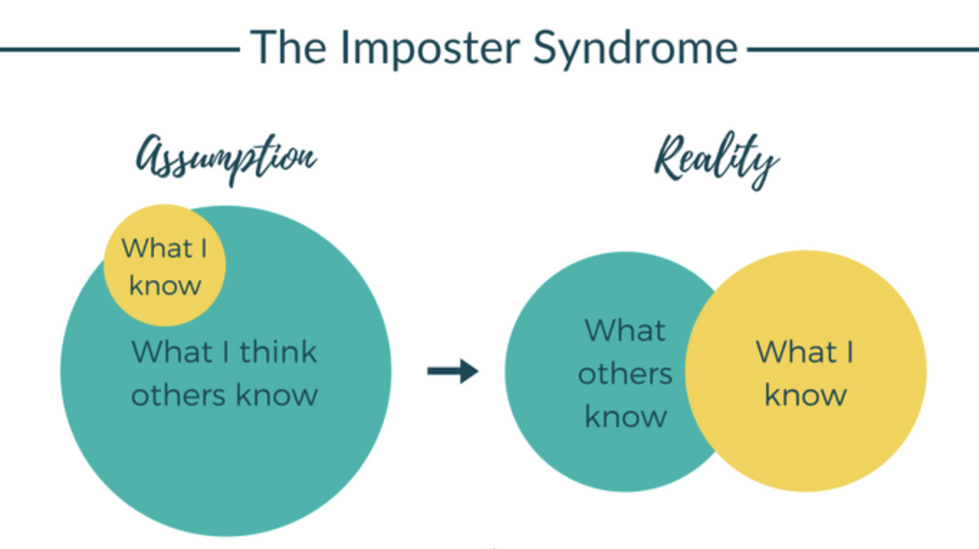

Slide 9
