Slide 1
Learning Objectives
• Create symbols.
• Understand the naming convention of symbols.
• Customize the icon menu.
• Use the Mark/Verify, Export to Spreadsheet, and Update from
Spreadsheet tools.

Slide 2
CREATING SYMBOLS
Ribbon: Schematic > Other Tools >
Symbol Builder drop-down > Symbol Builder
Toolbar: ACE:Main Electrical 2 > Symbol Builder
or ACE:Miscellaneous > Symbol Builder
Menu: Components> Symbol Library > Symbol Builder
Command: AESYMBUILDER
Figure 1 The Symbol Builder drop-down

Slide 3
Figure 2 The Select Symbol / Objects dialog box

Slide 4
Name
Objects Area
Insertion point Area
Attribute template Area
Preview Area

Slide 5
Figure 3 The Block Editor environment

Slide 6
Common Tools
Figure 4 The Symbol Builder Attribute
Editor palette
Figure 5 The common tools of the Symbol Builder Attribute Editor palette

Slide 7
Figure 6 The Symbol Configuration dialog box

Slide 8
Figure 7 The Convert Text to Attribute dialog box

Slide 9
Symbol Audit
Figure 8 The Symbol Audit dialog box

Slide 10
Required Rollout
Figure 9 The Required rollout

Slide 11
Figure 10 The check marks displayed
on the left of the attributes inserted
Figure 11 Attributes inserted into a symbol

Slide 12
Figure 12 The Insert / Edit Attributes
dialog box
Figure 13 Attributes after changing their height

Slide 13
Optional Rollout
POS Rollout
Rating Rollout
Wire Connection Rollout
Figure 14 The drop-down list displayed after choosing the arrow in the Wire Connection rollout

Slide 14
Figure 15 The Insert Wire Connections dialog box

Slide 15
Figure 16 Wire connection attribute inserted on the left of the symbol
Figure 17 Wire connection attribute inserted on the right of the symbol

Slide 16
Pins Rollout
Link Lines Rollout
Figure 18 A drop-down list displayed
Figure 19 The Done button in the Edit panel

Slide 17
Figure 20 The Close Block Editor: Save Symbol dialog box

Slide 18
NAMING CONVENTION OF SYMBOLS
In AutoCAD Electrical, a particular naming convention is used for naming symbols.
Schematic Symbols
Panel Layout Footprint Symbols
Connector Symbols
Plug / Jack Connector Pin Symbols
Splice Symbol
Parametric Twisted Pair Symbols

Slide 19
Stand-alone PLC I/O Point Symbols
PLC I/O Parametric Build Symbols
Stand-alone Terminal Symbols
Wire Number Symbols
Wire Dot Symbols
Source / Destination Wire Signal Arrow Symbols
Cable Marker Symbols
Inline Wire Marker Symbols
One-line Symbol

Slide 20
CUSTOMIZING THE ICON MENU
Ribbon: Schematic> Other Tools > Icon Menu Wizard
Toolbar: ACE:Main Electrical 2 > Symbol Builder > Icon Menu Wizard
or ACE:Miscellaneous > Icon Menu Wizard
Menu: Components> Symbol Library > Icon Menu Wizard
Command: AEMENUWIZ
Figure 21 The Select Menu file dialog box

Slide 21
Figure 22 The Icon Menu Wizard dialog box

Slide 22
Figure 23 The Add drop-down list displayed
Component

Slide 23
Figure 24 The Add Icon - Component dialog box
New Circuit
Add Circuit

Slide 24
Figure 25 The Add Existing Circuit dialog box

Slide 25
New submenu
Figure 26 The Create New Submenu dialog box

Slide 26
MISCELLANEOUS TOOLS
Marking and Verifying Drawings
Ribbon: Project > Project Tools > Mark/Verify DWGs
Toolbar: ACE:Main Electrical 2 > Project Manager >
Mark/Verify Drawings
or ACE:Project > Mark/Verify Drawings
Menu: Projects > Mark/Verify Drawings
Command: AEMARKVERIFY

Slide 27
Figure 27 The Mark and Verify dialog box

Slide 28
Figure 28 The REPORT: Changes made on this drawing since last mark command dialog box

Slide 29
Exporting the Data to the Spreadsheets
Ribbon: Import/Export Data > Export > To Spreadsheet
Toolbar: ACE:Main Electrical 2 > Schematic Reports >
Export to Spreadsheet
or ACE:Schematic Reports > Export to Spreadsheet
Menu: Projects> Export to Spreadsheet > Export to Spreadsheet
Command: AEEXPORT2SS

Slide 30
Figure 29 The Export to Spreadsheet dialog box

Slide 31
Figure 30 The Component Data Export dialog box

Slide 32
Figure 31 The Drawing Settings Data Export dialog box

Slide 33
Updating Data from the Spreadsheet
Ribbon: Import/Export Data > Import > From Spreadsheet
Toolbar: ACE:Main Electrical 2 > Schematic Reports >
Update from Spreadsheet
or ACE:Schematic Reports > Update from Spreadsheet
Menu: Projects> Export to Spreadsheet > Update from Spreadsheet
Command: AEIMPORTSS

Slide 34
Figure 32 The Update Drawings per Spreadsheet Data dialog box

Slide 35
Using Project-Wide Utilities
Figure 33 The Project-Wide Utilities dialog box

Slide 36
Figure 34 The Project-wide Attribute Size Change dialog box

Slide 37
Figure 35 The Project-wide AutoCAD Electrical Style Change dialog box

Slide 38
Tutorial 1
In this tutorial, you will create a symbol, insert attributes into it,and then save it. Next, you will insert the symbol that created into the drawing.
The following steps are required to complete this tutorial:
Create a new drawing C13_tut01.dwg in the CADCIM project.
Insert a ladder in the drawing.
3. Create a symbol, insert attributes, and insert wire connection attributes to the symbol.
4. Save and insert the symbol.
5. Save and close the drawing file.

Slide 39
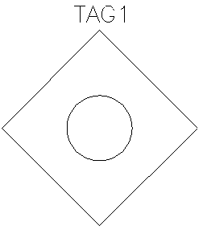

Figure 36 The polygon inserted in the drawing
Figure 37 The TAG1 attribute inserted into the symbol

Slide 40
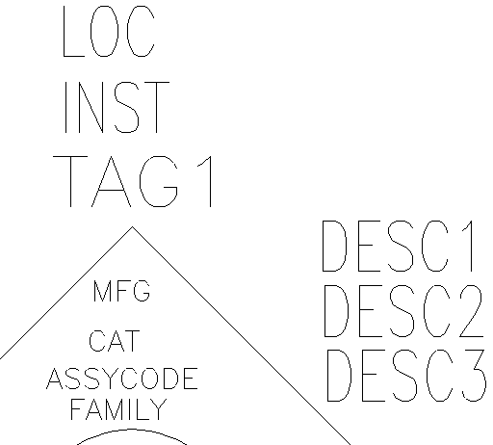
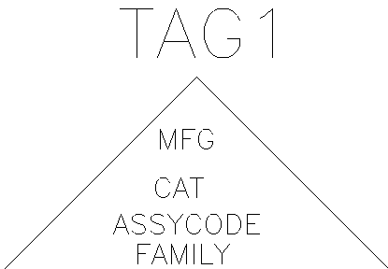
Figure 38 Different attributes inserted into
the symbol
Figure 39 Different attributes inserted into
the symbol

Slide 41
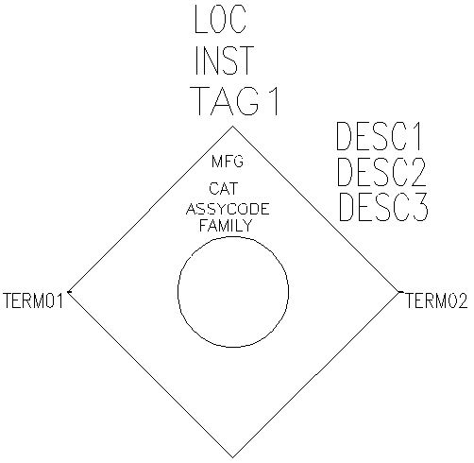
Figure 40 TERM01 and TERM02 inserted into the symbol

Slide 42
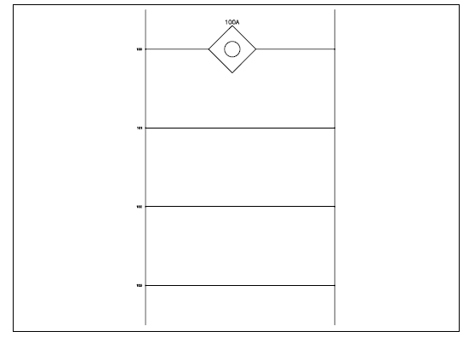
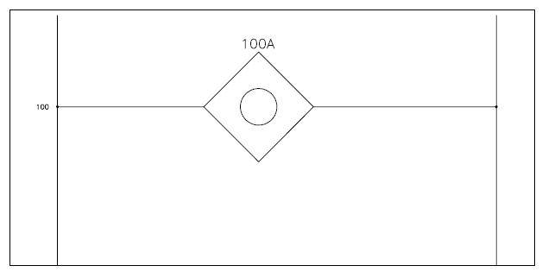
Figure 41 Symbol inserted into a ladder
Figure 42 The zoomed view of the symbol inserted into a ladder

Slide 43
Tutorial 2
In this tutorial, you will add the symbol that you created in Tutorial 1 of this chapter to the Insert Component dialog box using the Icon Menu Wizard tool. You will then, insert the component to the drawing.
The following steps are required to complete this tutorial:
Open the drawing C13_tut01.dwg from the CADCIM project.
Save the drawing as C13_tut02.dwg.
Add the drawing to the CADCIM project list.
4. Add a new icon to the menu.
Insert the component to the drawing.
Save and close the drawing.

Slide 44
Figure 43 The Icon Menu Wizard dialog box showing the icon of the symbol

Slide 45
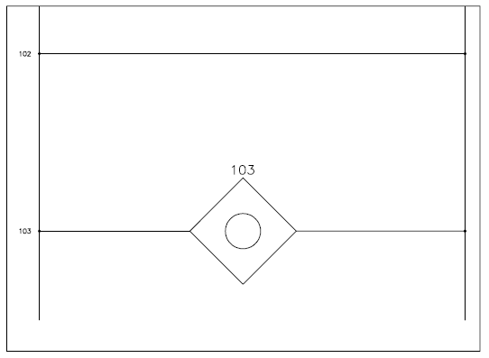
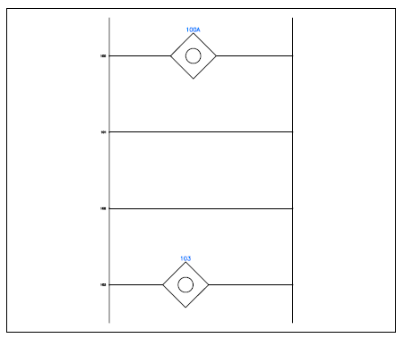
Figure 44 Symbol inserted into the ladder
Figure 45 The zoomed view of the symbol inserted into the ladder

Slide 46
Tutorial 3
In this tutorial, you will export data from a drawing file to an excel sheet, make changes in that sheet and then import the sheet data to the drawing file.
The following steps are required to complete this tutorial:
Open, save, and add the drawing to the active project.
b. Export the data.
c. Modify the data
d. Import the data
e. Save the drawing.

Slide 47
Figure 46 The Export to Spreadsheet dialog box
Figure 47 The Select file name for drawing’s XLS output dialog box

Slide 48
Figure 48 The data changed in the DESC1, DESC2 columns
Figure 49 The data changed in the SEC, SUBSEC, and SHDWGNAM columns

Slide 49
Figure 50 Choosing Properties > Drawing properties from the shortcut menu
Figure 51 Values changed in the Drawing, Section, Sub-Section edit boxes

Slide 50
Tutorial 4
In this tutorial, you will mark a drawing in the CADCIM project, make changes in the drawing and then verify the drawing using the Mark/Verify DWGs tool. (Expected time: 15 min)
The following steps are required to complete this tutorial:
Open, save, and add the drawing.
b. Mark the drawing.
c. Modify the drawing.
d. Verify the drawing.
e. Save the drawing.

Slide 51
Figure 52 The Mark and Verify dialog box

Slide 52
Figure 53 The modified Mark and Verify dialog box

Slide 53
Figure 54 The REPORT: Changes made on this drawing since last Mark command dialog box

Slide 54
Figure 55 The Report Generator dialog box

Slide 55
Figure 56 Attributes added to the symbol

Slide 56
Figure 57 Submenu created in the Icon Menu Wizard dialog box

Slide 57
Figure 58 The Icon Menu Wizard dialog box displaying the Miscellaneous submenu

