Slide 1

Tabletop Menu Tablets
Pilot

Slide 2
Summary
A tablet test launch was conducted on September 10th, simulating a full-service scenario. Fifty guests, consisting of friends and family, were invited to test Sauce & Spoon's integrated tabletop menu tablets before the official pilot launch.
The objectives of the tablet test launch were to evaluate:
The tablets' functionality and user-friendliness.
The training of the staff.
Key findings:
The majority of customers encountered no technical issues and found ordering food and navigating the tablet to be fairly to very easy. The main problem was with tablets freezing.
Staff training and logistics for both back of house (BOH) and front of house (FOH) services may be areas for improvement.

Slide 3
Overview
The tablet test launch milestone was assessed based on quality standards related to tablet functionality, user-friendliness, and staff training in tablet usage.
Surveys were sent digitally to 50 customers and feedback was collected on the following quality standards.
Functionality: Less than 5% of customers reported technical issues with tablet usage on a weekly basis.
Ease of use: 95% of all customers independently placed orders using tablets, with a checkout time of 1 minute or less.
Staff training: Staff addressed 98% of customer questions and concerns regarding tablet usage, and 98% of meal orders were accurately prepared according to customer requests.

Slide 4
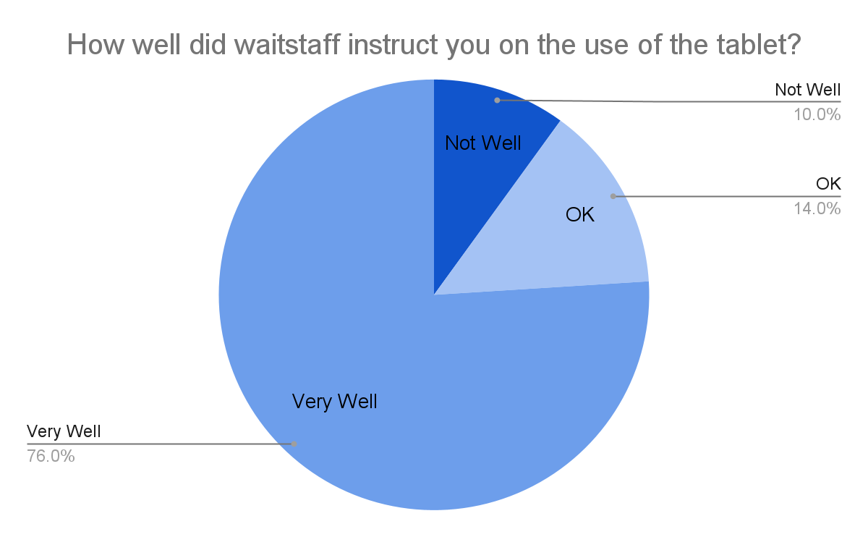
Findings
90% of customers found the waitstaff's instructions on tablet usage satisfactory or very helpful.
10% (5 out of 50) of the customers did not feel that the waitstaff provided adequate instructions on using the tablets.
The results did not meet the 98% quality standard for waitstaff effectively addressing customer questions and concerns about tablet usage.

Slide 5
Next Steps
The first recommendation focuses on the 10% of customers who reported inadequate instructions on tablet usage.
Seydou Biallo will be available as a subject matter expert for one week after the tabletop menu tablet launch to assist staff with questions related to guiding customers on tablet usage, navigating the menu, placing orders, applying coupons, processing payments, and more.
Staff training will be further improved and tailored to address specific customer scenarios through on-the-job training.

Slide 6
Next Steps
The second recommendation addresses the issue of 28% of orders being inaccurately prepared.
Investigate the order ticket handling process to meal preparation to identify the causes of errors.
Implement a quality assurance check for each prepared order to ensure it aligns with customer requests before serving it to the table.

