Slide 1
A Graph RAG System for TfL Data
Transforming API Data into Queryable Knowledge
A comprehensive pipeline for ingesting and querying London Transport (TfL) data.
Leverages the Neo4j graph database to store complex entities and their relationships.
Employs a Retrieval-Augmented Generation (RAG) model to translate natural language queries into powerful Cypher statements.

Slide 2
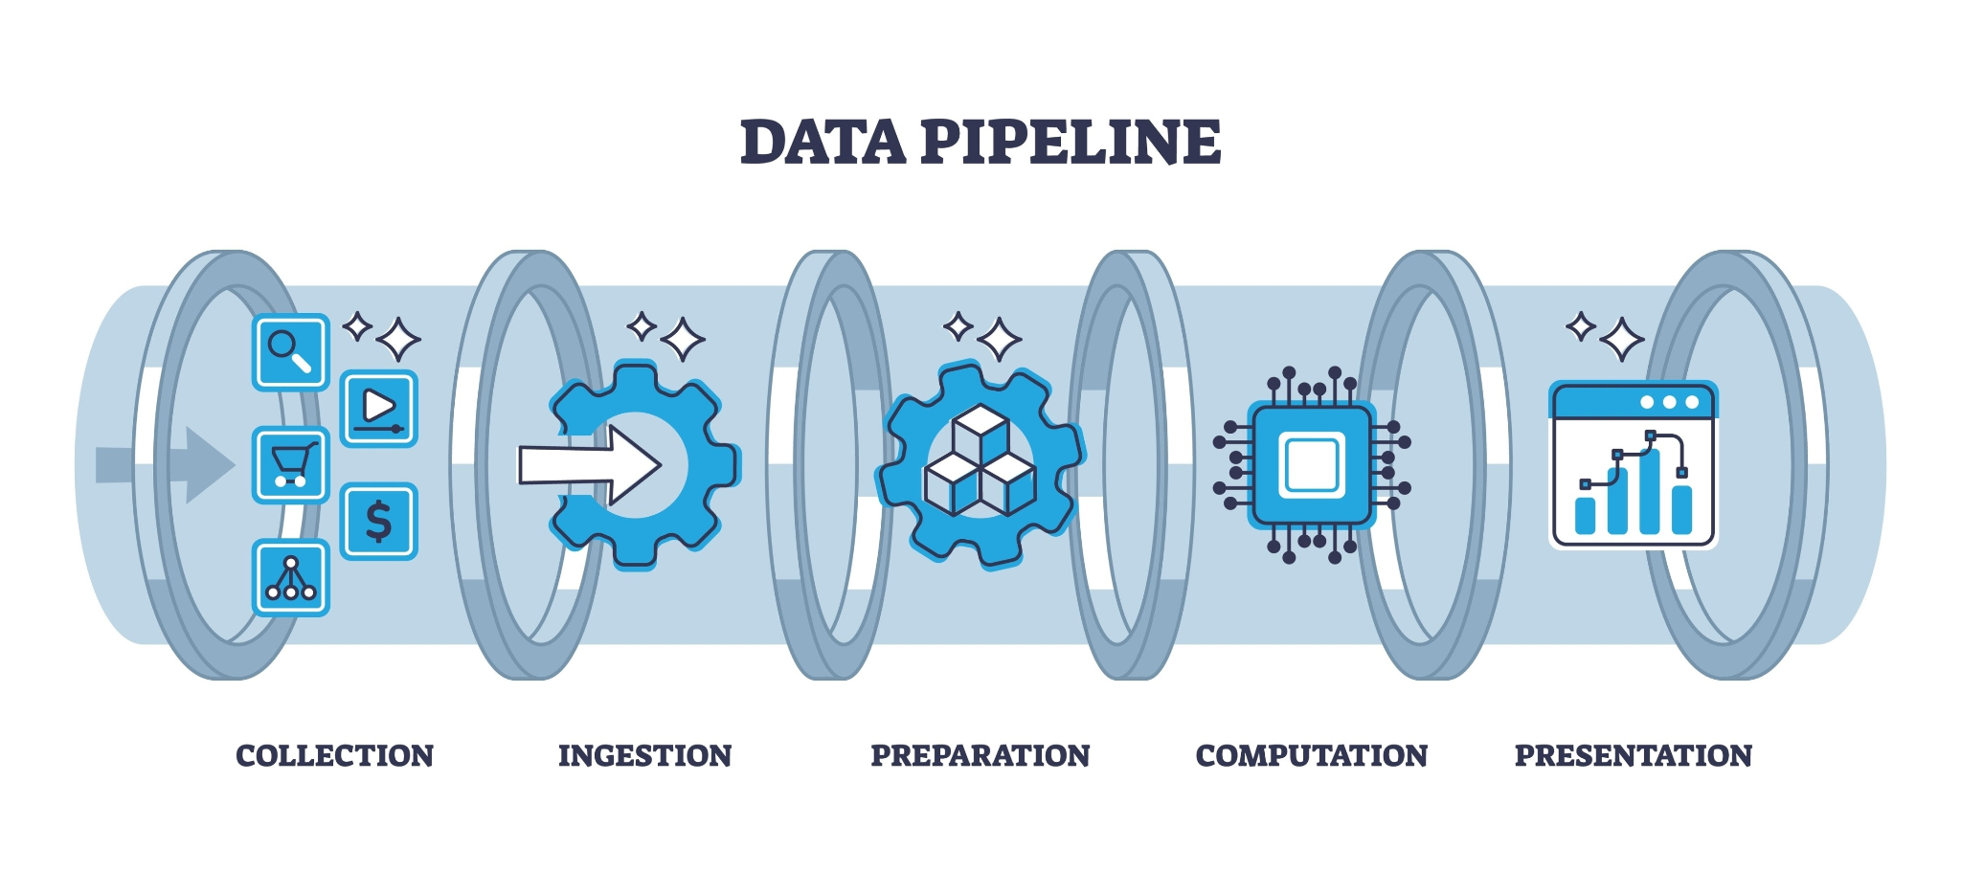
2. Pipeline Architecture
The overall data flow, from raw data to actionable results.

Slide 3
2. Pipeline Architecture
Ingestion:
Raw data from the TfL API (JSON).
An ETL (Extract, Transform, Load) Python script processes and loads the data.
Creation of nodes and edges within the Neo4j database.
RAG Core:
User Query: A natural language question is posed by the user (e.g., "Which stations are on the Northern line?").
Schema Introspection: The system dynamically queries Neo4j to retrieve the current graph schema.
LLM Translation: The query, augmented with the graph schema, is sent to an LLM (GPT-4) which generates a Cypher statement.
Execution & Fallback:
The generated Cypher query is executed on the Neo4j database.
Intelligent fallback mechanisms are in place to handle query failures.
Results:
The data returned from Neo4j.
The results are presented to the user.

Slide 4
3. Nodes
The system utilizes 14 node types (labels) to represent entities within the TfL network.
Station: Represents a physical station.
Line: Represents a transport line (e.g., Central Line, Jubilee Line).
StopPoint: A specific stop.
Platform: A station platform.
FareZone: A geographical fare zone.
Operator: An entity that operates a line.
BikePoint: A public bicycle docking station.
Incident: A disruption or service issue.
Interchange: A node representing a multi-line connection point.
Timetable: A schedule.
AccessibilityFeature: Accessibility-related features (e.g., lifts).
Facility: General amenities (e.g., restrooms).
Landmark: A landmark or place of interest near a station.
Geolocation: Geographical coordinates.

Slide 5
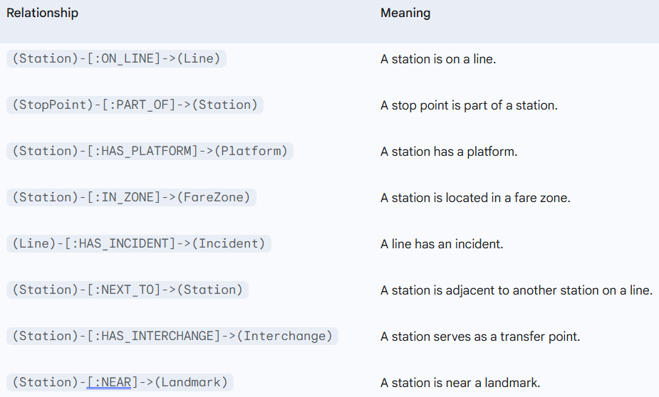
4. Edges
Edges define the directional relationships between nodes, creating a contextually rich data structure.

Slide 6
5. RAG
This model allows for natural language querying of the data.
Introspection:
The system is not reliant on a rigid schema. It dynamically queries Neo4j to obtain a list of available labels and relationship types.
This introspected schema is included in the prompt to the LLM, ensuring that generated queries are always valid for the current database state.
LLM (GPT-4) Translation:
The prompt combines the user's query with the retrieved graph schema.
The LLM is strictly instructed to output a JSON object containing the Cypher statement and its parameters.

Slide 7
6. Summary & Future Work
This Graph RAG system is a robust and scalable solution for transforming complex data into a naturally queryable knowledge base.
The synergy between graph databases and LLMs provides a flexible and powerful method for data retrieval.
Future Directions:
Integration of additional transit modes (buses, DLR).
Development of a visual user interface for graph interaction.
Incorporation of real-time data streams (e.g., train locations, congestion).

