Slide 1
Bayesian diagnosis of Complex Regional Pain Syndrome 1 (CRPS 1)
CRPS 1 is a chronic pain syndrome and nerve disorder
occurring in the arms or legs after an initial acute injury.
Karl Diedrich
BMI 6300 Medical Decision Making

Slide 2
Negative feedback loop
Initial injury pain
Increased pain
Upregulation of pain receptors
and catecholamines
Lactic acid buildup
Vasoconstriction

Slide 3
Treatment
Physical and Occupational Therapy
  2-3 weeks 5-6 hours per day intensive (Sherry 2003)
  Breaks negative feedback cycle
Treatments are non-invasive; possible CRPS 1 diagnosed with high sensitivity low specificity tests is worth treating if no contraindications to therapy exist

Slide 4
Under-diagnosed
CPRS 1 is rare, 0.02% population (Quisel 2005), so medical staff don’t look for it
CPRS 1 starts with another injury of disease so medical staff often think the problem is already diagnosed
Delayed Diagnosis: 30 month average (Wasner et al. 2003)

Slide 5
Current Diagnostic Criteria
International Association for the Study of Pain (IASP)
The presence of an initiating noxious event
Continuing pain, allodynia, or hyperalgesia in which the pain is disproportionate to any known inciting event.
Evidence at some time of edema(swelling), changes in skin blood flow or abnormal sudomotor (sweat gland stimulation) activity in the region of pain.
This diagnosis is excluded by the existence of other conditions that would otherwise account for the degree of pain and dysfunction. (Harden & Bruehl 2006)

Slide 6
IASP Diagnosing Criteria lacks Specificity
When physicians uses the diagnosis criteria CRPS 1 is over-diagnosed (Harden & Bruehl 2006)
CRPS 1 findings are common to many injuries and medical conditions
  Diagnosis by first excluding initiating acute injury

Slide 7
Proposed Boolean Diagnostic Criteria
1) Continuing pain, which is disproportionate to any inciting event.
2) 1 symptom in each of 4 categories:
  Sensory: hyperesthesia
  Vasomotor: temperature asymmetry and/or skin color changes and/or skin color asymmetry
  Sudomotor/Edema: Edema and/or sweating changes and/or sweating asymmetry
  Motor/Trophic: Decreased range of motion and/or motor dysfunction (weakness, tremor, dystonia) and/or trophic changes (hair, nail, skin)
3) 1 sign in 2 or more categories:
  Sensory: Evidence of hyperalgesia (to pinprick) and/or allodynia (to light touch)
  Vasomotor: Temperature asymmetry and/or skin color changes and/or asymmetry
  Sudomotor/Edema: Evidence of edema and/or sweating changes and/or sweating asymmetry
  Motor/Trophic: Evidence of decreased range of motion and/or motor dysfunction (weakness, tremor, dystonia, neglect) and/or trophic changes (hair, nail, skin) (Harden & Bruehl 2006)

Slide 8
Testing diagnostic criteria
Criteria | Sensitivity | Specificity | PPV | NPV | FPR | FNR
IASP | 0.98 | 0.36 | 0.21 | 0.99 | 0.74 | 0.02
Bruehl’s | 0.70 | 0.94 | 0.67 | 0.94 | 0.06 | 0.30
Sensitivity: Test+ if CRPS 1; TP/(TP+FN)
Specificity: Test- if no CRPS 1; TN/(TN+FP)
Positive Predictive Value (PPV): Proportion correct positive diagnosis; TP/(TP+FP)
Negative Predictive Value (NPV): Proportion correct negative; TN/(TN+FN)
False Positive Rate (FPR) = FP/(FP + TN) = 1 – specificity
False Negative Rate (FNR) = FN/(FN + TP) = 1- sensitivity

Slide 9
Informatics
CRPS 1 is often missed so automatic monitoring of Electronic Medical Records (EMR) for CRPS 1 signs and symptoms could alert medical staff when to look for CRPS 1
Bayesian monitor of CRPS 1 findings in EMR could alert staff of possible CRPS 1.
CRPS 1 diagnosis tool is a standalone tool to test the concept

Slide 10
Probabilities of Signs & Symptoms
Variable | P[sign|CRPS 1] | P[symptom|CRPS 1]
Allodynia | 0.74 | -
Decreased range of motion | 0.70 | 0.80
Color changes | 0.66 | 0.87
Hyperalgesia | 0.63 | -
Temperature Asymmetry | 0.56 | 0.79
Edema | 0.56 | 0.80
Weakness | 0.56 | 0.75
Sweating changes | 0.24 | 0.53
Dystonia | 0.14 | 0.20
Nail changes | 0.09 | 0.21
Hair changes | 0.09 | 0.24
Tremor | 0.09 | 0.24
Hyperesthesia | - | 0.65
Burning pain | - | 0.81
Female | 0.80 | -

Slide 11
Diagnostic by Multi-membership Bayes Theorem
P[CRPS 1] = 0.0002
With CRPS 1 and sign
Prior probability of disease
P[CRPS 1]*P[ Sign 1|CRPS 1]
P[CRPS 1| Sign 1] =
P[CRPS 1]*P[ Sign 1|CRPS 1] + P[ no CRPS 1] * P[ Sign 1|no CRPS 1]
With sign
P[CRPS 1|Sign 1]*P[ Sign 2|CRPS 1]
P[CRPS 1| Sign 2] =
P[CRPS 1]*P[ Sign 2|CRPS 1] + P[ no CRPS 1] * P[ Sign 2|no CRPS 1]
Repeat for each sign

Slide 12
Probabilistic versus Boolean Diagnosis
Probabilistic Bayes’ Theorem takes into account the strength of the association between a finding and a disease.
P[Allodynia|CRPS 1] = 0.74
P[Skin color changes|CRPS 1] = 0.09
Weighted equally in a Boolean system but given relative weights in the probabilistic Bayes’ Theorem
The positive diagnosis cutoff probability can be adjusted to attain desired sensitivity and specificity
  No contraindications -> Lower cutoff
  Contraindications -> higher cutoff

Slide 13
Sensitivity and Specificity
No CRPS 1 diagnosis
Diagnosed with CRPS 1
No CRPS 1 population
CRPS 1 population
patients
TN
TP
FN
FP
Probability of CRPS 1
Test CRPS 1 Diagnostic tool against a pool of CRPS 1 and No CRPS 1 patients that have recovered from acute injuries
Notes:
FP = Alpha = type I error
FN = Beta = type II error

Slide 14
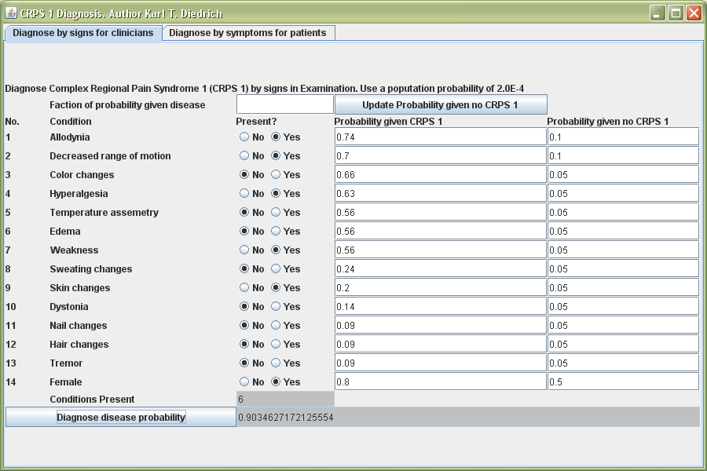

Slide 15
References
Harden, Norman R. & Stephen P. Bruehl. “Diagnosis of Complex Regional Pain Syndrome.” Clinical Journal of Pain 22, no. 5 (2006): 415-419.
Quisel, A., et al. “Complex regional pain syndrome underdiagnosed.” The Journal of Family Practice 54, no. 6 (2005), http://www.jfponline.com/Pages.asp?AID=1947
Sherry, David. “Amplified Musculoskeletal Pain or Reflex Neurovascular Dystrophy (RND) A guide for parents of children with RND ” (2003), http://www.childhoodrnd.org/index.html
Wasner G. et al. “Complex regional pain syndrome – diagnostic, mechanisms, CNS involvement and therapy.” Spinal Cord 41 (2003): 61-75.

